Slide 1
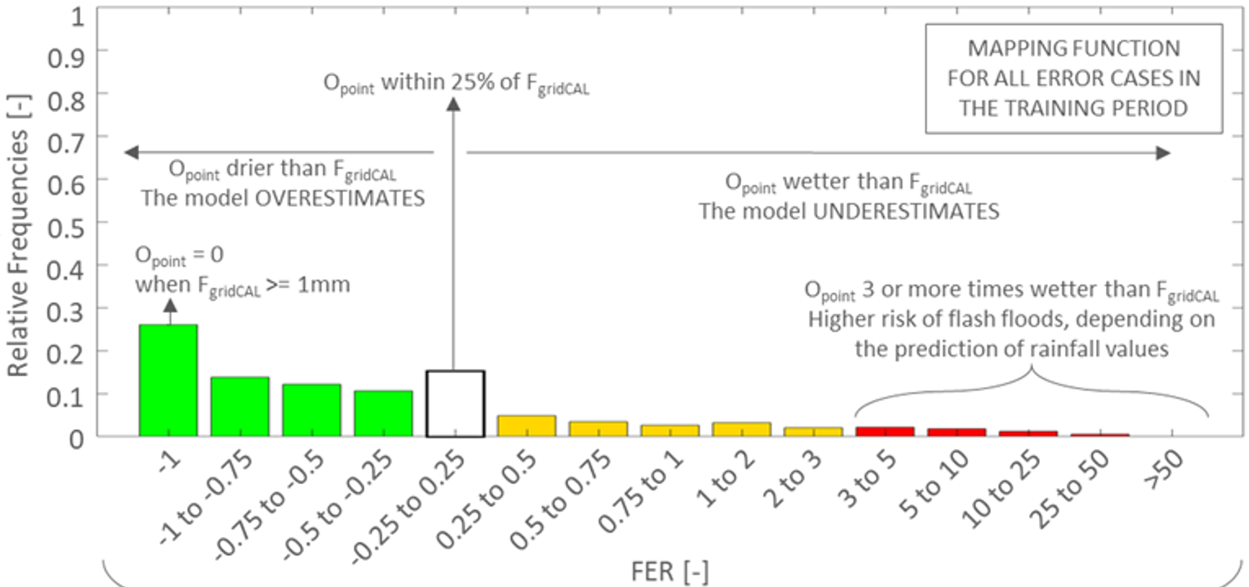
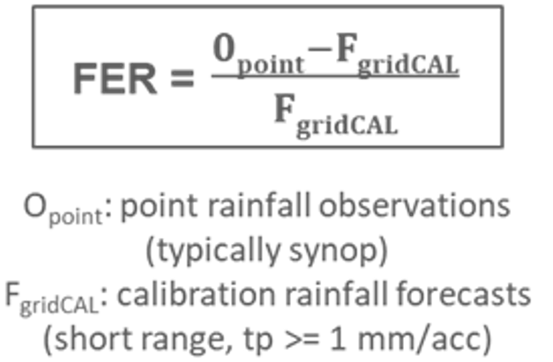
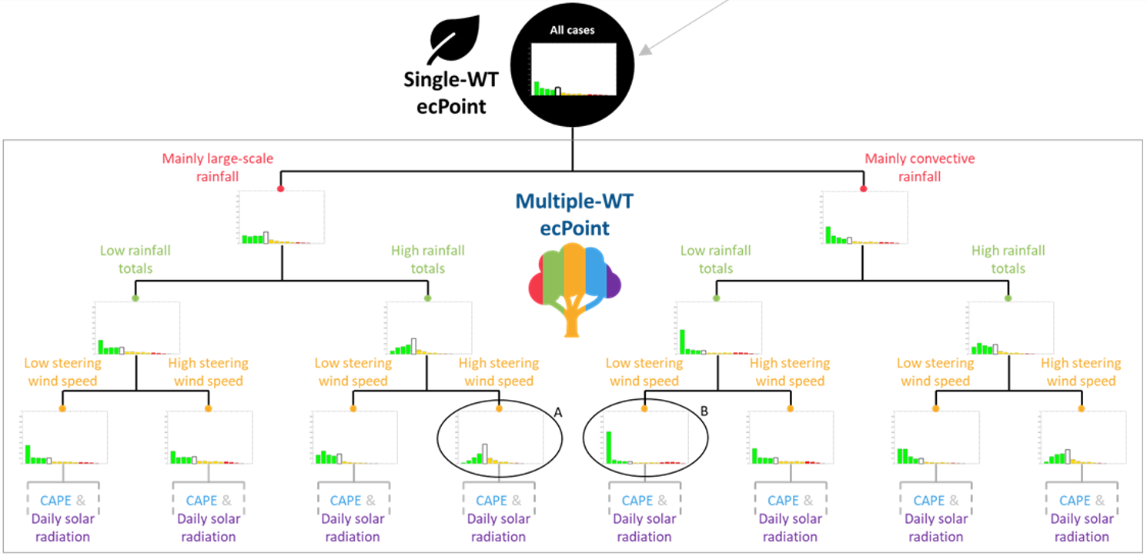
(b)
Errors distribution:
MAPPING FUNCTION (MF)
(a)
Error formulation for accumulated variables (e.g., rainfall)
FORECAST ERROR RATIO (FER)
(c)
Error distributions used in the post-processing of accumulated NWP model outputs (example provided for rainfall). When they are not split in grid-box weather types (WT), the post-processing approach is called ecPoint_SingleWT. When they are, the post-processing approach is called ecPoint_MultipleWT and it is based on a decision tree (DT).

