Slide 1

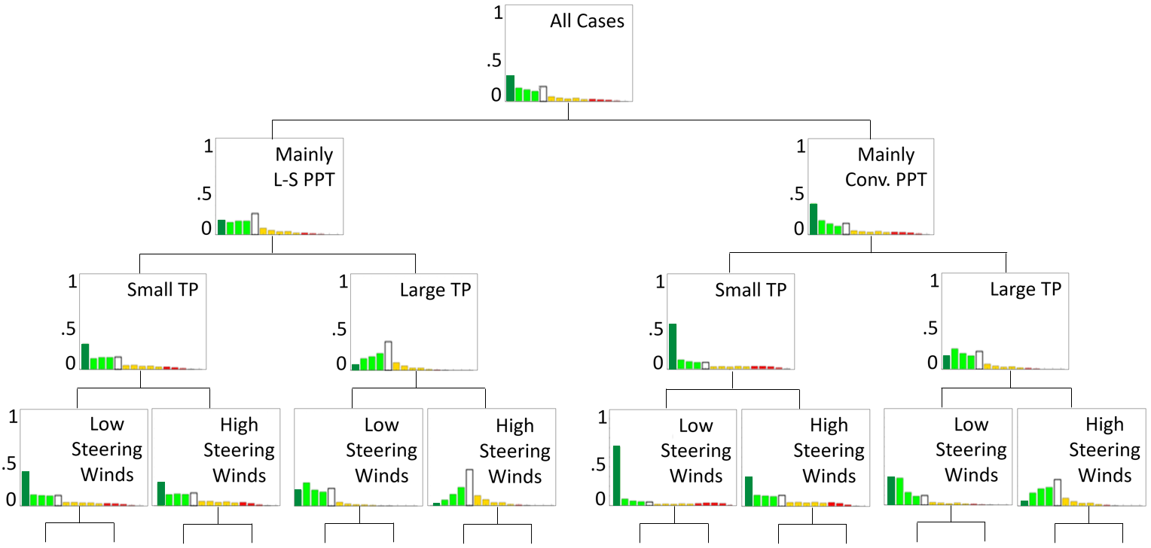
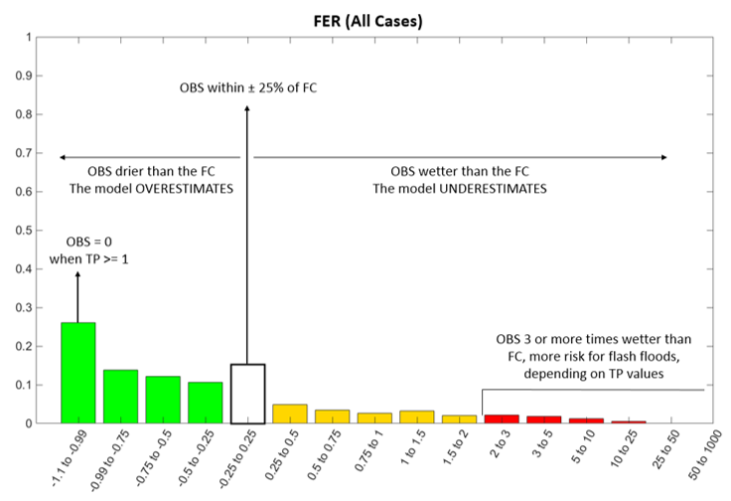

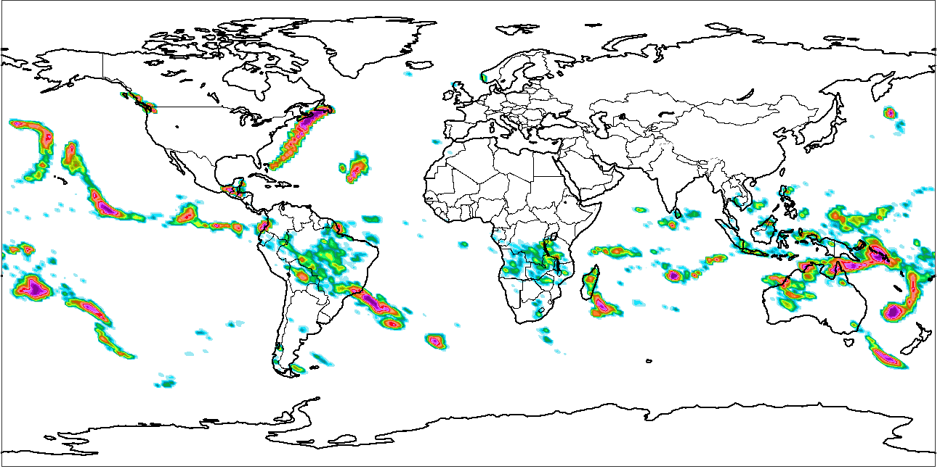
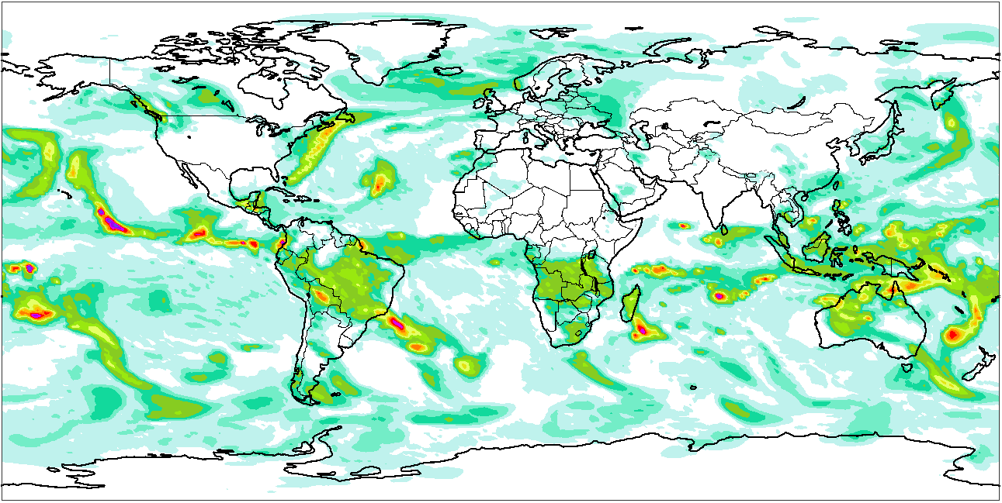
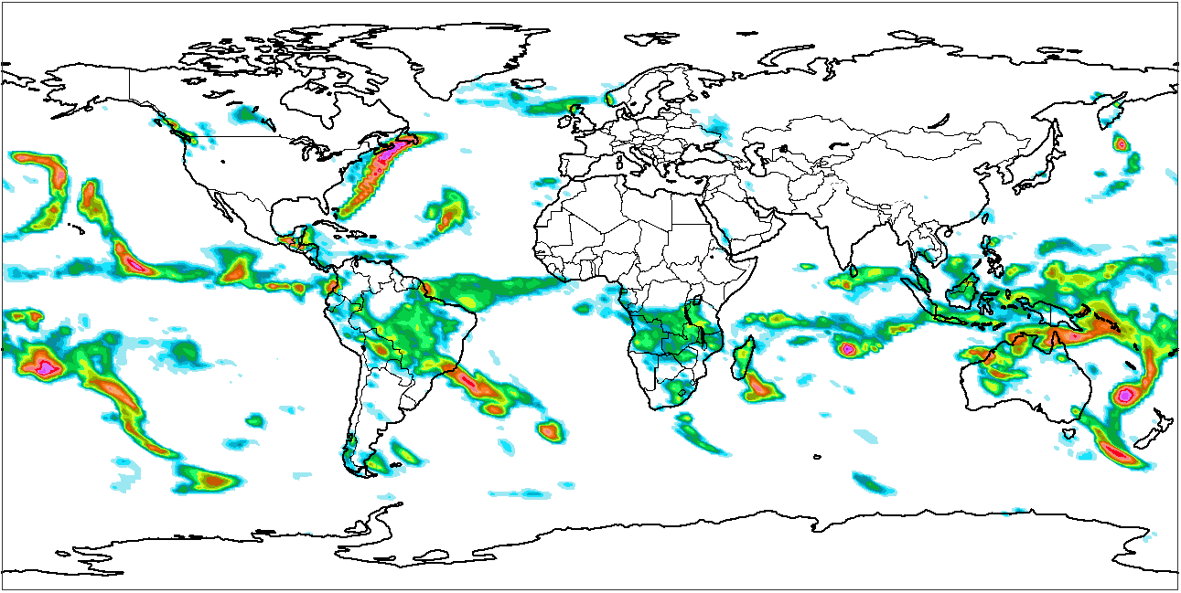
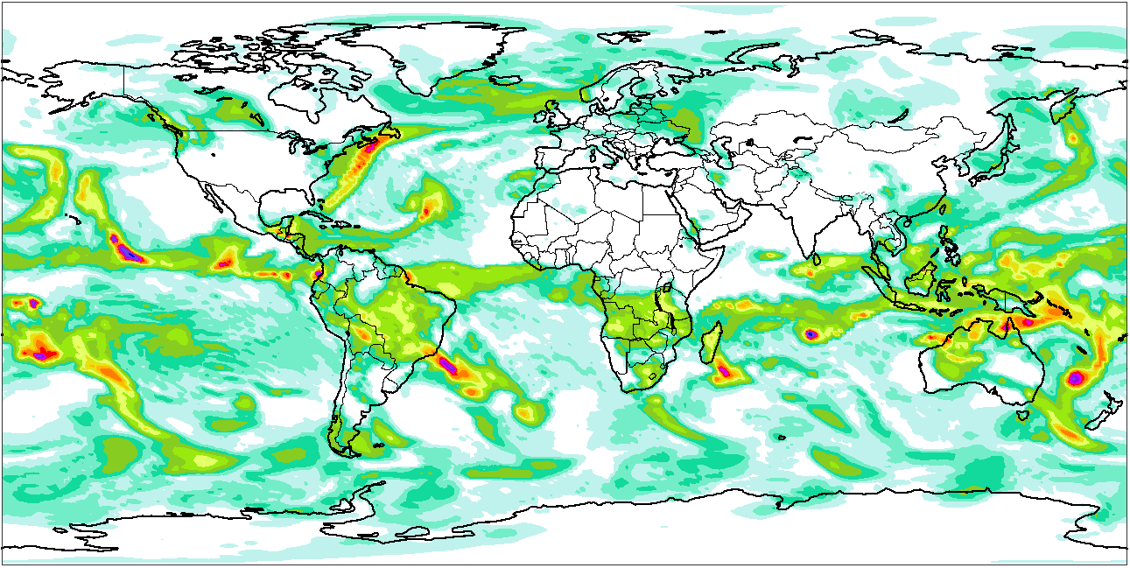
CALIBRATION
(Offline, for each model and model version)
Predictors
forecasts
Expert elicitation is used to define the predictors hierarchy
Inputs
Exploratory Analysis
A “2-sided Kolmogorov-Smirnov test” and “distribution similarity scores” determine the G_WTs
Rainfall forecasts & observations
Expert elicitation is then applied again to refine the breakpoints of the G_WTs
Establishing the relationship between forecasts and observations
(FORECAST ERROR RATIO, FER)
Creating a decision tree with all G_WTs
FER =
O_{point} - F_{gridCAL}
F_{gridCAL}
100
Mapping Function (MF) for all cases
Decision Tree Example
90
OBS within ± 25% of FC
80
70
OBS drier FC
OVERESTIMATION
OBS wetter FC
UNDERESTIMATION
60
50
Probabilities [%]
40
OBS=0 when TP>=1
30
OBS 3 or more times wetter than FC. Higher risk of FF, depending on TP values.
20
10
0
-1
-1 to -0.75
-0.75 to -0.5
-0.5 to -0.25
-0.25 to 0.25
0.25 to 0.5
0.5 to 0.75
0.75 to 1
1 to 1.5
1.5 to 2
2 to 3
3 to 5
5 to 10
10 to 25
<25
FER values [-]
GLOBAL FORECASTS GENERATION
(Operational, run twice per day)
Point rainfall forecast distribution for all members, at a grid-box
Point rainfall forecast distribution for one ENS member, at a grid-box
ENS forecasts distribution, at a grid-box
ENS forecast, at a grid-box
Prob (%) of not exceeding Thr
1
ENS Memb. 1
ENS Memb. 2
ENS Memb. 3
ENS Memb. 4
Probability
Probability
+
+
+
+ … =
1%
2
99th Perc_PR
Rainfall (mm)
Rainfall (mm)
Rainfall (mm)
Rainfall (mm)
Thr
99th Perc_ENS
The grid-box WT determines, for each member, how the ENS forecast is converted into point rainfall forecasts.
Rainfall (mm)
Prob. Exceeding a Threshold (%)
Percentiles (mm)
1
2
Raw ENS
Global Maps Available to Users
Point-Rain

