Slide 1
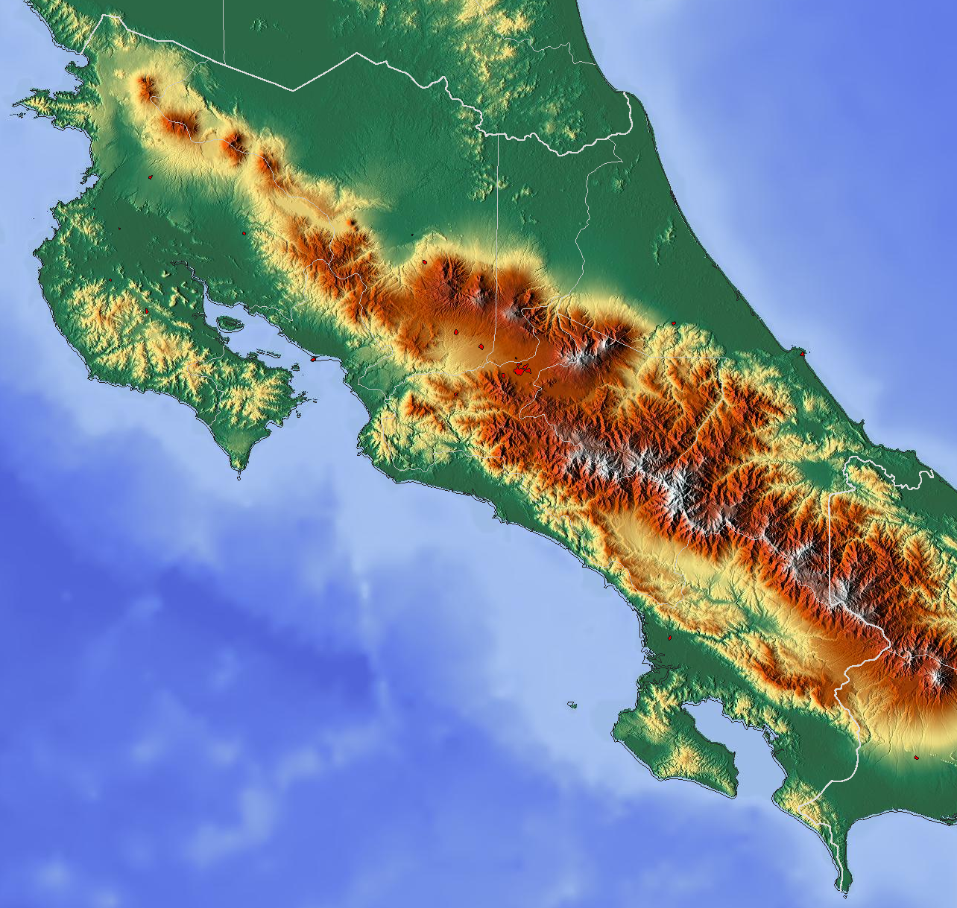
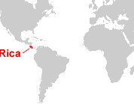
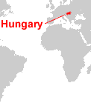
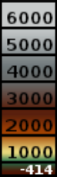
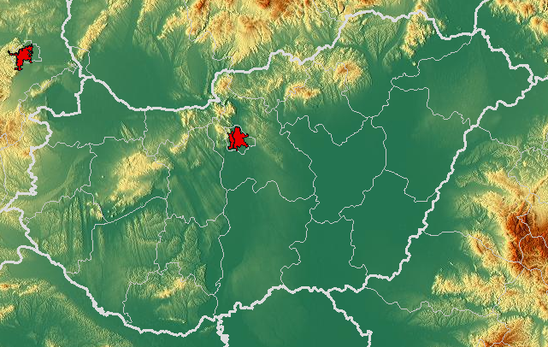
Nicaragua
a
Costa Rica
Caribbean Sea
San José
Pacific
Ocean
Extra-Tropics
metres
Hungary
Panama
Costa
Tropics
Rica
Extra-Tropics
Ukraine
Slovakia
Austria
Budapest
Hungary
Slovenia
Romania
Bosnia and
Herzegovina
b
Serbia

