Slide 1
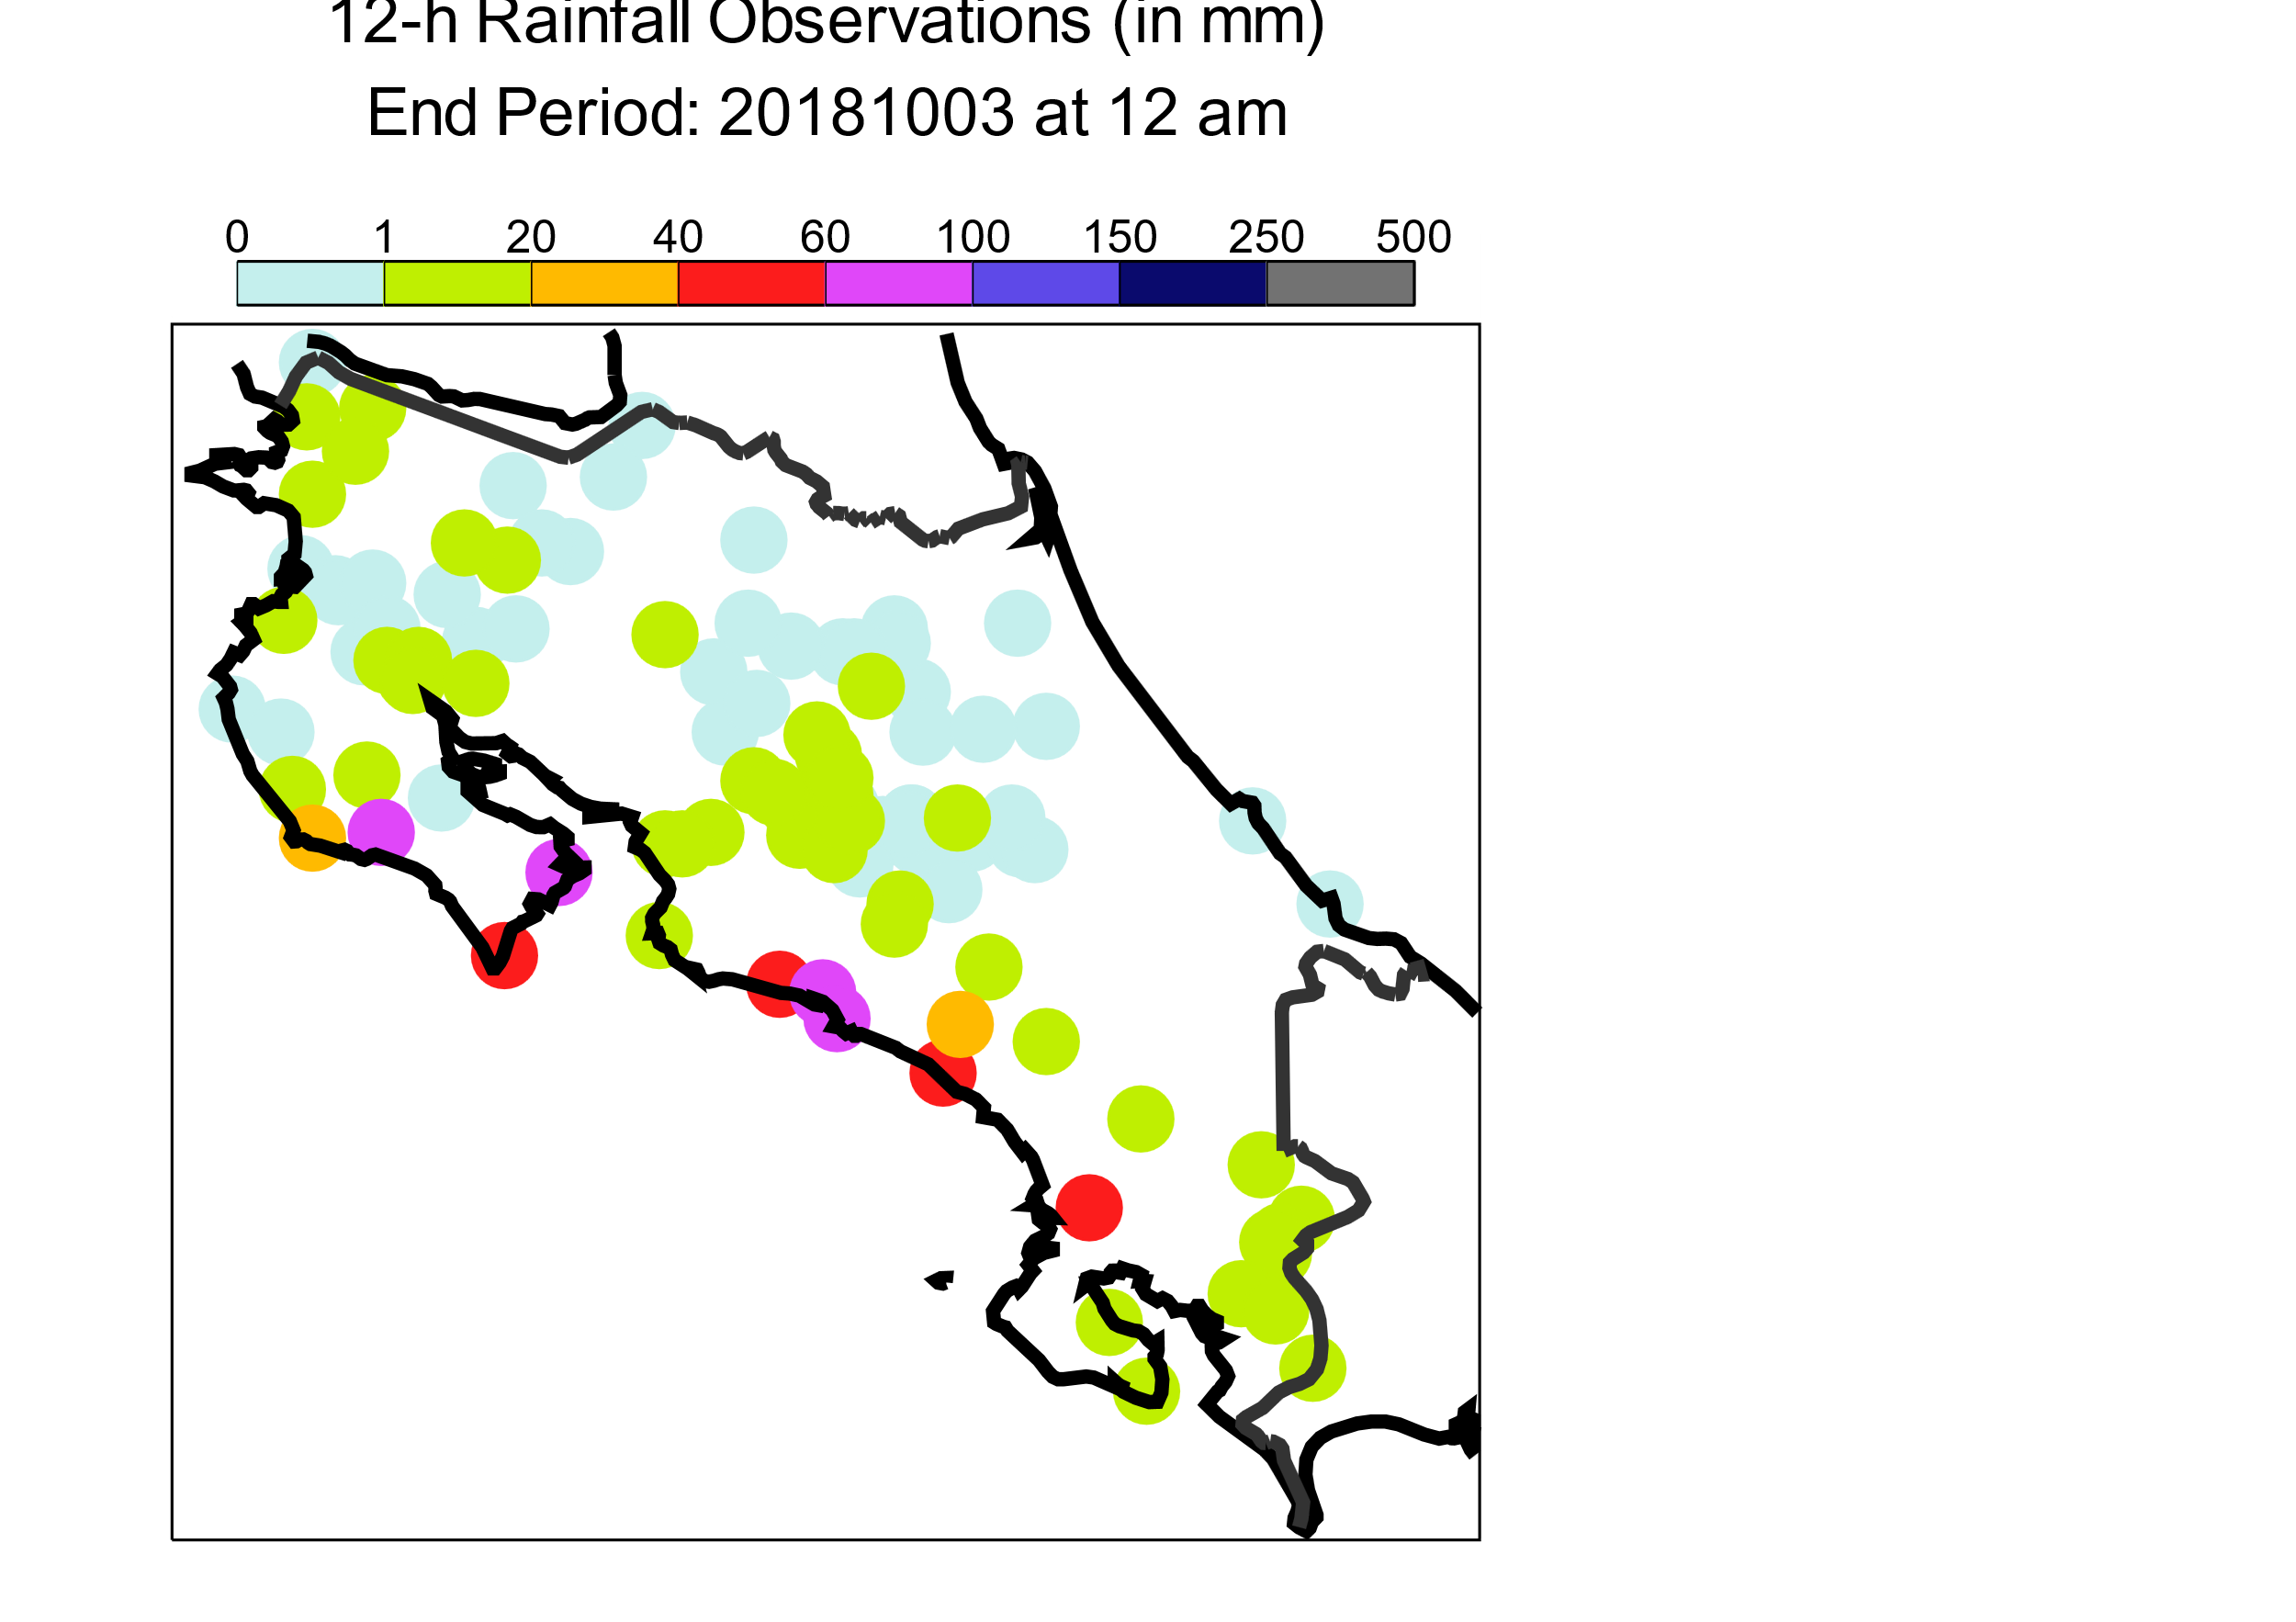
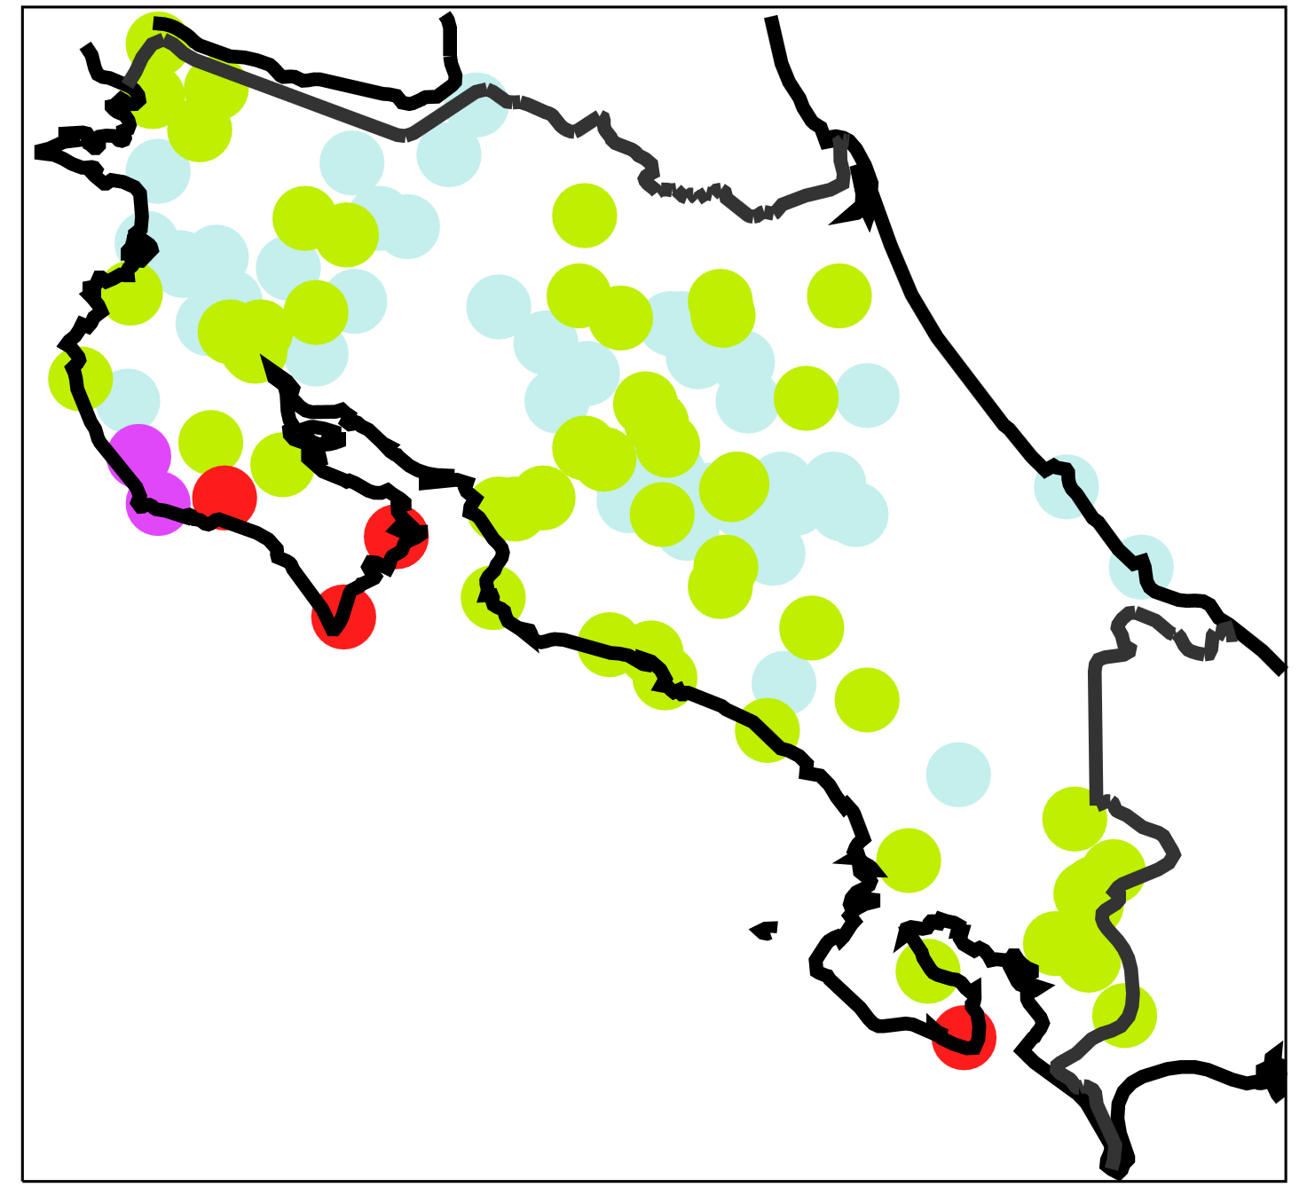
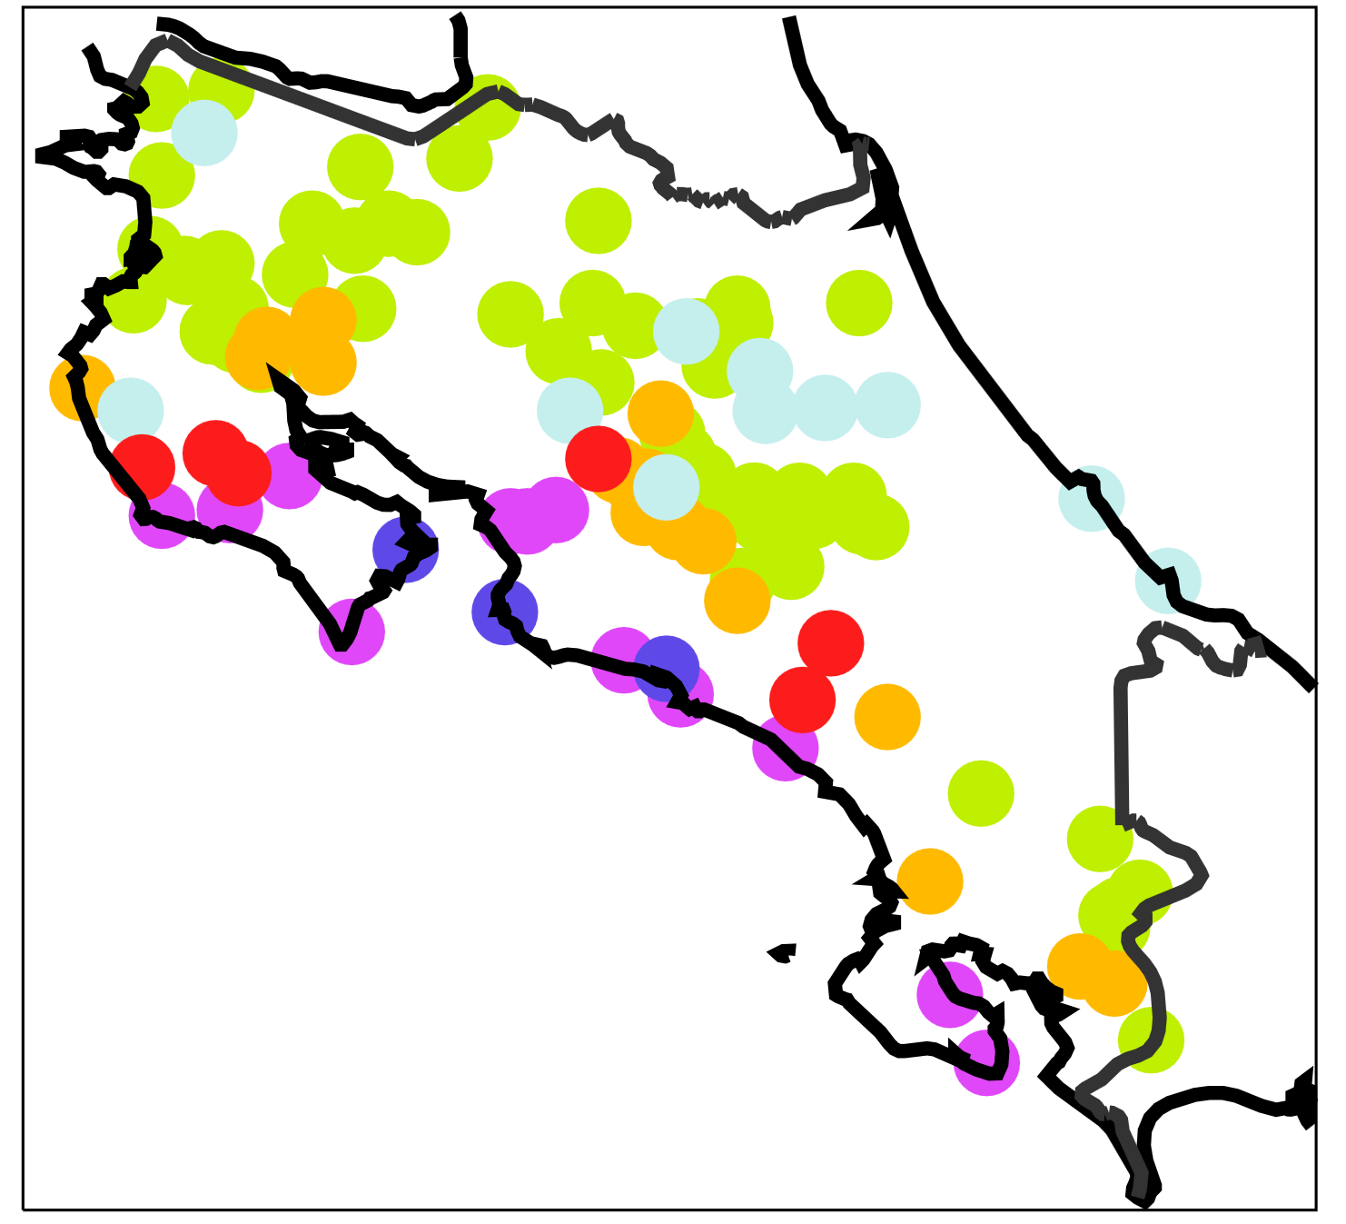
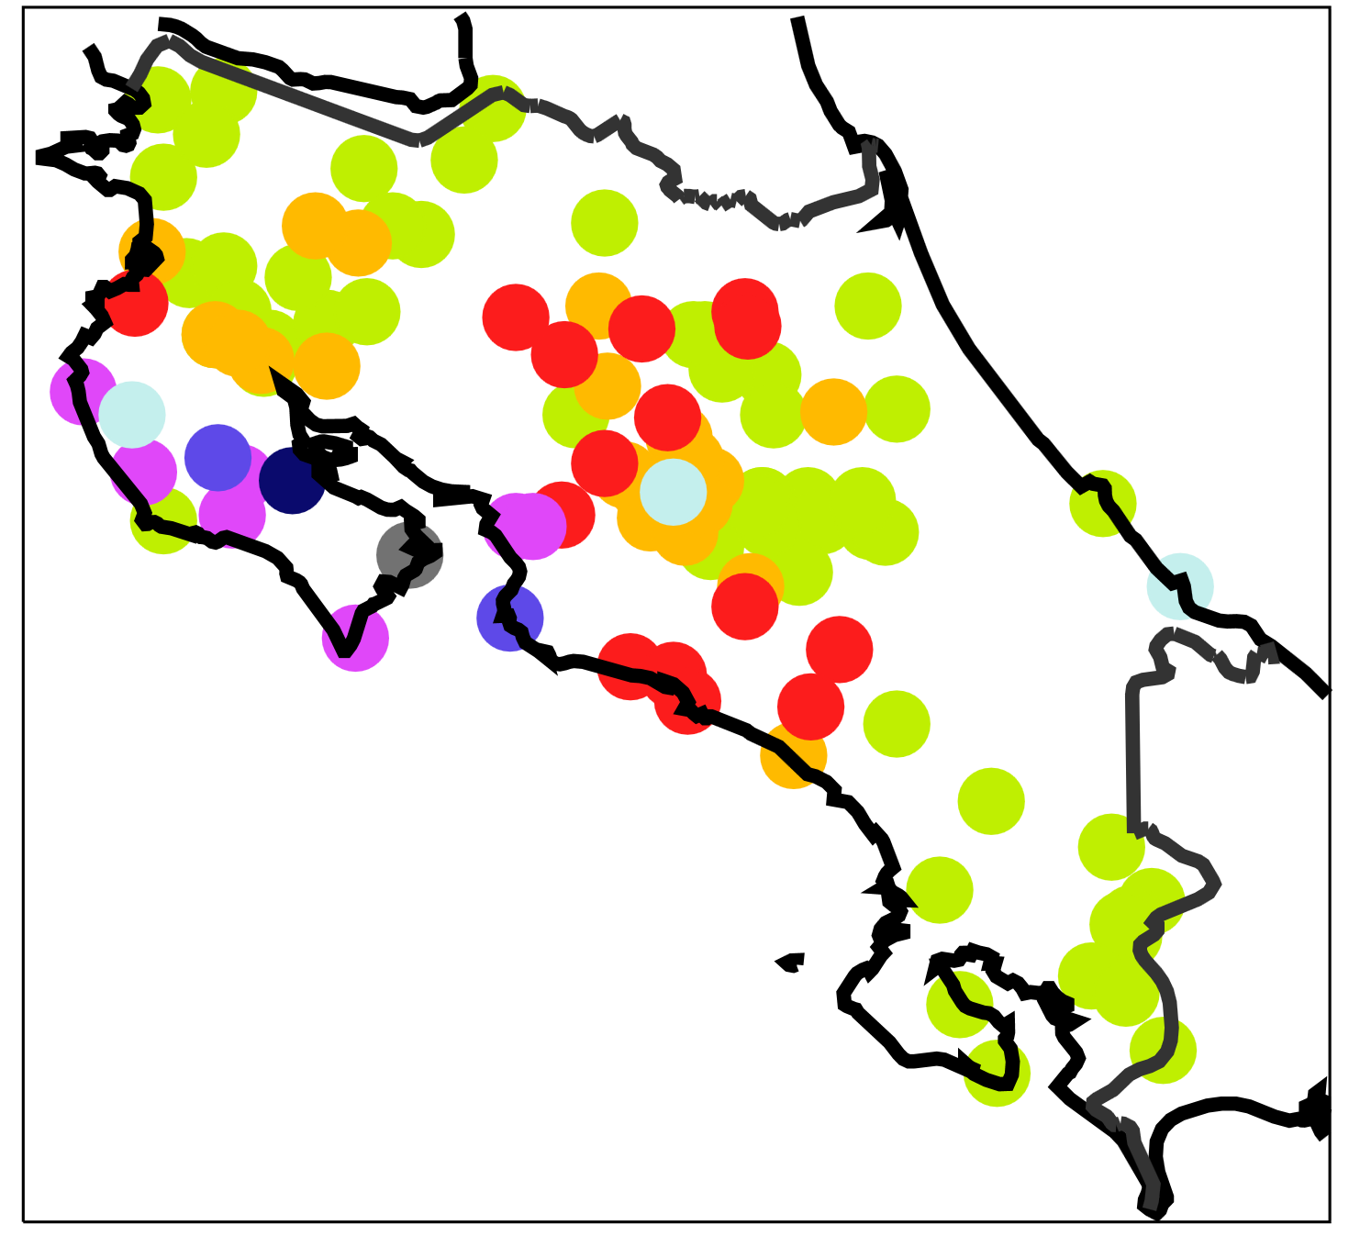
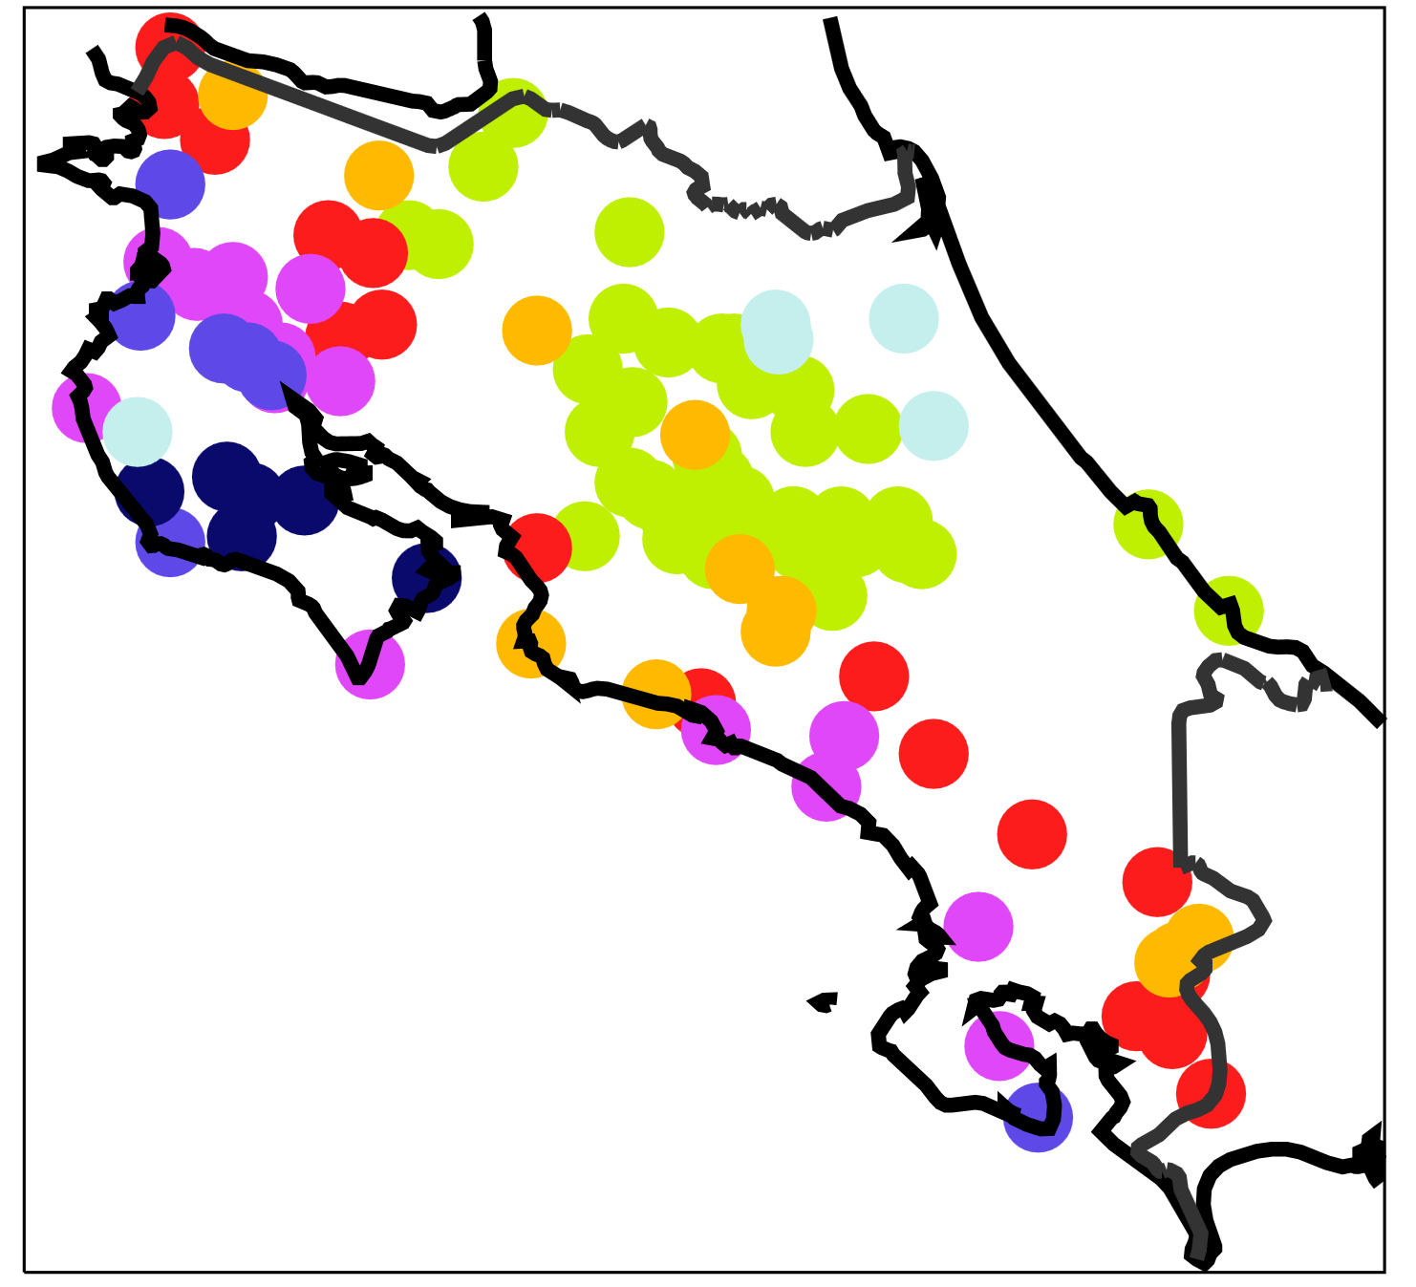
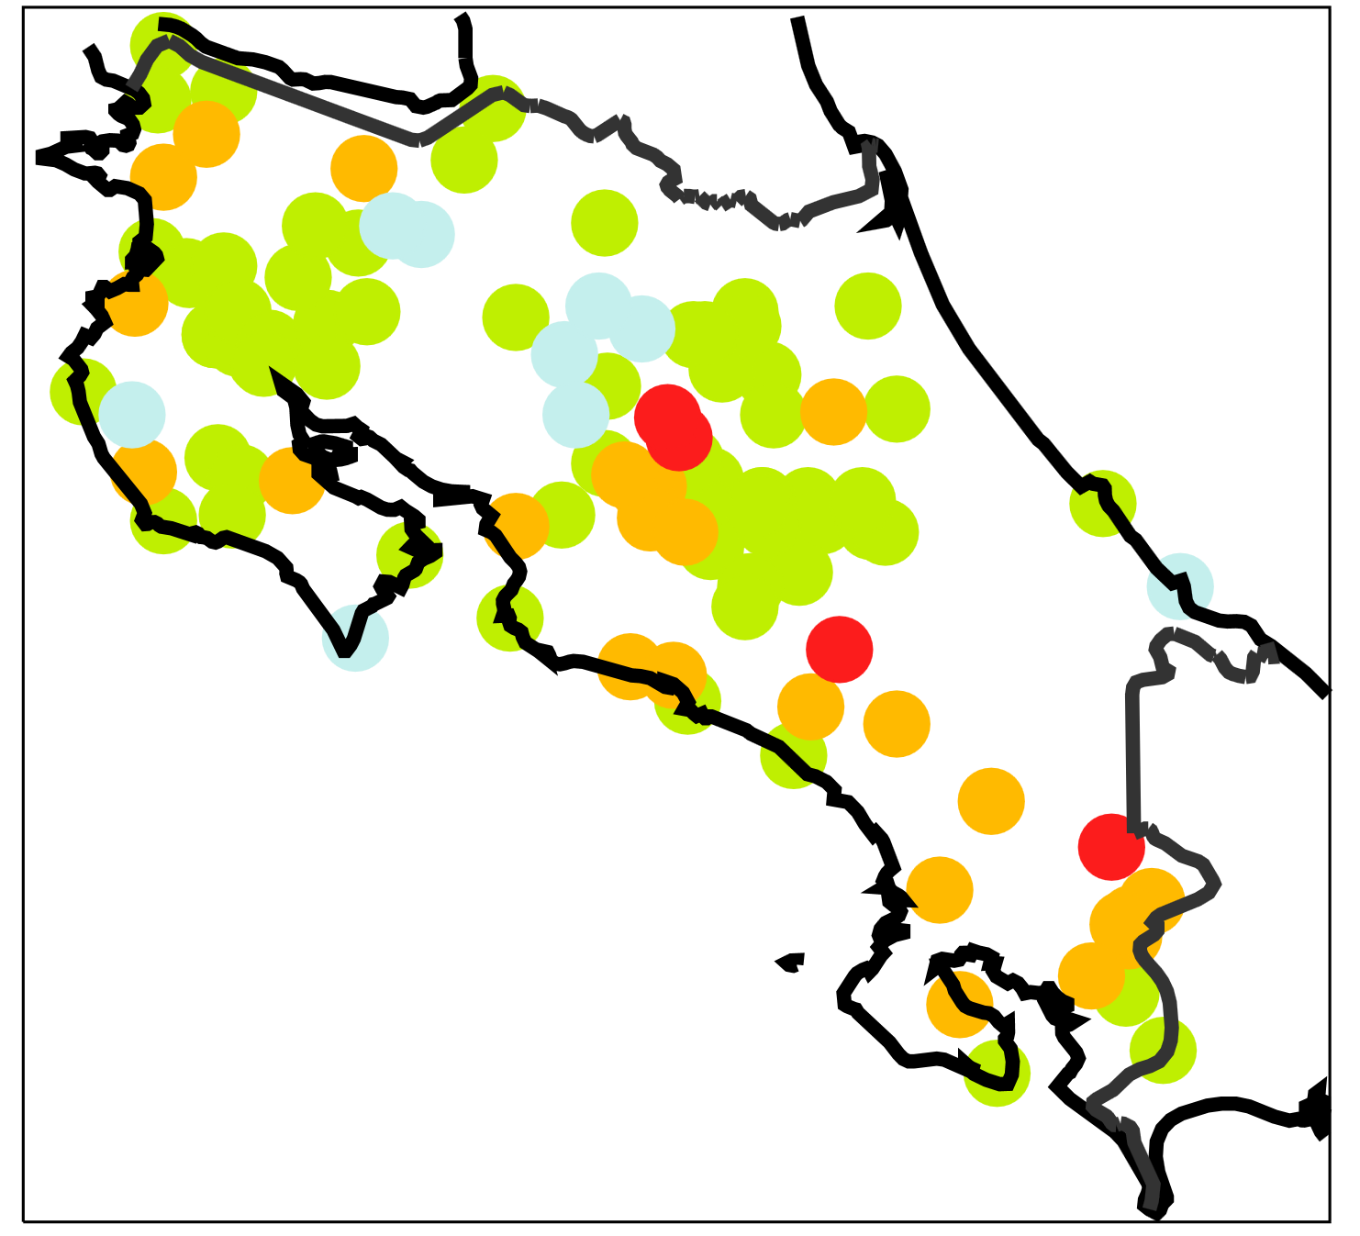
mm / 12h
a
b
2018/10/03 06 UTC to
2018/10/03 18 UTC
(LT: 2018/10/03 0 am to
2018/10/03 12 am)
2018/10/03 18 UTC to
2018/10/04 06 UTC
(LT: 2018/10/03 12 am to
2018/10/04 0 am)
c
d
2018/10/04 06 UTC to
2018/10/04 18 UTC
(LT: 2018/10/04 0 am to
2018/10/04 12 am)
2018/10/04 18 UTC to
2018/10/05 06 UTC
(LT: 2018/10/04 12 am to
2018/10/05 0 am)
e
f
2018/10/05 06 UTC to
2018/10/05 18 UTC
(LT: 2018/10/05 0 am to
2018/10/05 12 am)
2018/10/05 18 UTC to
2018/10/06 06 UTC
(LT: 2018/10/05 12 am to
2018/10/06 0 am)

