Slide 1


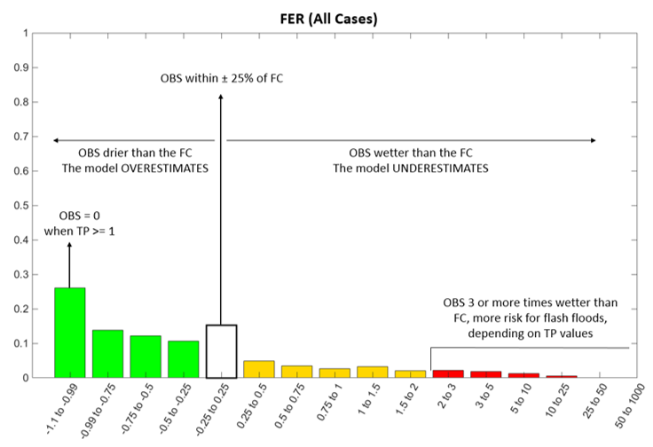
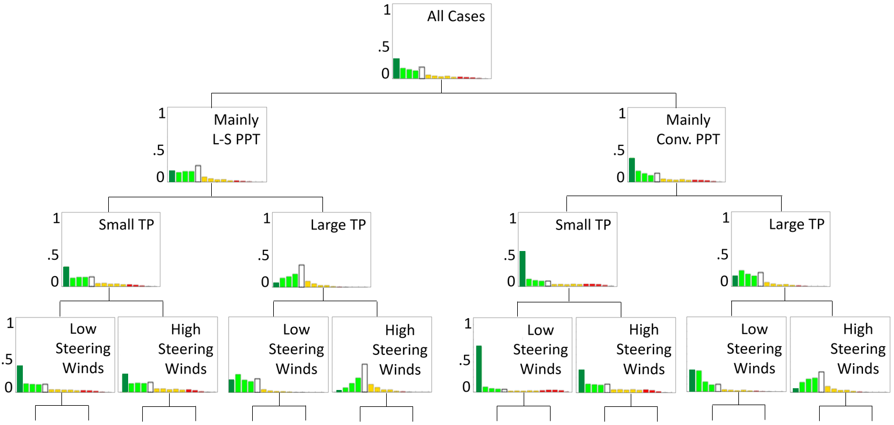
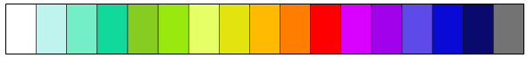
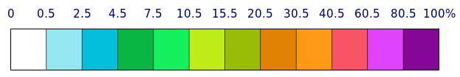
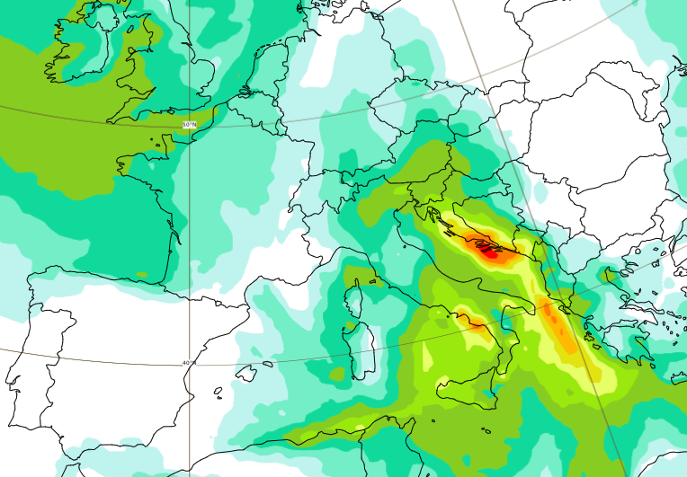
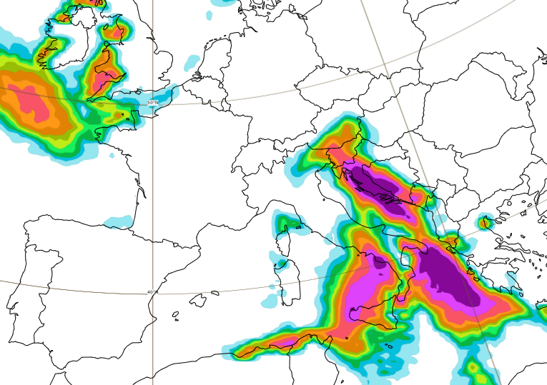
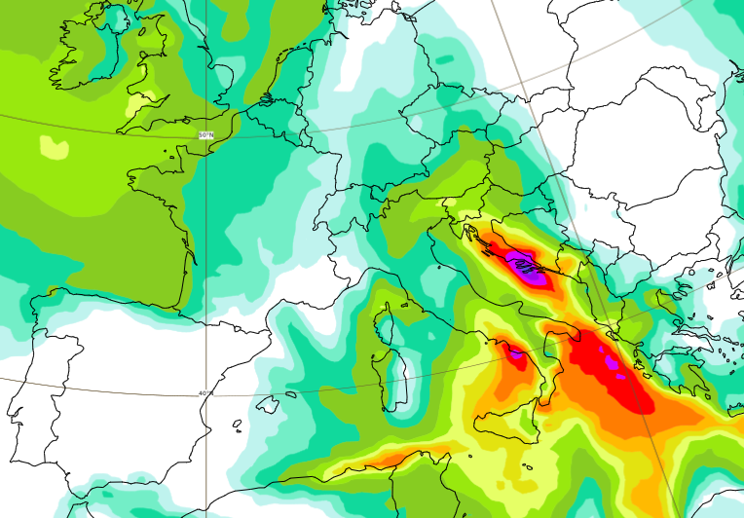
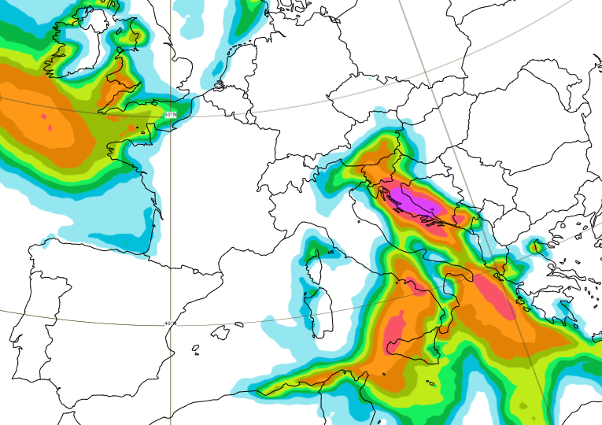
CALIBRATION
(Offline, for each model and model version)
GLOBAL FORECASTS GENERATION
(Operational, twice daily)
ENS forecasts distribution (of 51 values) for one grid-box
100
Mapping Function (MF) for all O-F pairs
ENS forecast, for one grid-box
Point rainfall forecast distribution (of 5100 values) for one grid-box, for all ENS members
90
OBS within ± 25% of FC
ecPoint-Rainfall forecast distribution (of 100 values) for one grid-box, for each ENS member
O - F
80
FER =
F
70
OBS drier FC
OVEREST.
OBS wetter FC
UNDEREST.
60
ENS Memb. 1
ENS Memb. 2
ENS Memb. 3
Probability (%)
Probabilities [%]
50
OBS=0 for TP>=1
40
OBS 3 or more times wetter than FC. Higher risk of FF, depending on TP values.
Probability (%)
+
+
+ … =
30
20
Rainfall (mm)
Rainfall (mm)
Rainfall (mm)
Rainfall (mm)
Establishment of the relationship between O-F pairs:
FORECAST ERROR RATIO (FER)
10
The G_WT determines, for each member, how the ENS forecast is converted into point rainfall forecasts.
0
-1
-1 to -0.75
-0.75 to -0.5
-0.5 to -0.25
-0.25 to 0.25
0.25 to 0.5
0.5 to 0.75
0.75 to 1
1 to 1.5
1.5 to 2
2 to 3
3 to 5
5 to 10
10 to 25
<25
Percentiles (mm)
Probability of Not Exceeding a Threshold (%)
FER values [-]
Prob_ENS not exceeding Thr
Rainfall forecasts (F) & observations (O)
Expert elicitation is used to define the predictors hierarchy
Probability (%)
Probability (%)
Prob_ecPoint not exceeding Thr
Inputs
Exploratory Analysis
“2-sided Kolmogorov-Smirnov test” and “distribution similarity scores” determine the G_WTs
Fixed x %
Predictors
forecasts
Expert elicitation is then applied again to refine the G_WTs
Rainfall (mm)
(100-x)^{th} Perc
ENS
(100-x)^{th} Perc
ecPoint
Fixed Thr (mm)
Rainfall (mm)
Creation of a decision tree with all the G_WTs
99th Percentile (mm/12h)
Probability (%) of not exceeding 10 mm/12h
500
0
1000
10.5
80.5
7.5
100
4.5
30.5
2.5
40.5
0.5
15.5
60.5
80
20.5
100
125
60
150
300
50
200
40
10
30
2
20
0.5
0
5
Decision Tree Example
Raw ENS
Raw ENS
ecPoint-Rainfall
ecPoint-Rainfall

