Slide 1
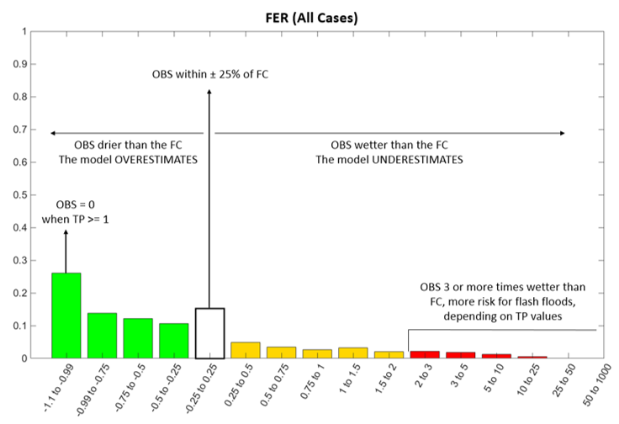
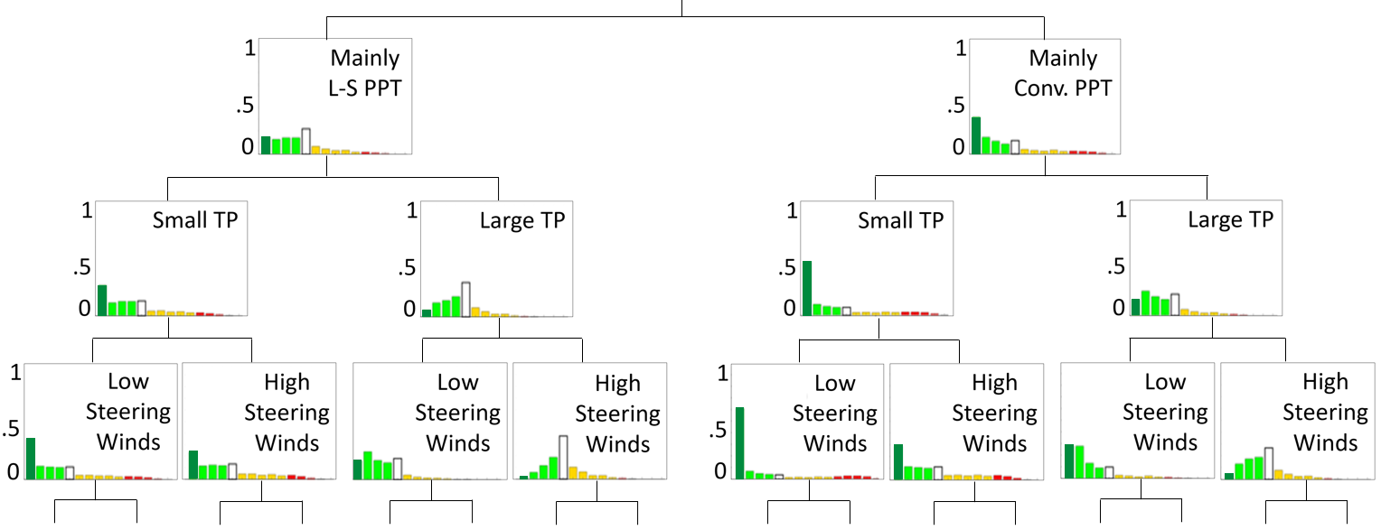
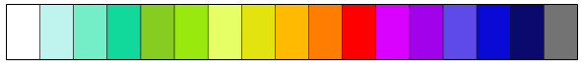
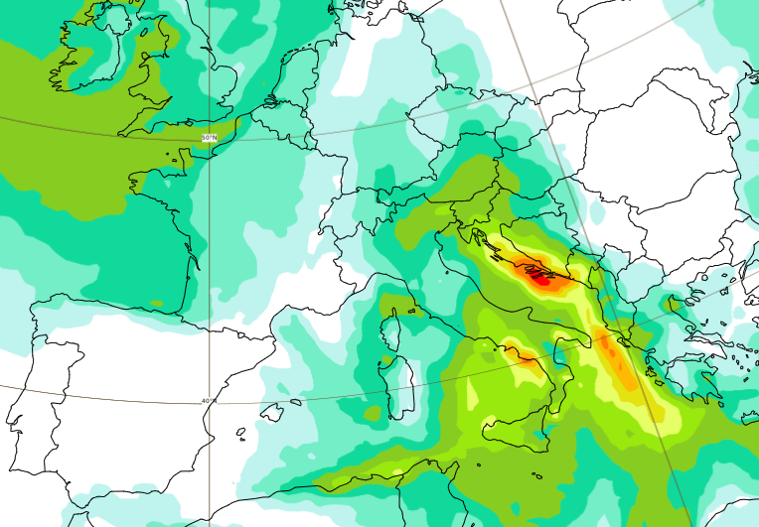
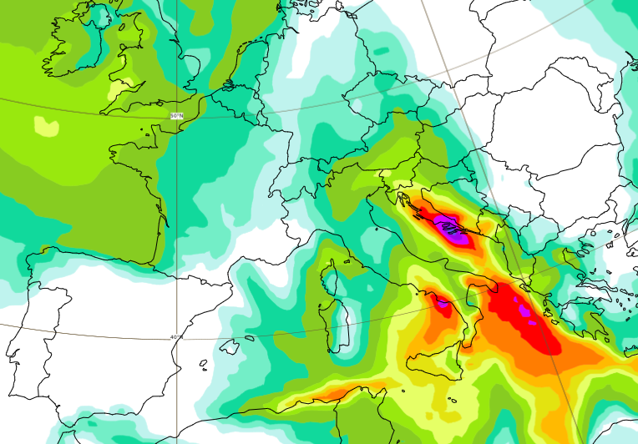
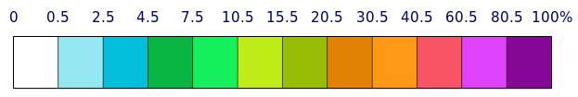
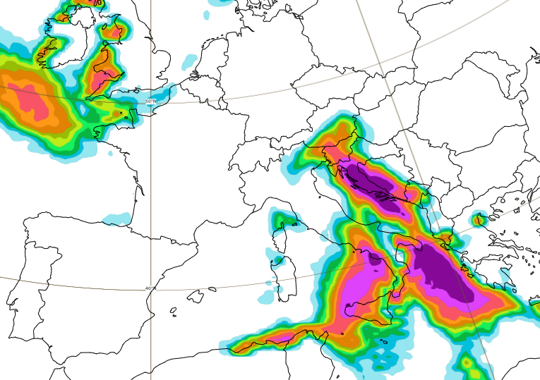
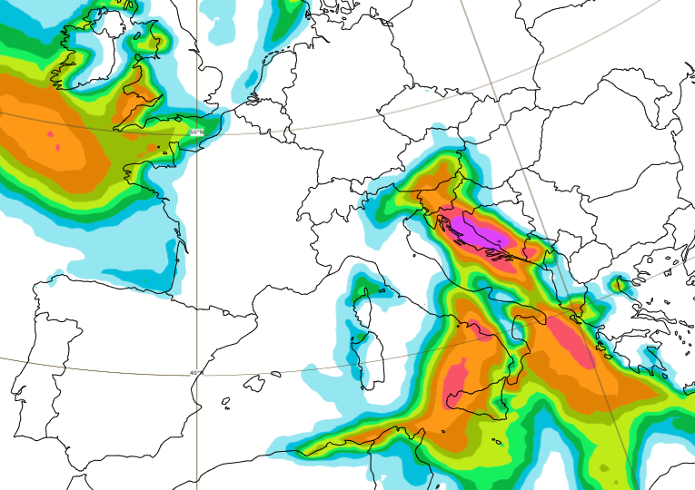
FORECASTS CALIBRATION (Offline, for each NWP model and model version)
a
Rainfall forecasts (FC)
Rainfall observations (OBS)
List of predictors
P = [P1, …, Pn]
100
Mapping Function (MF) for all O-F pairs
90
OBS within ± 25% of FC
80
OBS drier FC
OBS wetter FC
70
TP: total precipitation
FF: flash floods
Computation of the Forecast Error Ratio (FER)
60
Probabilities [%]
OBS=0 for
TP>=1
50
40
OBS 3 or more times wetter than FC. Higher risk of FF, depending on TP values.
FER =
OBS - FC
30
FC
20
10
Exploratory Analysis
0
-1
-1 to -0.75
-0.75 to -0.5
-0.5 to -0.25
-0.25 to 0.25
0.25 to 0.5
0.5 to 0.75
0.75 to 1
1 to 1.5
1.5 to 2
2 to 3
3 to 5
5 to 10
10 to 25
<25
Expert elicitation defines the predictors’ hierarchy
“2-sided Kolmogorov-Smirnov test” determines grid-box weather types (G_WTs)
Expert elicitation refines the G_WTs
FER values [-]
100
Mainly large- scale TP
Decision Tree Example
100
Mainly Conv. TP
50
50
100
0
0
50
Small TP
Large TP
Small TP
Large TP
100
0
Creation of a decision tree with all G_WTs
50
Low winds
High winds
Low winds
High winds
Low winds
High winds
Low winds
High winds
0
b
FORECASTS GENERATION (Operational)
Forecast for a grid-box, for each ensemble member
Raw ECMWF ensemble (ENS) ecPoint-Rainfall
The G_WT determines, for each member, how the ENS forecast is converted into point rainfall forecasts.
Forecast for a grid-box, for all ensemble members
Raw ECMWF ENS forecasts distribution (of 51 values) for one grid-box
ENS Memb_1
ENS Memb_2
ENS Memb_3
Probability density
ecPoint-Rainfall forecasts distribution (of 5100 values) for one grid-box, for all ENS members
Probability density
+
+
+ … =
Rainfall (mm)
Rainfall (mm)
Rainfall (mm)
Rainfall (mm)
PRODUCTS (available on ecCharts)
c
0
1000
0.5
2
5
10
20
30
40
50
60
80
100
125
150
200
300
Percentiles (Perc, mm)
500
Rainfall totals (in mm/12h) for the 99th percentile
Probability density
Raw ENS
ecPoint-Rainfall
Fixed x %
(100-x)^{th} Perc ENS
(100-x)^{th} Perc ecPoint
Rainfall (mm)
80.5
60.5
40.5
20.5
30.5
15.5
0
10.5
0.5
2.5
4.5
Probability of Exceeding a Threshold (%)
7.5
100
Probability (in %) of exceeding 10 mm/12h
Prob_ENS of exceeding Thr
Probability density
Prob_ecPoint of exceeding Thr
Raw ENS
ecPoint-Rainfall
Fixed Threshold (Thr)
Rainfall (mm)

