Slide 1
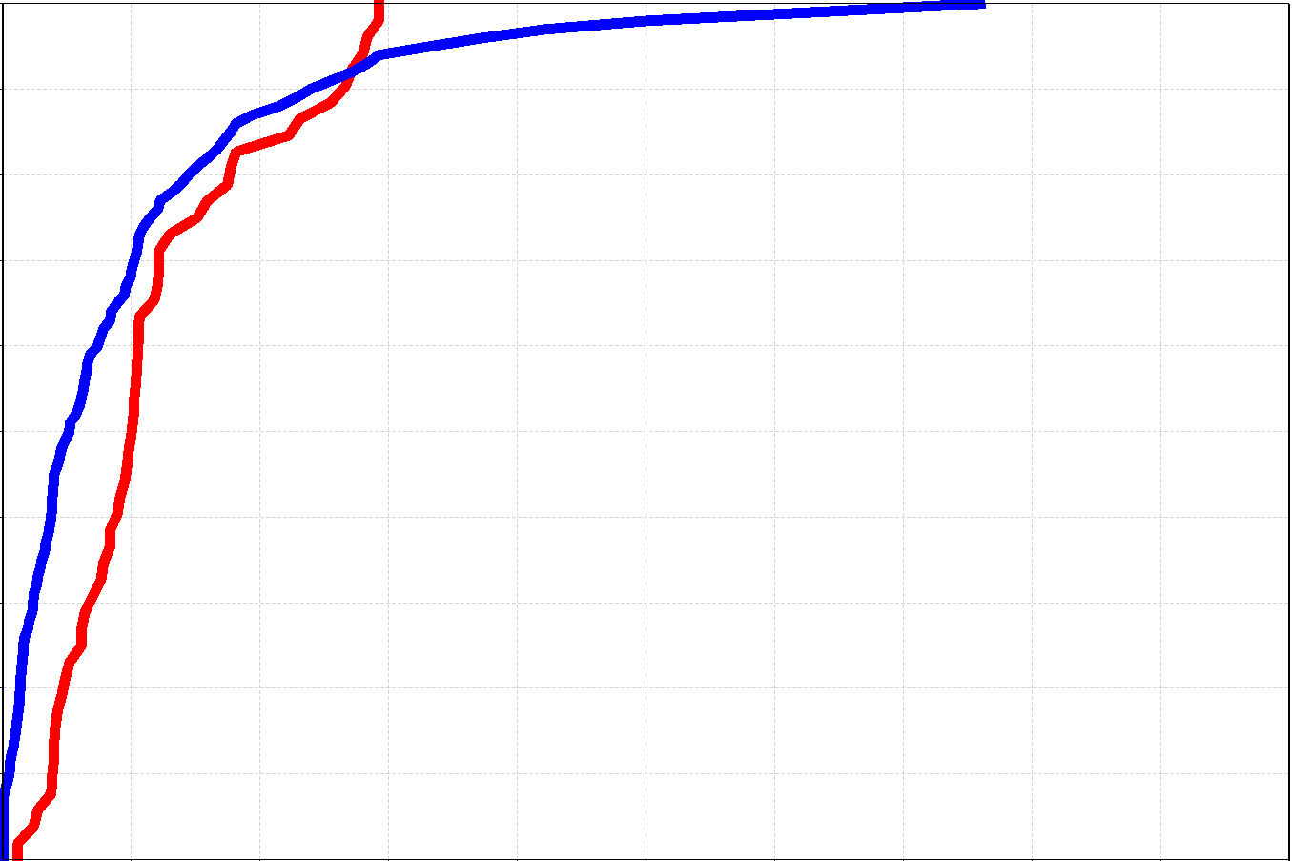
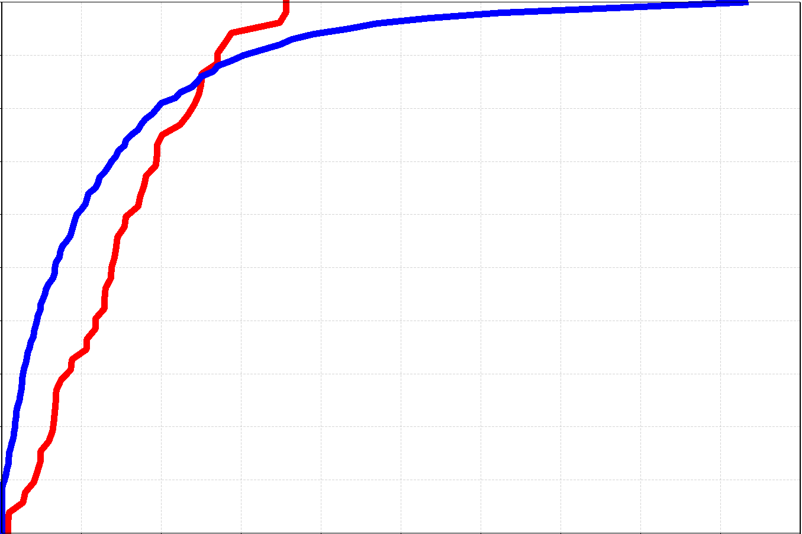
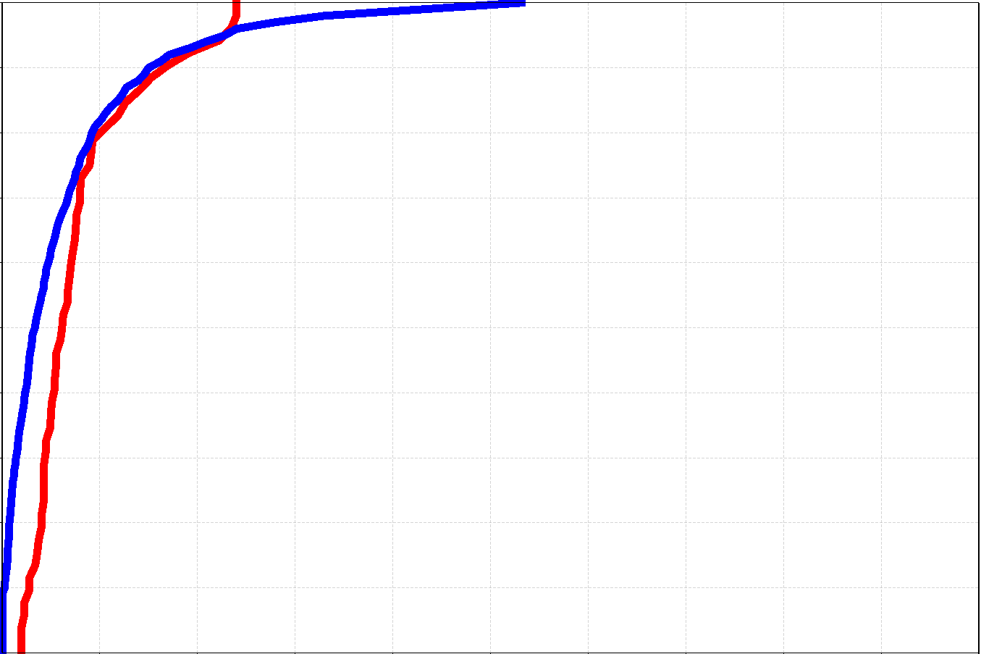
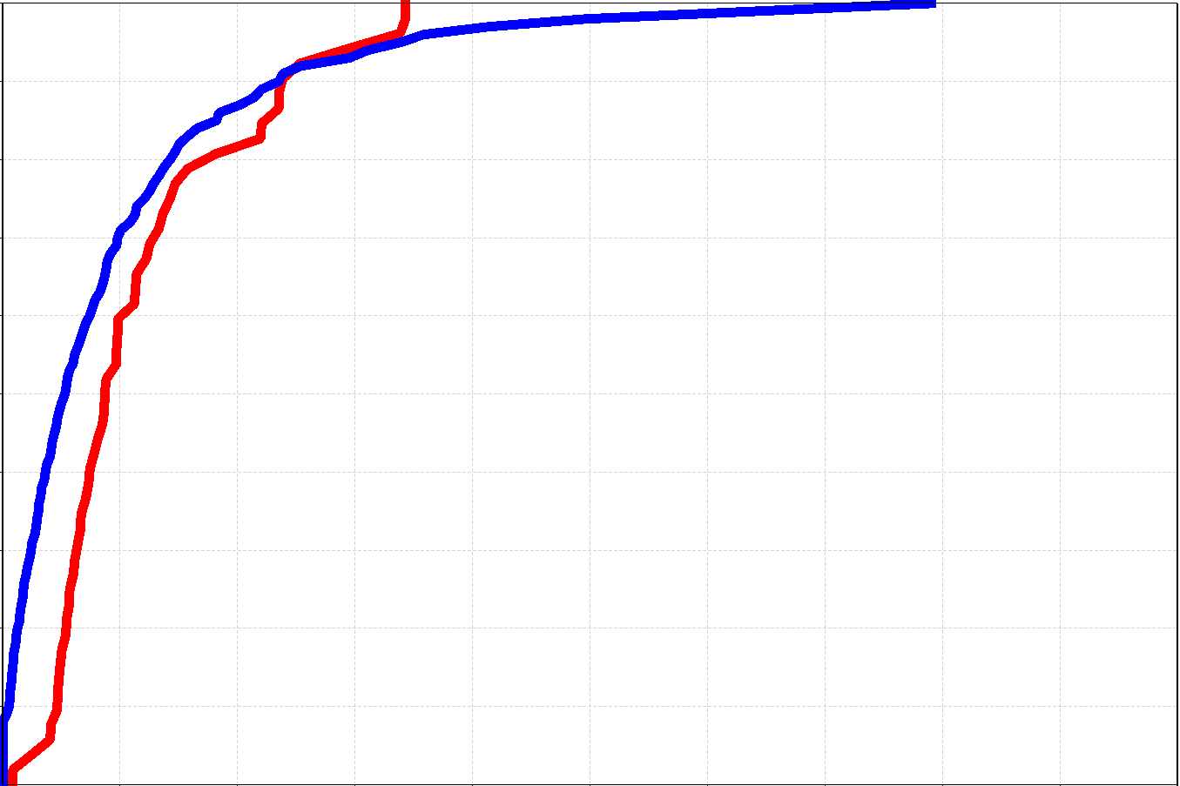
FC: 2018/10/04, 00UTC (t+18,t+30)
VT (LT): 2018/10/04 12 am - 2018/10/05 0 am
FC: 2018/10/04, 12UTC (t+18,t+30)
VT(LT): 2018/10/05 0 am - 2018/10/05 12 am
South Coast of
Nicoya Peninsula
Raw ENS ecPoint-Rainfall
100
80
60
Prob. [%] to not exceed
40
20
a
b
0
Inland Parts of
Nicoya Peninsula
100
80
60
Prob. [%] to not exceed
40
20
c
d
0
0 100 200 300 400 500
Total precipitation [mm/12h]
0 100 200 300 400 500
Total precipitation [mm/12h]

