Slide 1
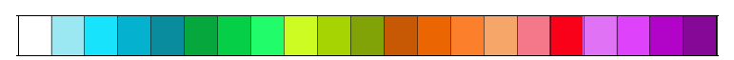
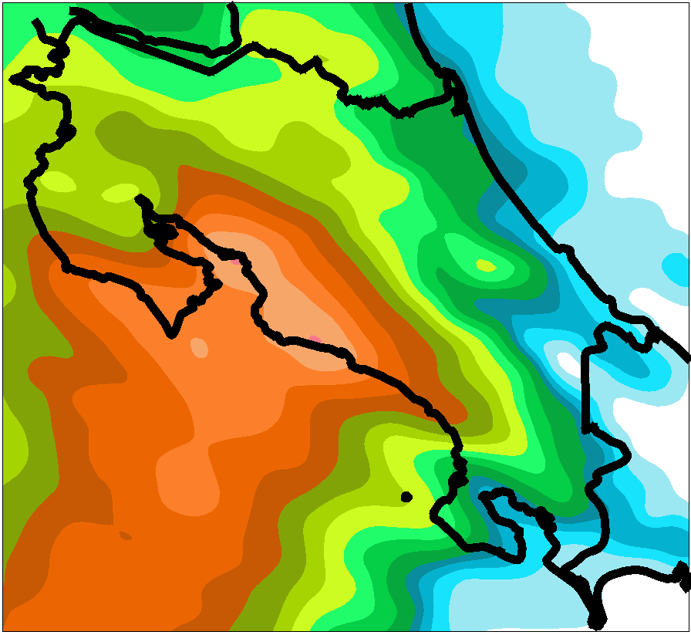
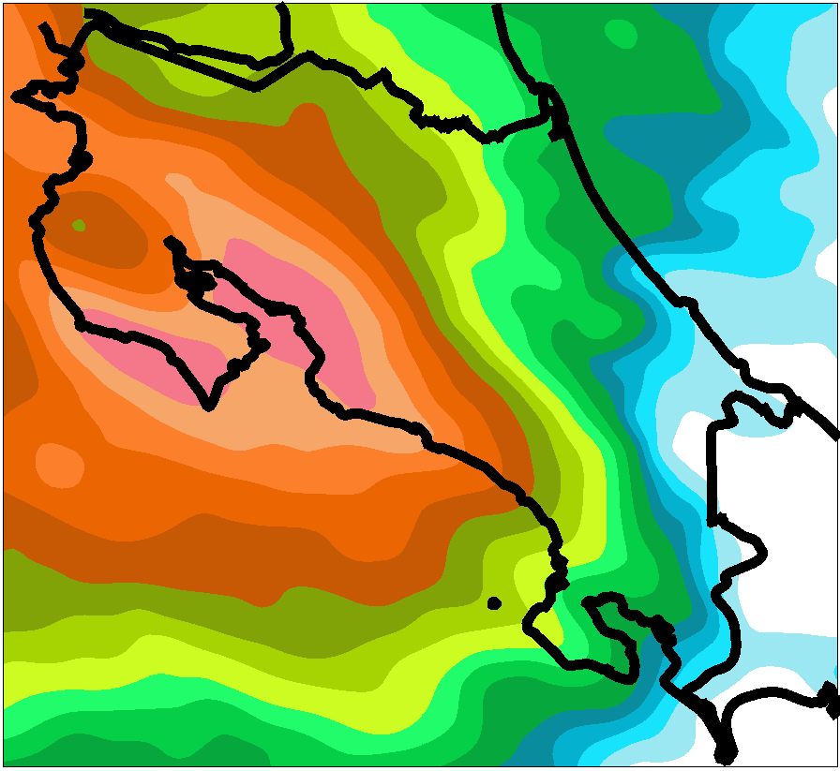
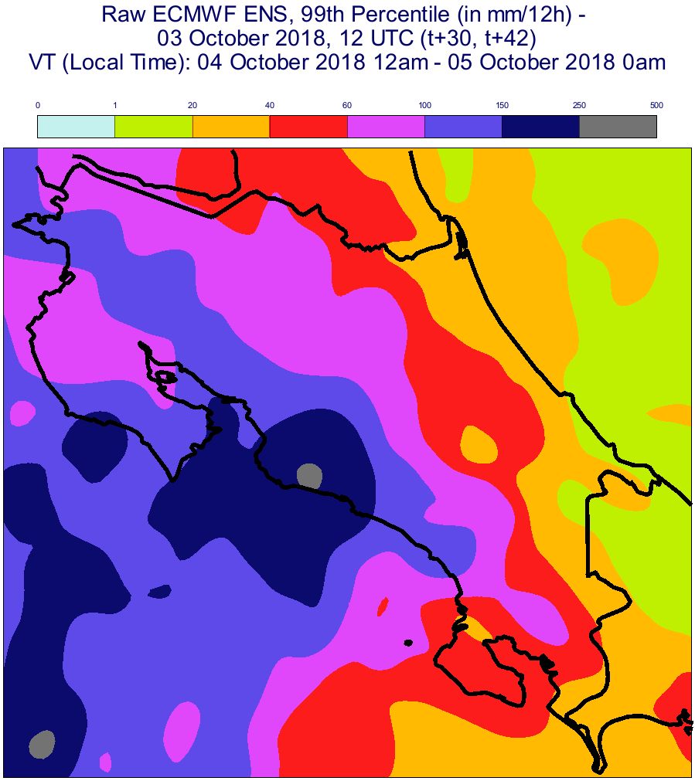
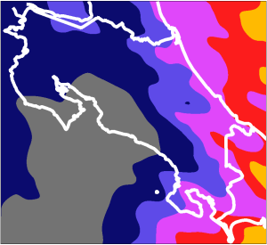
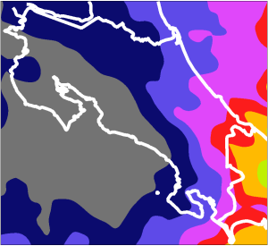
20.5
35.5
80.5
16.5
50.5
70.5
90.5
30.5
40.5
60.5
13.5
25.5
0.5
10.5
0
2.5
3.5
4.5
8.5
Prob. (in %) of exceeding 50 mm/12h
1.5
6.5
100
2018/10/04 00 UTC (t+18,t+30)
VT (LT): 2018/10/04 12am to 2018/10/05 0am
2018/10/04 12 UTC (t+18,t+30)
VT (LT): 2018/10/05 0am to 2018/10/05 12am
a
b
0
1
20
40
60
100
150
250
500
99th Percentile (in mm/12h)
2018/10/04 00 UTC (t+18,t+30)
VT (LT): 2018/10/04 12am to 2018/10/05 0am
2018/10/04 12 UTC (t+18,t+30)
VT (LT): 2018/10/05 0am to 2018/10/05 12am
c
d

