Slide 1
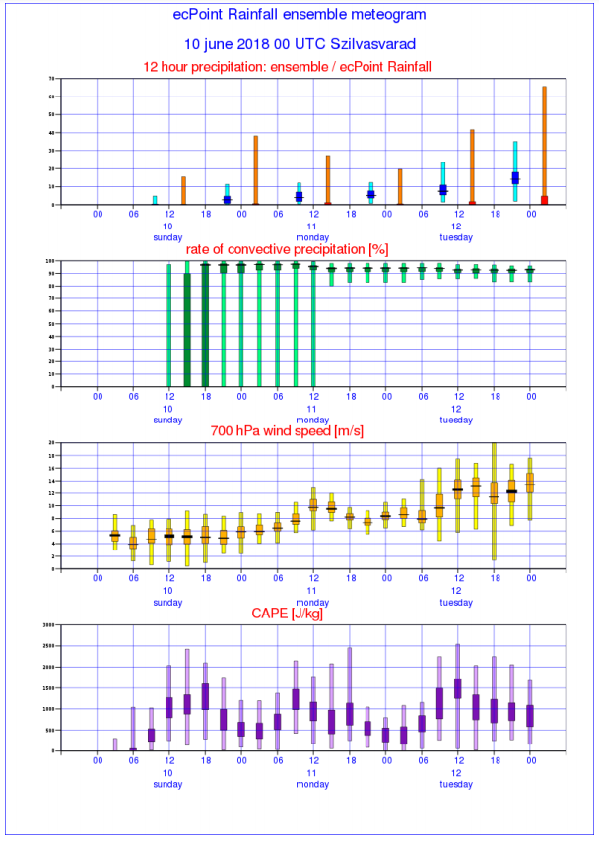
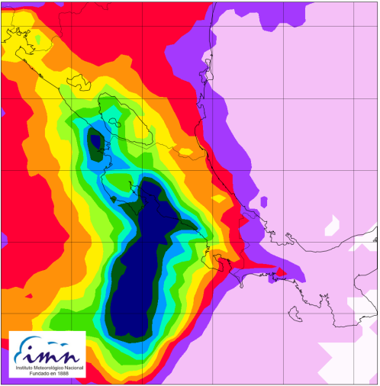

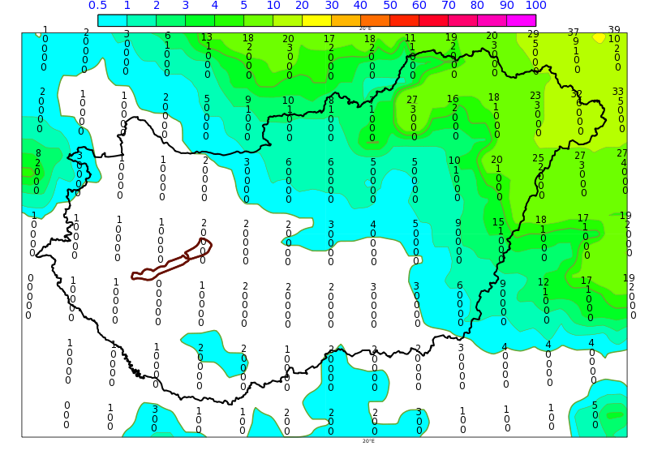
ecPoint-Rainfall, Lluvia de 12 horas 2018100412 f=018 (P85)
Hora Local: 2018/10/05 a la = horas
a
100
b
13.5 °N
70
80
60
12 °N
50
40
60
30
20
10.5 °N
[mm/12h]
10
0
40
8 °N
100
20
90
6.5 °N
80
70
60
50
0
40
88 °W 86.5 °W 85 °W 83.5 °W 82 °W 80.5 °W
30
20
10
12-hourly ecPoint Rainfall
10 June 2018 00 UTC (t+24, t+36)
Values (in mm) of the 90th (top number), 75th, 50th, 25th, 10th (bottom) percentiles per grid box (0.5-degrees resolution)
Probabilities (in %) of exceeding 10 mm/12h (contour shades, original ECMWF ENS resolution of ~18 km)
0
c
18
16
14
%
12
10
8
[%]
6
4
2
0
3000
2500
2000
1500
1000
500
0

