Slide 1
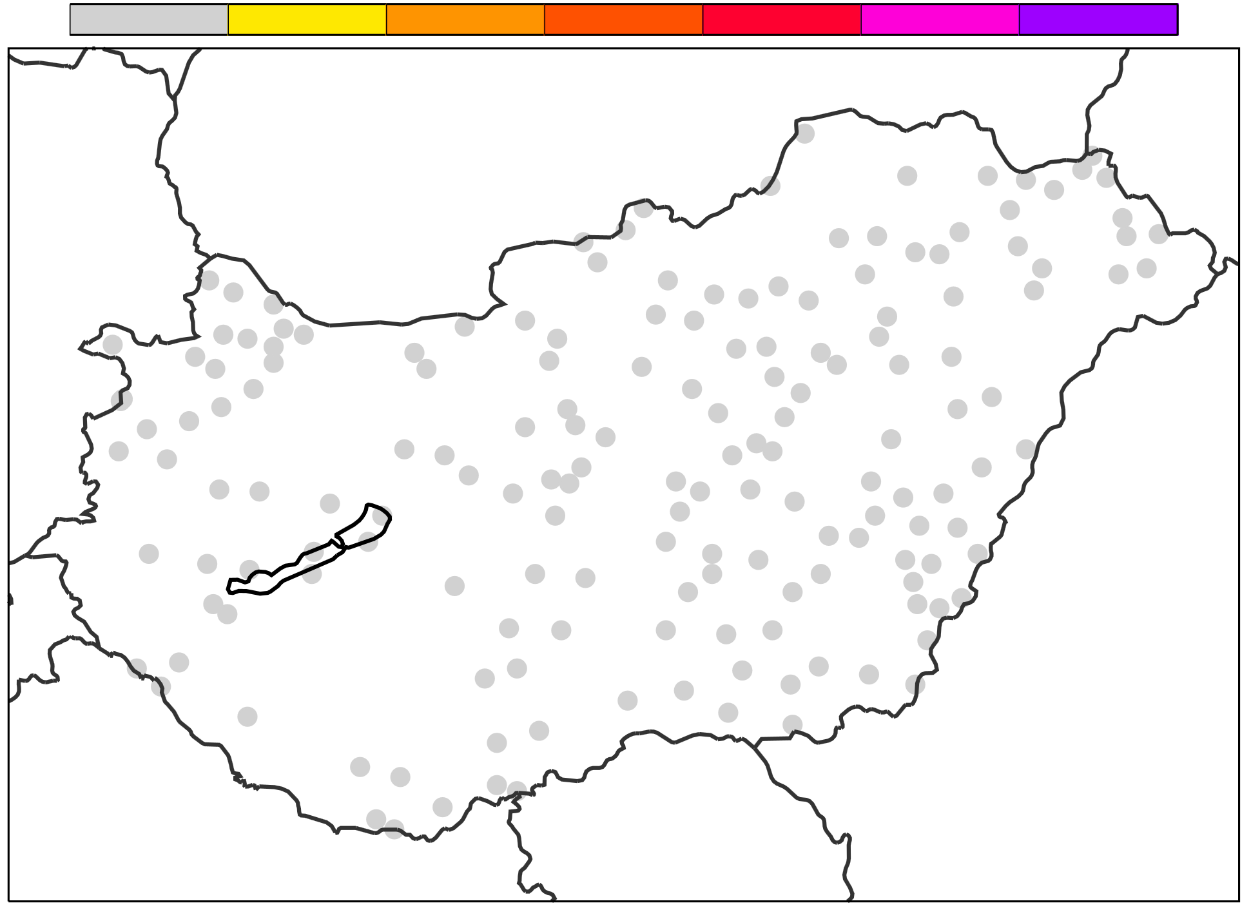
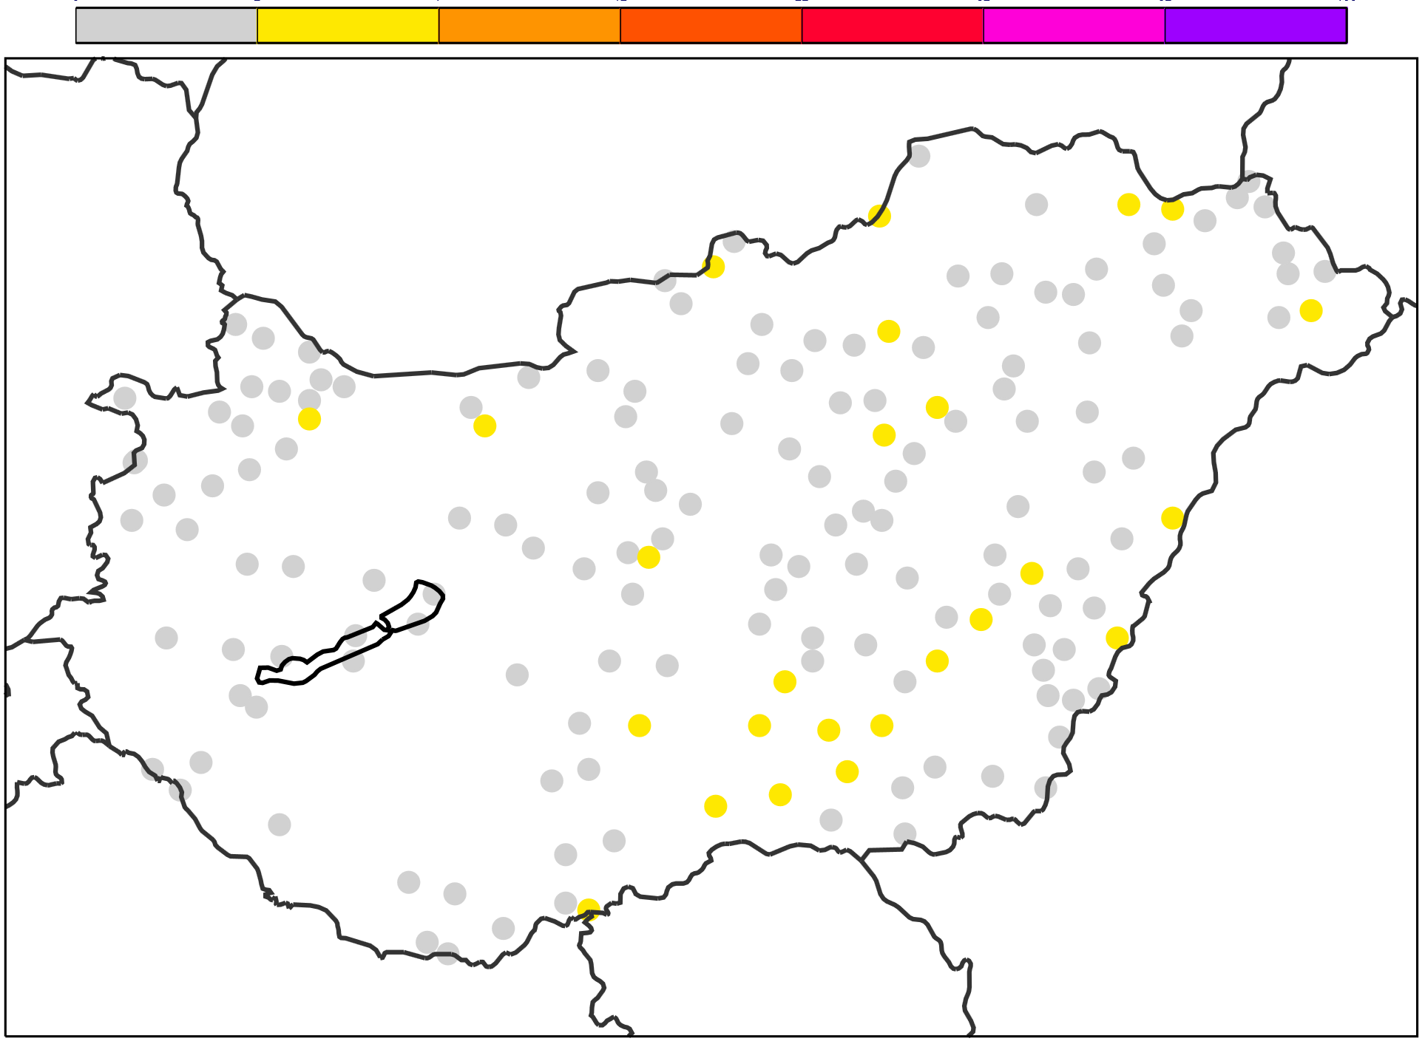
% of times obs>fc over the verification period (June 1st to August 31st 2018)
Reliable FC
FC underestimation
FC underestimation
5
0
10
15
20
30
40
1
60
100
0
2
7
12
22
32
52
100
For observation at location Y
95th percentile
99th percentile
Verification Period
OBS
FC percentiles
Xth
Day 1
..
.
..
.
Day N
sum(OBS>FC) / N * 100 (%)

