Slide 1
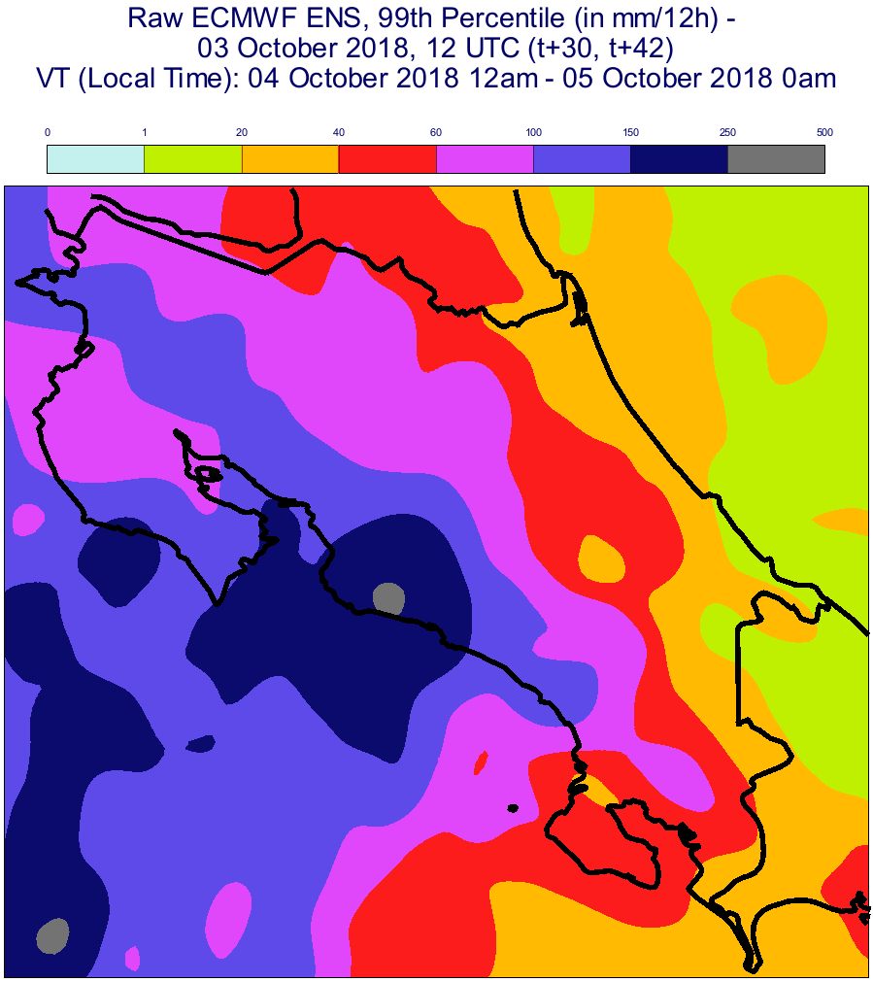

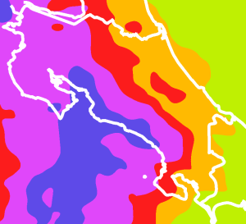
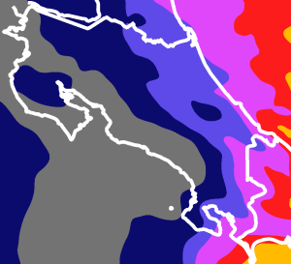
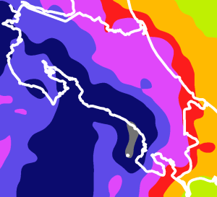
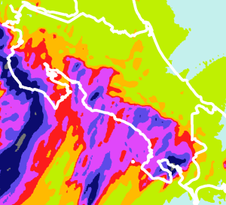
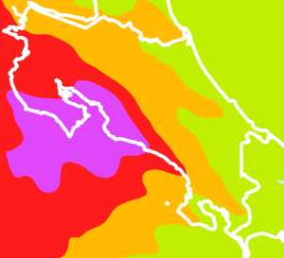
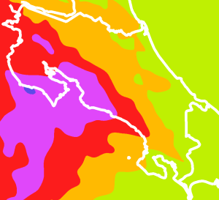
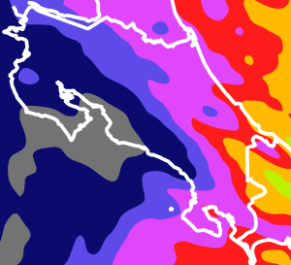

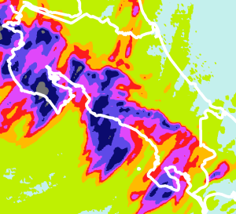
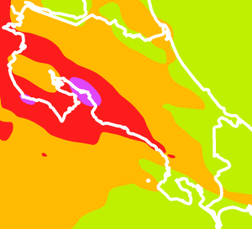
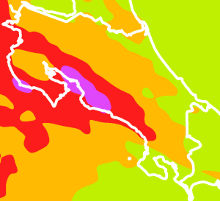


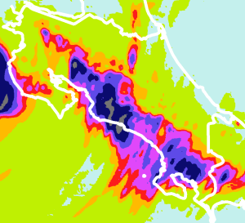
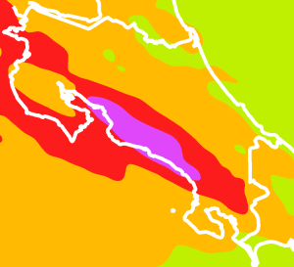
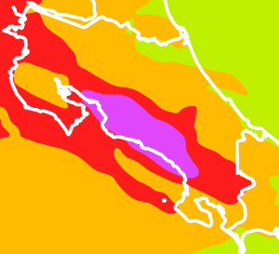
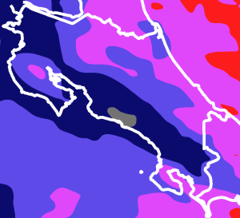

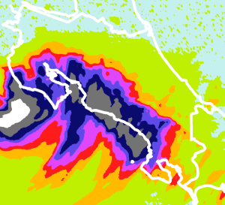
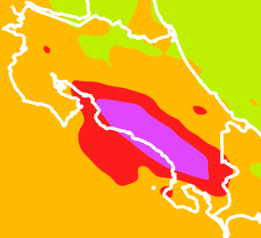
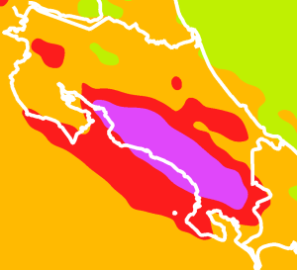
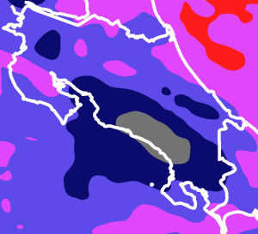

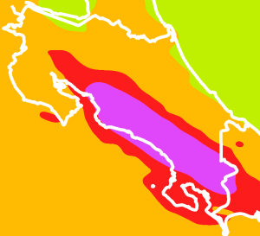

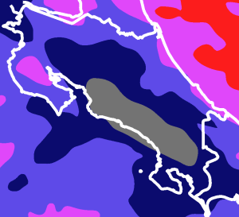

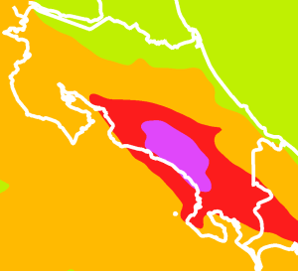
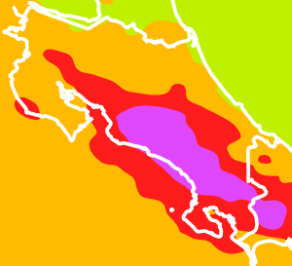
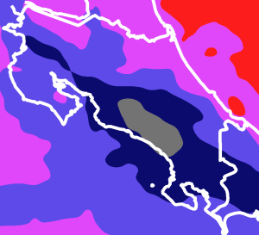

mm / 12h
0 1 20 40 60 100 150 250 500
85th Percentile
ecPoint-Rainfall
85th Percentile
Raw ENS
99th Percentile
ecPoint-Rainfall
Wettest Member
Raw ENS
Deterministic WRF-1.5
(from IMN)
DAY 1
2018/10/04 12UTC (t+6,t+18)
DAY 1
2018/10/04 18UTC (t+0,t+12)
DAY 2
2018/10/03 12UTC (t+30,t+42)
DAY 2
2018/10/03 18UTC (t+24,t+36)
DAY 3
2018/10/02 12UTC (t+54,t+66)
DAY 3
2018/10/02 18UTC (t+48,t+60)
DAY 4
2018/10/01 12UTC (t+78,t+90)
DAY 4
2018/10/01 18UTC (t+72,t+84)
VT (LT): 2018/10/04 12am to 2018/10/05 0am
Missing
DAY 5
2018/09/30 12UTC (t+102,t+114)
DAY 5
2018/09/30 18UTC (t+96,t+108)
Not Available
(WRF-1.5 max lead time corresponds to t+120)
DAY 6
2018/09/29 12UTC (t+126,t+138)
DAY 6
2018/09/29 18UTC (t+120,t+132)
Not Available
(WRF-1.5 max lead time corresponds to t+120)
DAY 7
2018/09/28 12UTC (t+150,t+162)
DAY 7
2018/09/28 18UTC (t+144,t+156)

