Slide 1
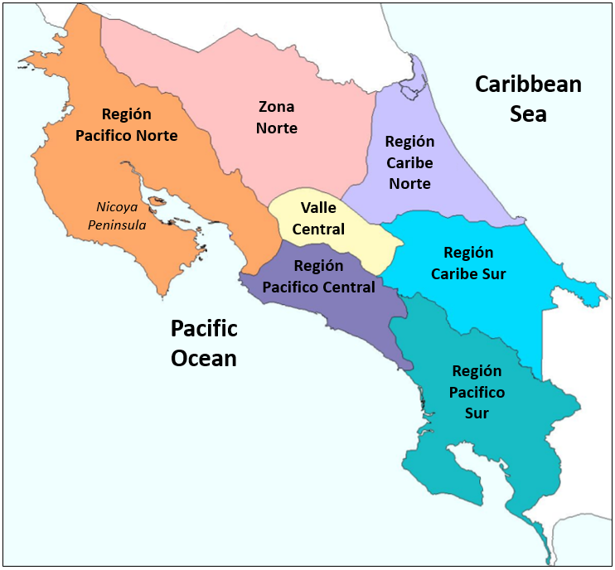
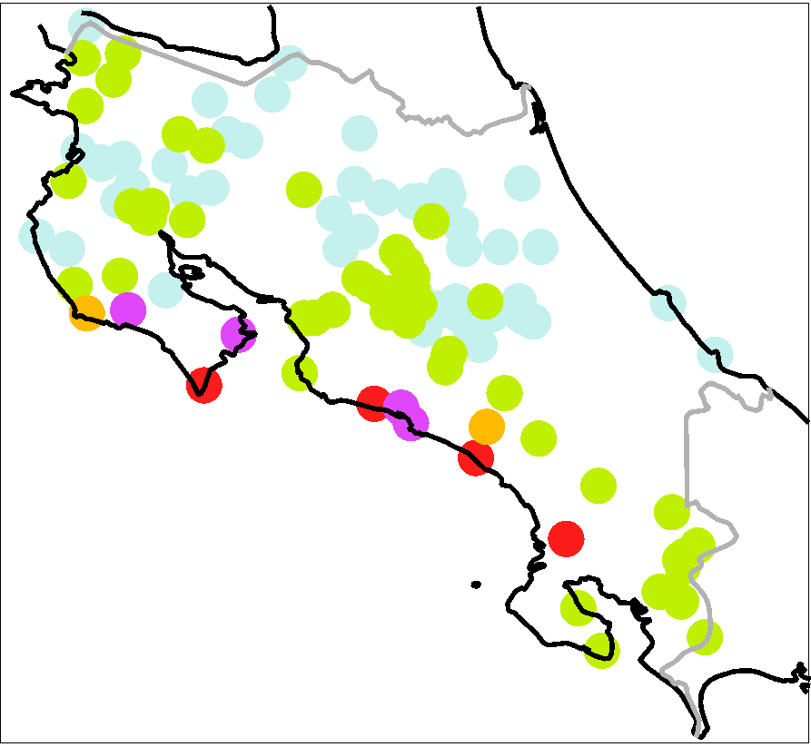
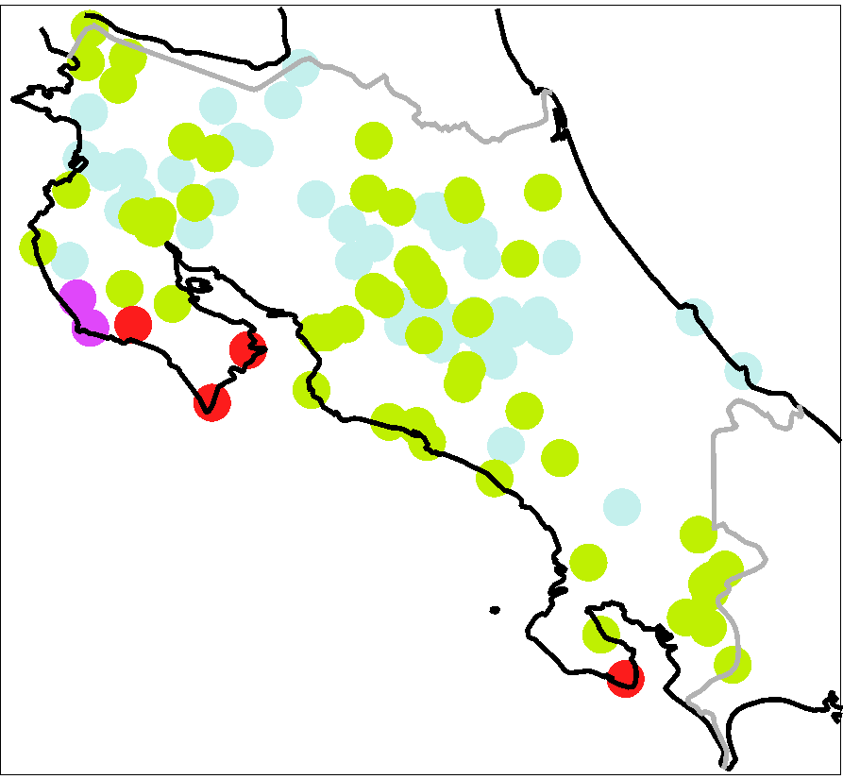

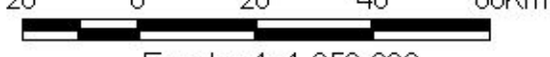

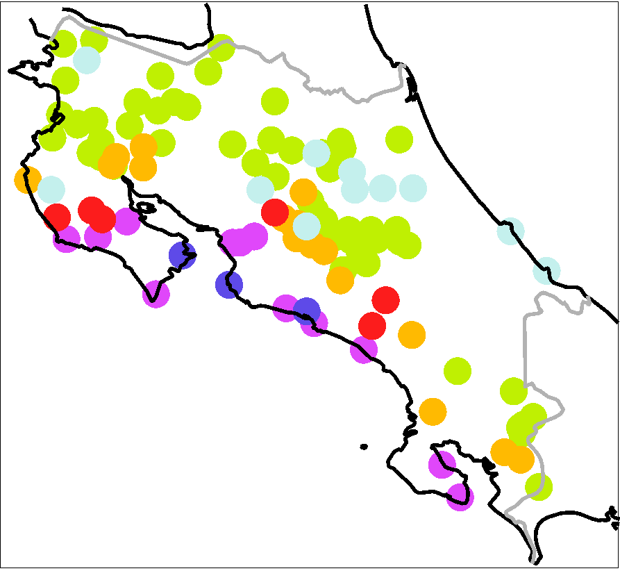
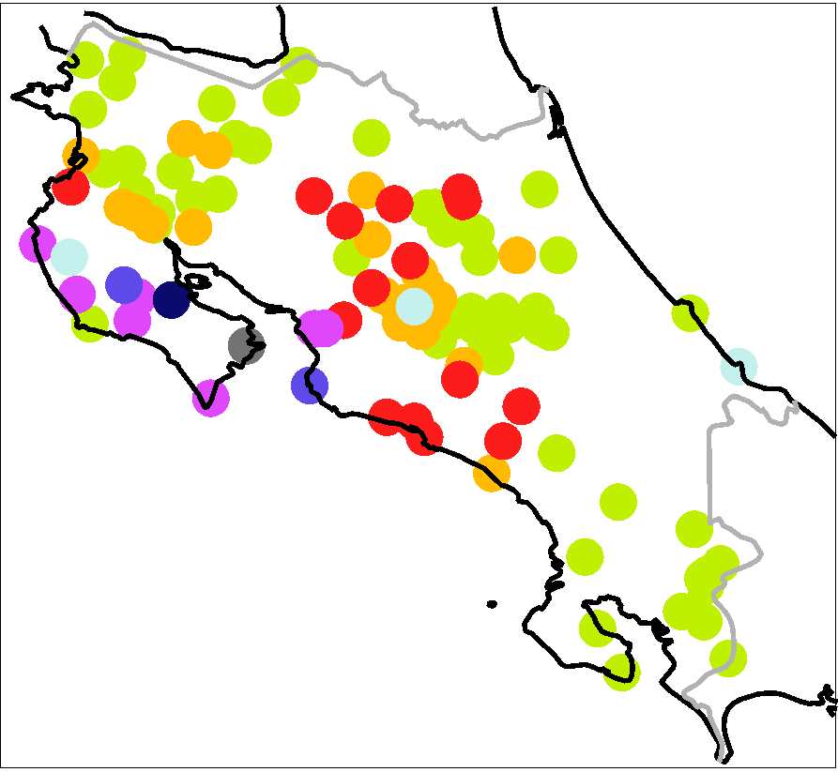
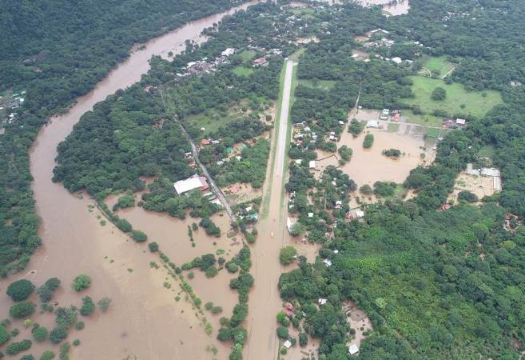
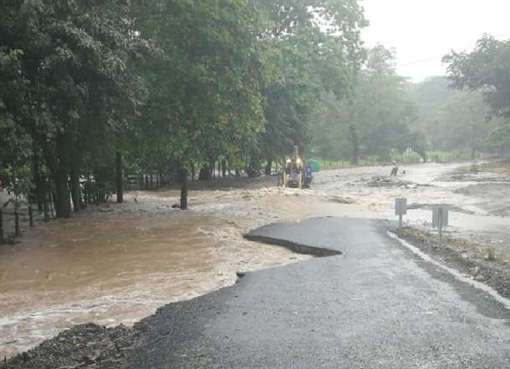
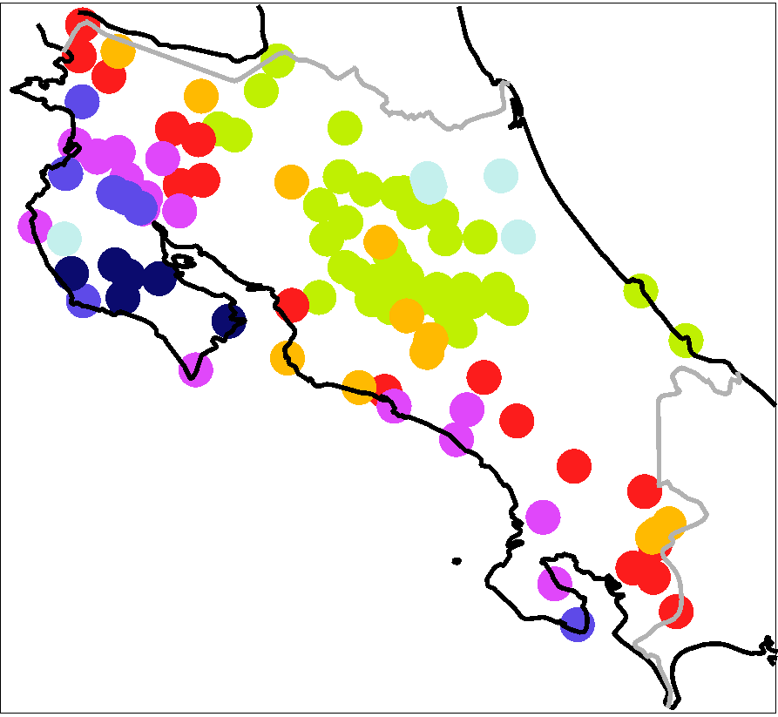
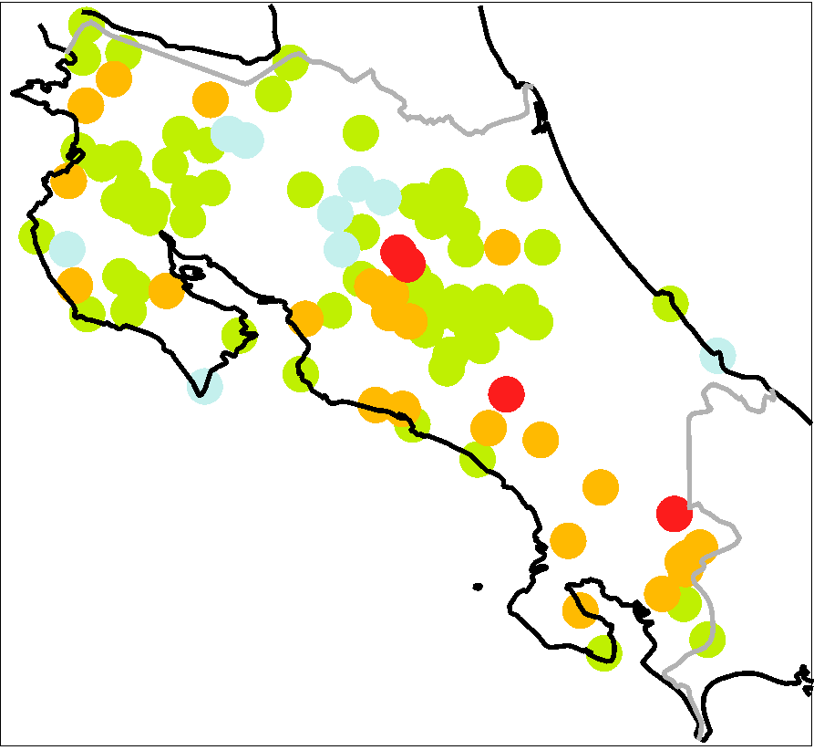
a
mm / 12h
0 1 20 40 60 100 150 250 500
Región
Pacifico Norte
Zona
Norte
Región
Caribe
Norte
Caribbean
O-1
O-2
Sea
Nicoya
Valle
Peninsula
Central
Región
Caribe Sur
Región
Pacifico
Central
20 0 20 40 60 km
Región
Pacifico
Sur
2018/10/03 6 UTC to 2018/10/03 18 UTC
(LT: 2018/10/03 0 am
to 2018/10/03 12 am)
2018/10/03 18 UTC to
2018/10/04 6 UTC
(LT: 2018/10/03 12 am
to 2018/10/04 0 am)
Scale 1: 1.850.000
Pacific
Ocean
O-3
O-4
i-1
2018/10/04 6 UTC to
2018/10/04 18 UTC
(LT: 2018/10/04 0 am
to 2018/10/04 12 am)
2018/10/04 18 UTC to
2018/10/05 6 UTC
(LT: 2018/10/04 12 am
to 2018/10/05 0 am)
i-2
O-5
O-6
2018/10/05 6 UTC to
2018/10/05 18 UTC
(LT: 2018/10/05 0 am
to 2018/10/05 12 am)
2018/10/05 18UTC to
2018/10/06 6 UTC
(LT: 2018/10/05 12 am
to 2018/10/06 0 am)

