Slide 1
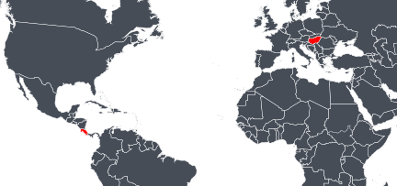
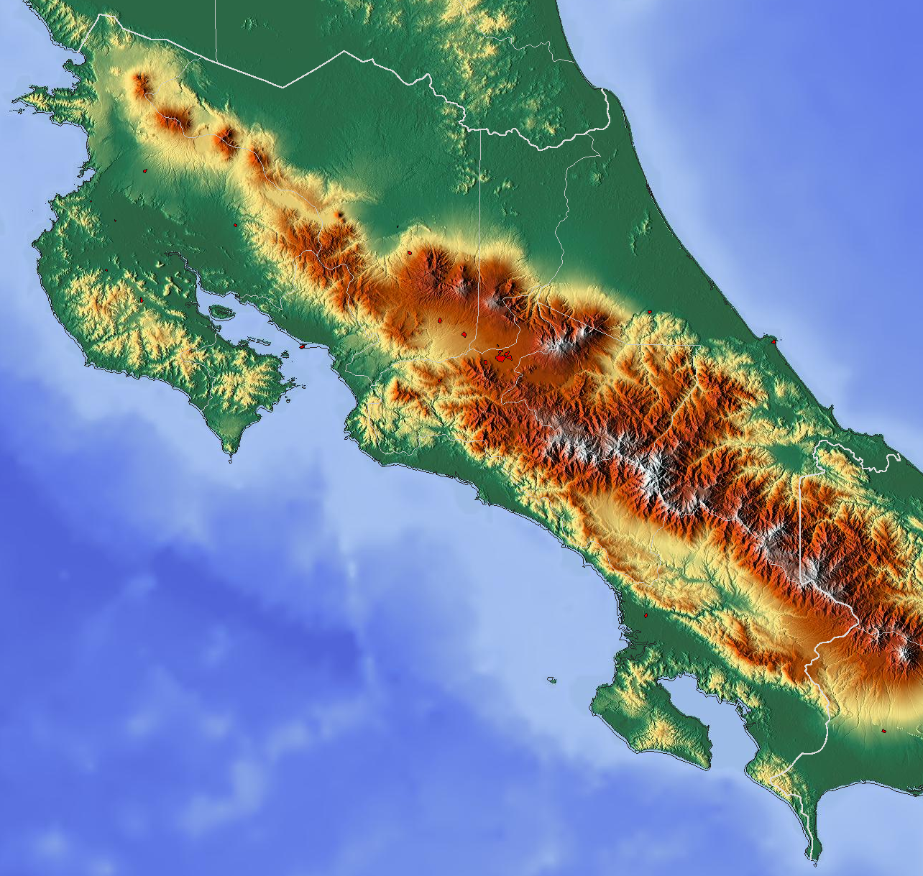
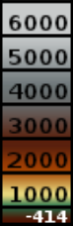
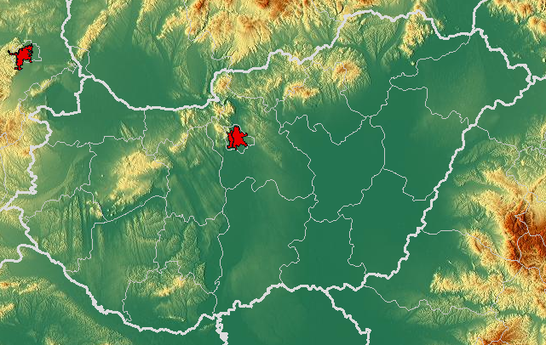
Hungary
a
Extra-Tropics
Tropics
Costa
Rica
Nicaragua
b
Costa Rica
Caribbean Sea
San José
metres
Pacific
Ocean
Panama
Ukraine
Slovakia
Austria
Budapest
Hungary
Slovenia
Romania
Bosnia and
Herzegovina
Serbia
c

