Slide 1
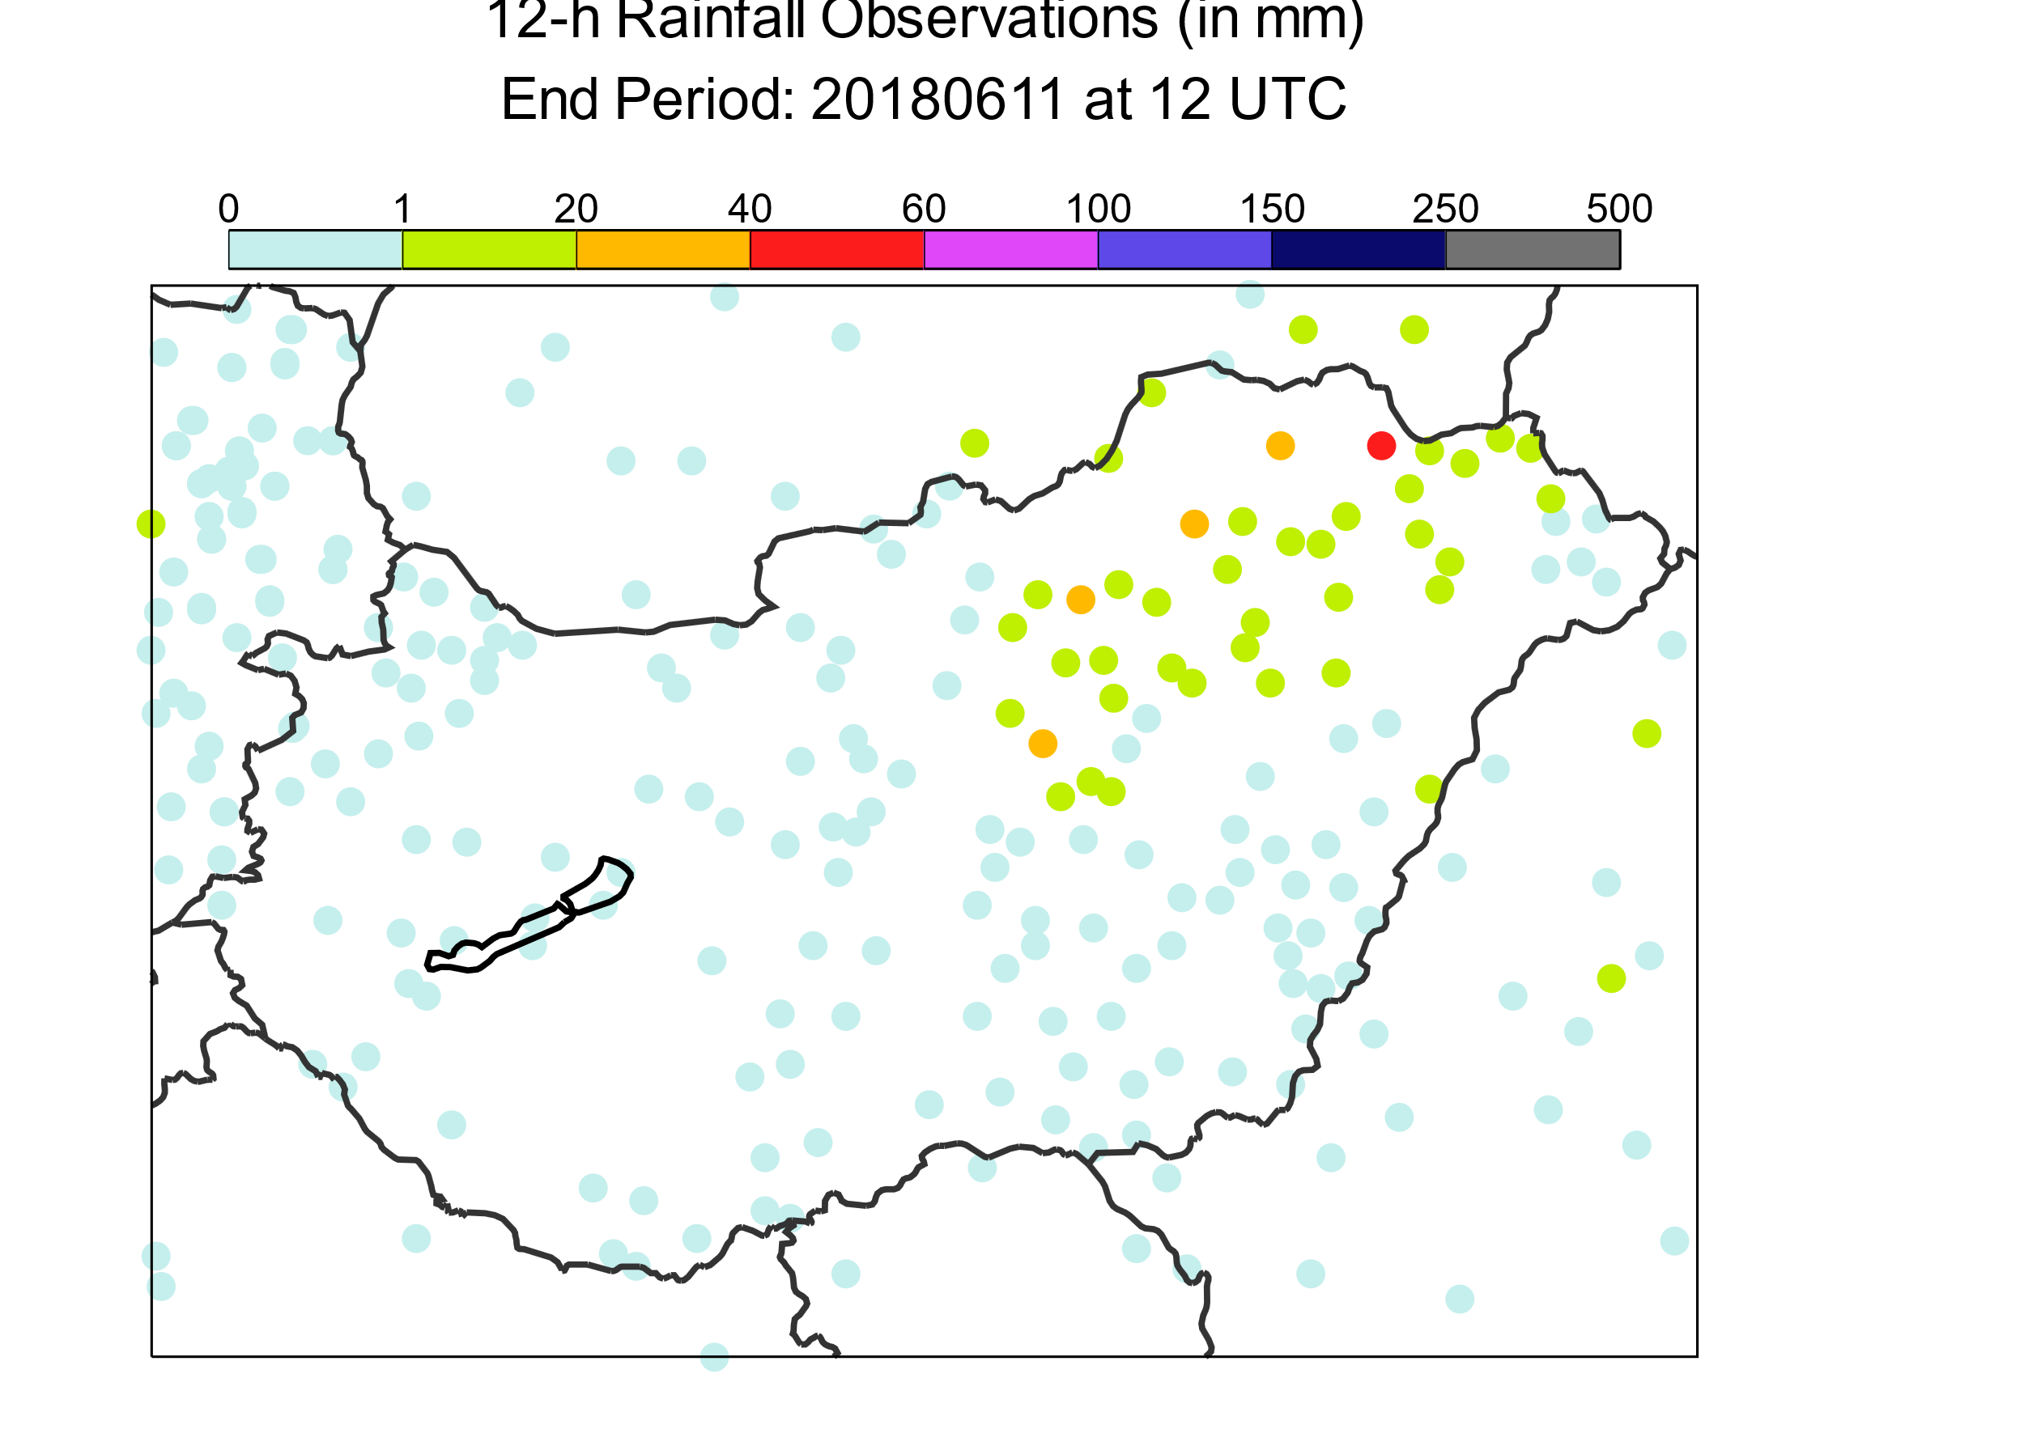
mm / 12h
2018/06/11 0 UTC to 2018/06/11 12 UTC
x

