Slide 1
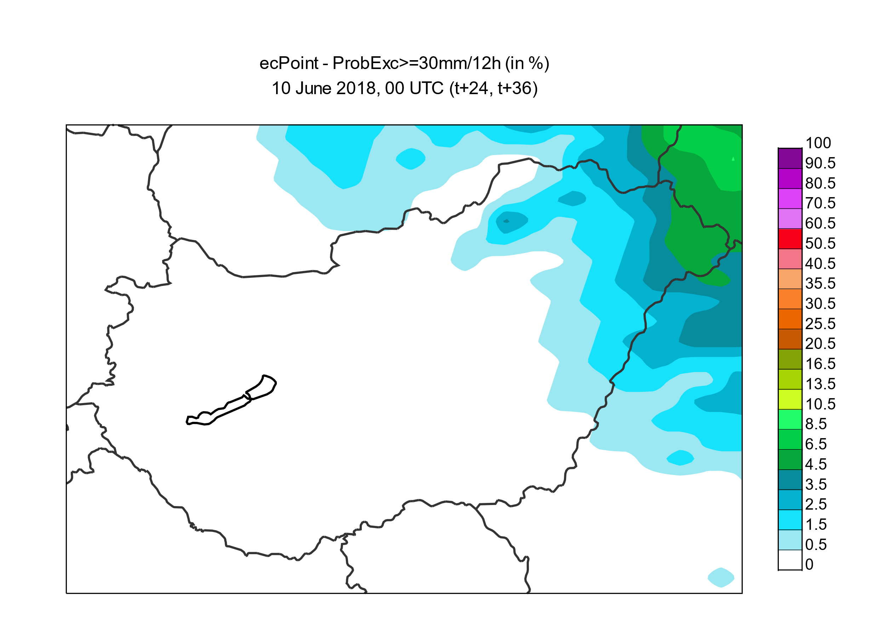
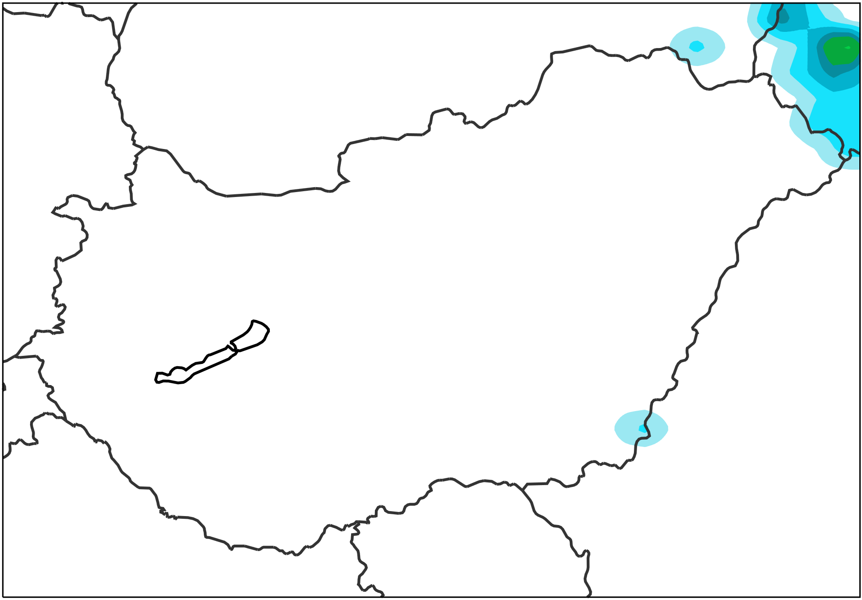
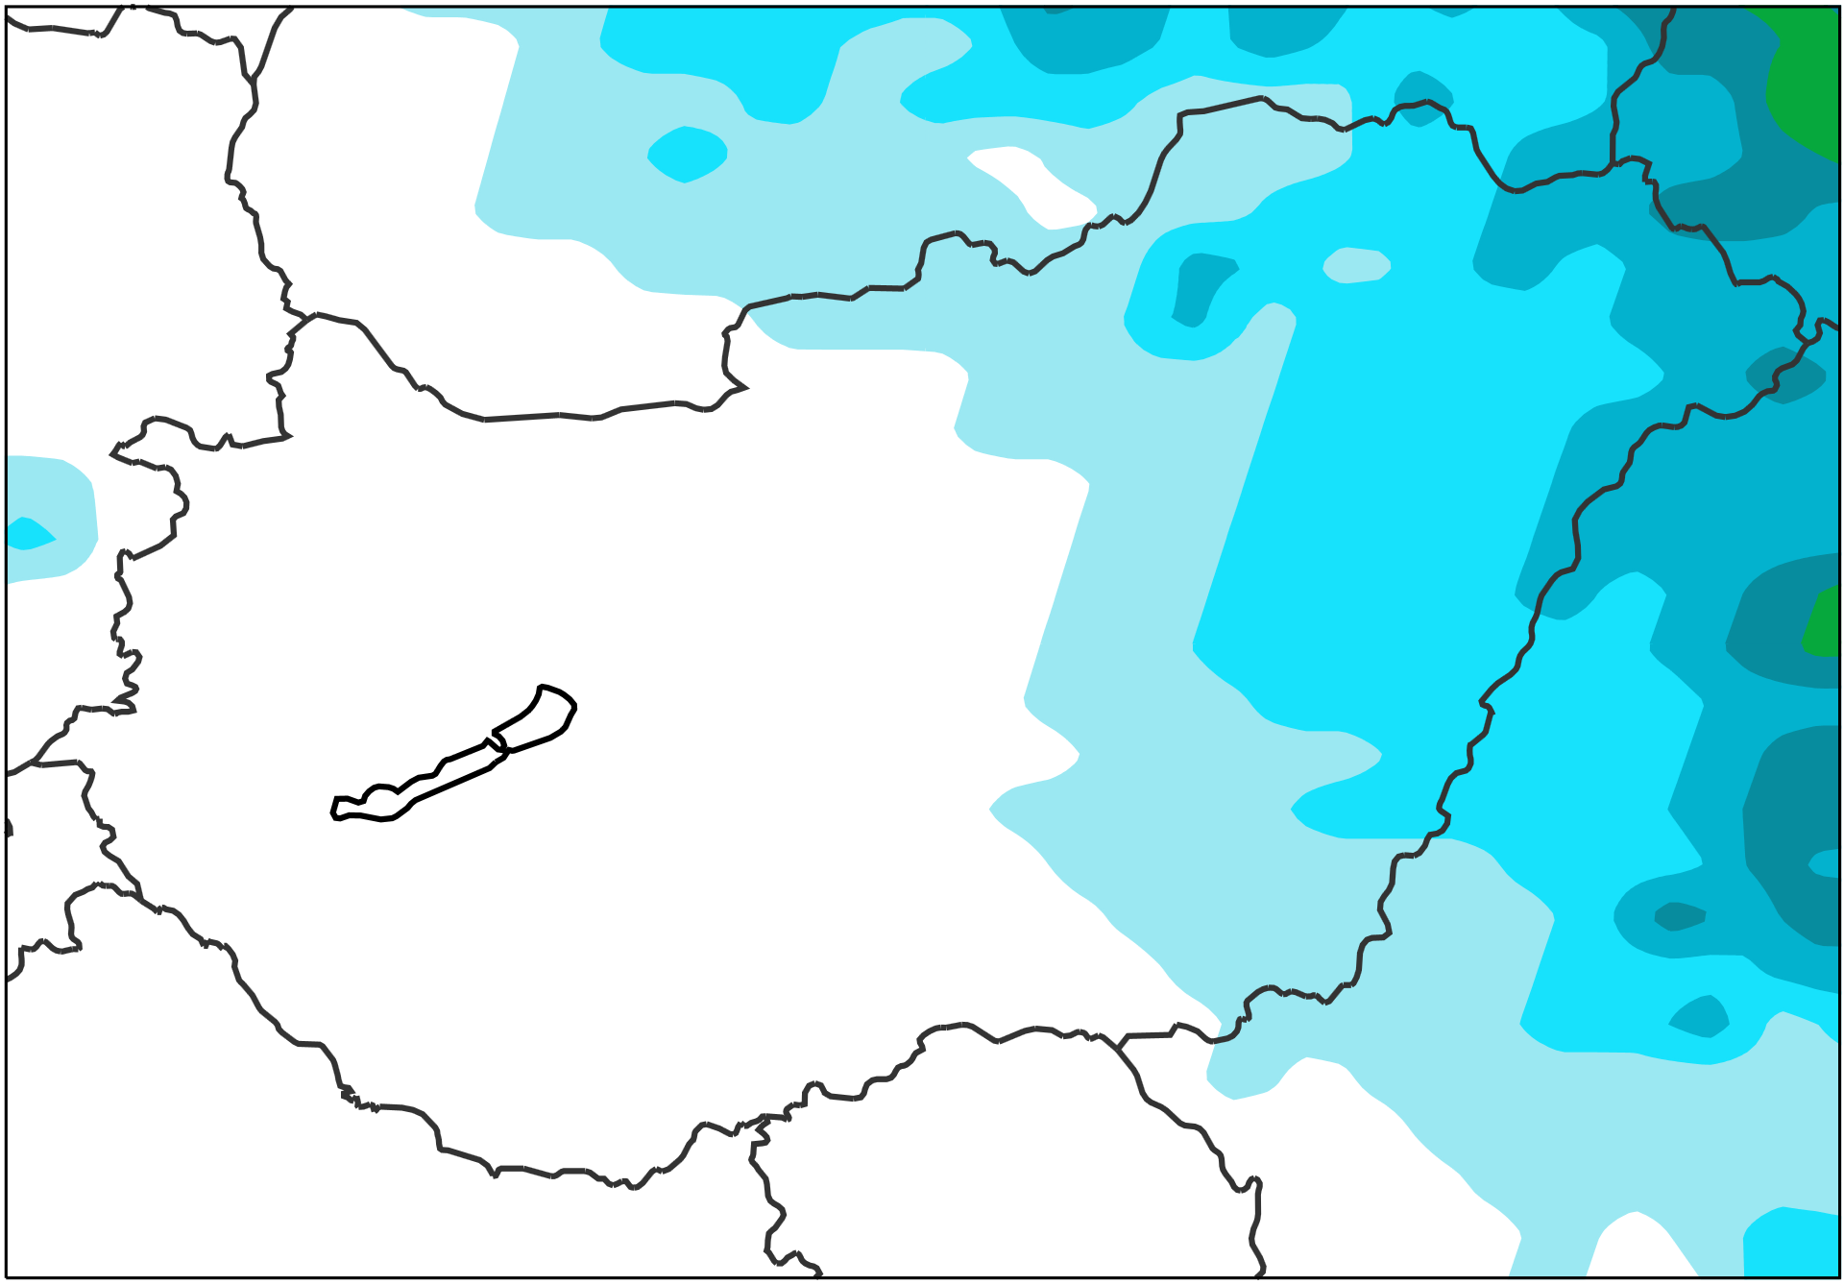
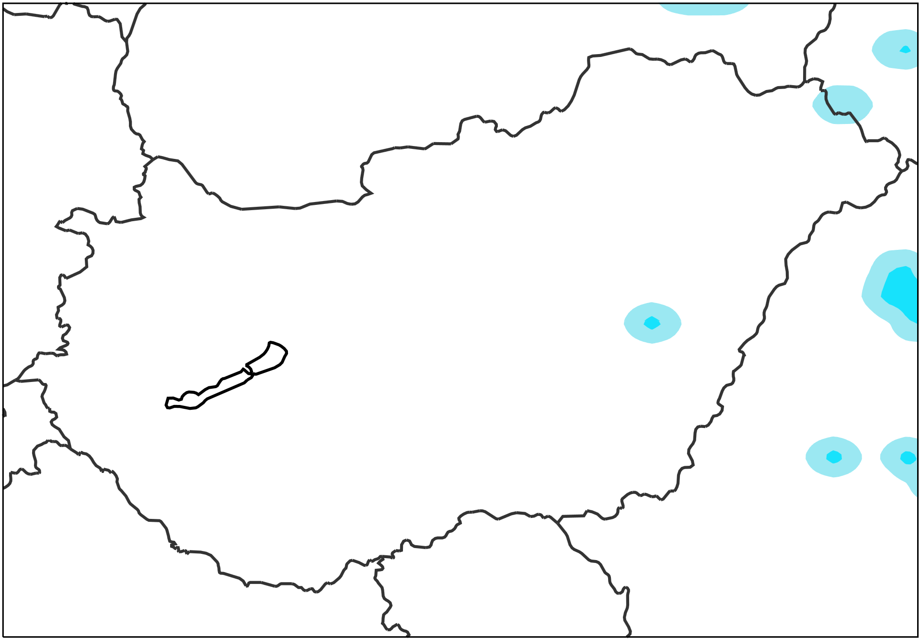
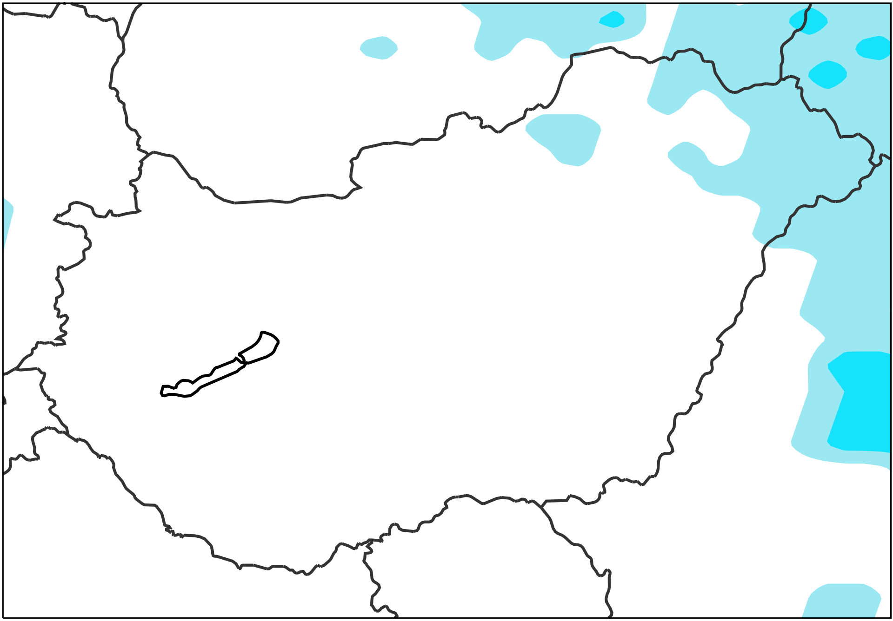
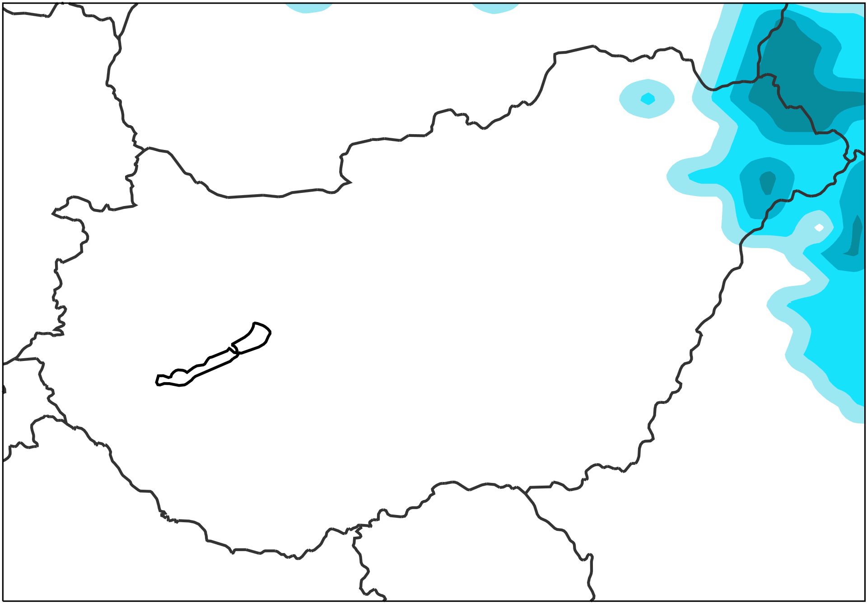
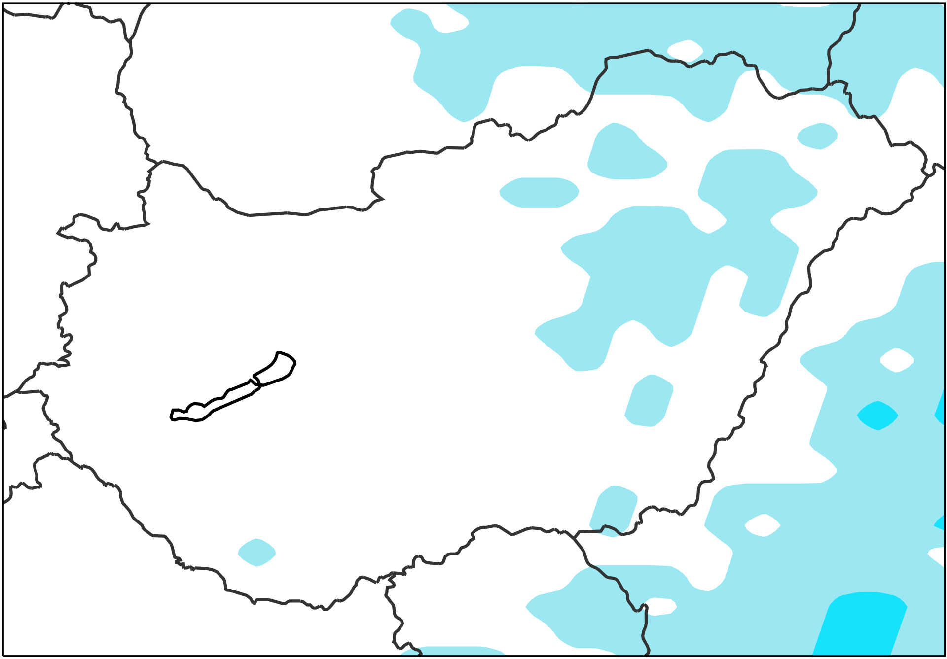
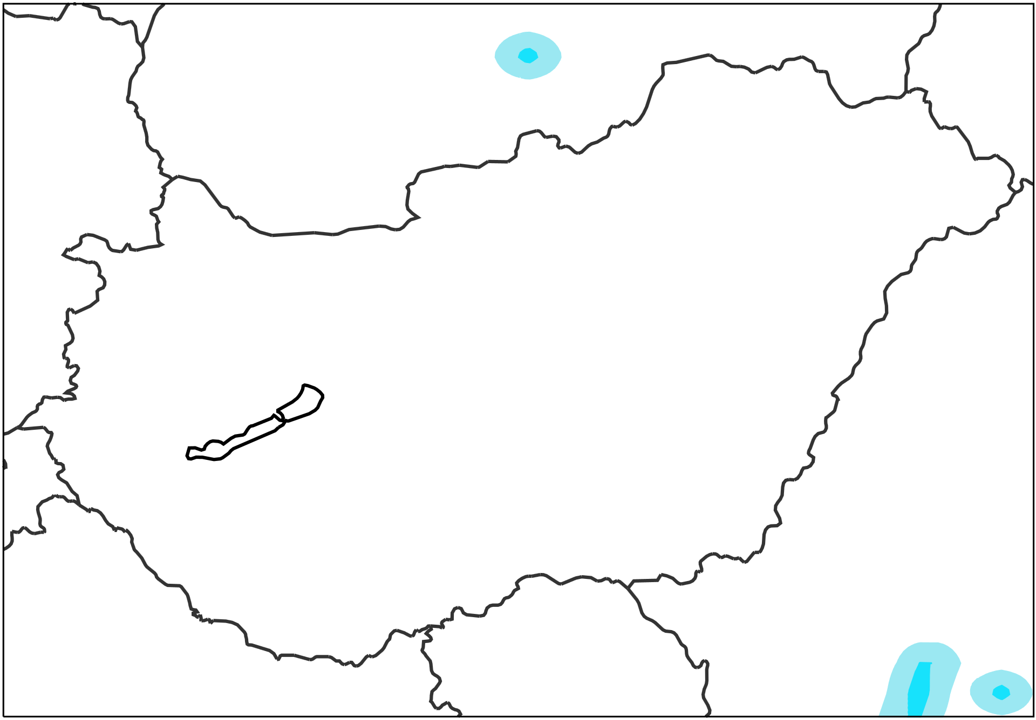
Probabilities of not exceeding 30 mm /12h
VT: 2018/06/11 00 UTC to 2018/06/11 12 UTC
ecPoint – Rainfall
Raw ENS
AROME (2.5km, OMSZ)
Would be nice to have.
2018/10/04 12 UTC
(t+6,t+18), DAY 1
[%]
2018/10/03 12 UTC
(t+30,t+42), DAY 2
2018/10/02 12 UTC
(t+54,t+66), DAY 3
2018/10/01 12 UTC
(t+78,t+90), DAY 4

