Slide 1
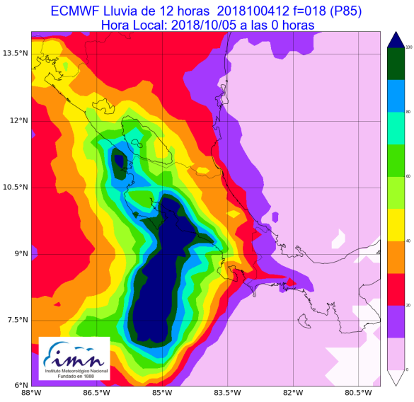
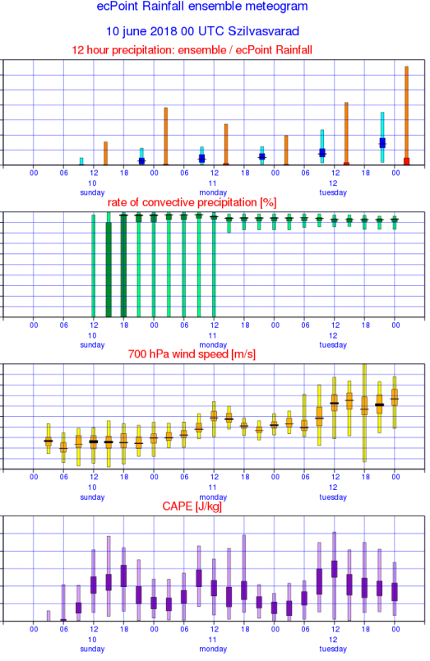

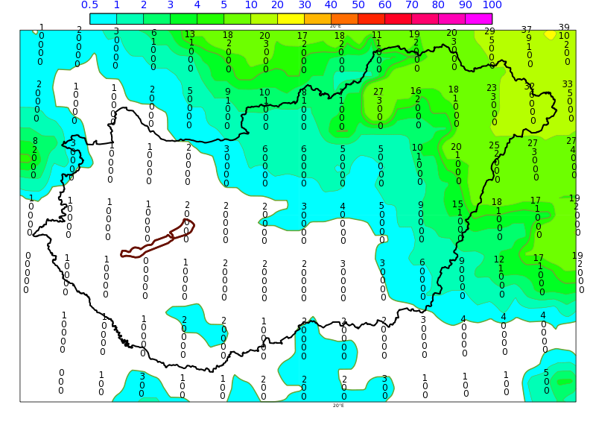
a
100
b
13.5 °N
70
80
60
12 °N
50
40
30
60
20
10.5 °N
[mm/12h]
10
0
40
8 °N
100
90
20
80
6.5 °N
70
60
50
40
0
30
88 °W 86.5 °W 85 °W 83.5 °W 82 °W 80.5 °W
20
10
0
ecPoint Rainfall 90th (top), 75th, 50th, 25th, 10th (bottom) percentiles per grid box (0.5 degrees)
10 June 2018 00 UTC (t+24, t+36)
12 hour precipitation (mm)
c
20
18
16
14
12
10
8
6
4
2
0
3000
2500
2000
1500
1000
500
0

