Slide 1
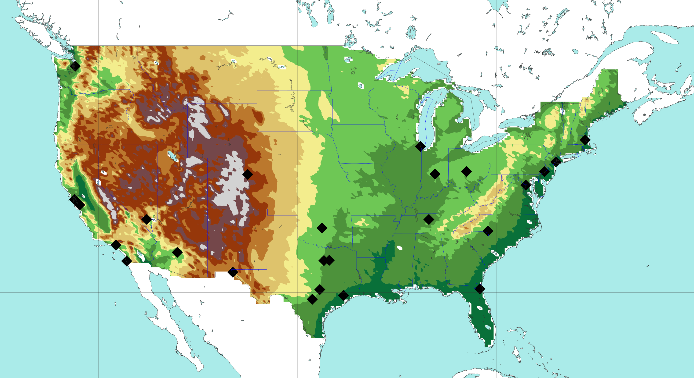

Orography at 1km resolution over the contiguous USA
Including the 25 most populated USA cities
50 °N
m.a.s.l.
5000
SEATTLE
2500
2000
CHICAGO
BOSTON
COLUMBUS
NEW YORK
1500
40 °N
DENVER
PHILADELPHIA
INDIANAPOLIS
WASHINGTON D.C.
1200
SAN FRANCISCO
LAS VEGAS
SAN JOSE
OKLAHOMA CITY
NASHVILLE
CHARLOTTE
750
PHOENIX
LOS ANGELES
FORTH WORTH
DALLAS
500
SAN DIEGO
AUSTIN
30 °N
EL PASO
JACKSONVILLE
HOUSTON
250
SAN ANTONIO
50
0
120 °W
100 °W
80 °W

