Slide 1
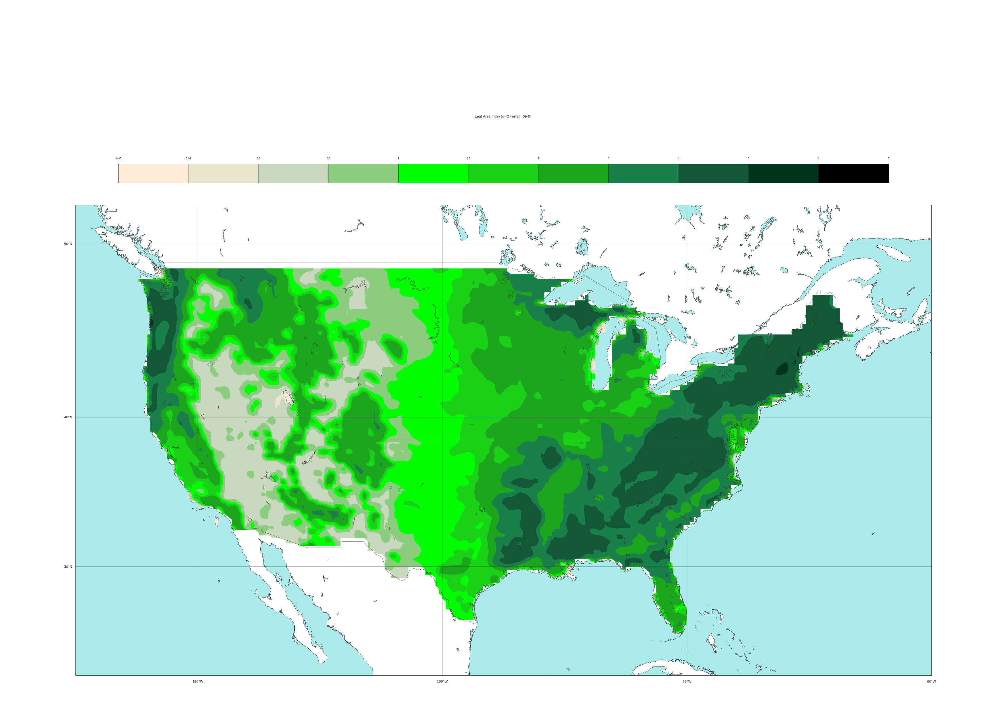
ML-model input feature: ERA5’s leaf area index (for high and low vegetation combined)
Climatological field, valid for the 1st of September
[-]
0
0.05
0.2
0.6
1
1.5
2
3
4
5
6
7
50 °N
40 °N
30 °N
120 °W
100 °W
80 °W

