Slide 1
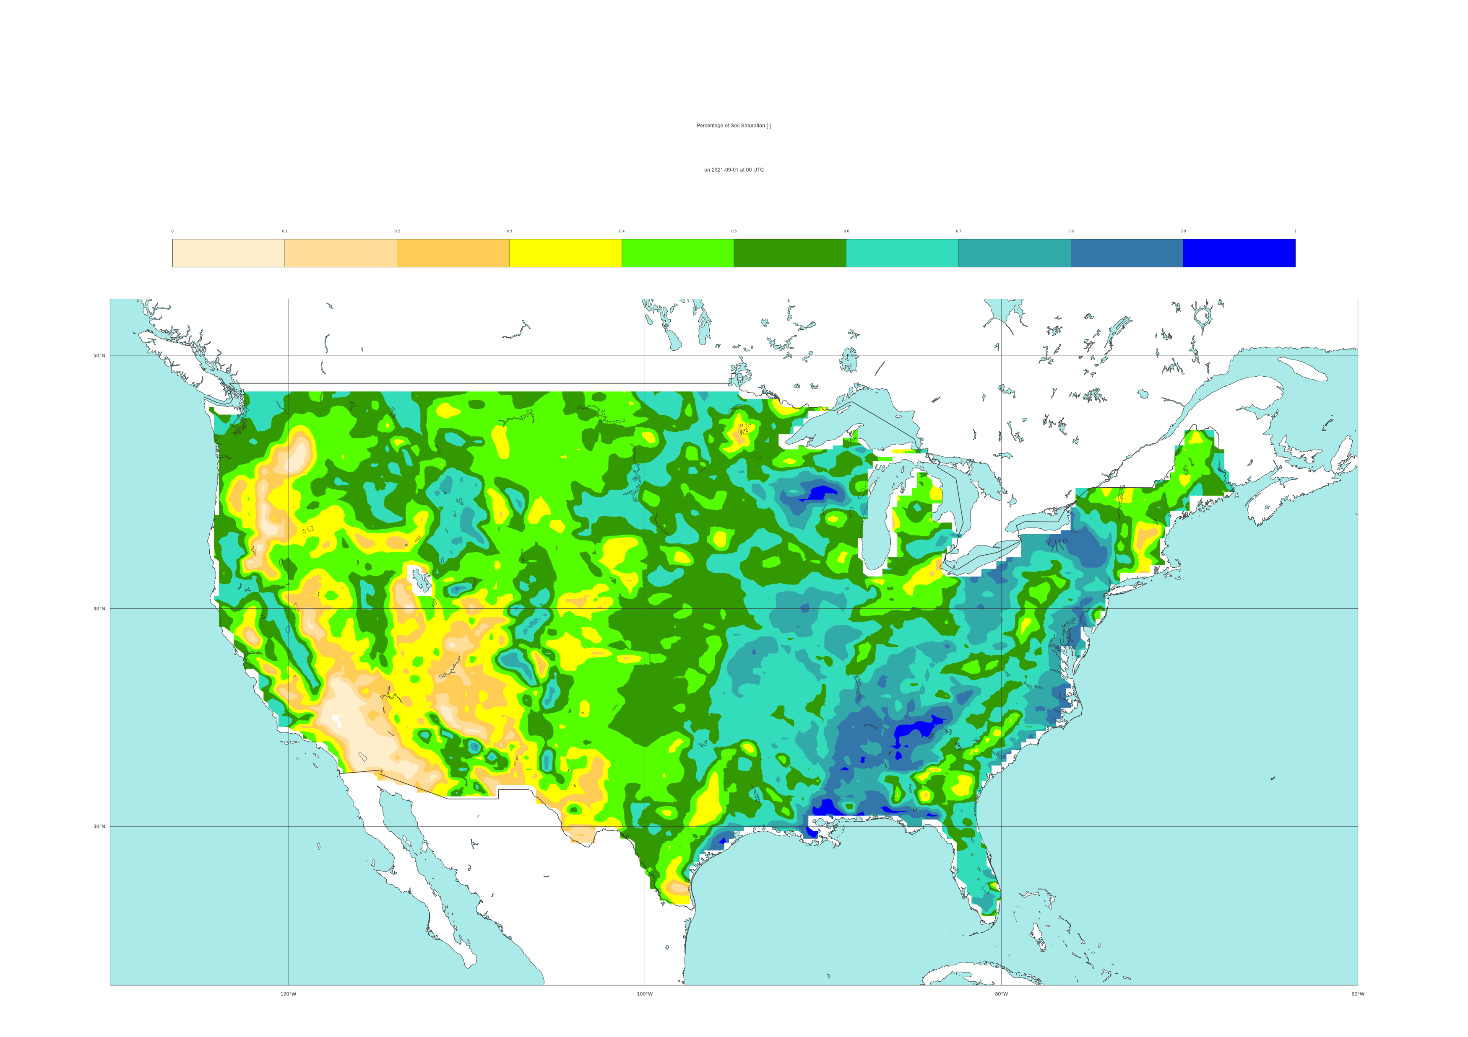
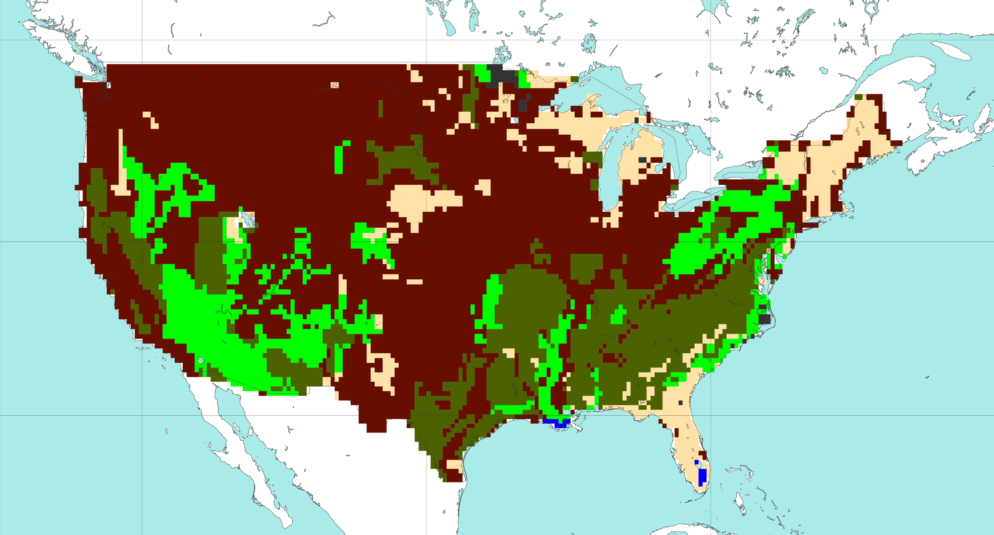

ERA5’s soil type
Static field
ML-model input feature: ERA5’s percentage of soil saturation
Dynamical field, VT: 31-08-2021 12 UTC to 01-09-2021 00 UTC
[%]
Coarse
Medium
Medium
fine
Fine
Very
fine
Organic
Tropical organic
0
10
20
30
40
50
60
70
80
90
100
50 °N
50 °N
40 °N
40 °N
30 °N
30 °N
a
b
120 °W
100 °W
80 °W
120 °W
100 °W
80 °W

