Slide 1
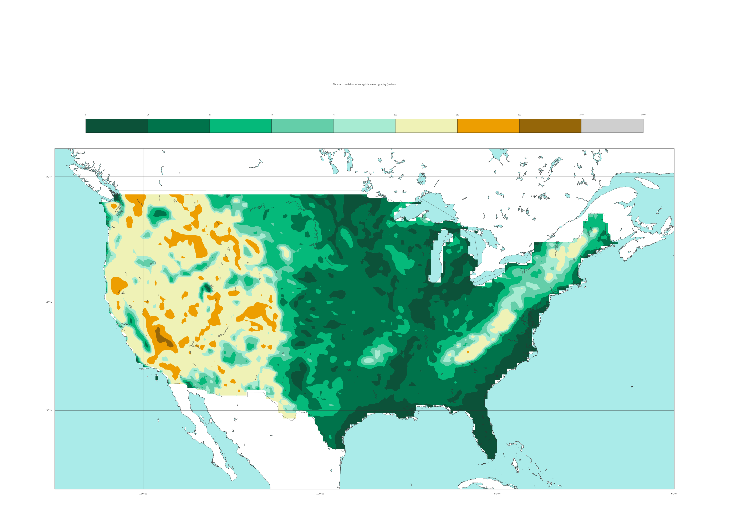

ML-model input feature: ERA5’s standard deviation of sub-grid scale orography
Static field
[metres]
0
10
25
50
75
100
250
500
1000
5000
50 °N
40 °N
30 °N
120 °W
100 °W
80 °W

