Slide 1


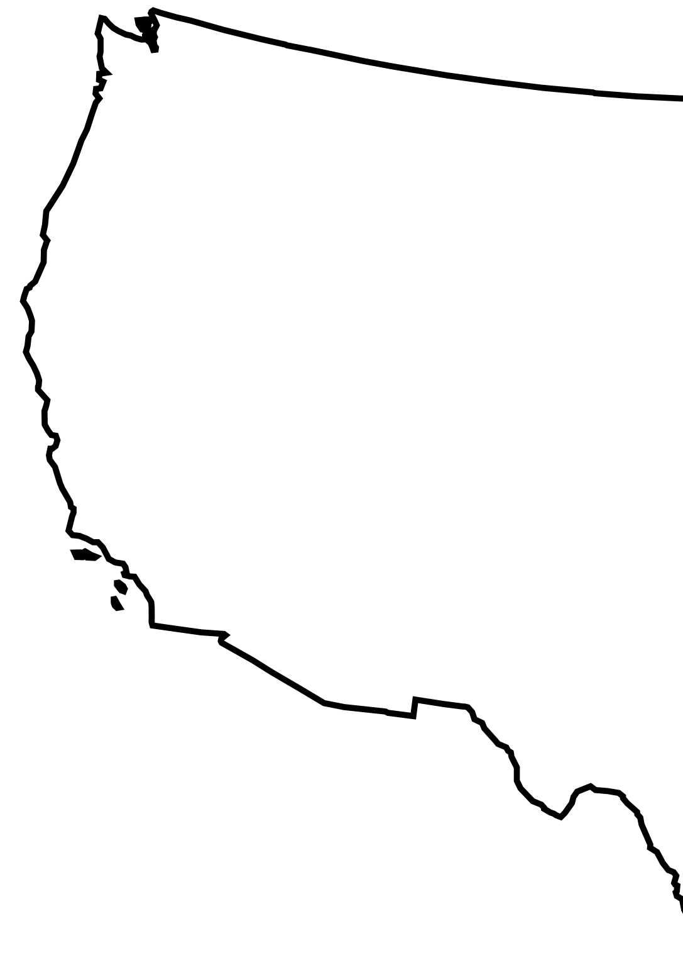
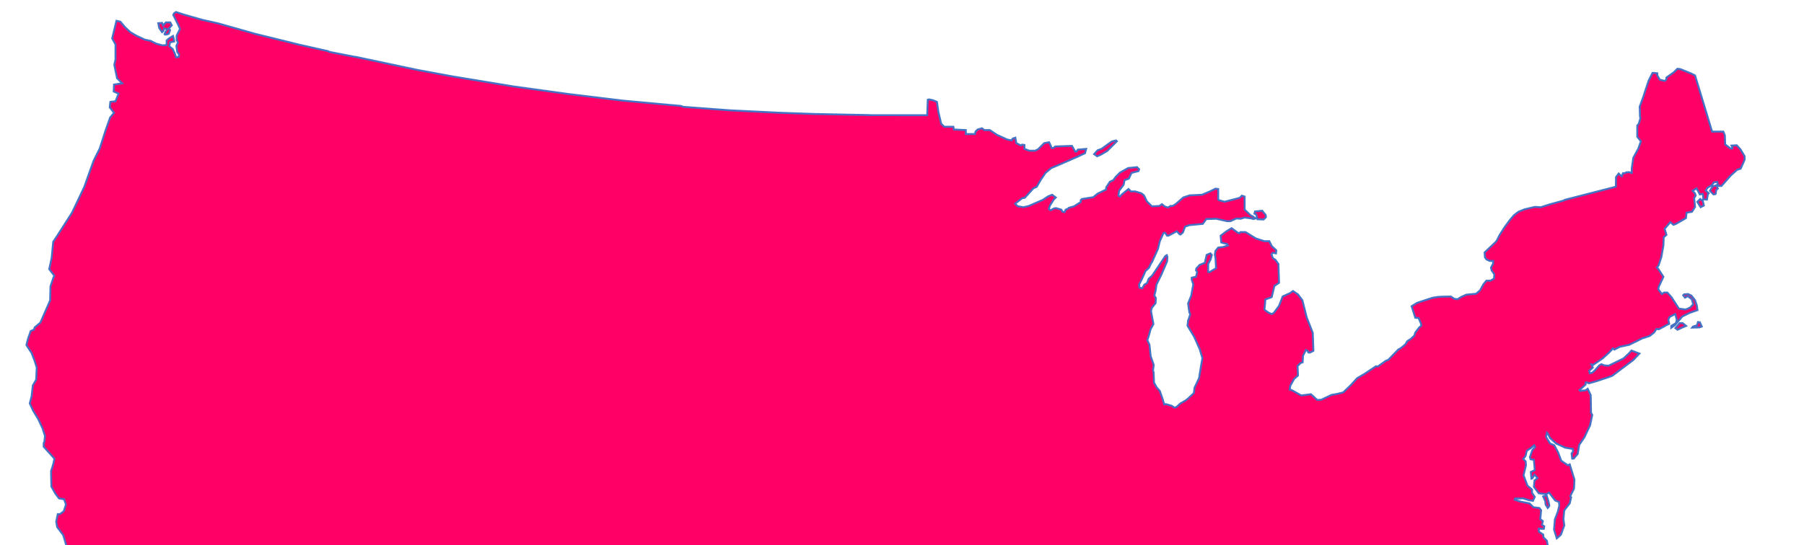
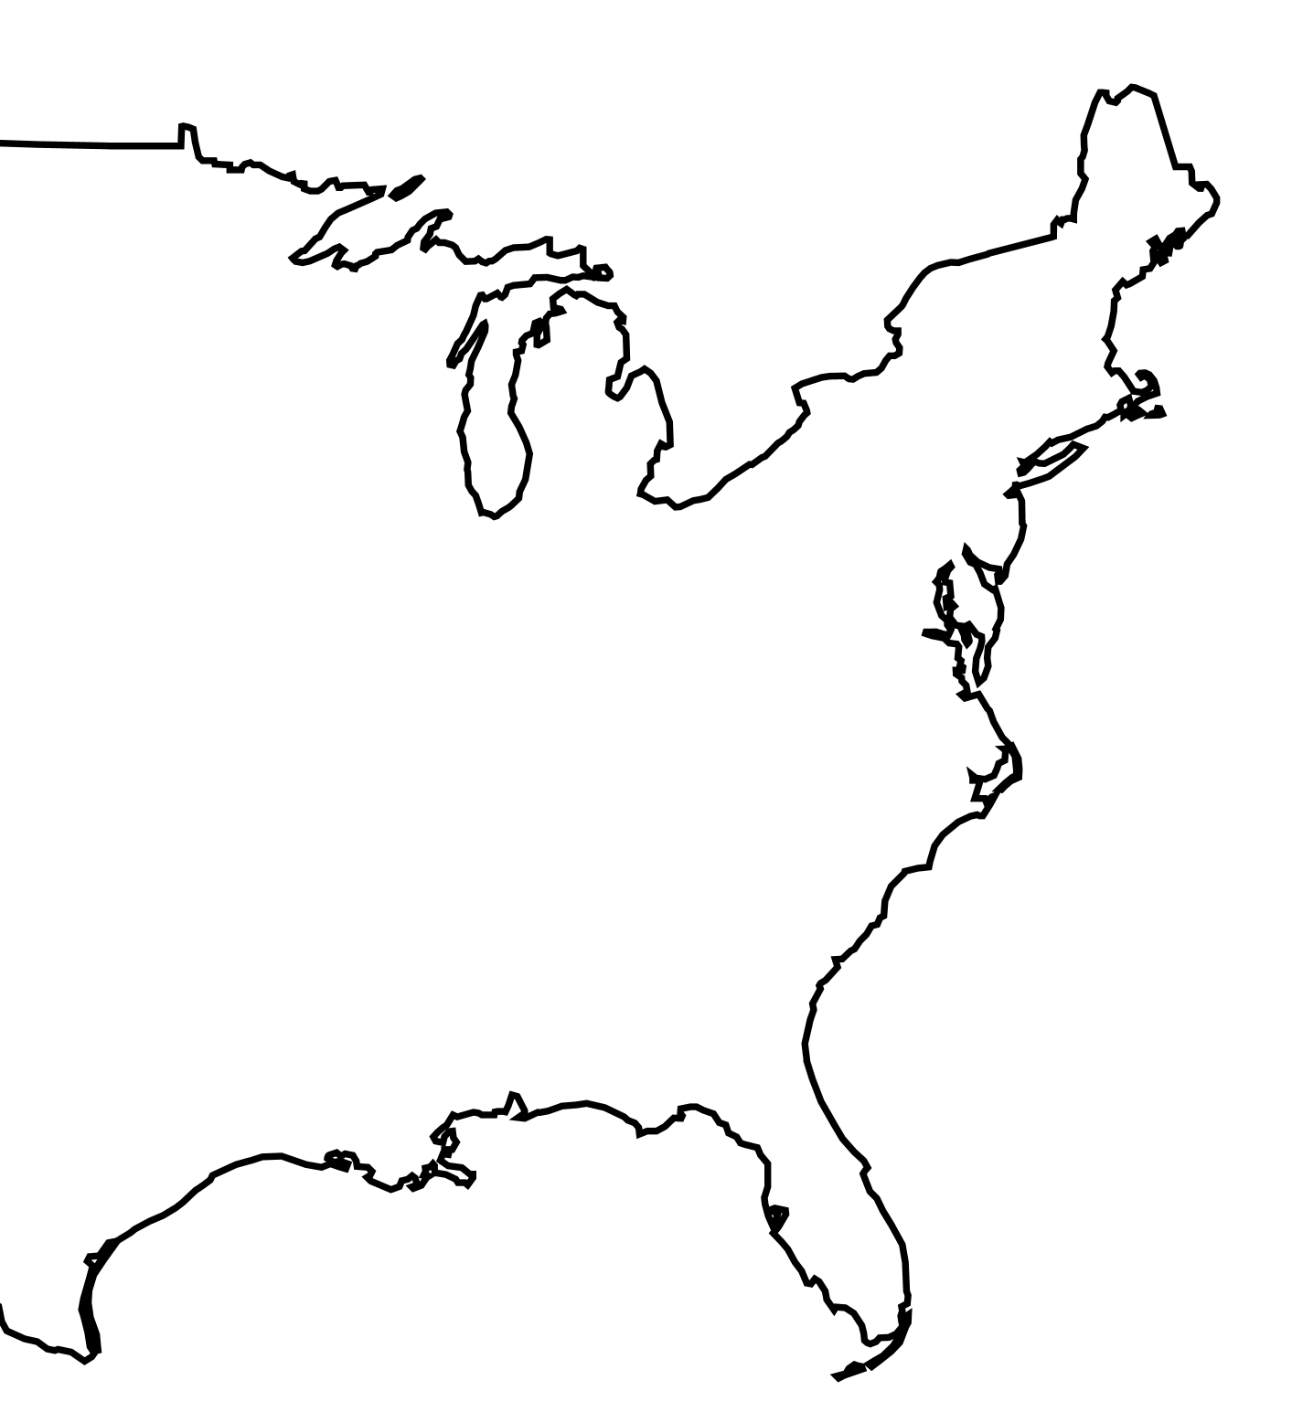

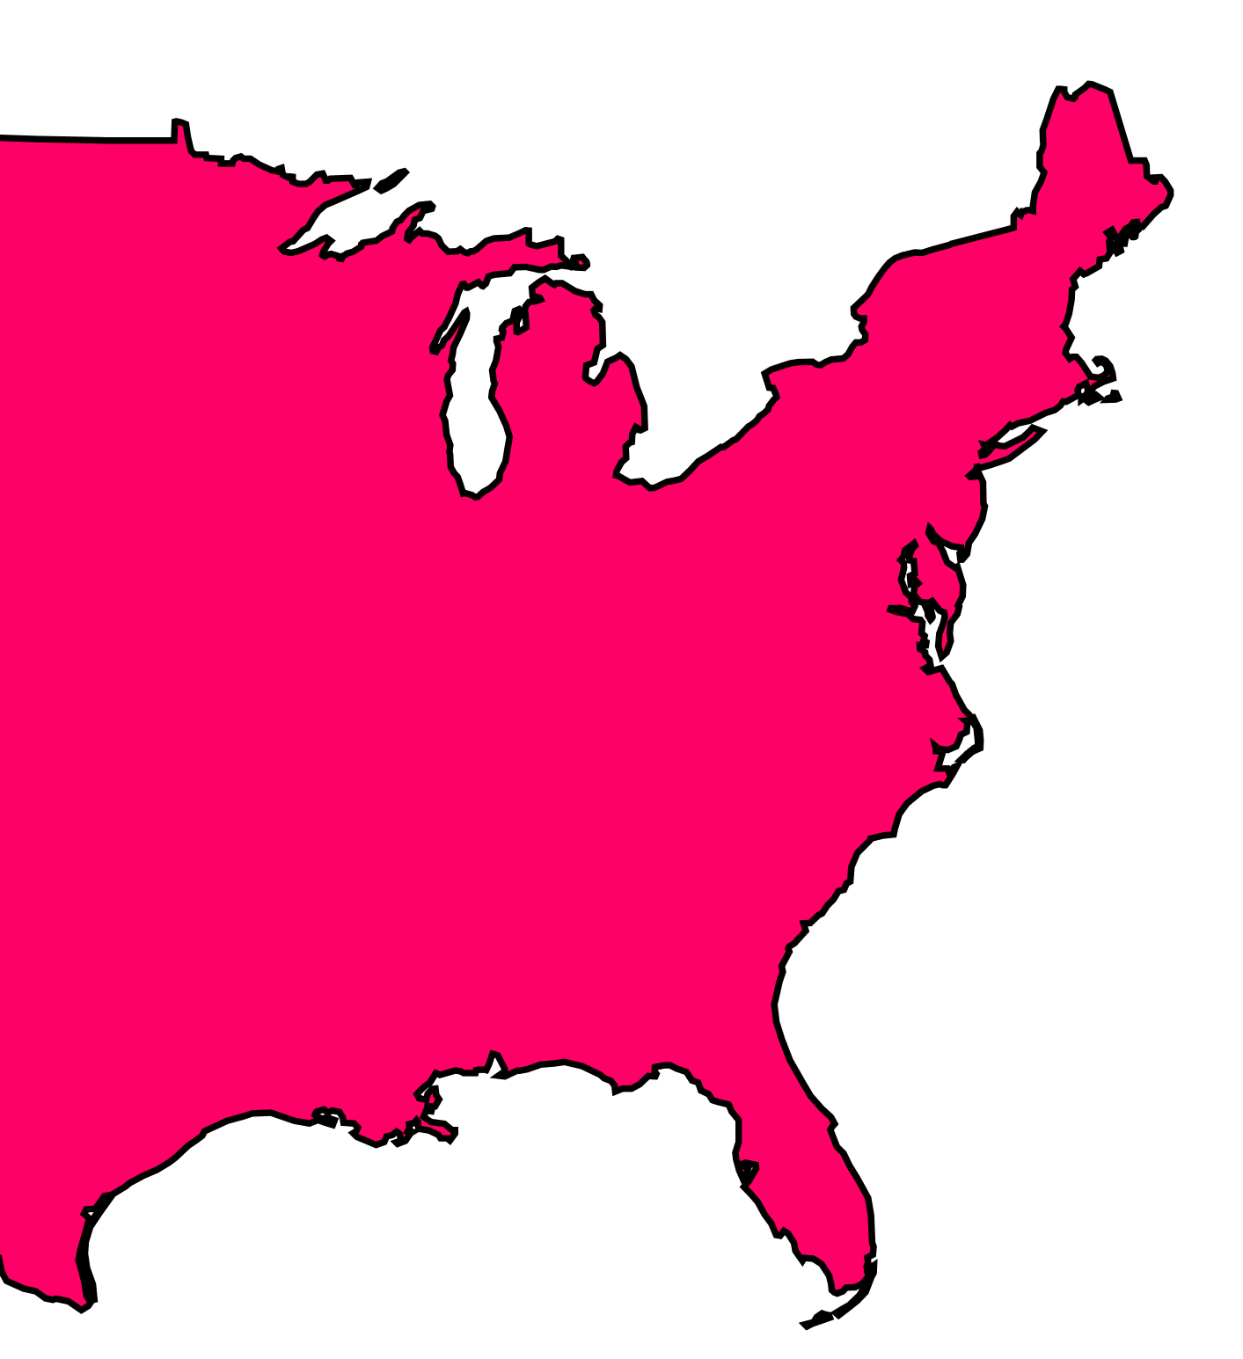

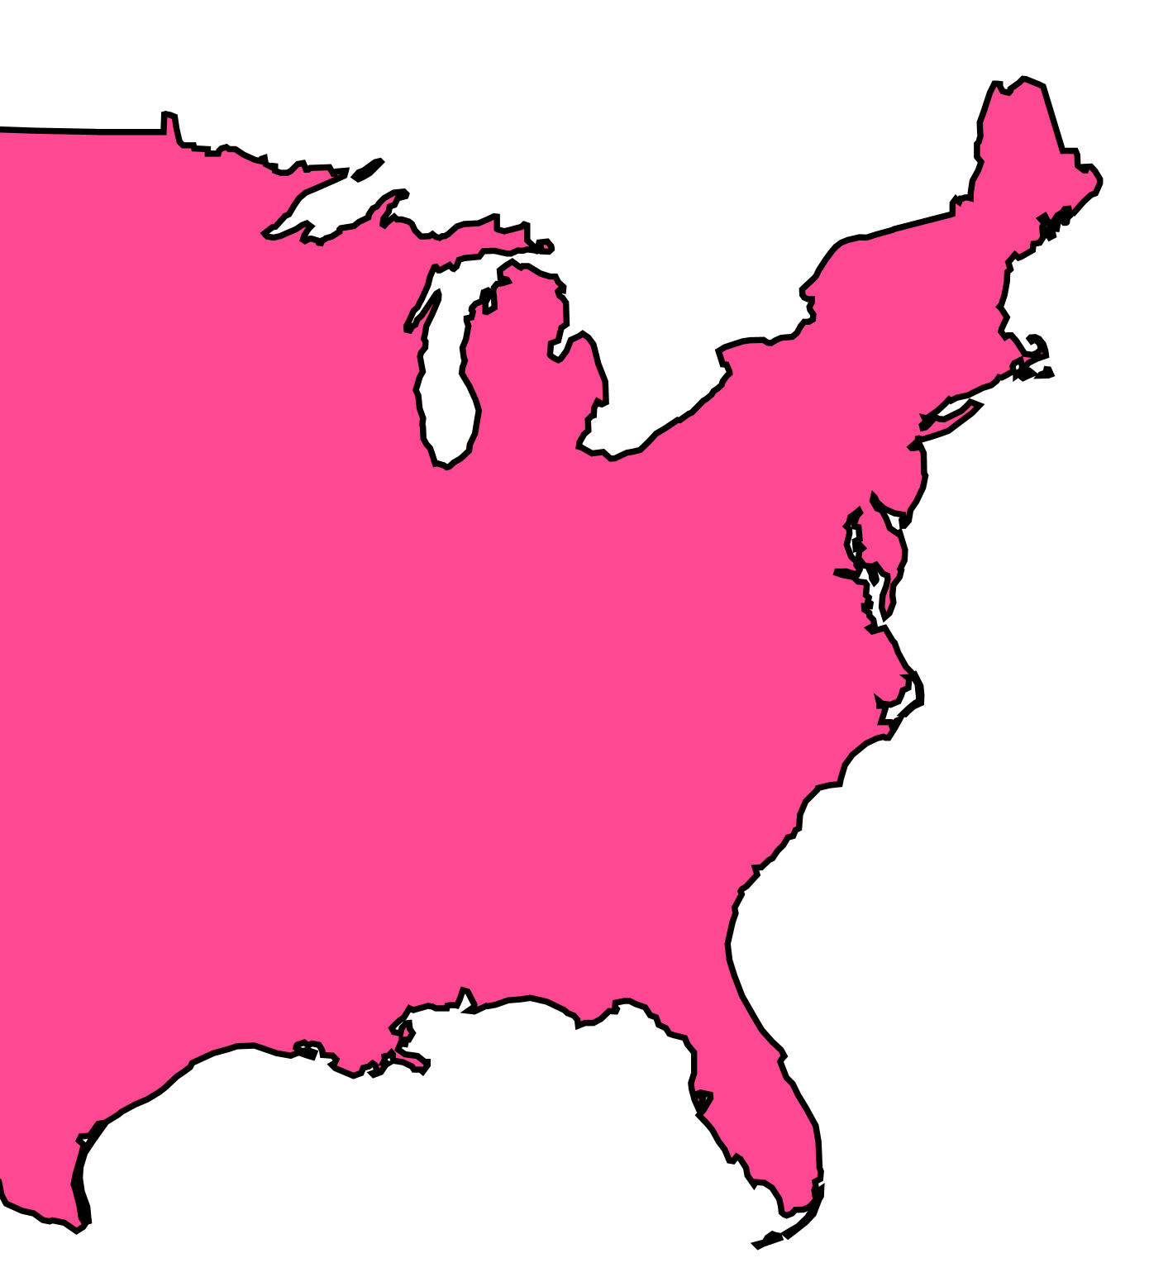
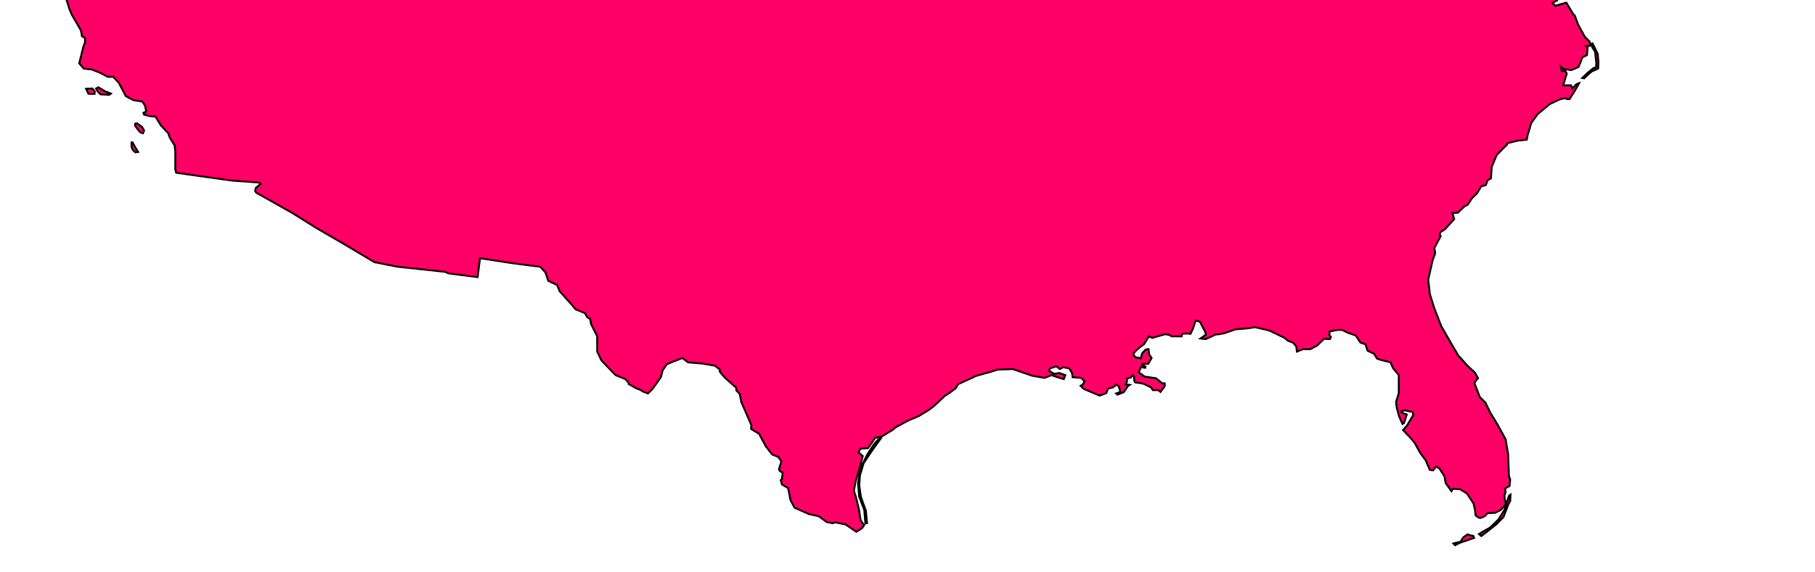
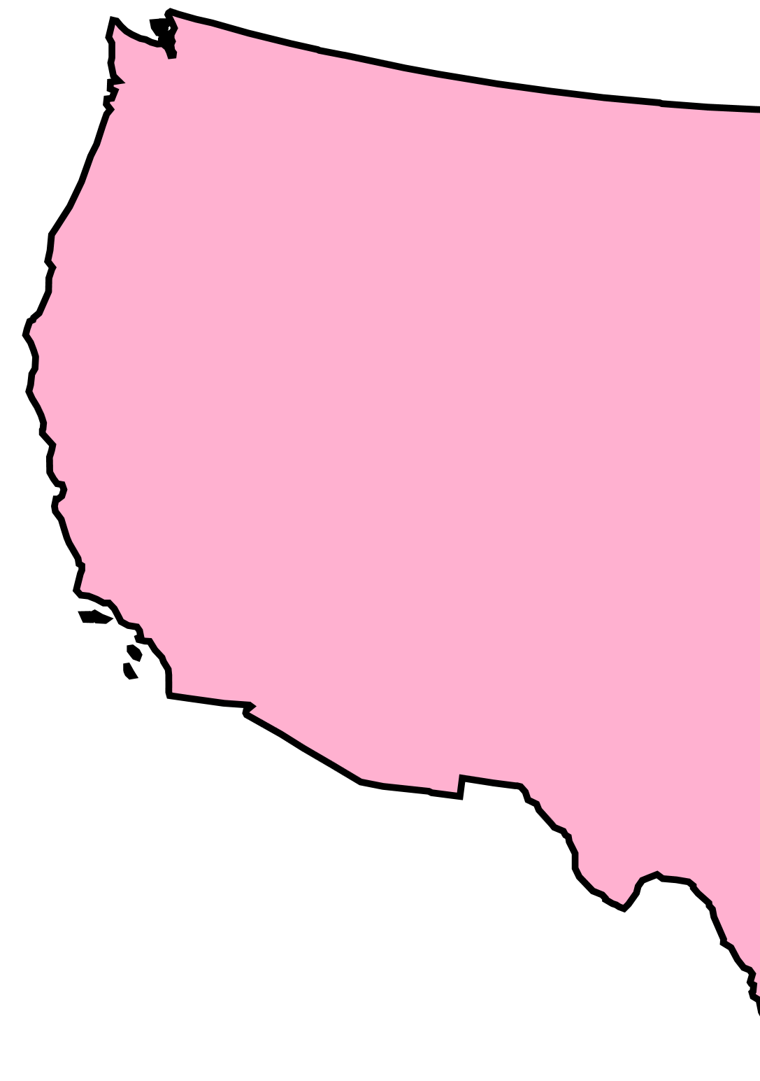





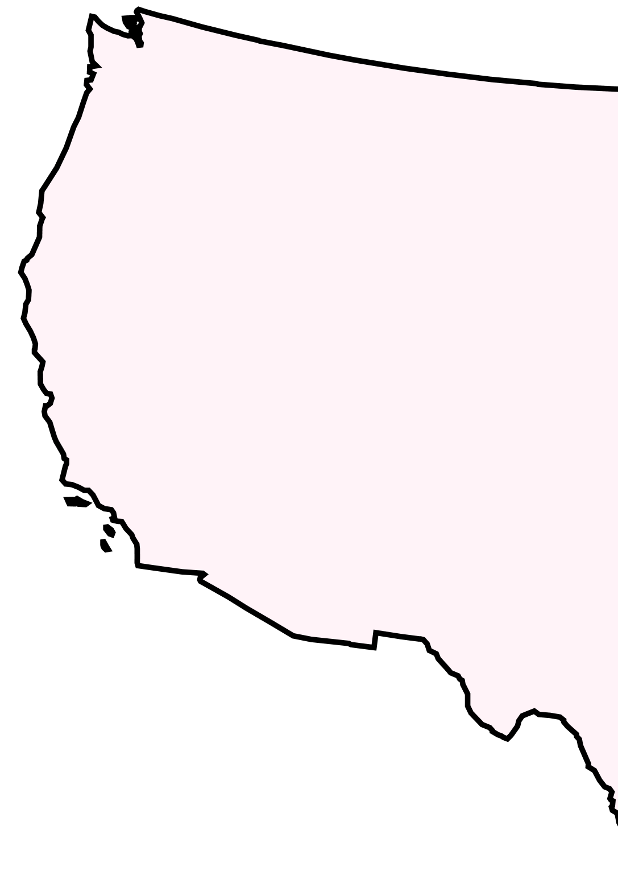







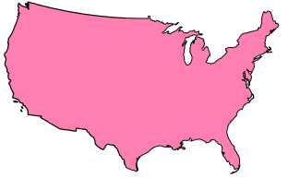


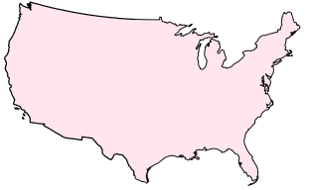
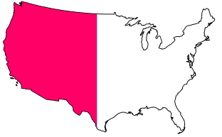




Slide 2




Study’s organization
The study is subdivided in three main sections: training of the ML model (ANN), verification of ANN’s outputs, and sensitivity analysis for ANN’s outputs
Training - Part n.2
(period: 2005 to 2020)
Train ANN using flash flood reports from NOAA’s Storm Event Database (Figure 2) and input features from ERA5-ecPoint (Figure 3g-h) and ERA5 (Figure,4b, 5, and 6).
Training – Part n.1
Define ANN’s architecture
Sensitivity Analysis n.3
Assess how the ANN’s accuracy varies when predicting flash floods in geographical areas that the model has never seen.
Training
ANN
Verification analysis n.1
(period: 2021 to 2023)
Test ANN’s output against
SED flash flood reports
03
COMPUTATING PROBABILITY OF OBSERVING A FLASH FLOOD IN A GRID-BOX
01
Sensitivity Analysis n.2
Assess how the ANN’s accuracy varies when predicting flash floods in geographical areas where there have never been recorded flash floods.
Sensitivity Analysis
Verification Analysis
Verification analysis n.2
(period: 2021 to 2023)
Feature importance using SHAP values.
02
Sensitivity Analysis n.1
Assess how the ANN’s accuracy is sensitive to having sparse and scarce flood reports in the training phase.
Verification analysis n.3
(period: 2022)
Test ANN’s output as pseudo flash flood reports in flash-flood-focused verification of rainfall forecasts

