Slide 1

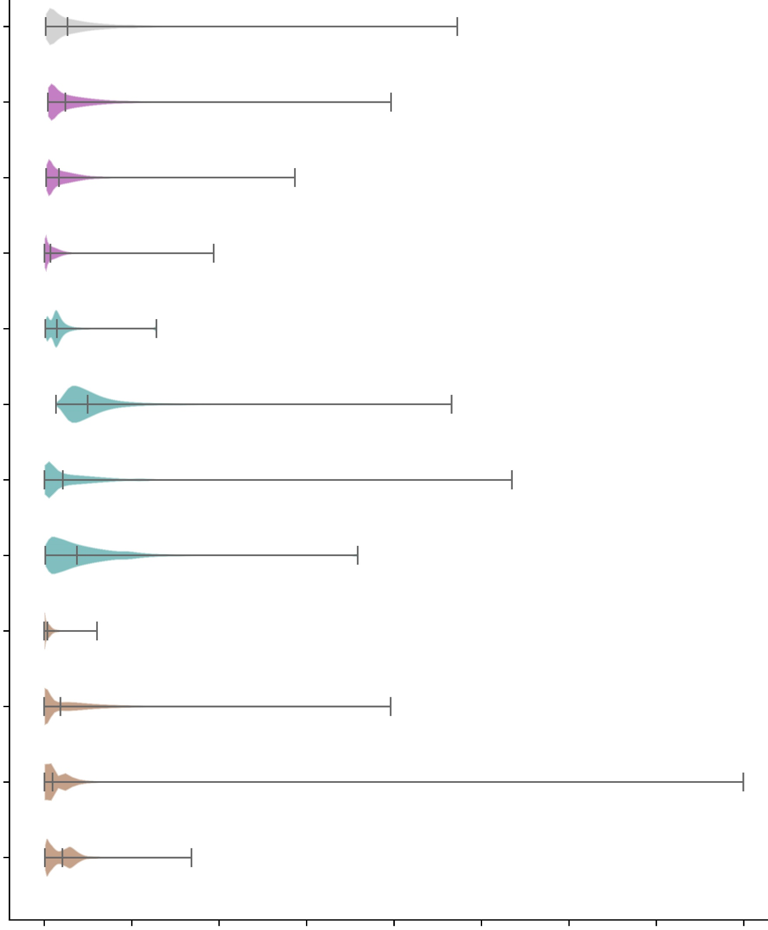

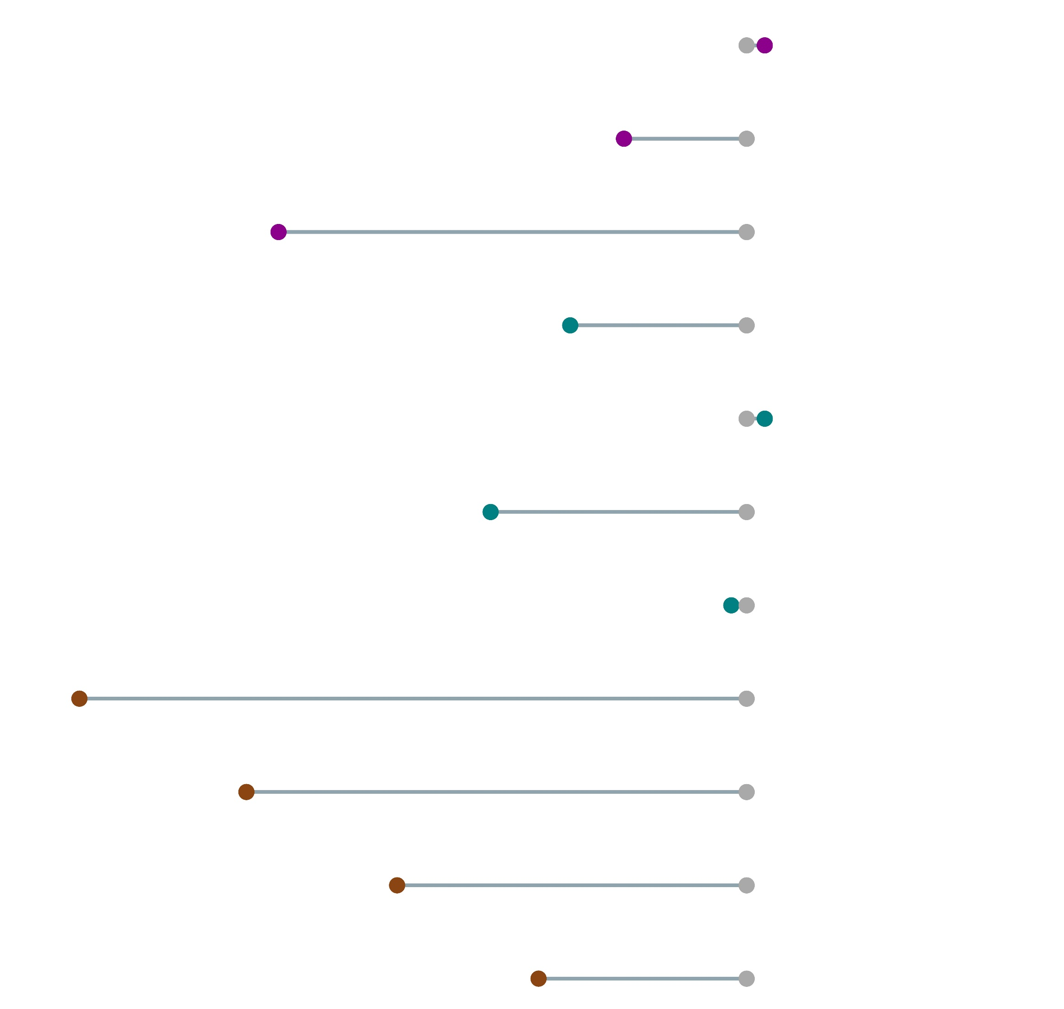










Train ML models only over data-rich areas to predict flash floods globally.
Distribution of predicted probabilities of having a flash flood in a grid-box
Flash flood signal: percentage difference in no. of grid-boxes exceeding the climatological average probability (=0.08%) of having a flash flood event
0
100
% of flash flood reports used for training
All data
247953
+1.42 %
APPROACH 1
-9.56 %
-36.50 %
-13.75 %
APPROACH 2 provides the overall smallest flash flood signal loss out of the three tested approaches, maintaining similar probability distributions to the training with all data.
APPROACH 2 (partial domain used for training)
(+ 1.42 %)
(-19.96 %)
(-1.18 %)
(-52.04 %)
APPROACH 3
(full domain used for training)
(-39.00 %)
(-27.25 %)
(-16.22 %)
0
2
4
6
8
10
12
14
16
Probabilities [%]

