Slide 1
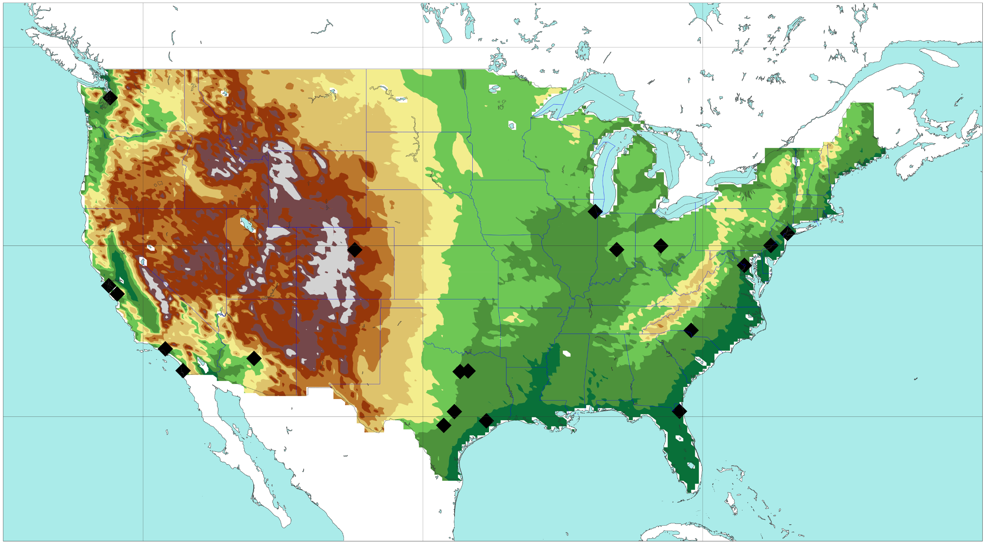

120 °W
100 °W
80 °W
m.a.s.l.
5000
50 °N
2500
SEATTLE
2000
1500
CHICAGO
NEW YORK
40 °N
DENVER
INDIANAPOLIS
1200
PHILADELPHIA
COLUMBUS
SAN FRANCISCO
WASHINGTON D.C.
SAN JOSE
750
PHOENIX
FORTH
WORTH
ATLANTA
LOS ANGELES
DALLAS
500
SAN DIEGO
AUSTIN
30 °N
JACKSONVILLE
250
SAN ANTONIO
HOUSTON
50
0

