Slide 1
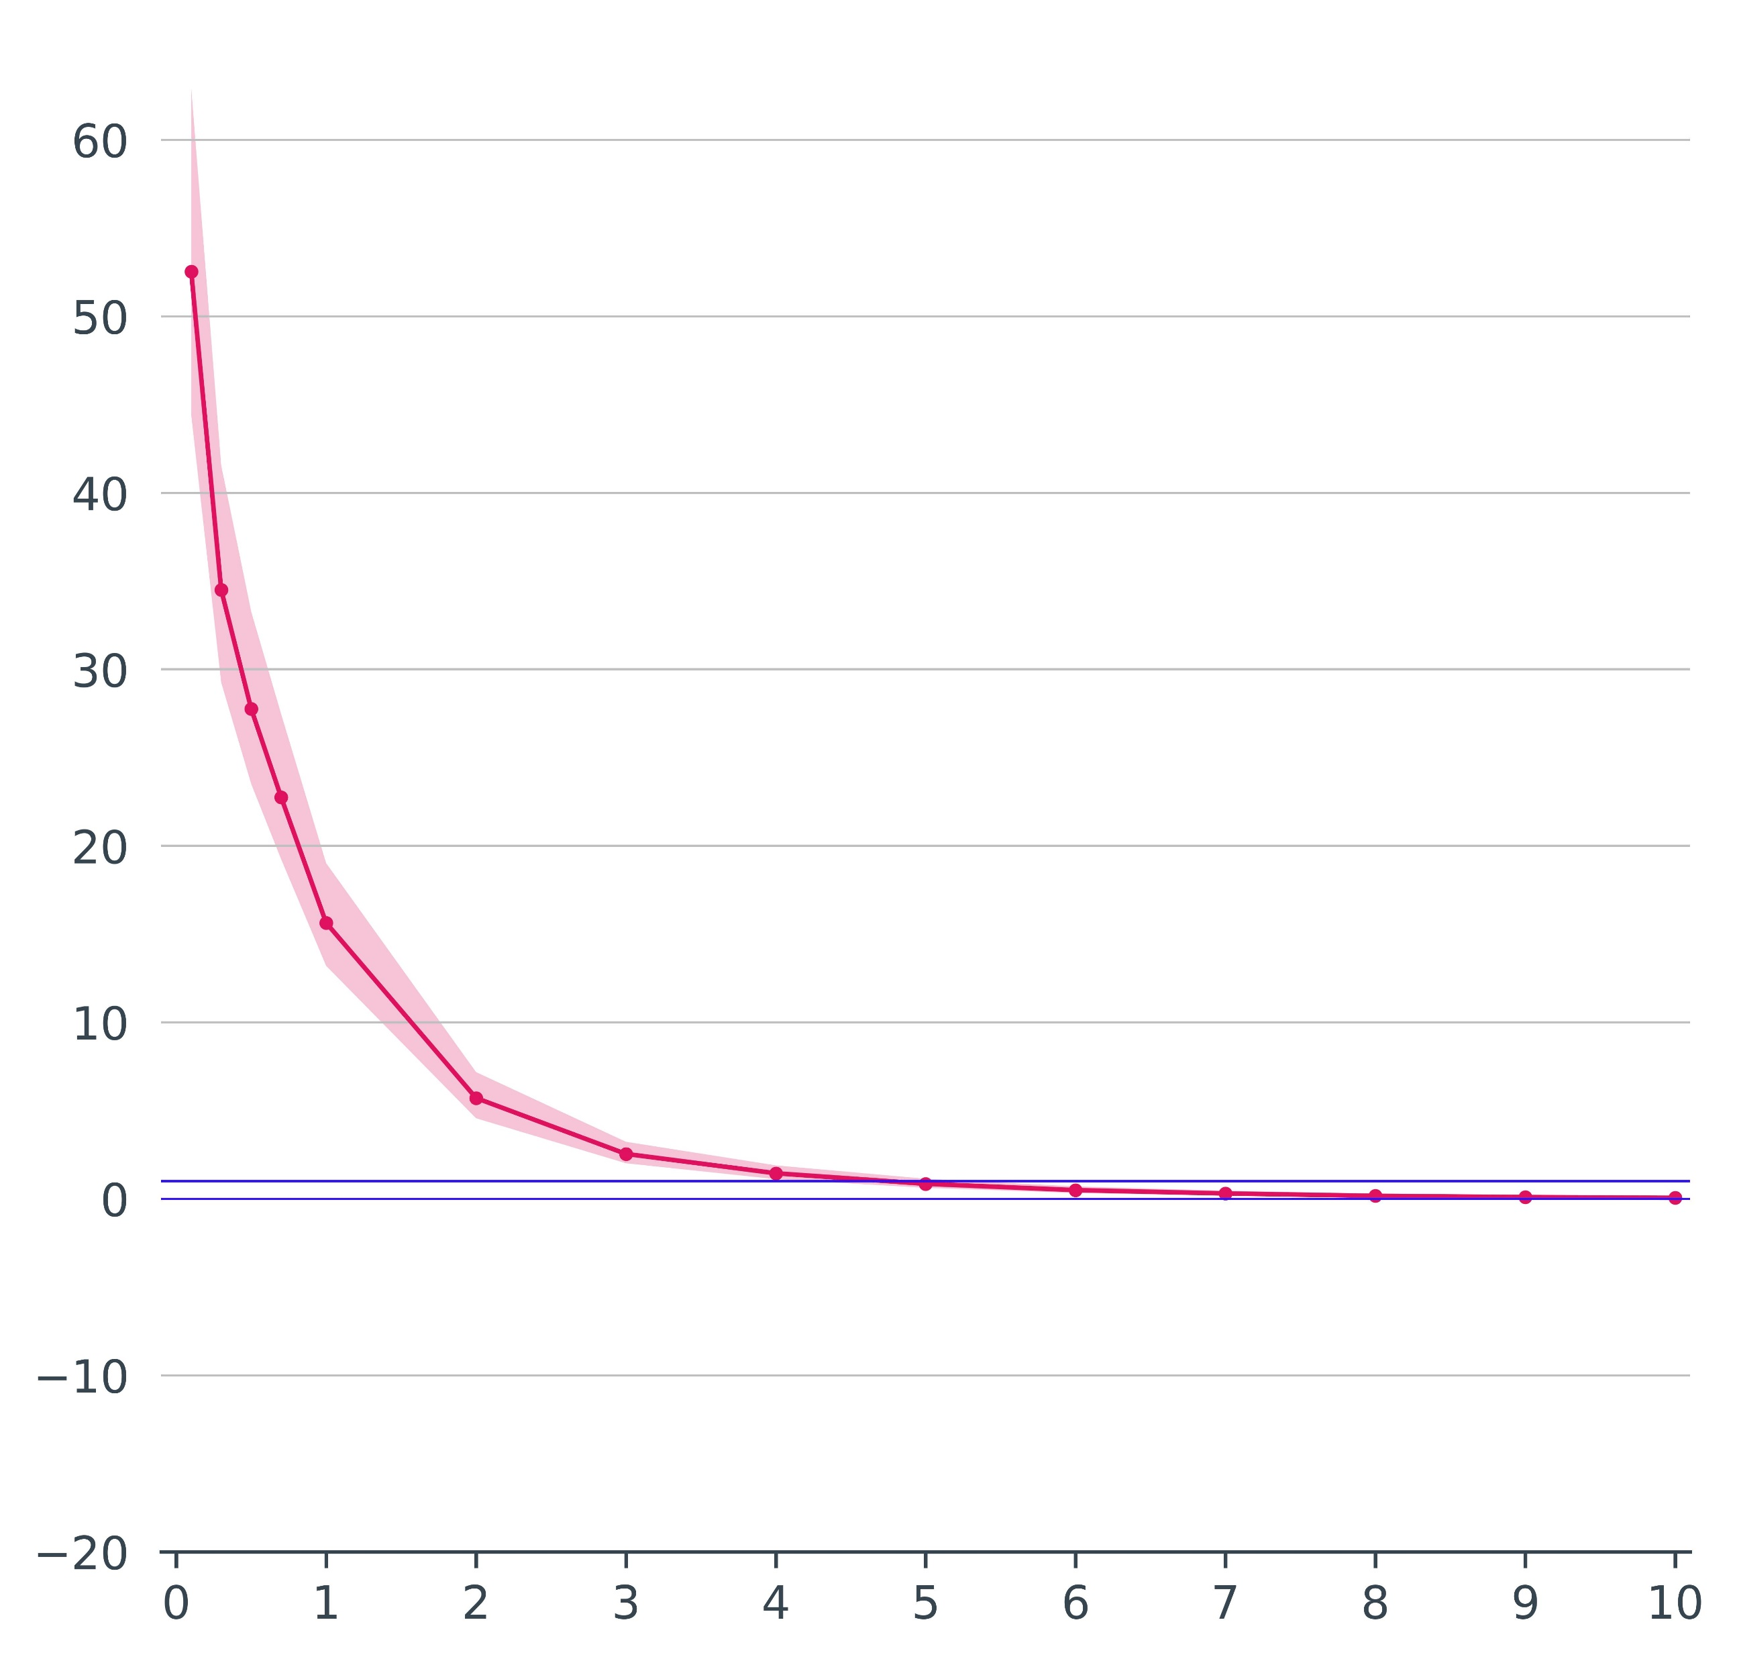
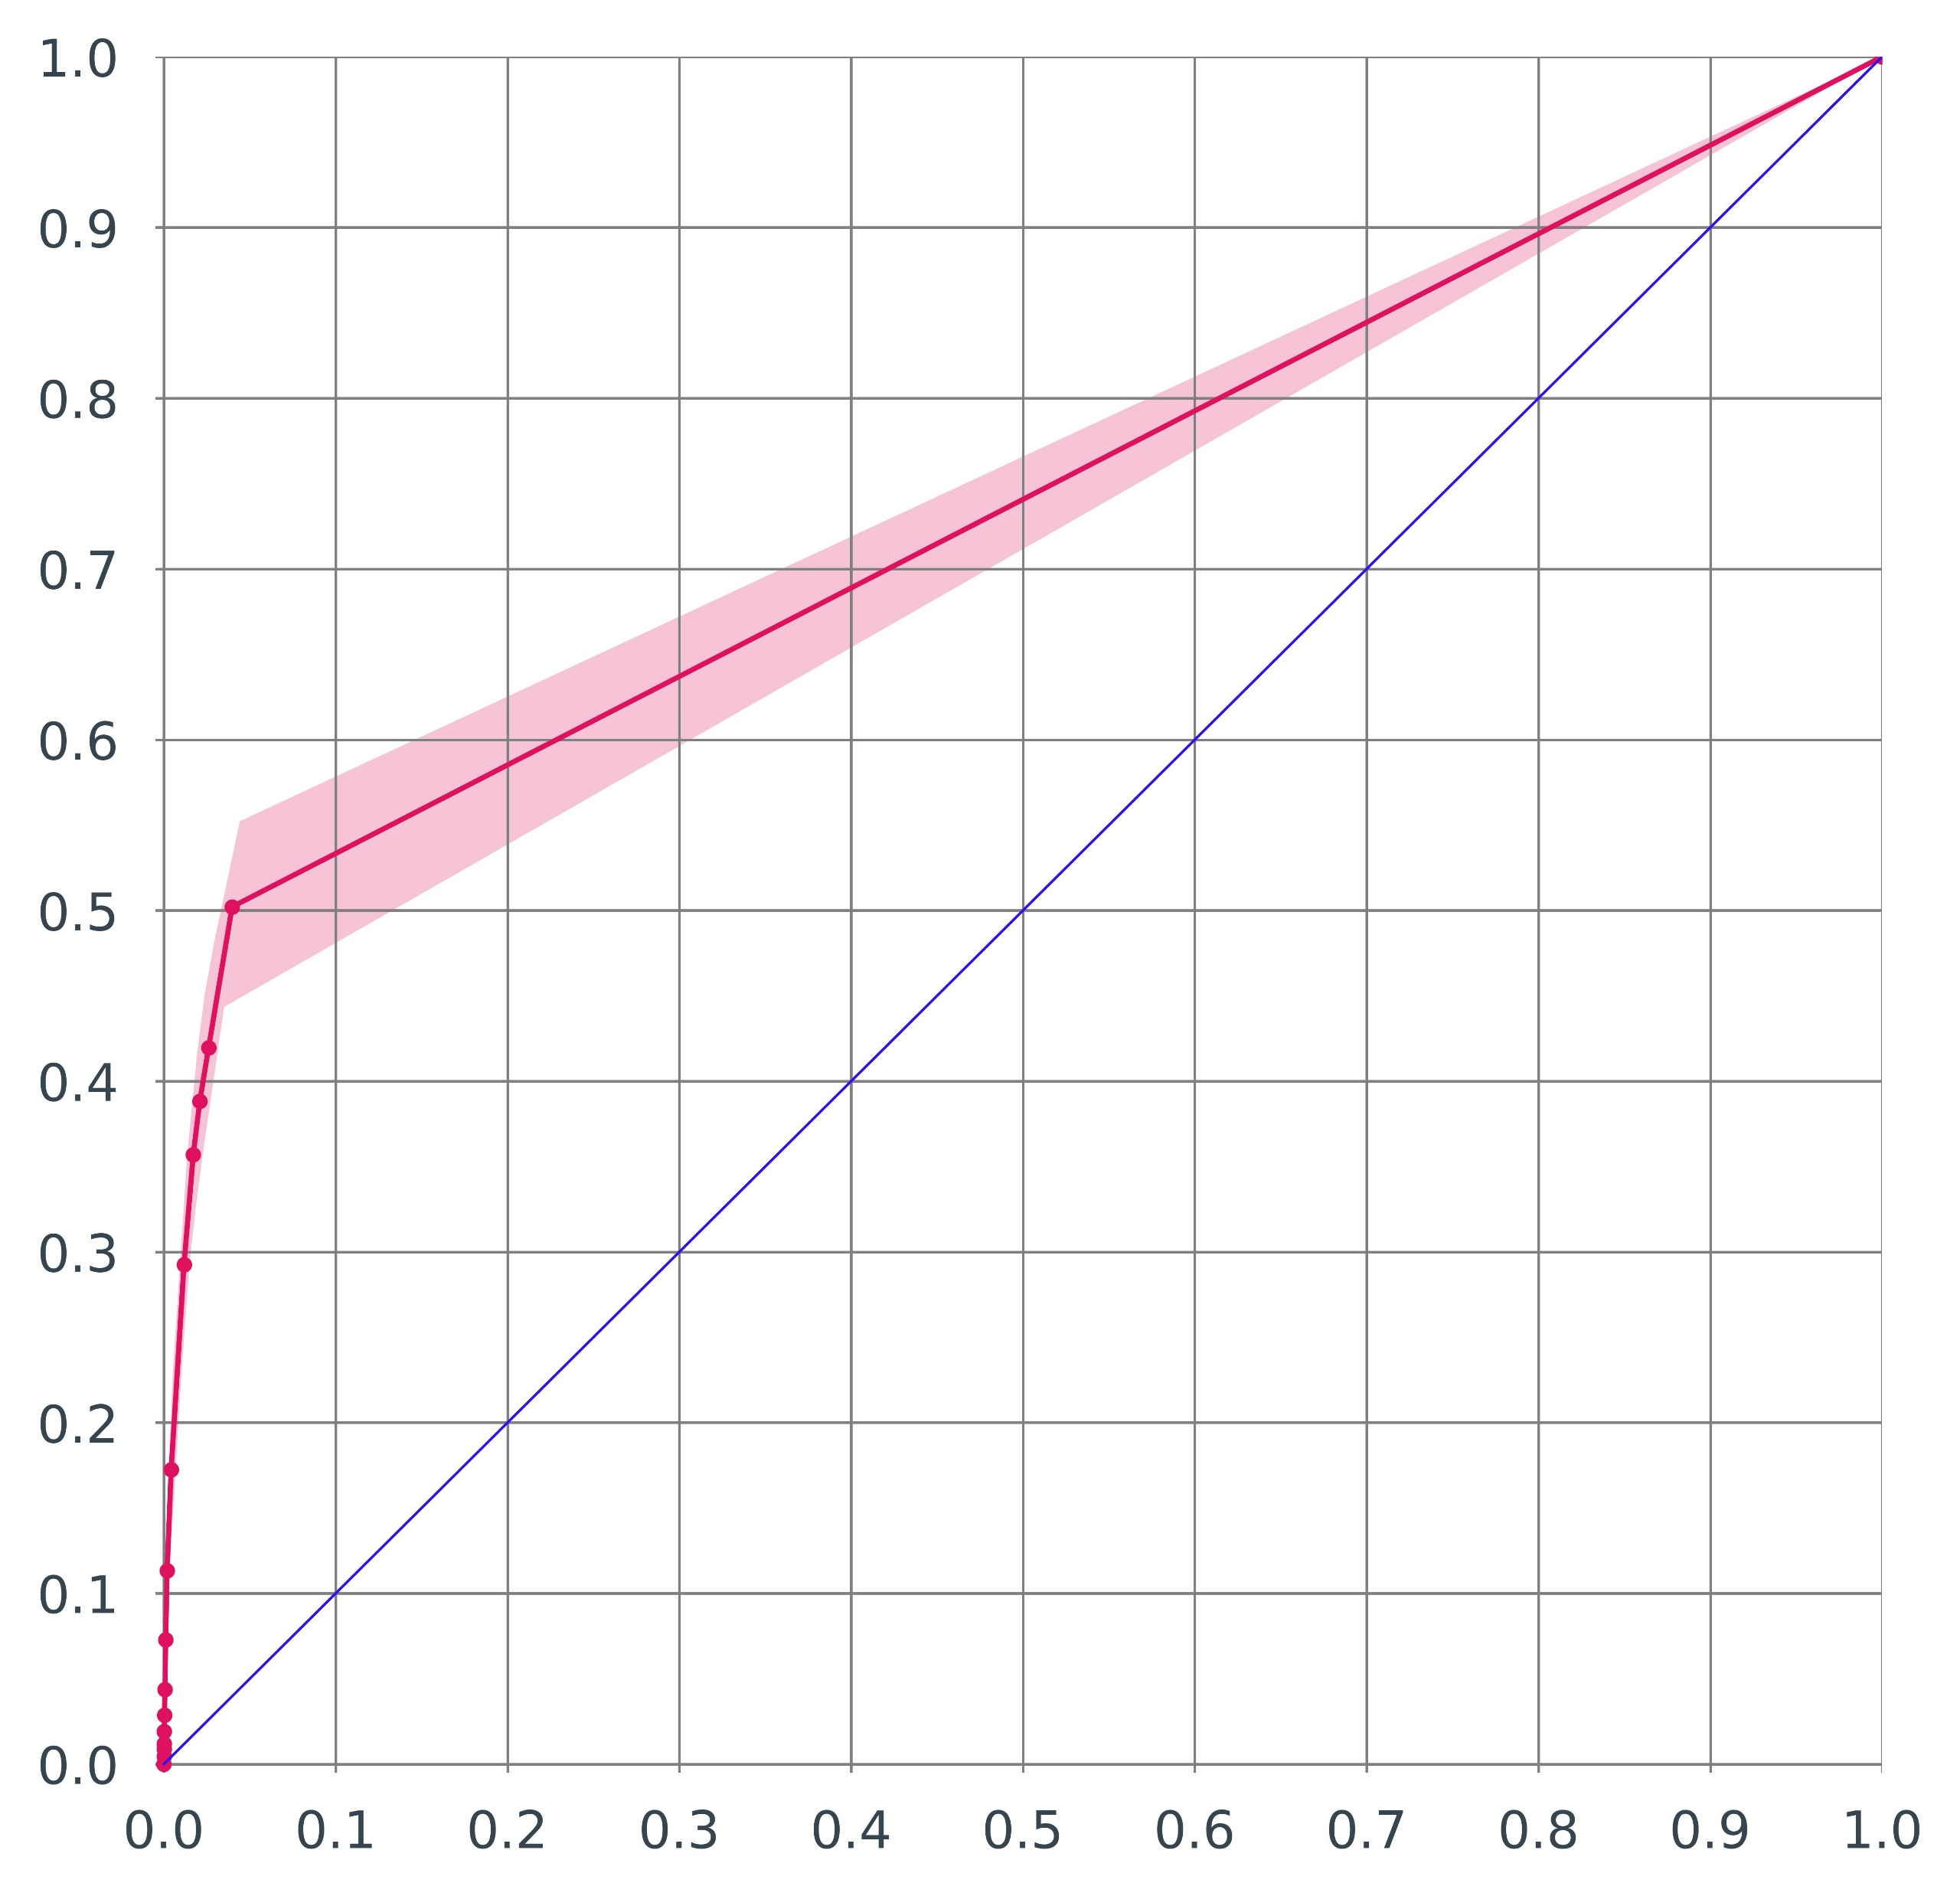
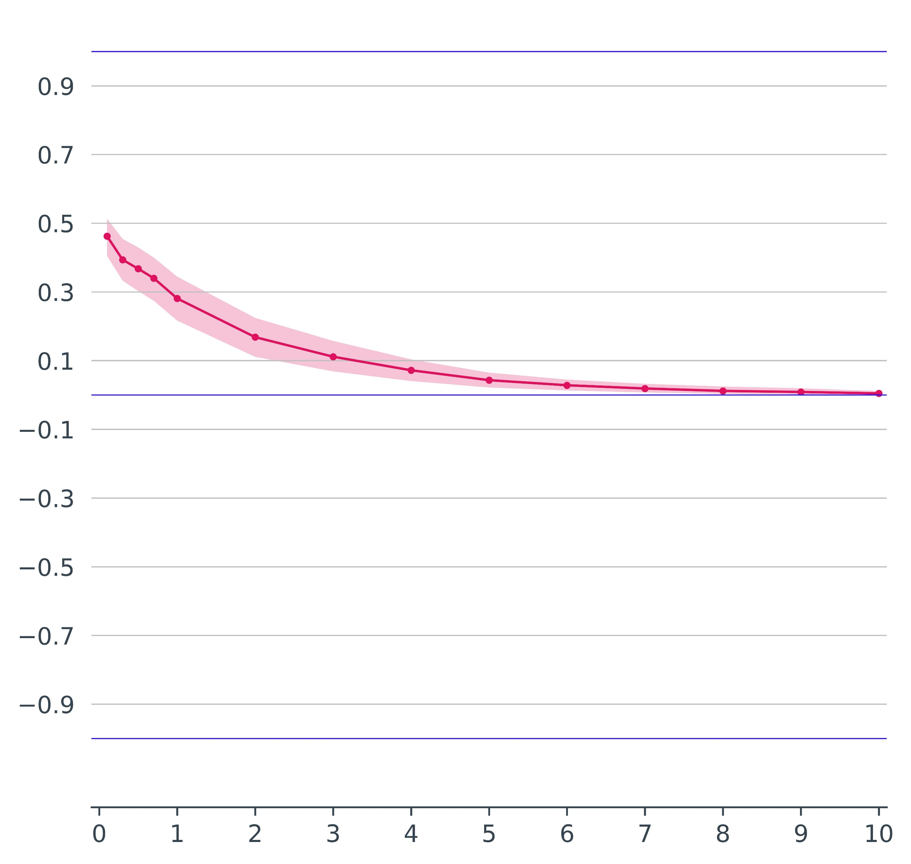
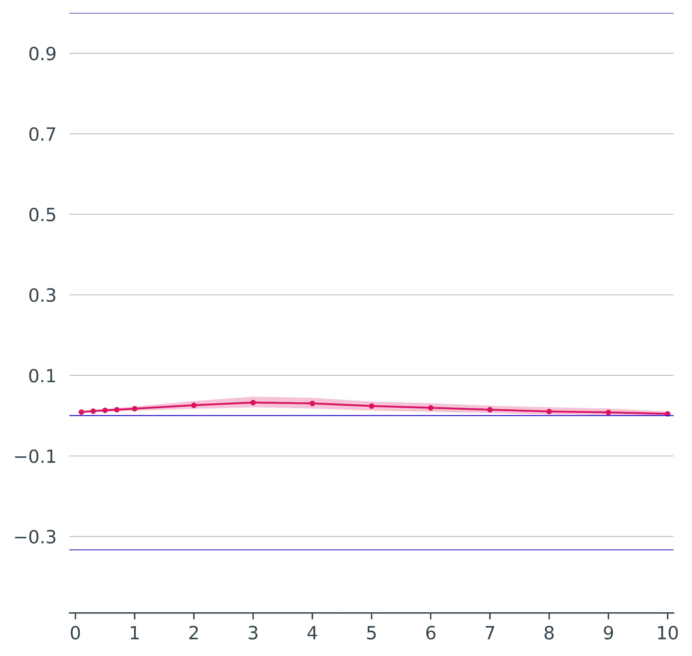
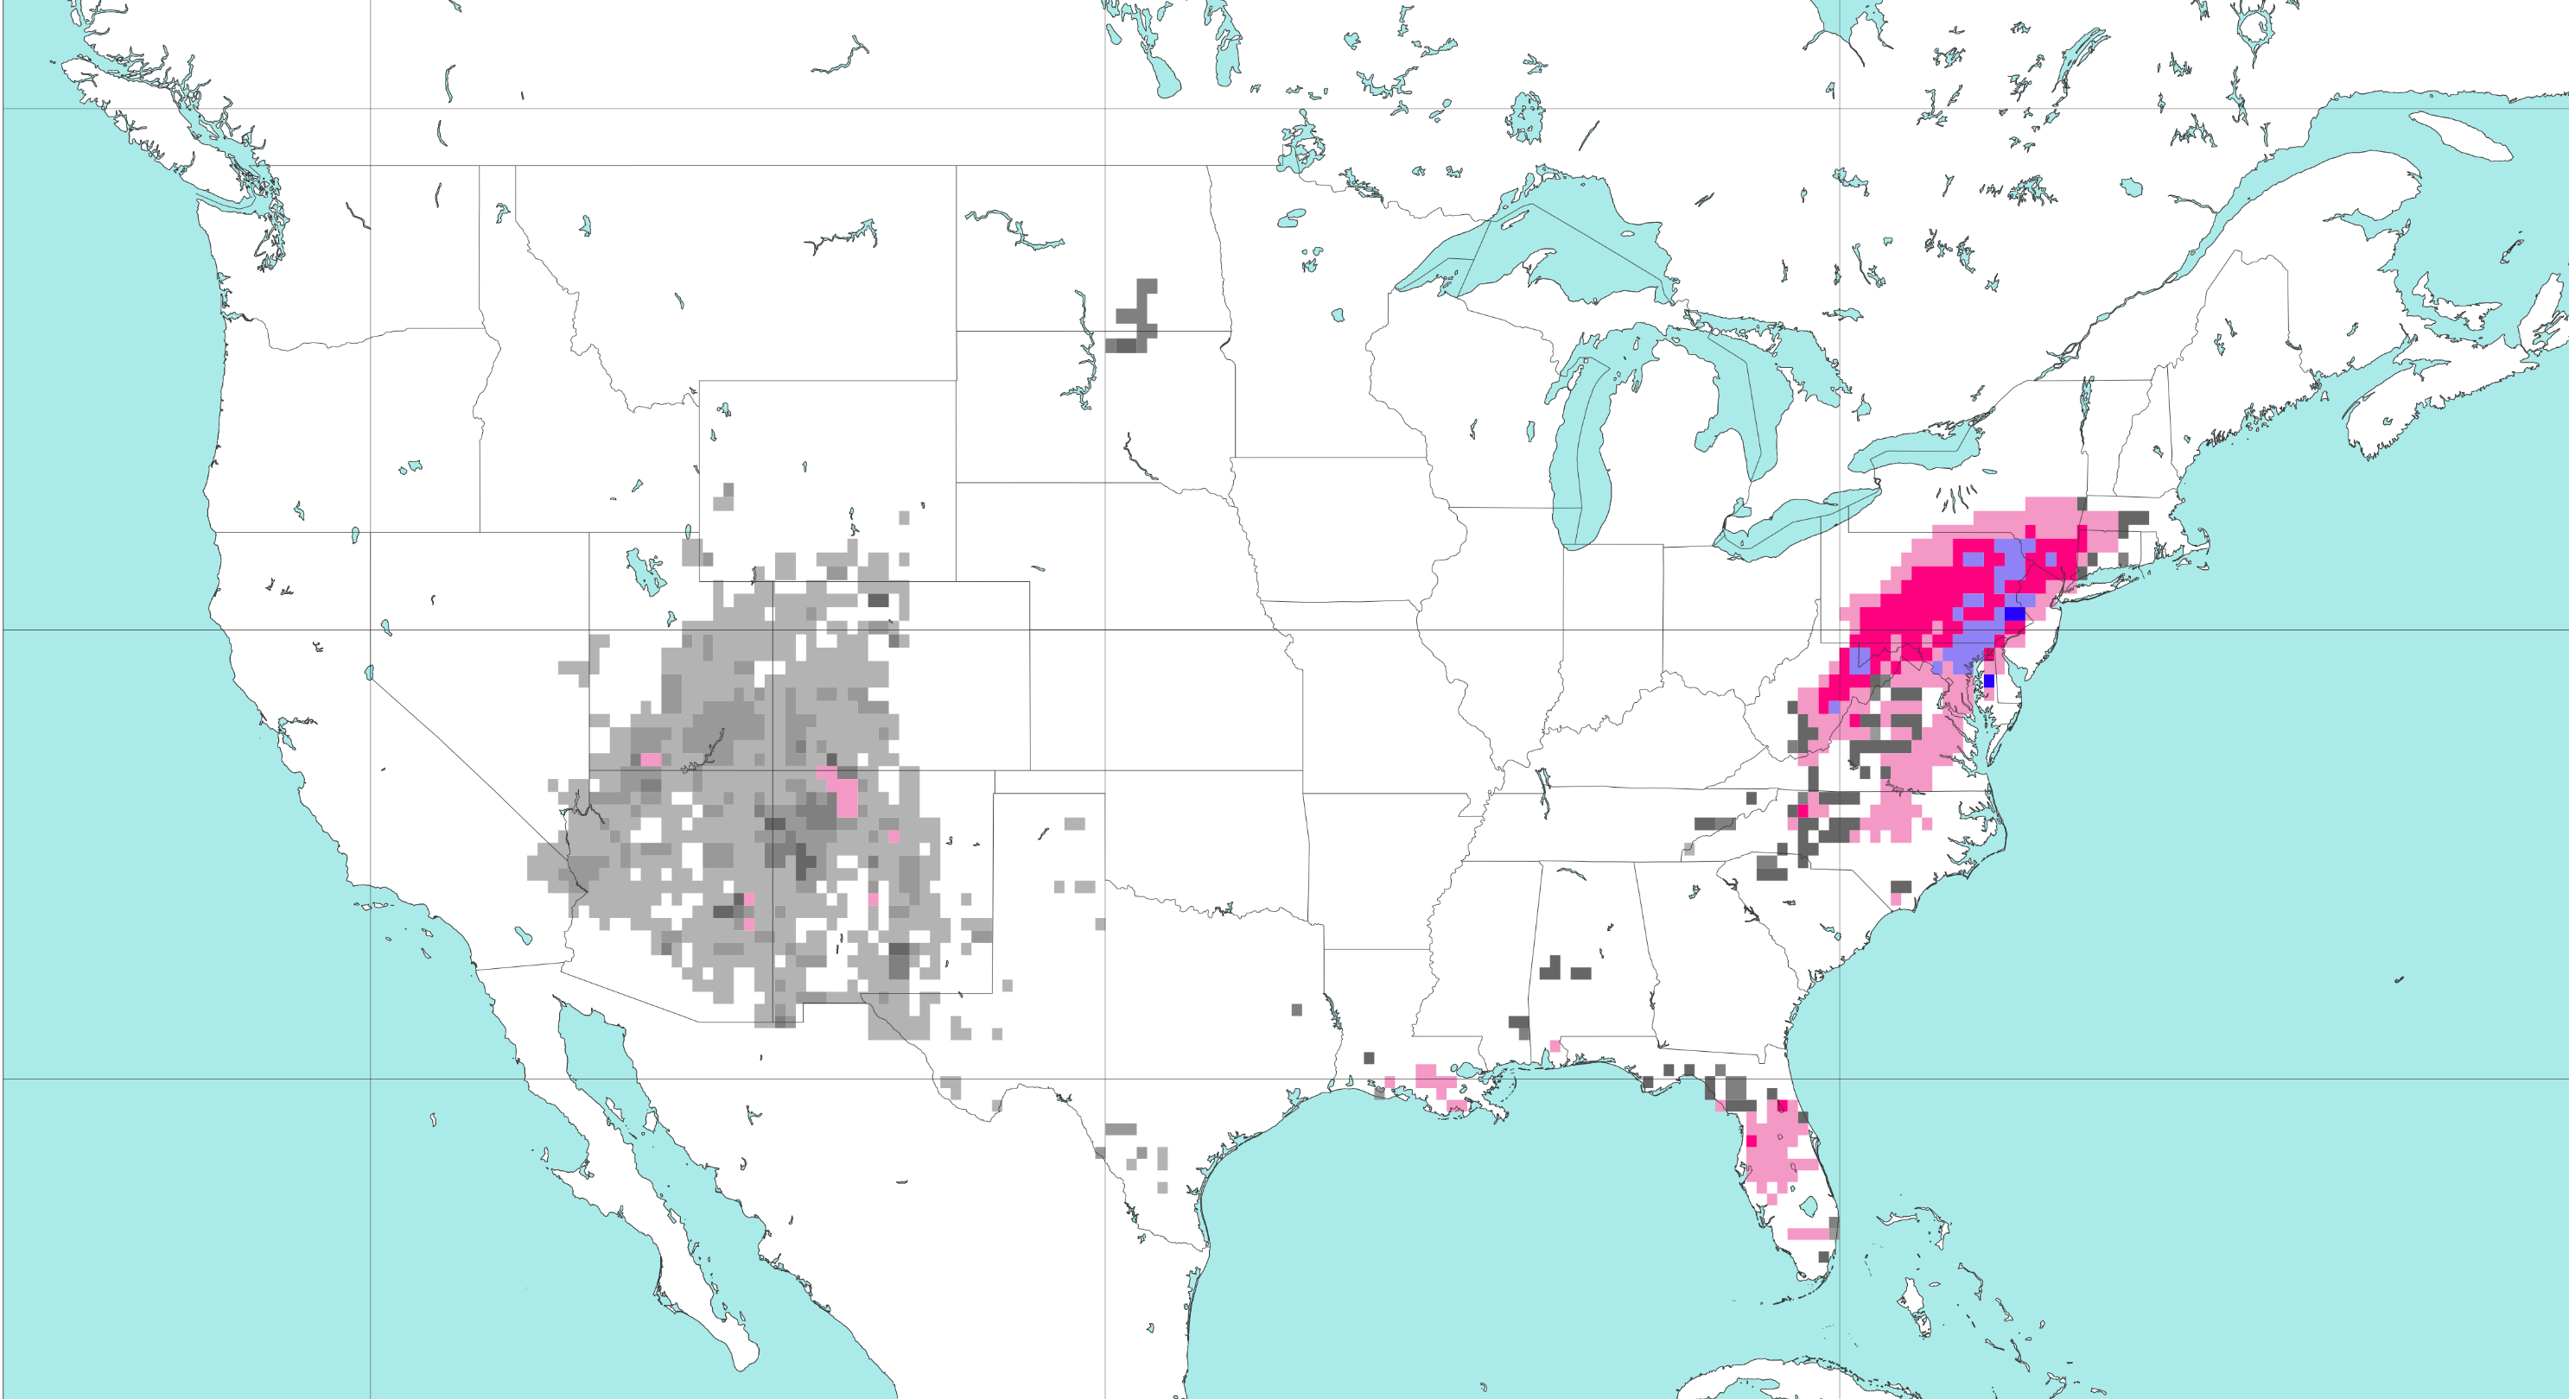

Objective verification for ANN’s outputs against SED flash flood reports, between 01-01-2021 and 31-12-2023
Best bias (FB) and skill (ETS) are reached for probabilities thresholds equal to 3%.
Frequency Bias (FB)
ROC curve
60
Over-
estimation
1
50
0.1%
a
b
40
0.8
30
0.3%
0.6
0.5%
0.7%
No skill
20
Hit rate [-]
Under-
estimation
0.4
10
FB = 1,
Perfect
0
FB = 0, Lower bound
0.2
0
1
2
3
4
5
6
7
8
9
10
0
Probability thresholds [%]
0
0.2
0.4
0.6
0.8
1
False alarm rate [-]
Pierce’s Skill Score (PSS)
Equitable Threat Score (ETS)
0.9
PSS = 1, Upper bound (perfect score)
ETS = 1 , Upper bound (perfect score)
0.7
c
0.9
0.5
0.7
d
0.3
0.5
0.1
PSS = 0, No skill
0.3
-0.1
-0.3
0.1
-0.5
ETS = 0 , No skill
-0.7
-0.1
-0.9
PSS = -1, Lower bound
-0.3
ETS = -1/3, Lower bound
0
1
2
3
4
5
6
7
8
9
10
0
1
2
3
4
5
6
7
8
9
10
Probability thresholds [%]
Probability thresholds [%]
Map plot for the probabilities [%] of having a flash flood event in a grid-box
VT: 01-09-2021 12 UTC to 02-09-2021 00 UTC
50 °N
%
100
10
7
5
40 °N
3
1
0.7
30 °N
0.5
0.3
e
0.1
120 °W
100 °W
80 °W
0

