Slide 1
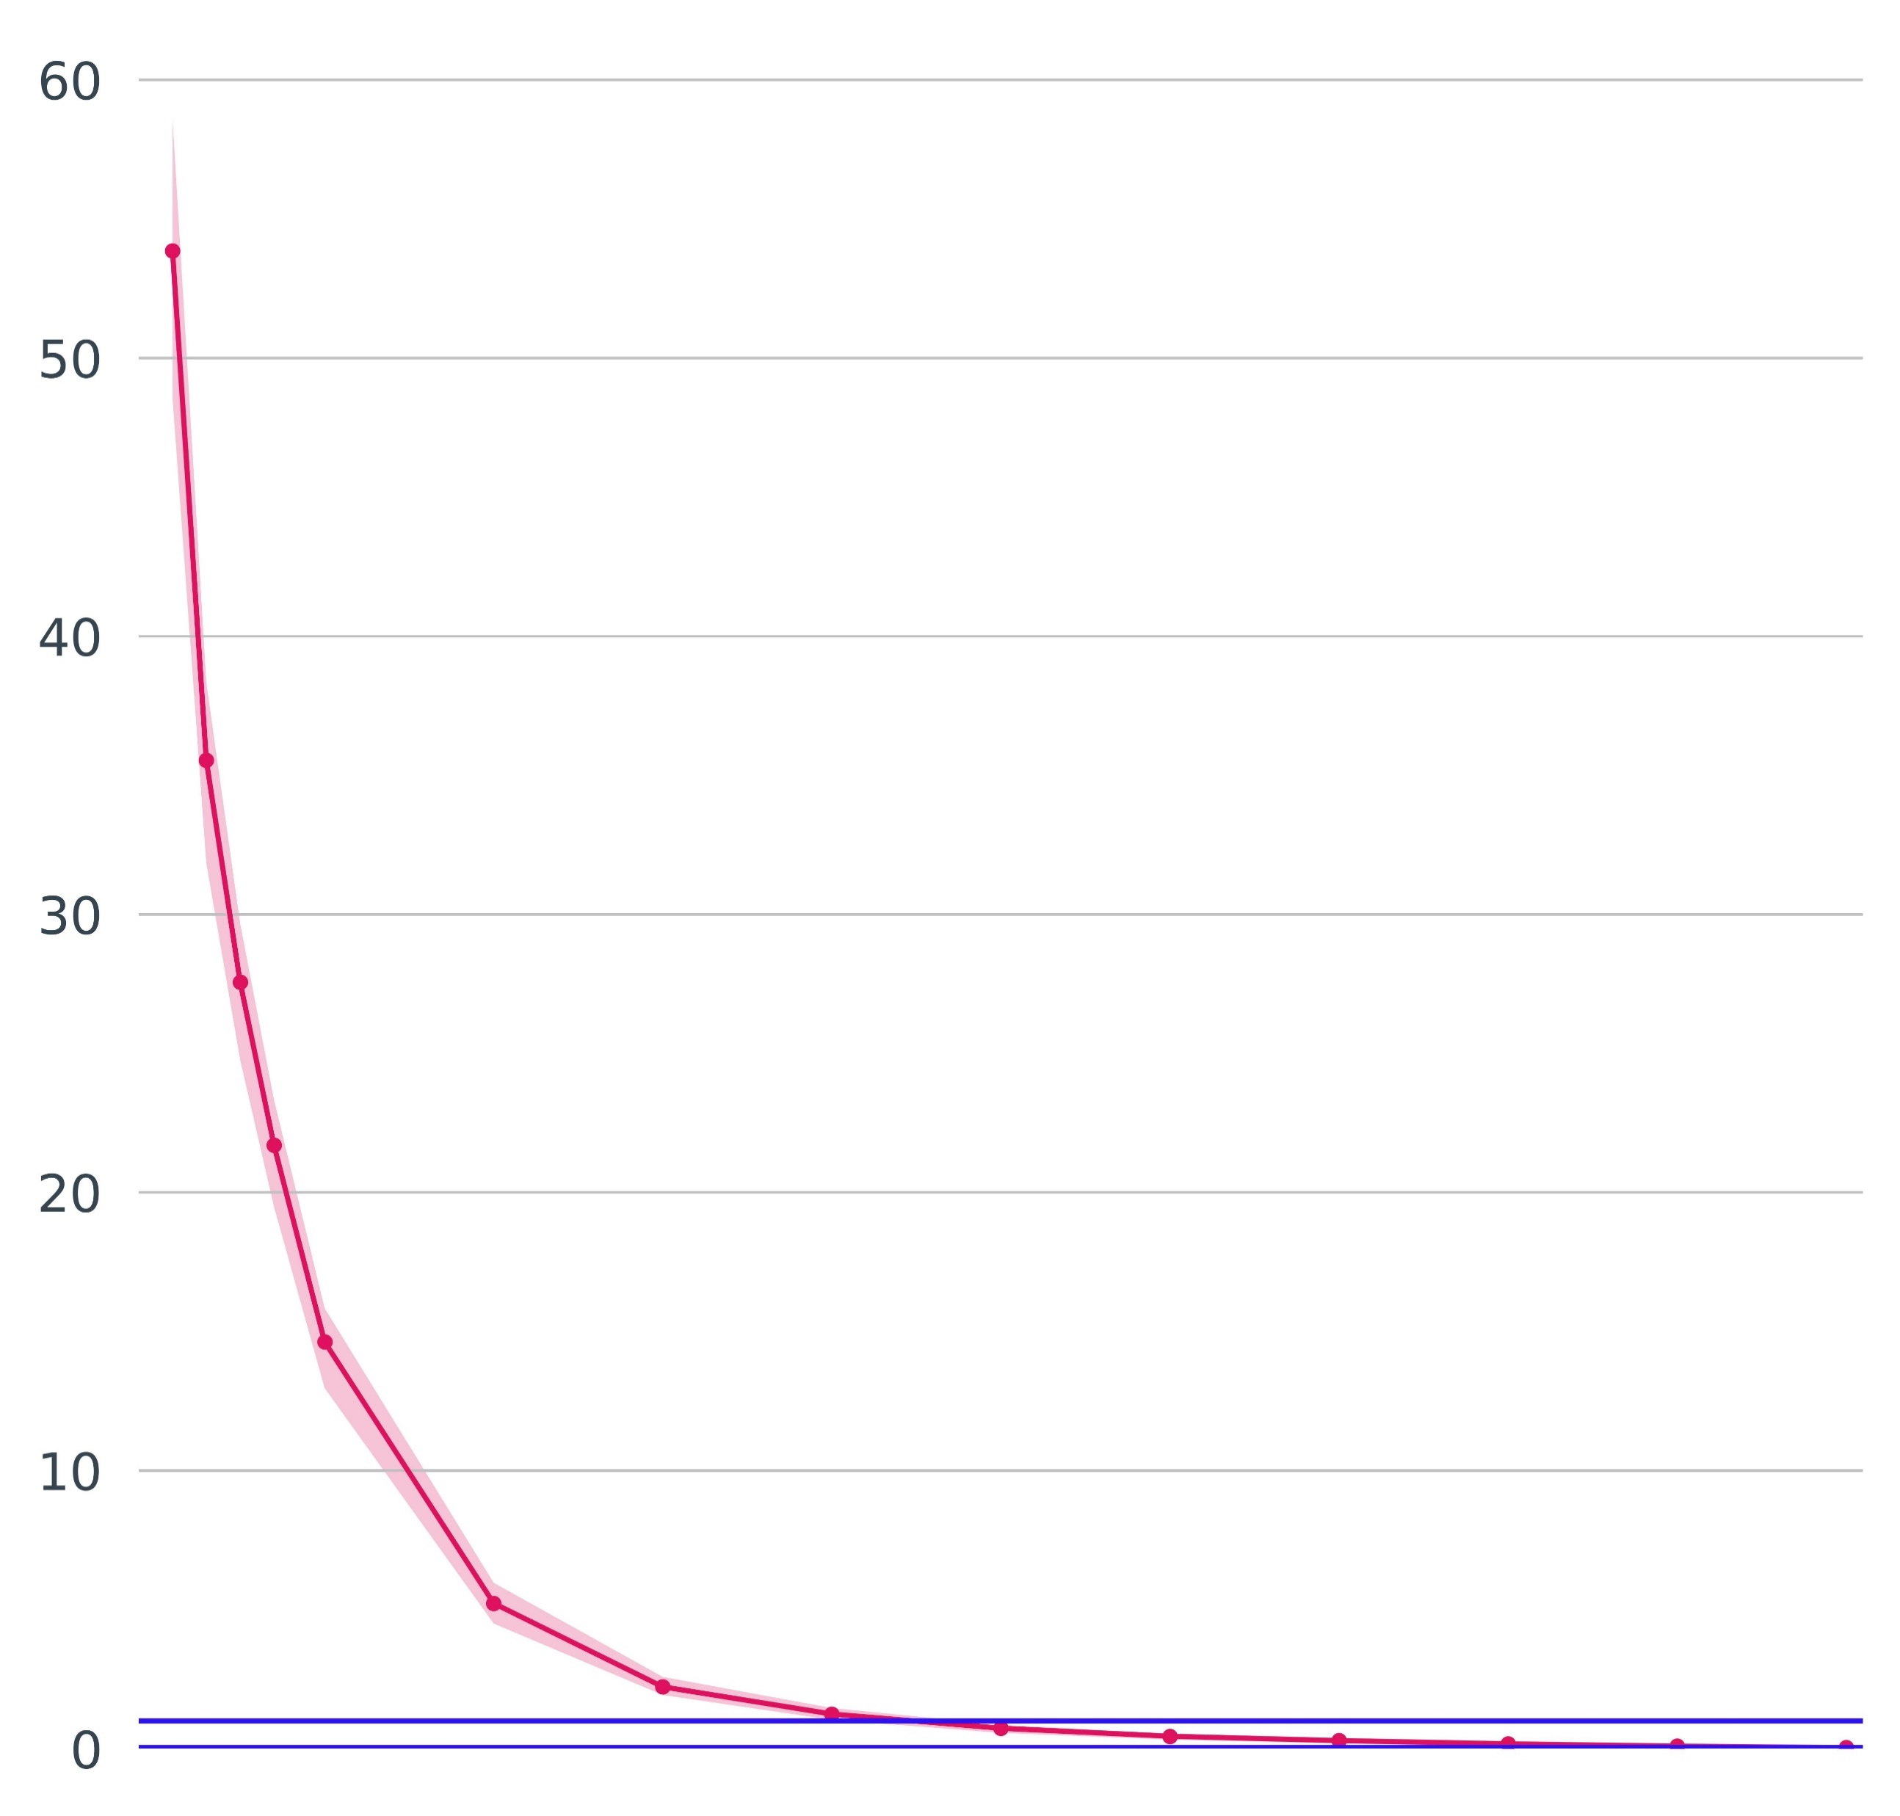
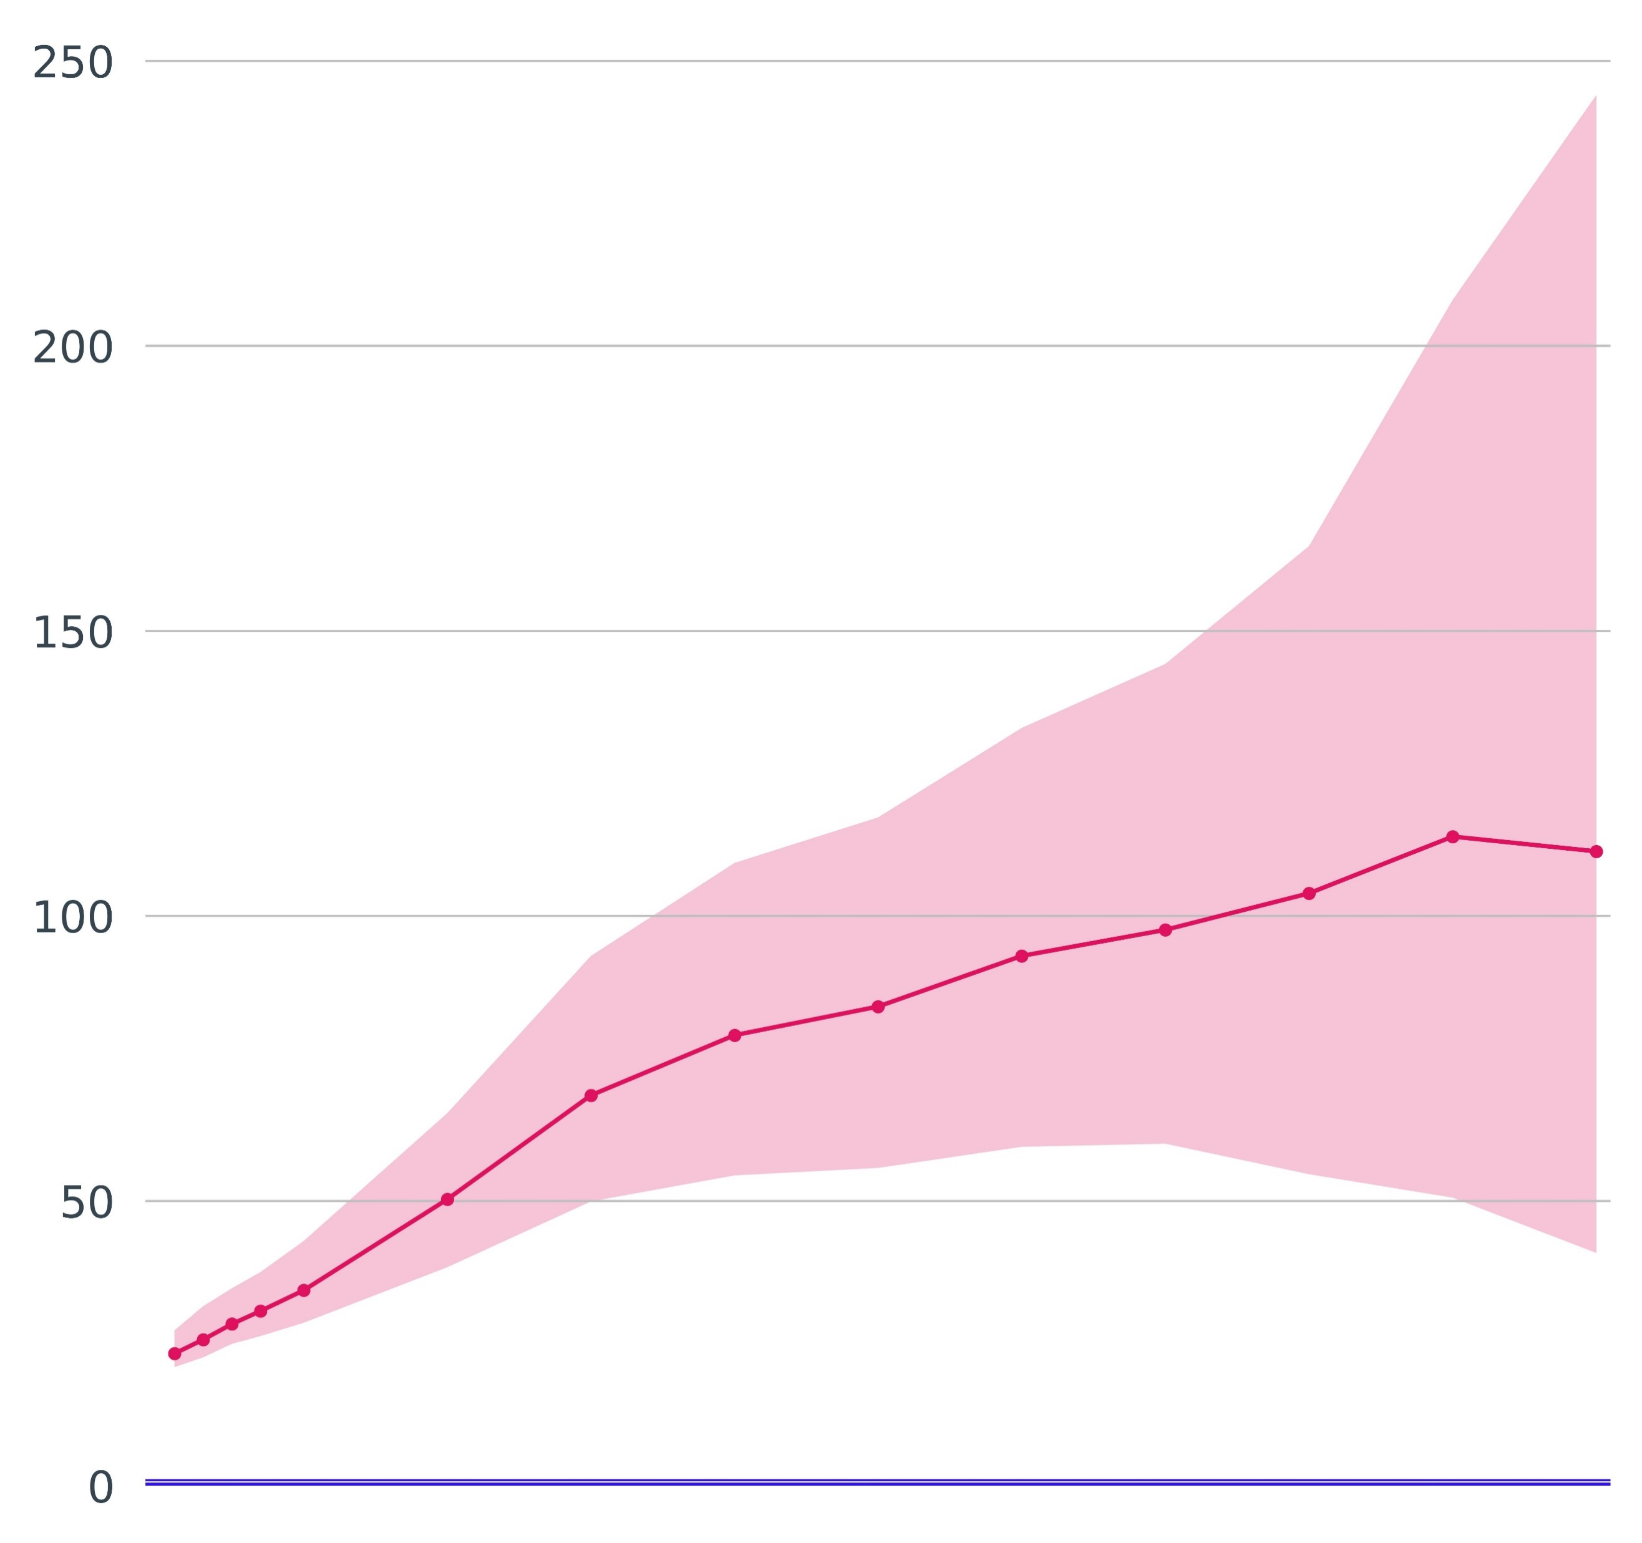
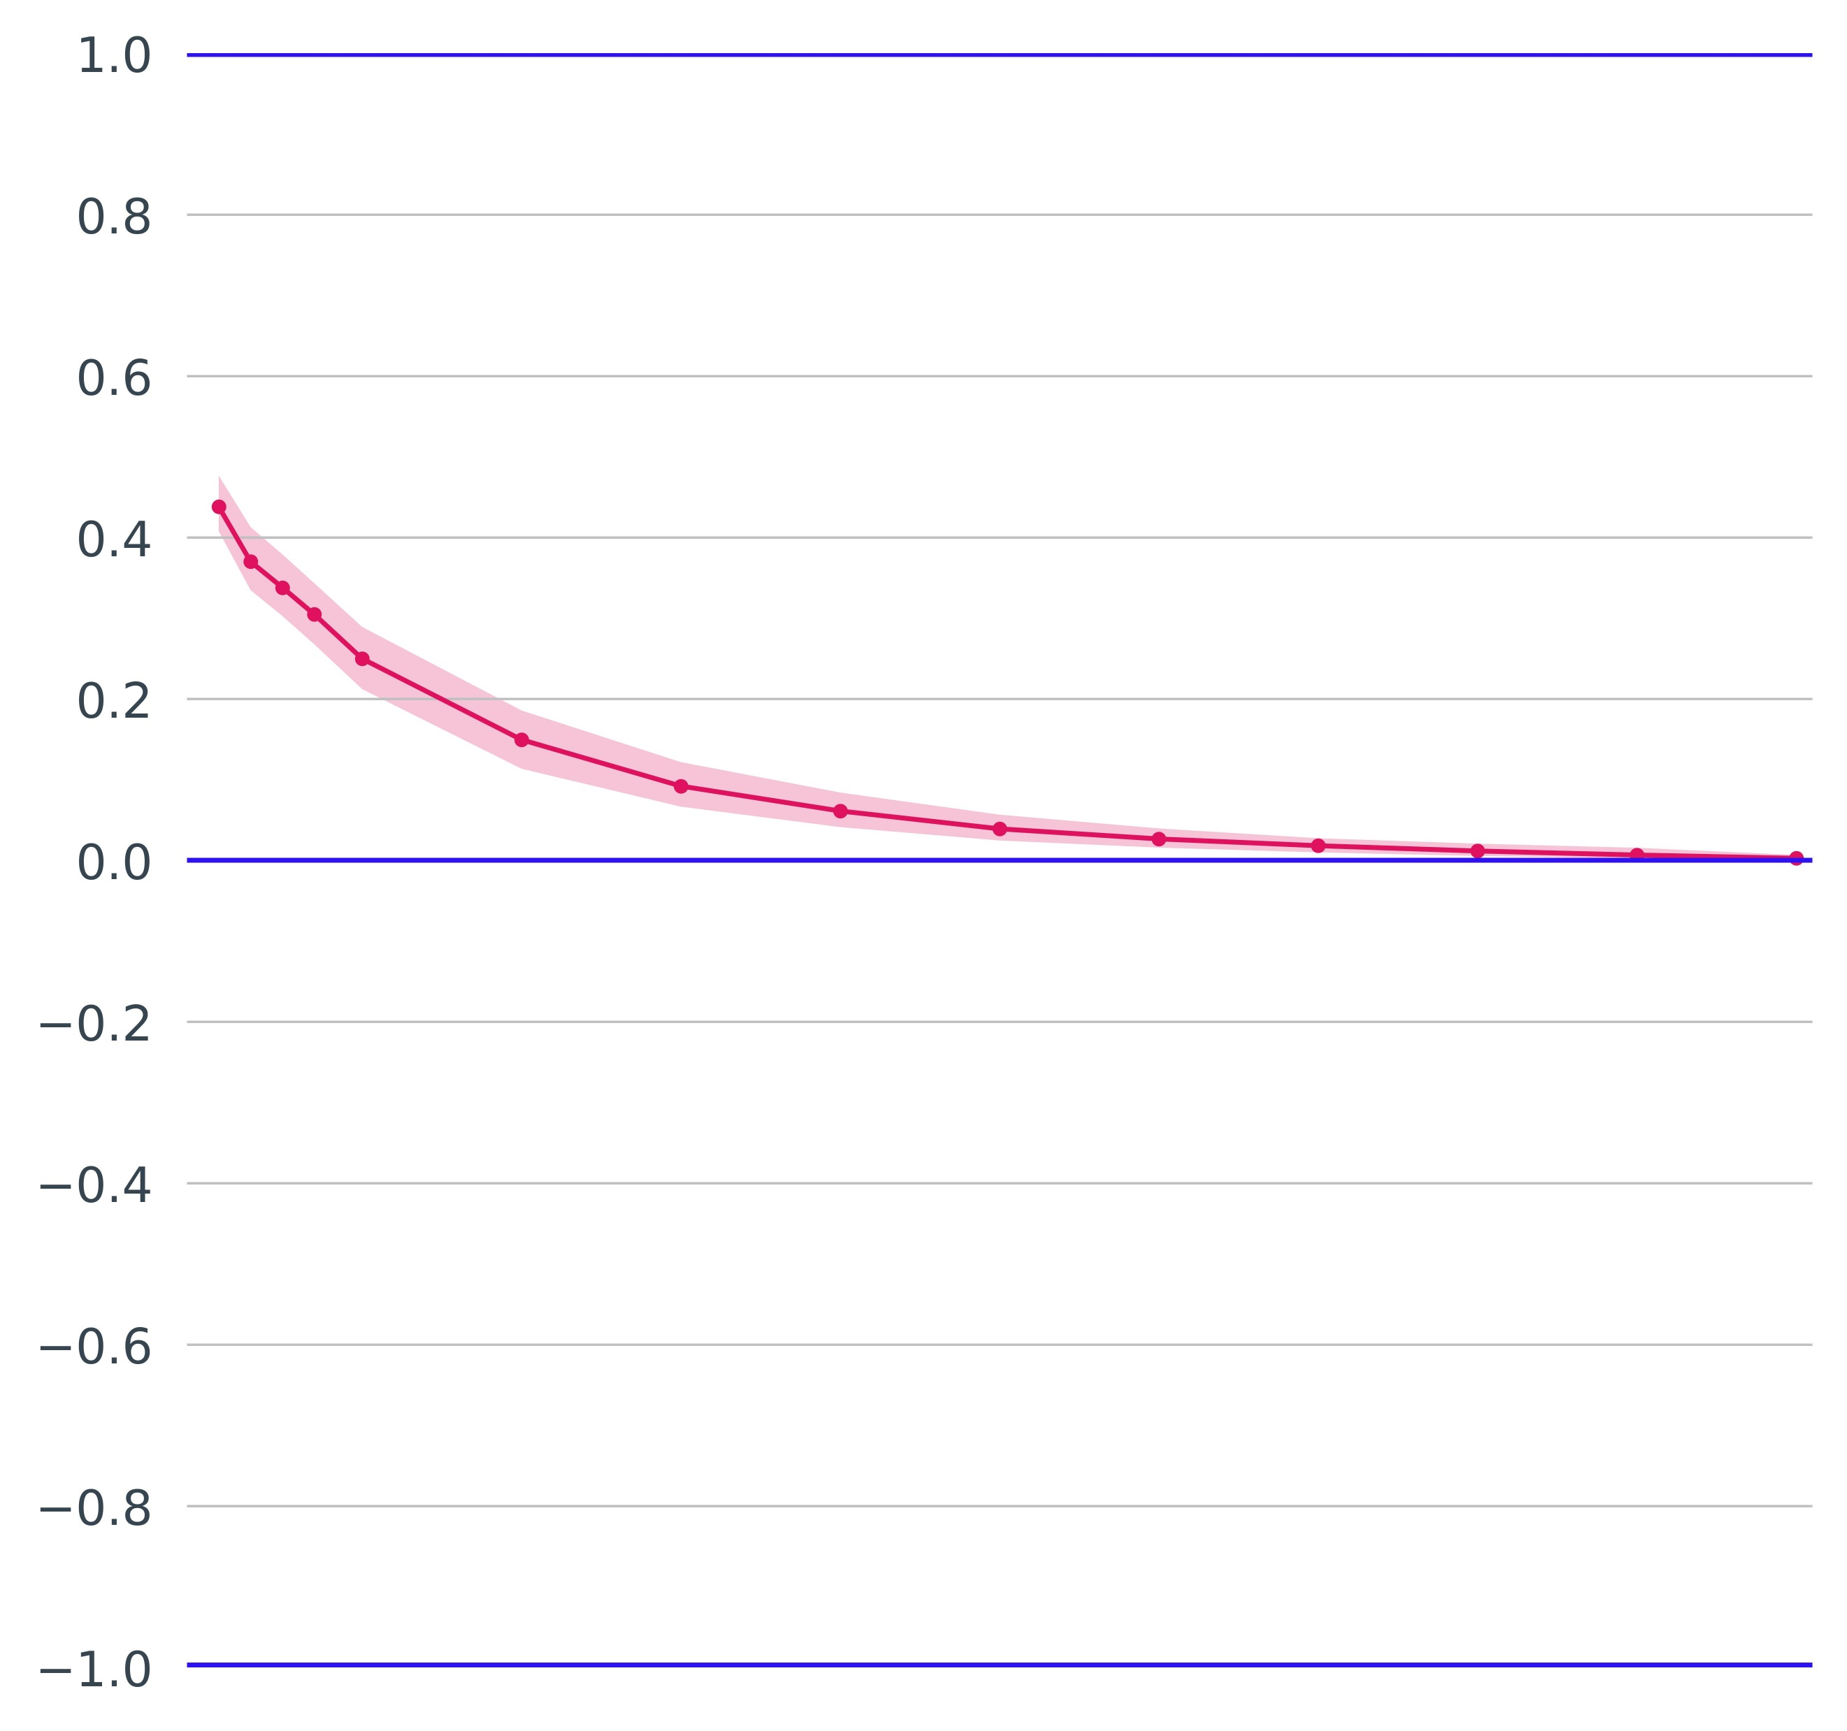
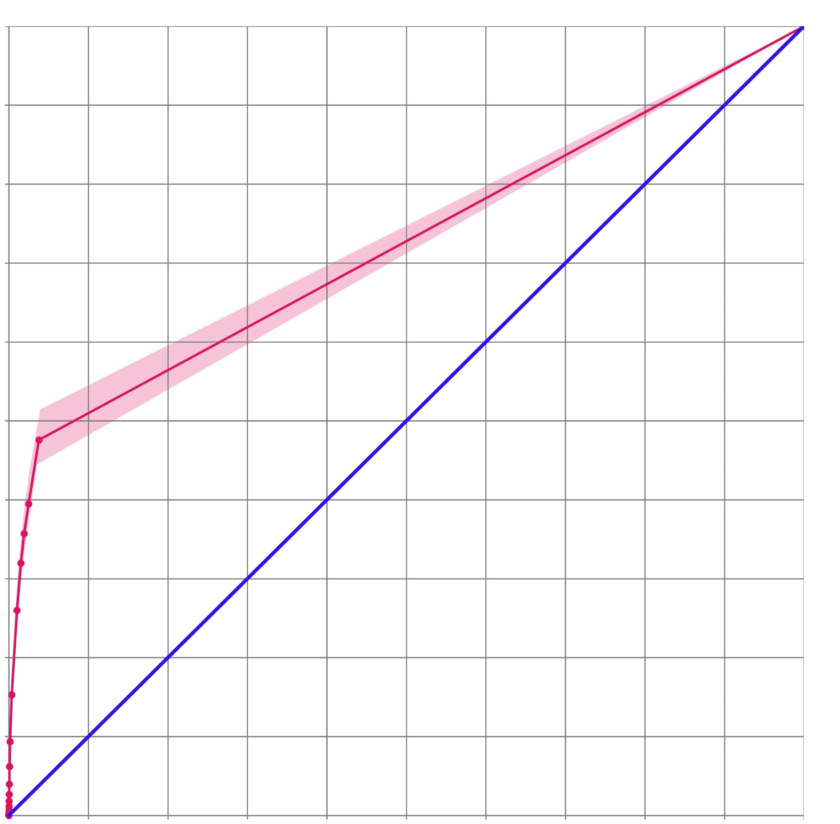
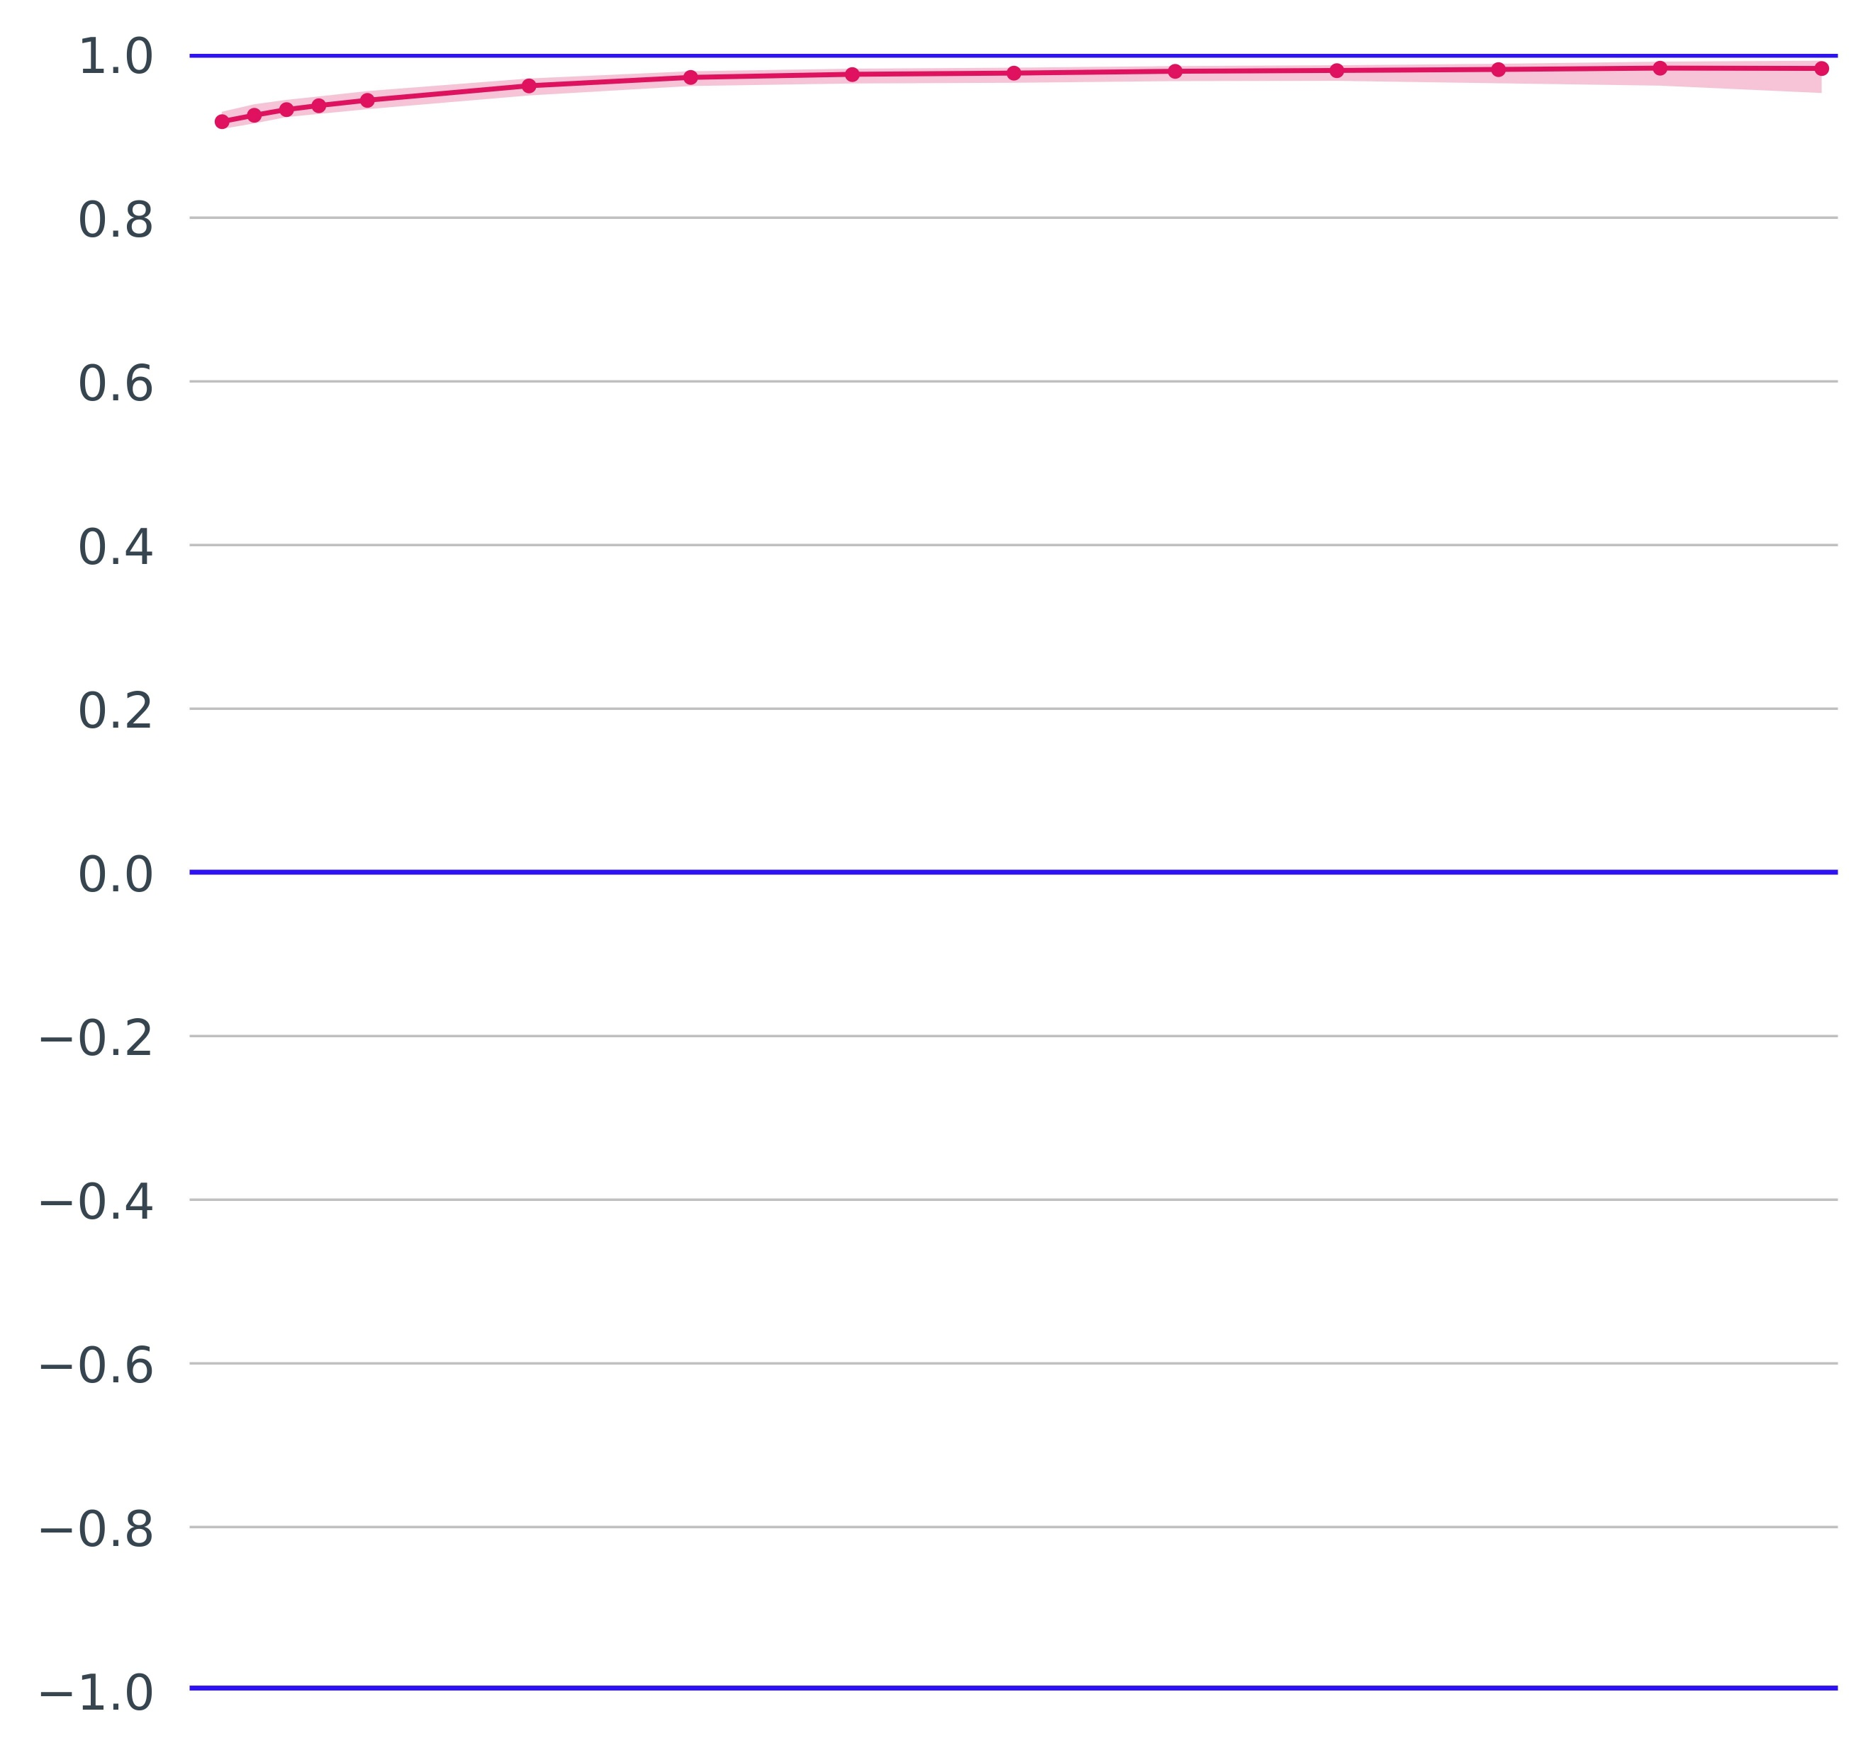
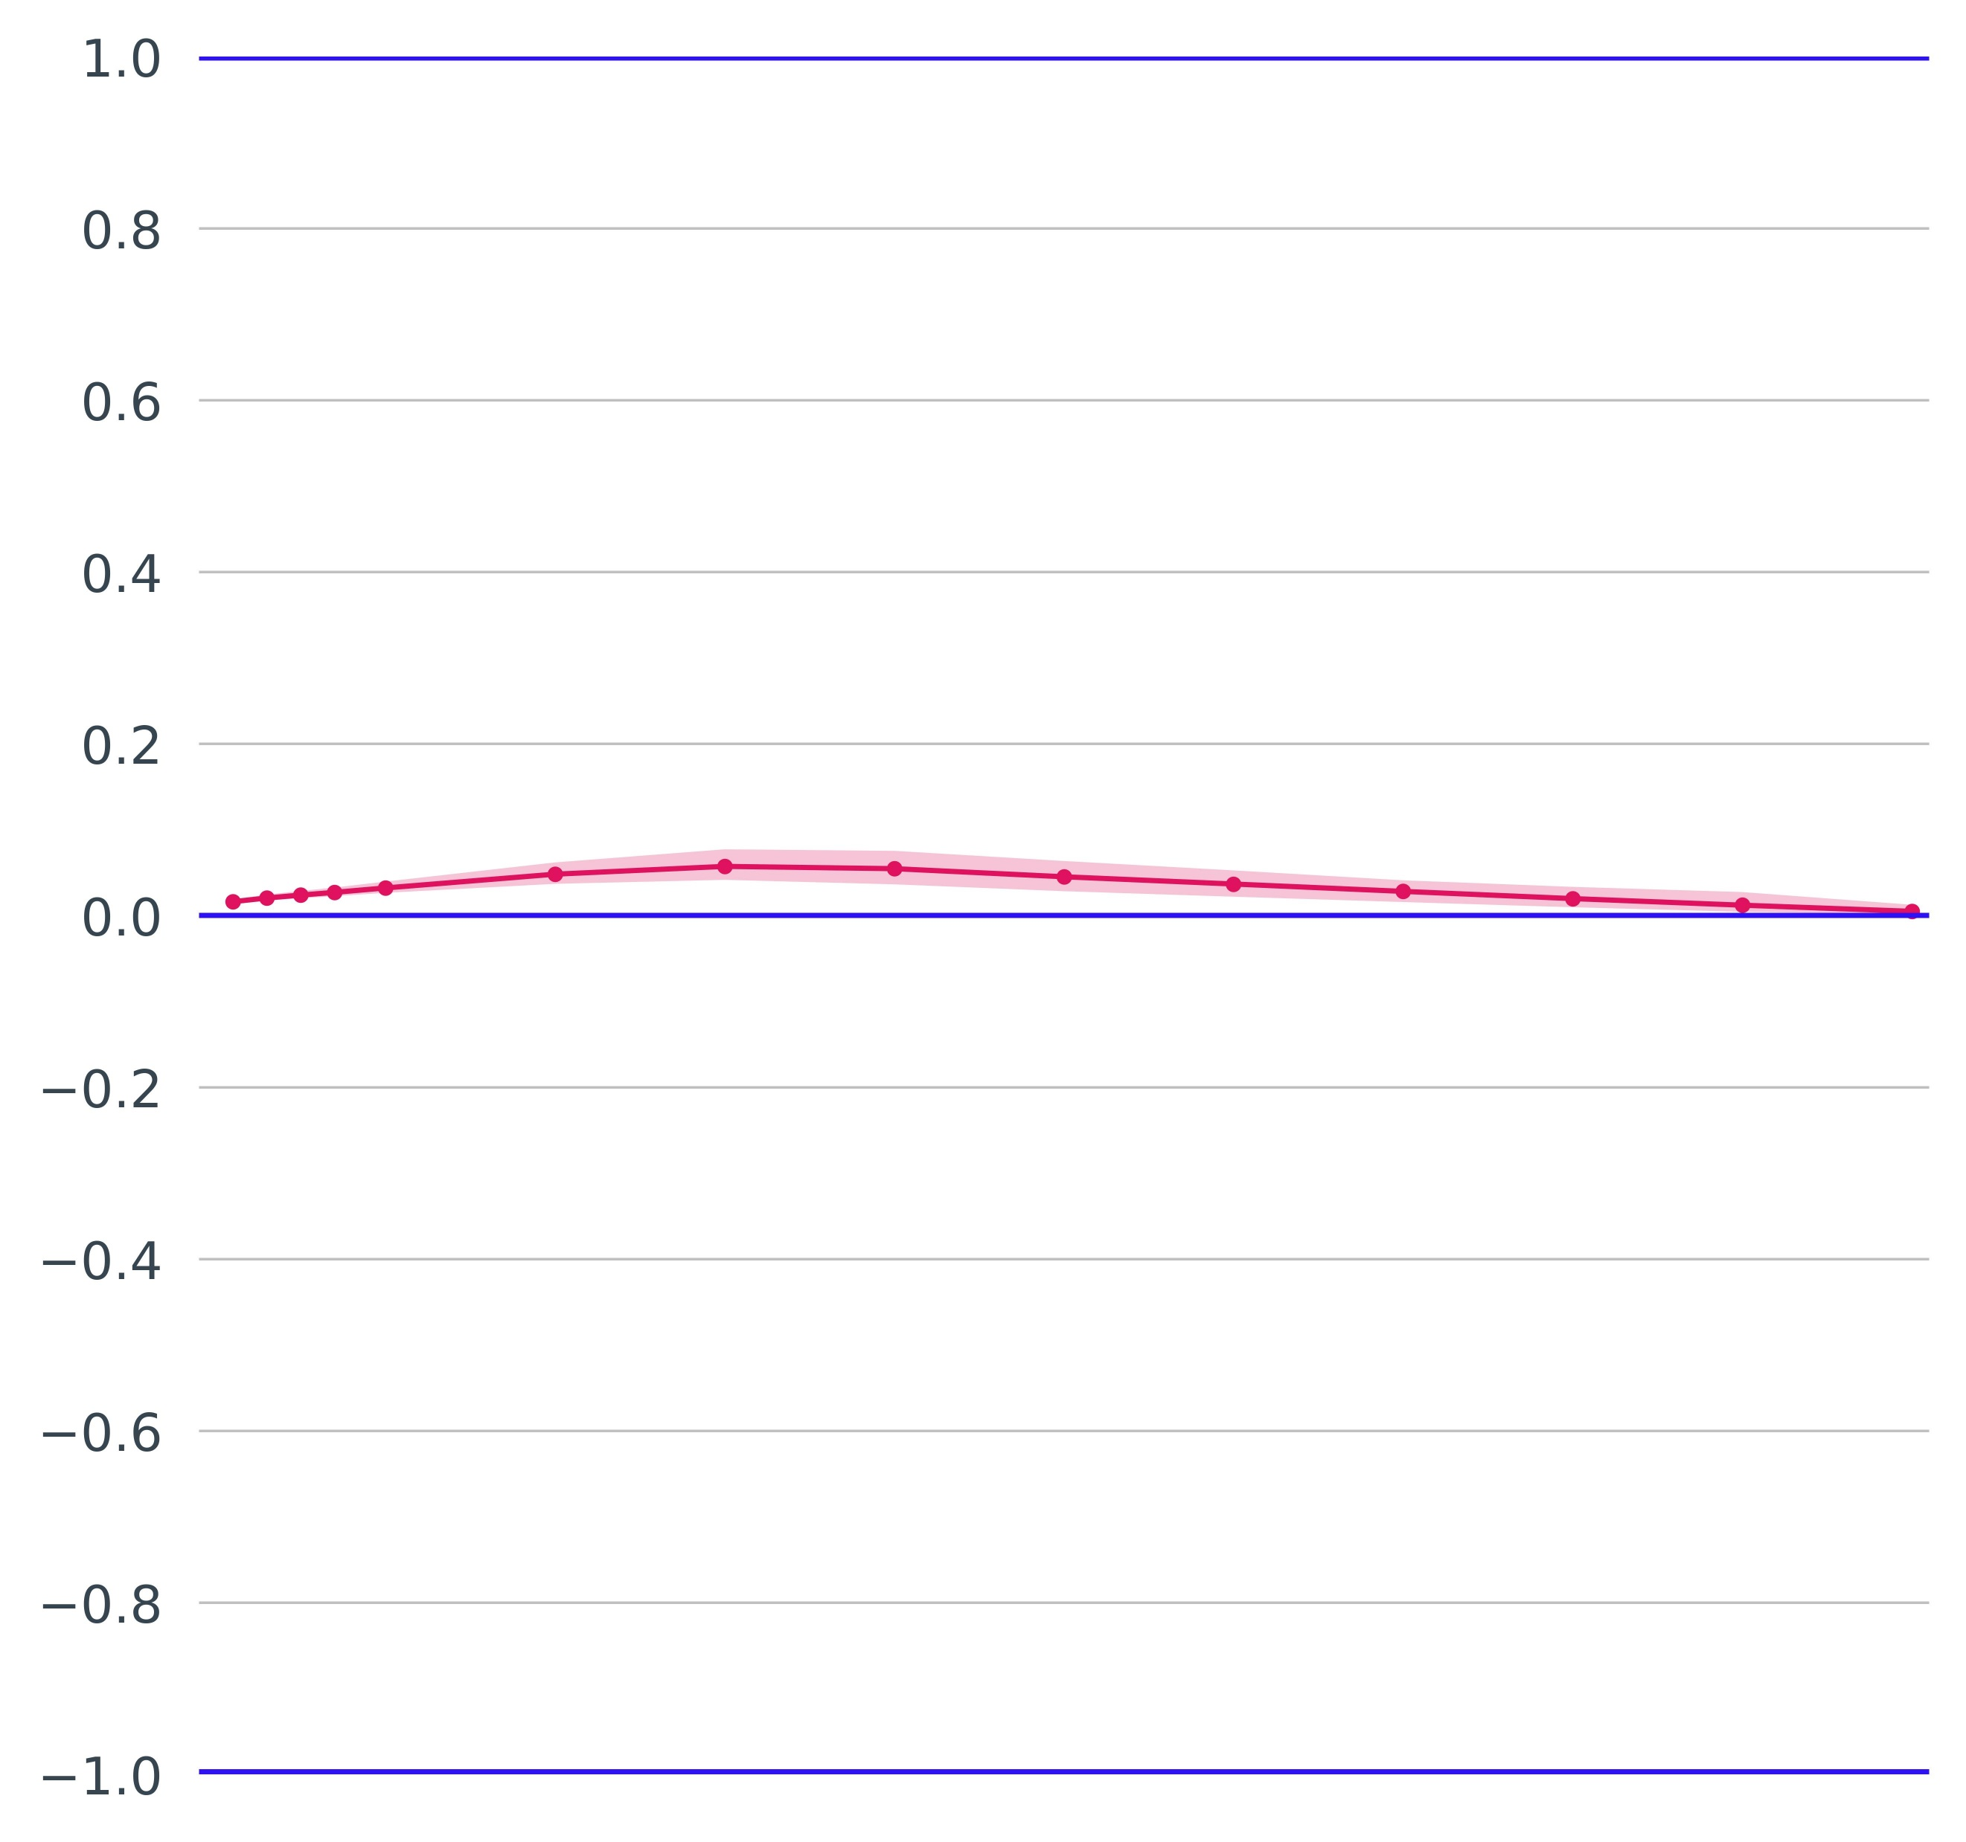
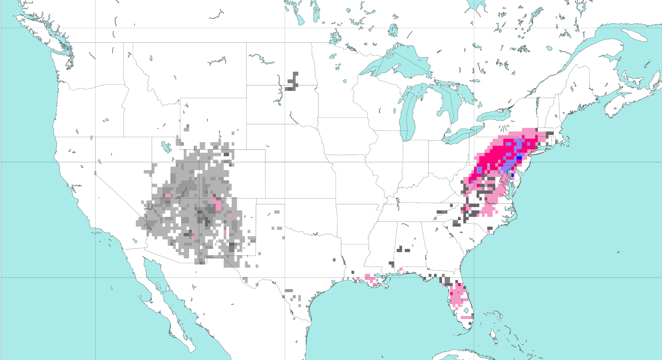
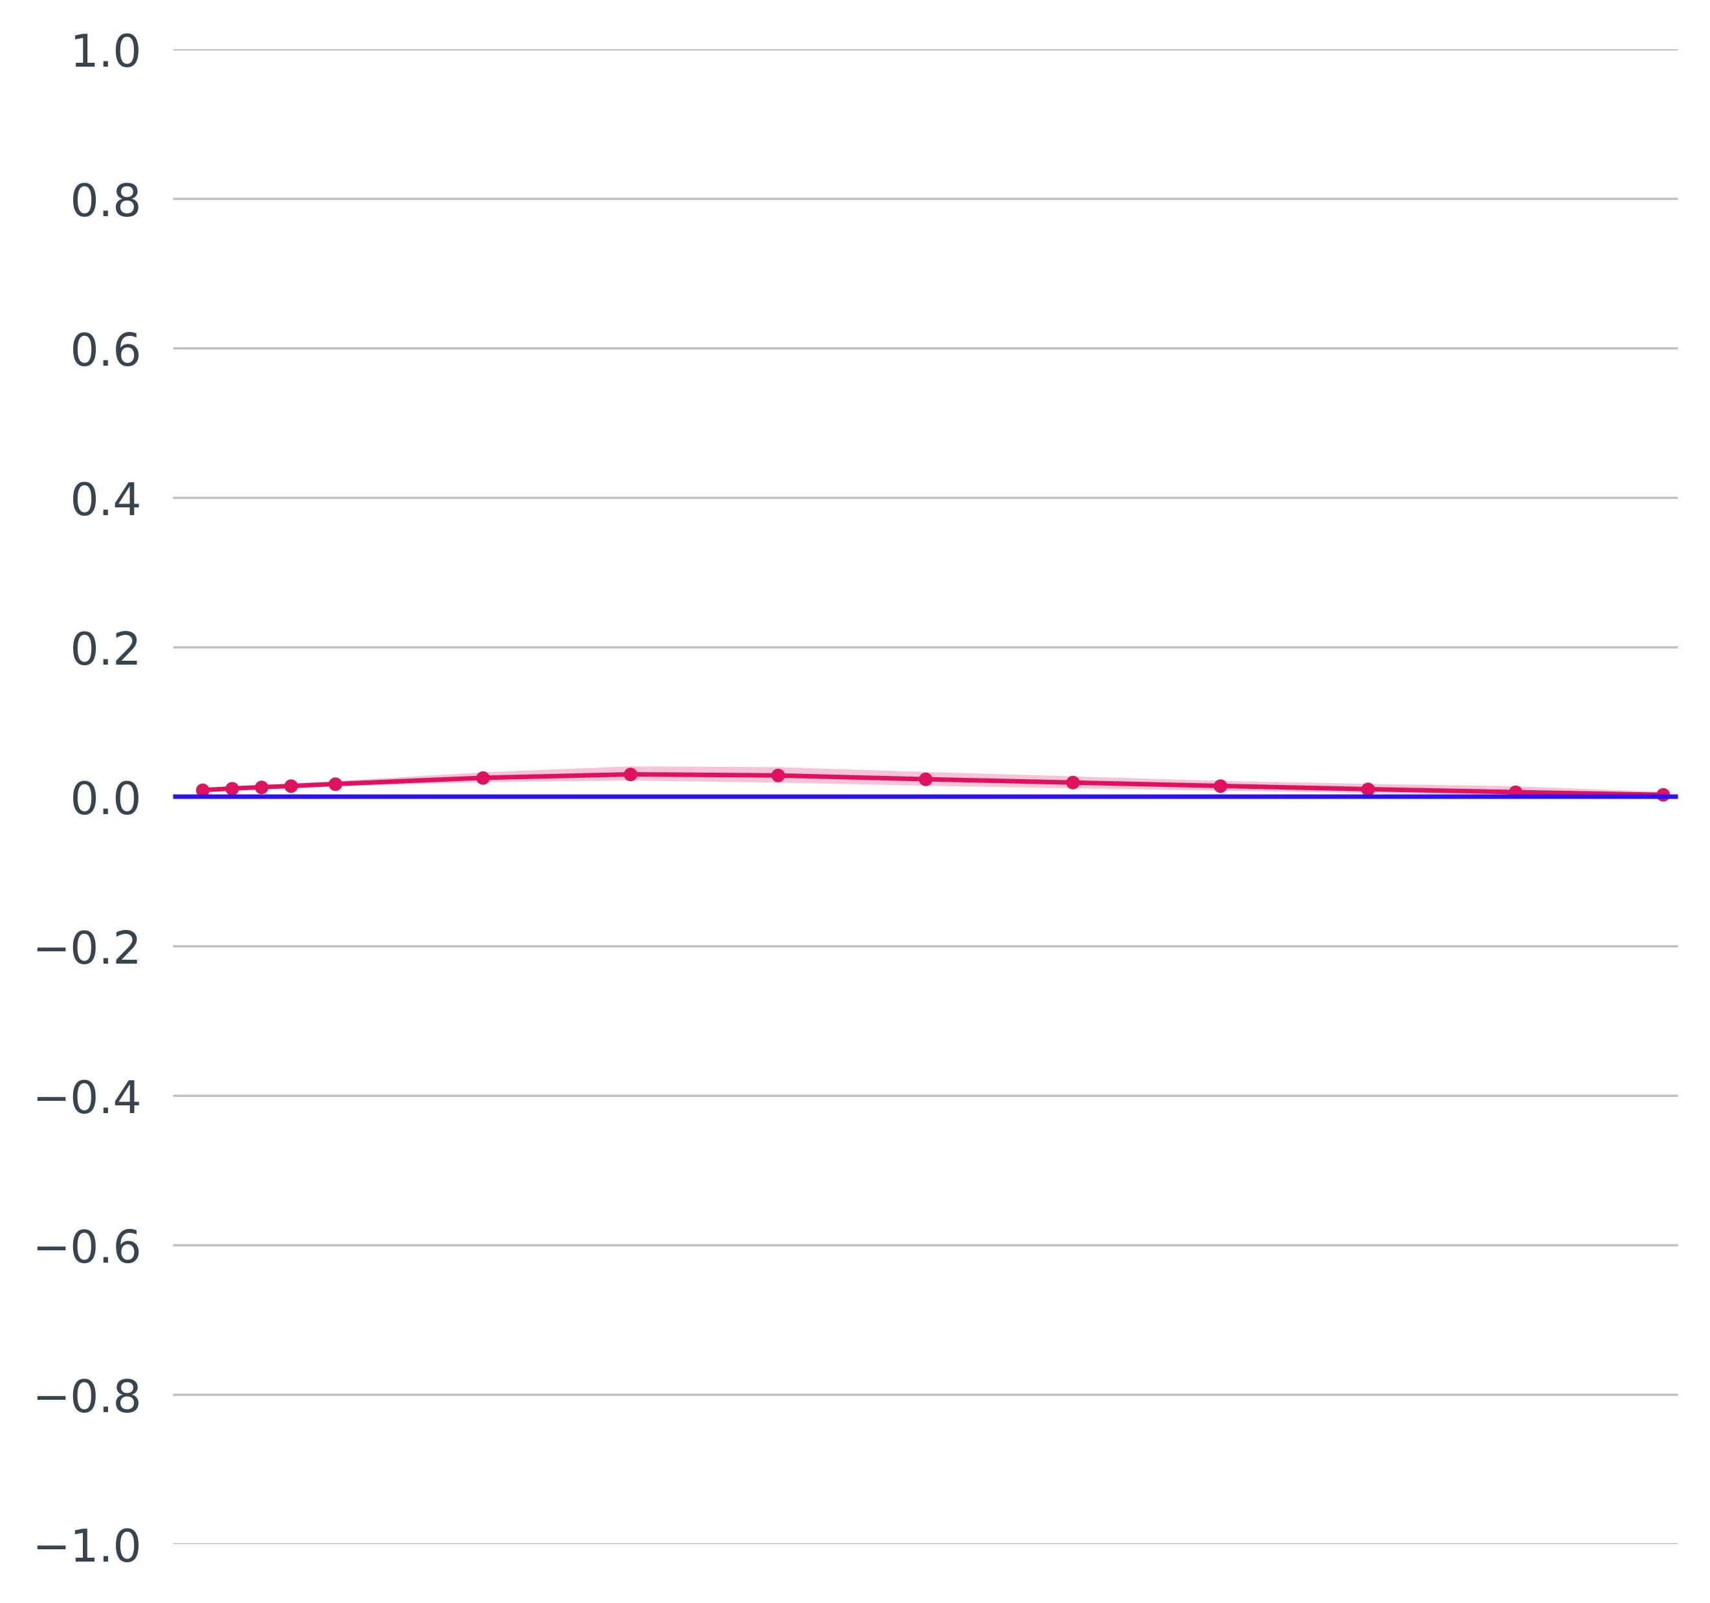

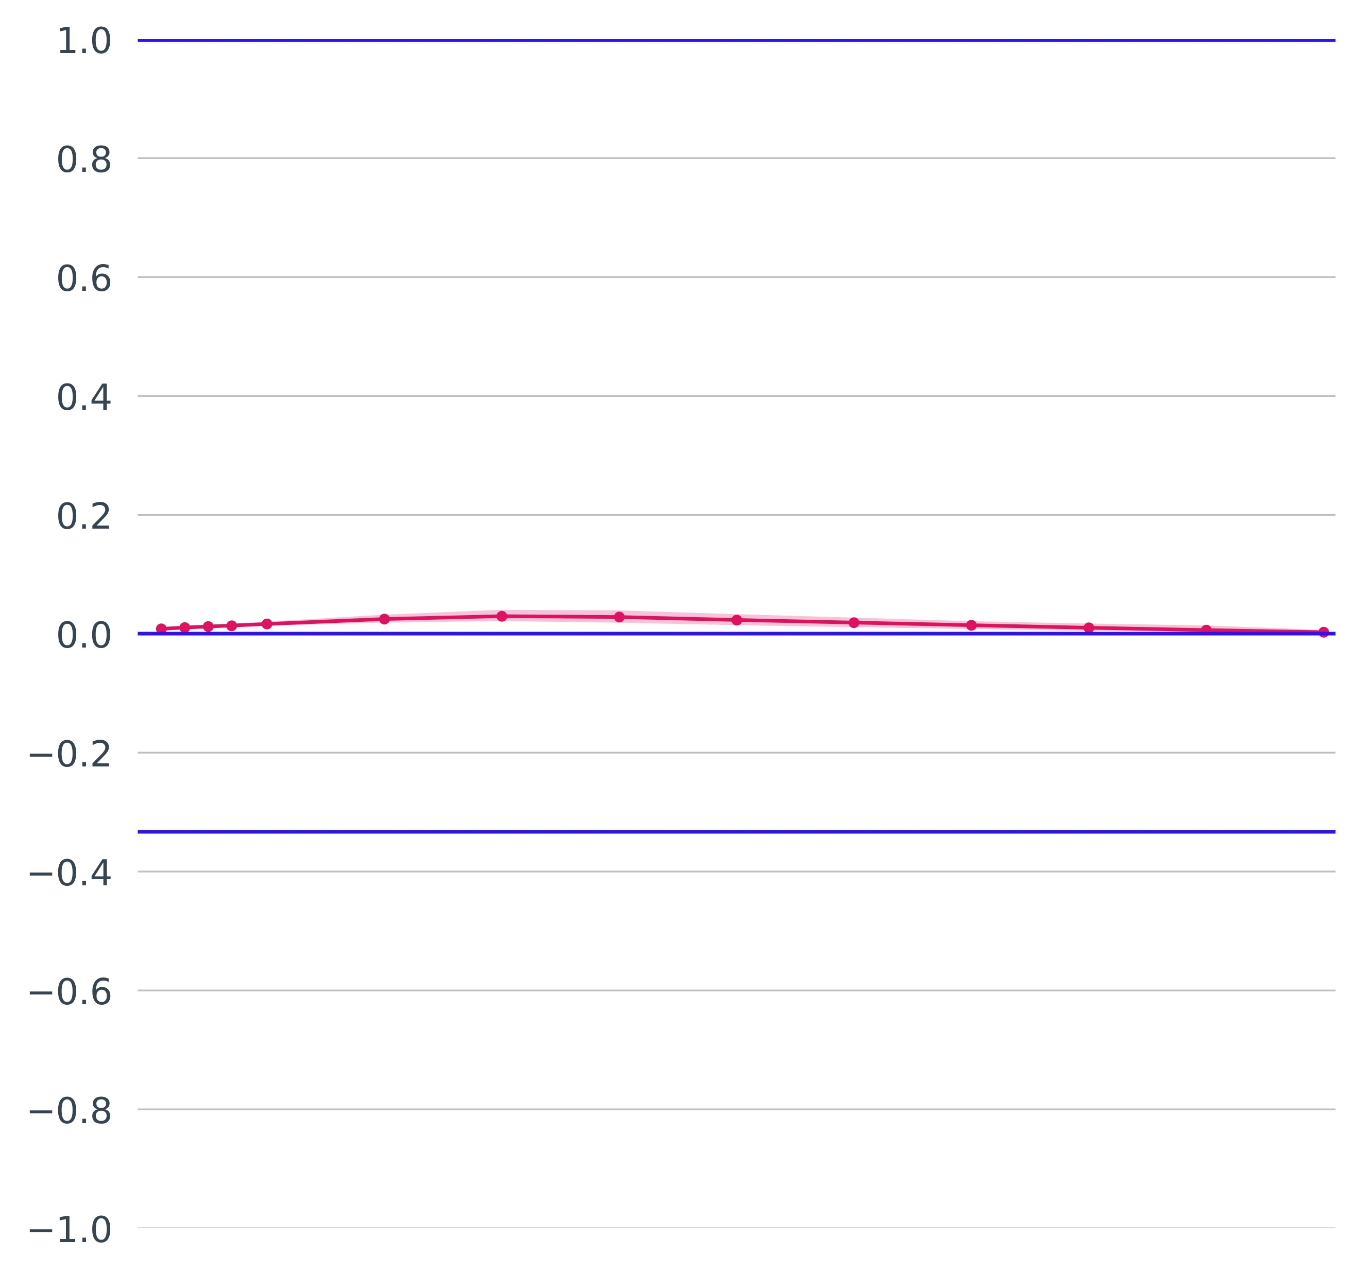
Objective verification for ANN’s outputs against SED flash flood reports, between 01-01-2021 and 31-12-2023
Different scores provide different flavours about the performance of the ANN’s outputs.
Frequency Bias (FB)
Odd’s Ratio (OR)
Pierce’s Skill Score (PSS)
60
Over-
estimation
a
250
c
1
PSS = 1, Upper bound (Perfect)
e
50
0.1%
0.8
200
0.6
40
0.4
0.3%
150
0.2
Better score
30
0.5%
0
PSS = 0, No skill
20
0.7%
100
-0.2
Under-
estimation
50
-0.4
10
FB = 1,
Perfect
-0.6
0
OR = 1, No skill
-0.8
0
FB = 0, Lower bound
OR = 0, Lower bound
-1
PSS = -1, Lower bound
0.1
1
2
3
4
5
6
7
8
9
10
0.1
1
2
3
4
5
6
7
8
9
10
0.1
Probability thresholds [%]
Probability thresholds [%]
1
2
3
4
5
6
7
8
9
10
Probability thresholds [%]
ROC curve
Yule’s Q (YQ)
Heidke Skill Score (HSS)
1
1
YQ = 1, Upper bound
(Perfect)
1
HSS = 1, Upper bound (Perfect)
0.8
0.8
0.8
0.6
0.6
0.6
0.4
0.4
Hit rate [-]
0.2
0.2
No skill
0
0
0.4
0.1%
-0.2
YQ = 0, No skill
-0.2
HSS = 0, No skill
0.2
1%
-0.4
-0.4
3%
b
-0.6
d
-0.6
f
0
-0.8
-0.8
0
0.2
0.4
0.6
0.8
1
-1
YQ = -1, Lower bound
-1
HSS = -1, Lower bound
False alarm rate [-]
0.1
1
2
3
4
5
6
7
8
9
10
0.1
Probability thresholds [%]
1
2
3
4
5
6
7
8
9
10
Map plot for the probabilities [%] of having a flash flood event in a grid-box
VT: 01-09-2021 12 UTC to 02-09-2021 00 UTC
Probability thresholds [%]
Critical Success Index (CSI)
%
1
CSI = 1, Upper bound (Perfect)
50 °N
100
0.8
10
0.6
7
0.4
5
0.2
40 °N
3
0
CSI = 0, Lower bound (No skill)
1
-0.2
0.7
-0.4
30 °N
0.5
-0.6
0.3
-0.8
g
i
0.1
-1
0.1
120 °W
100 °W
80 °W
0
1
2
3
4
5
6
7
8
9
10
Probability thresholds [%]
Map plot for the probabilities [%] of having a flash flood event in a grid-box
VT: 01-09-2021 12 UTC to 02-09-2021 00 UTC
Equitable Threat Score (ETS)
%
1
ETS = 1, Upper bound (Perfect)
50 °N
100
0.8
10
0.6
7
0.4
5
0.2
40 °N
3
0
ETS = 0, No skill
1
-0.2
0.7
-0.4
ETS = -1/3, Lower bound
0.5
-0.6
30 °N
0.3
-0.8
h
j
0.1
-1
0.1
0
1
2
3
4
5
6
7
8
9
10
120 °W
100 °W
80 °W
Probability thresholds [%]

