Slide 1
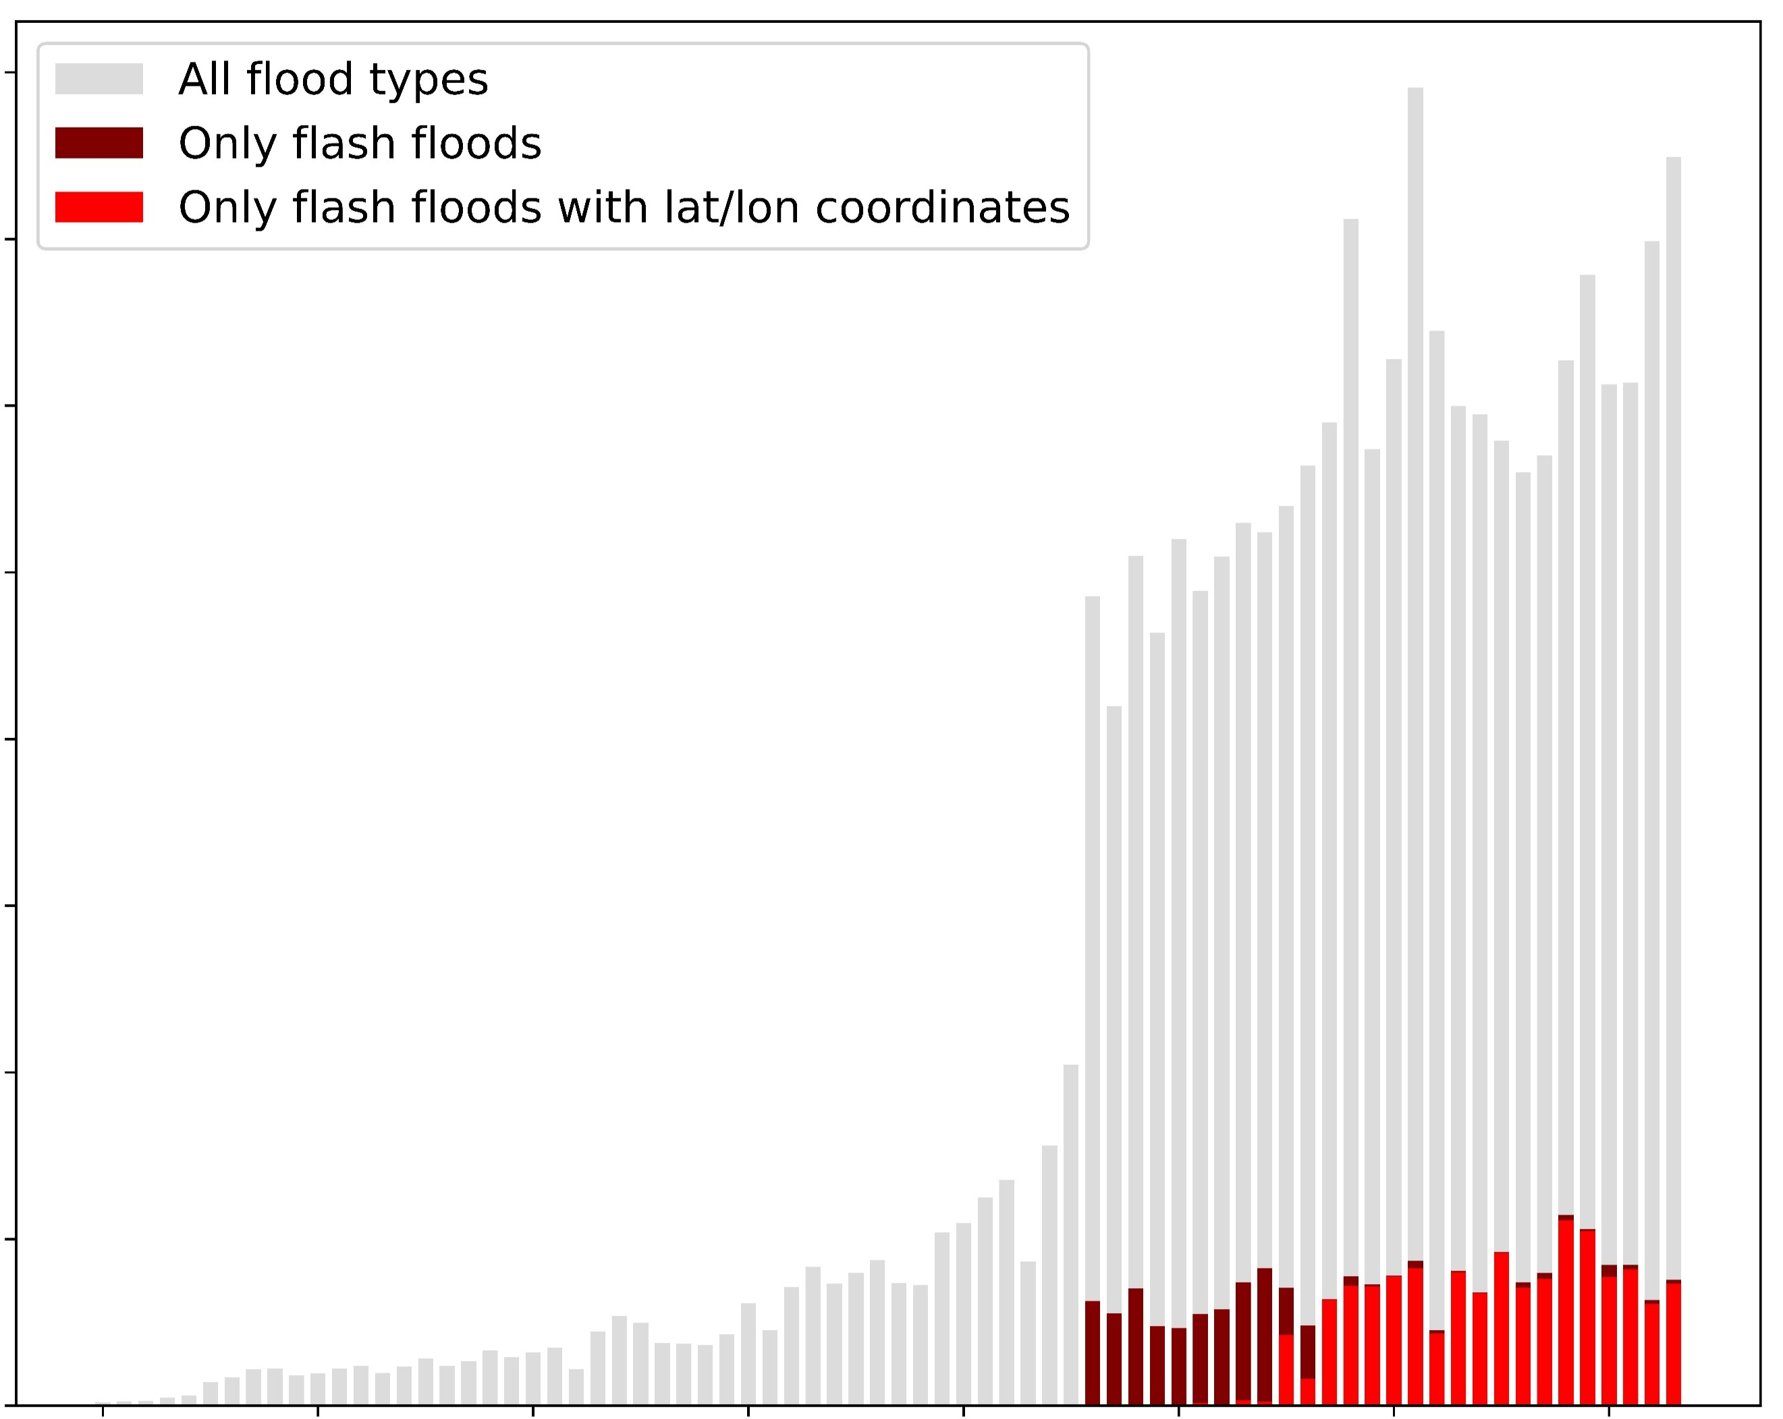
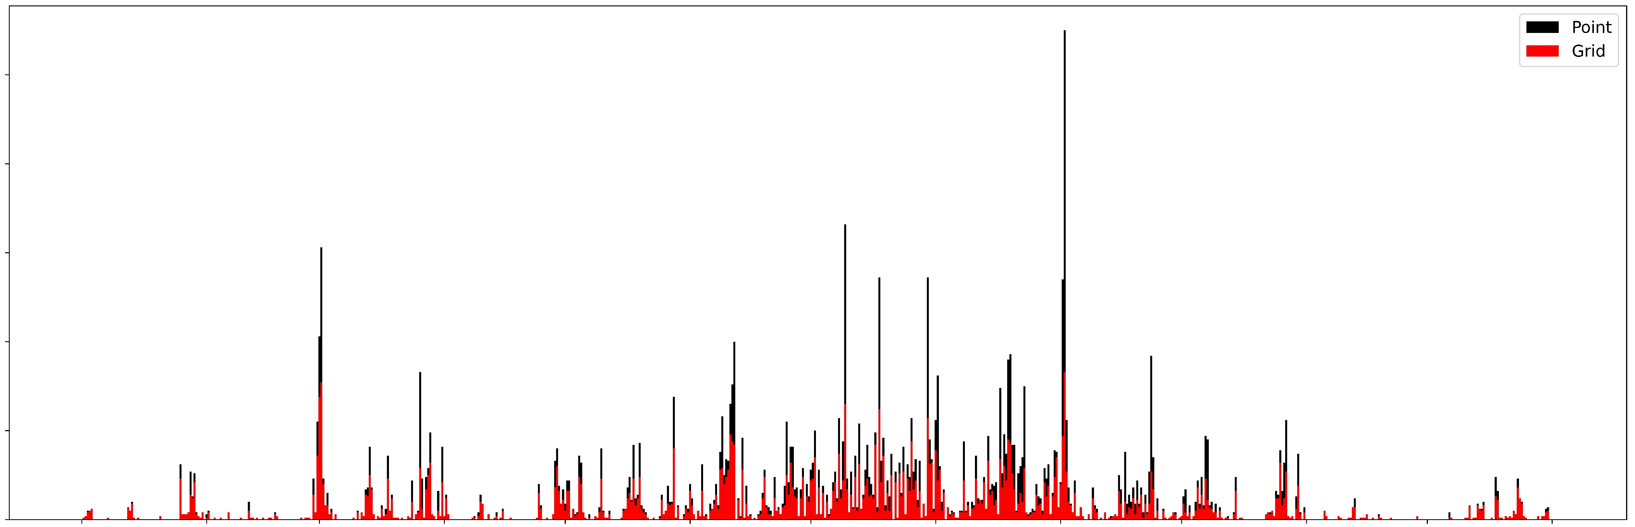
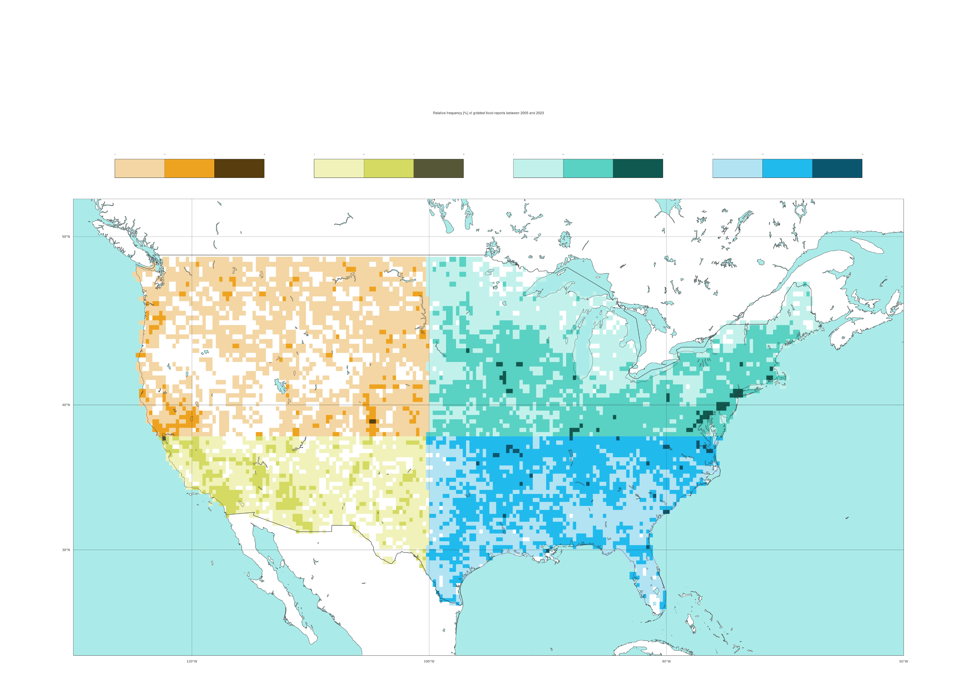
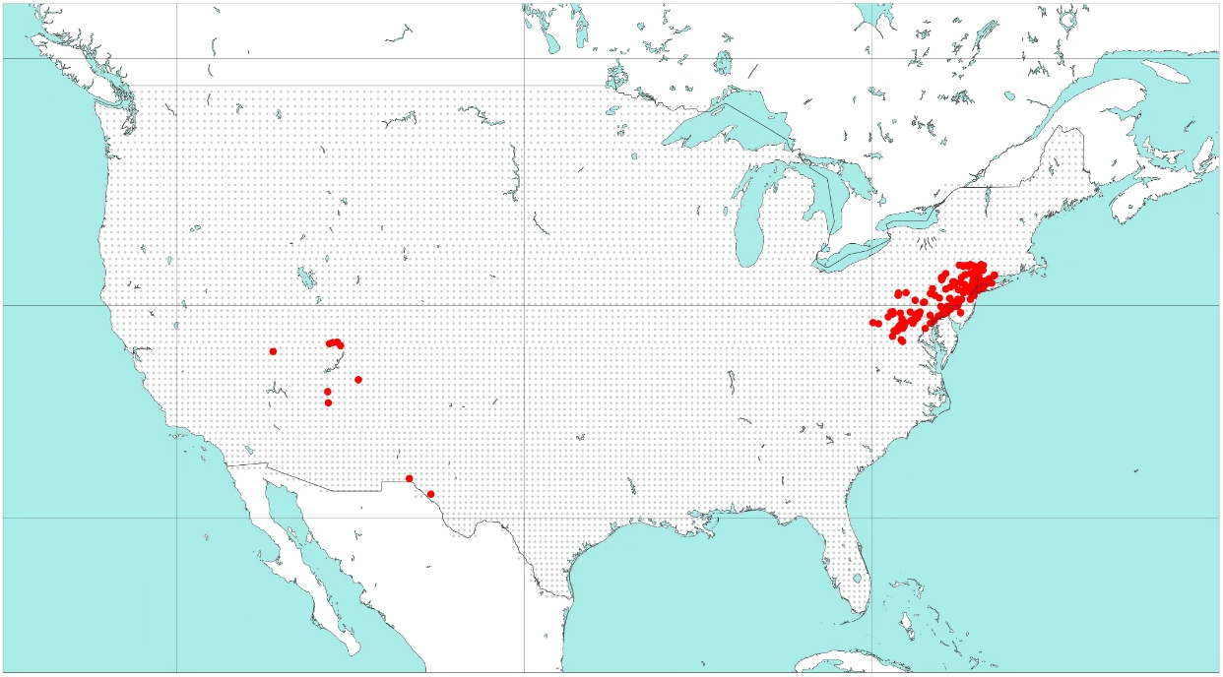
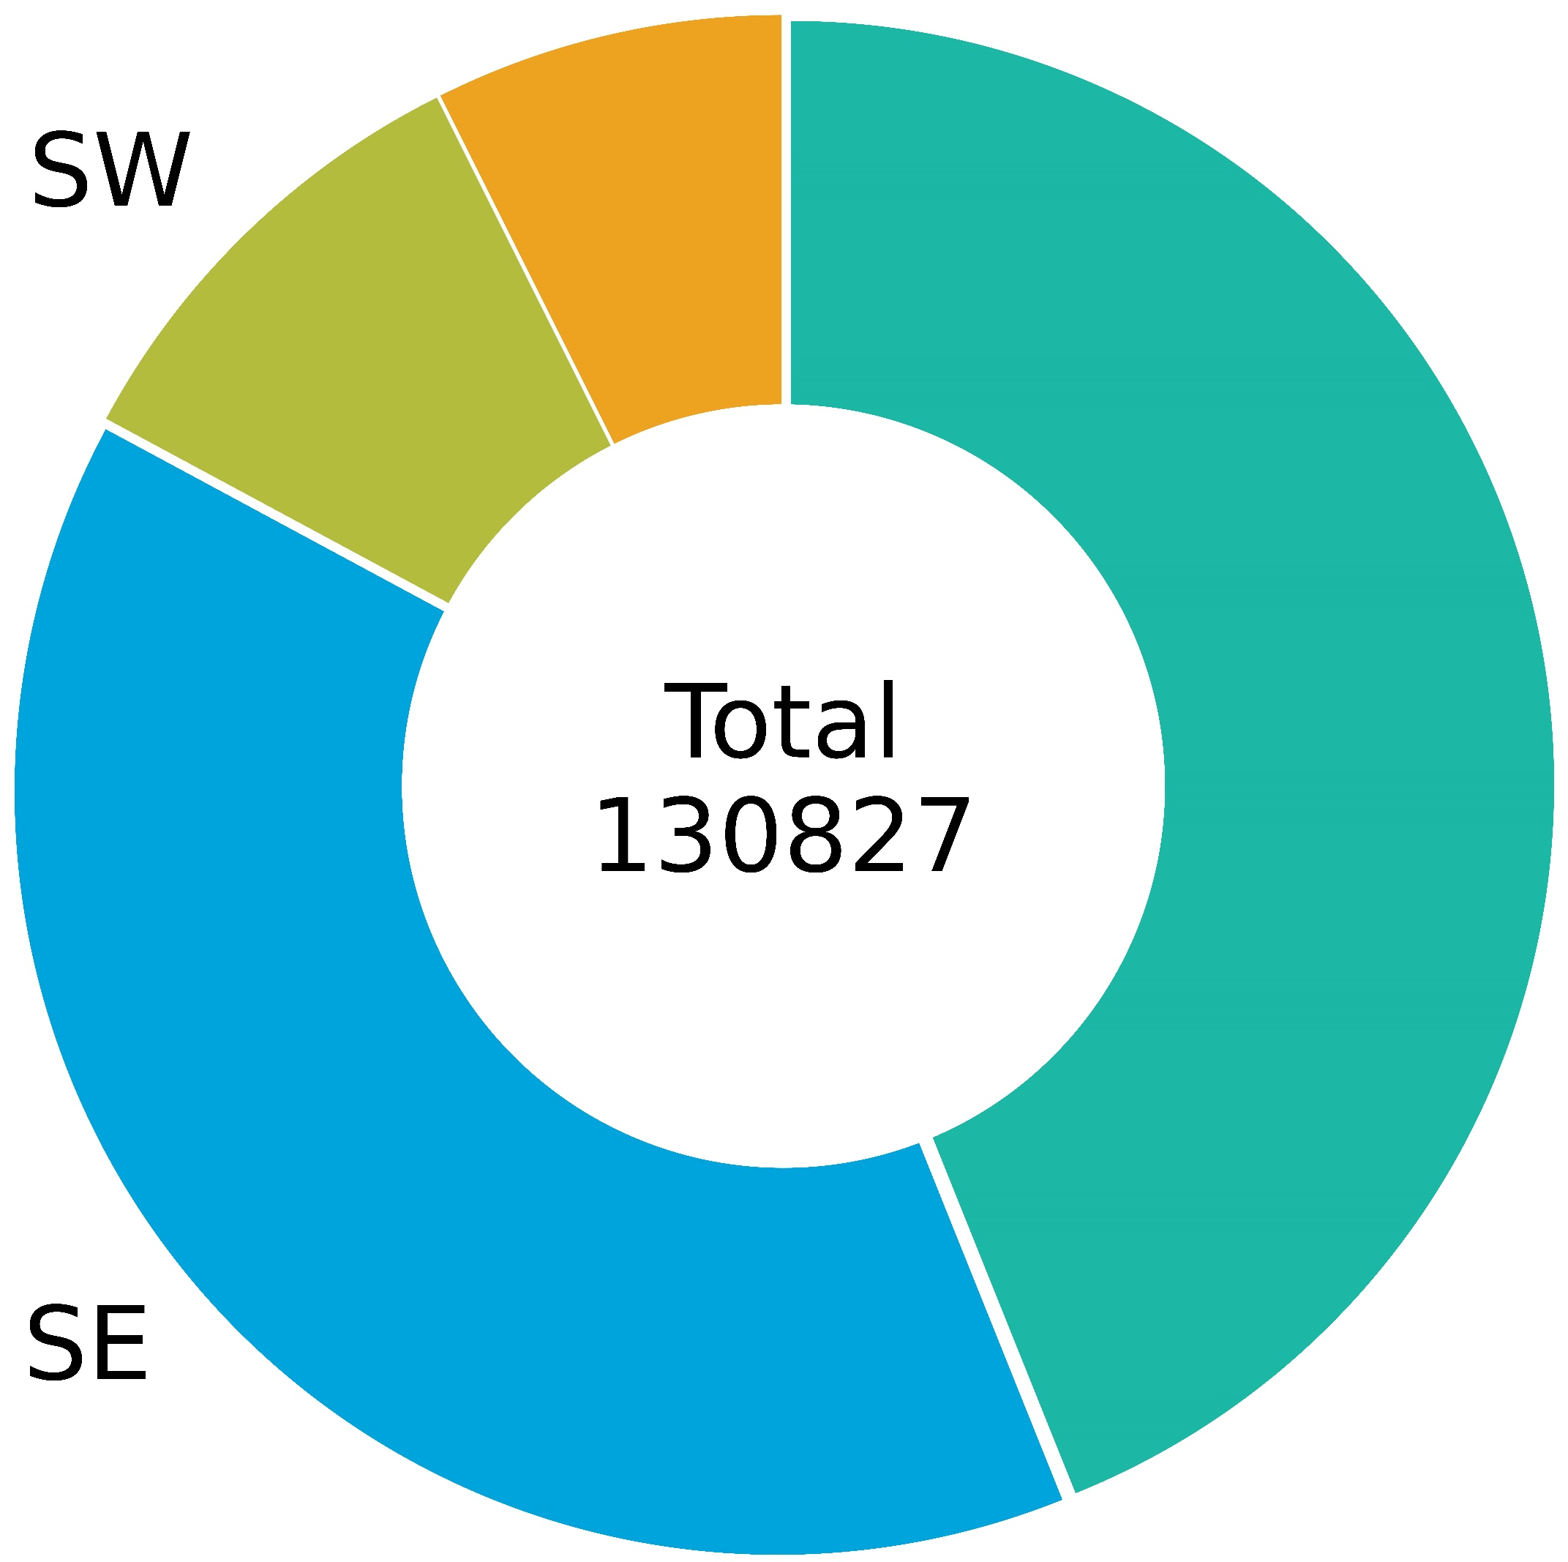
Timeseries of flood reports in NOAA’s Severe Event Database
Distinction between all flood types and flash floods (with and without spatial coordinates)
Timeseries of flash flood reports in 2021, accumulated over 12-hourly periods ending at 00 and 12 UTC
Distinction between point and gridded flash flood reports
8
Point
7
All flood types
250
Only flash floods
Gridded
End 12-hourly accumulation period 2021/09/02 at 00 UTC
6
Only flash floods
with lat/lon coord.
200
5
2021
150
Counts * 10⁴
Counts
4
3
100
2
50
1
0
1950
1960
1970
1980
1990
2000
2010
2020
0
Years
2021-01
2021-02
2021-03
2021-04
2021-05
2021-06
2021-07
2021-08
2021-09
2021-10
2021-11
2021-12
2022-01
Spatial distribution of the observed frequency of flash flood events in each grid-box
Distinction between 4 geographical areas: South-West (SW), North-West (NW), North-East (NE), South-East (SE)
0
%
%
%
%
0.1
1
10
0
0.1
1
10
0
0.1
1
10
0
0.1
1
10
Spatial distribution of gridded flash flood reports during the Ida storm
12-hourly accumulation period ending on 2021-09-02 at 00 UTC
North-West, NW
South-West, SW
North-East, NE
South-East, SE
120 °W
100 °W
80 °W
120 °W
100 °W
80 °W
50 °N
50 °N
40 °N
40 °N
9%
11%
Total
130827
30 °N
30 °N
41%
39%

