Slide 1


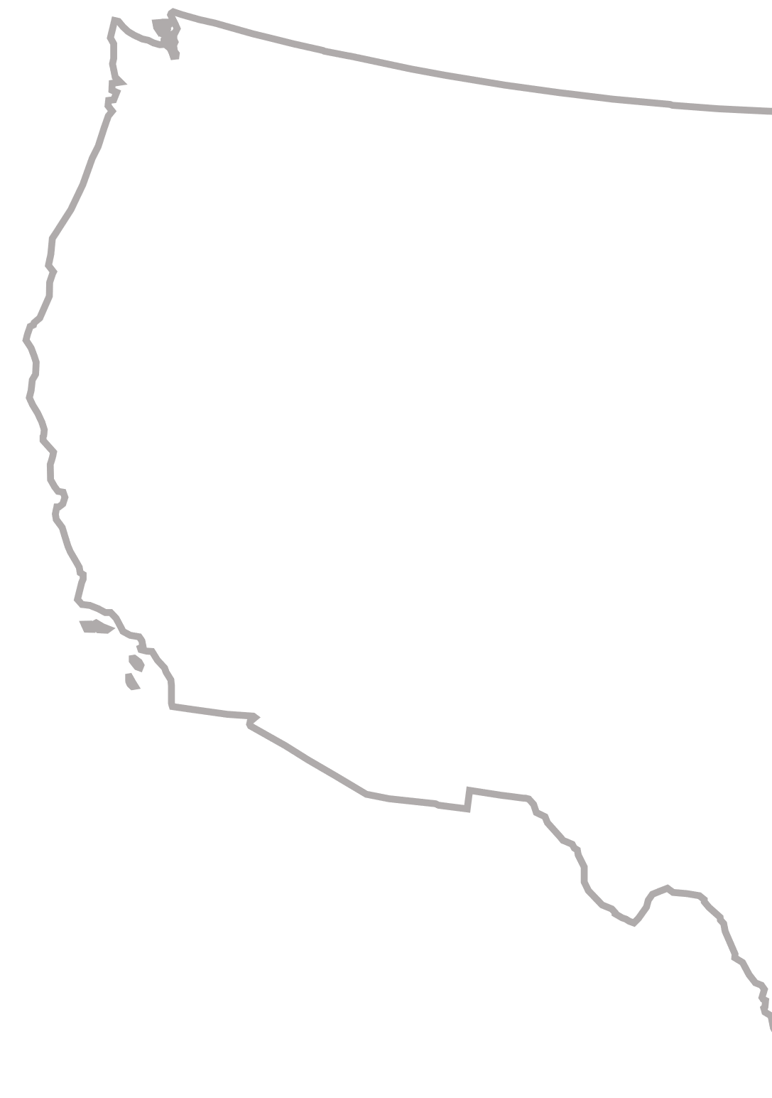

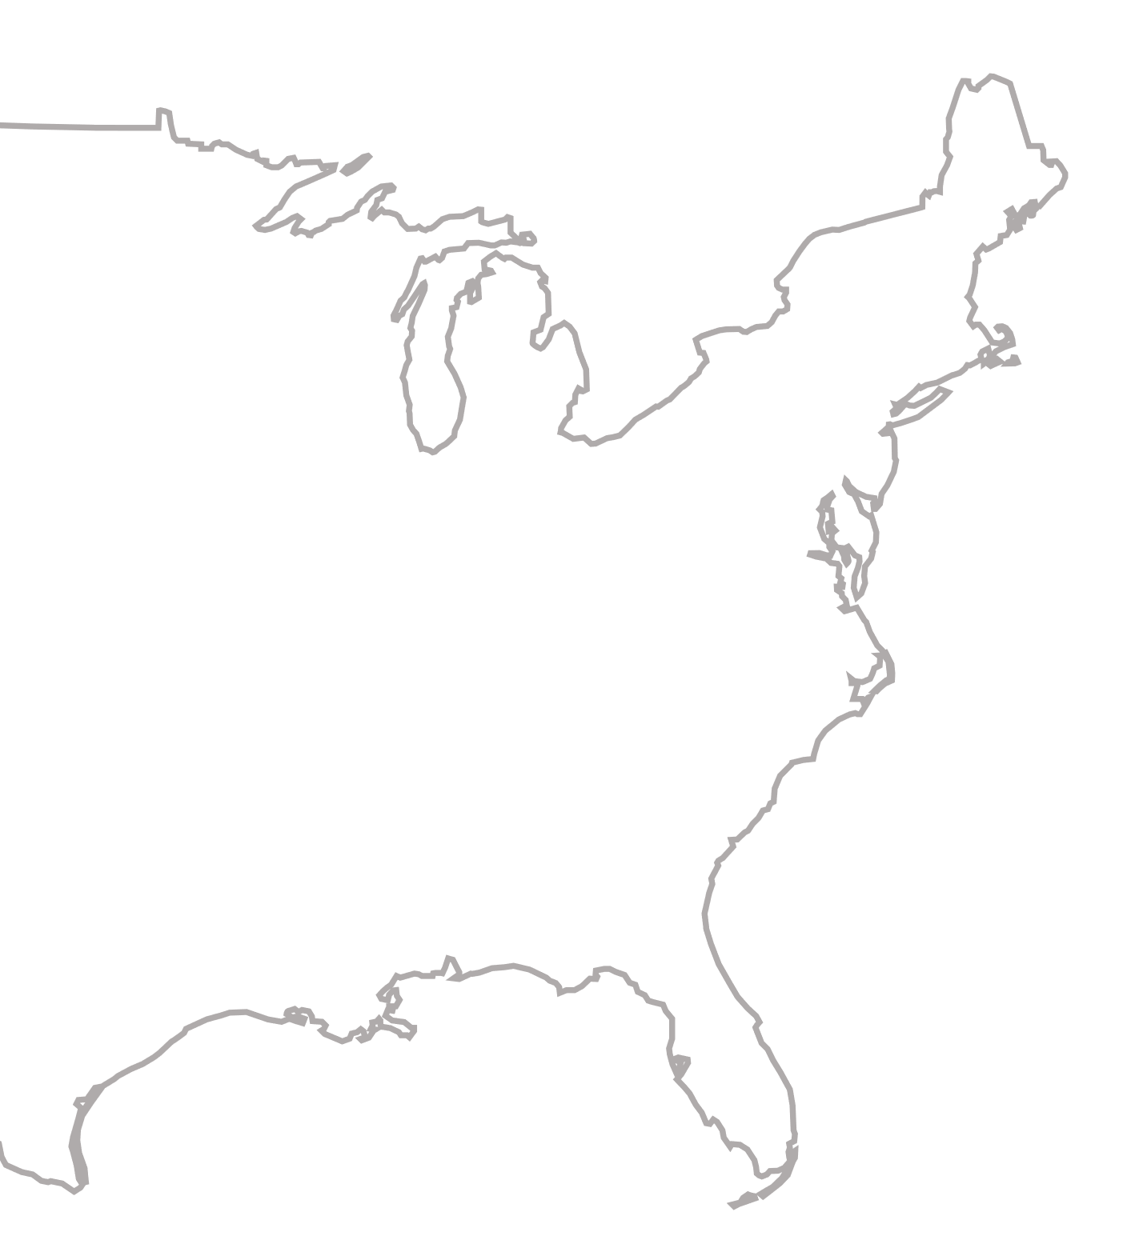









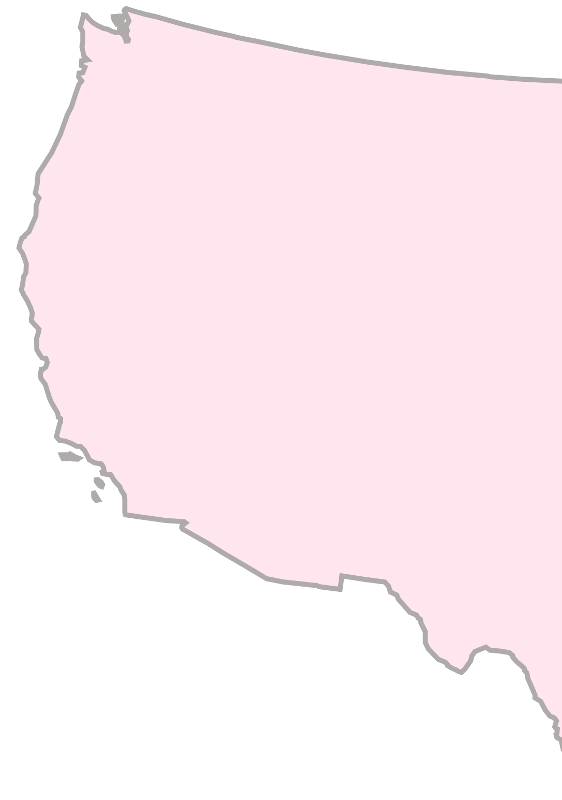
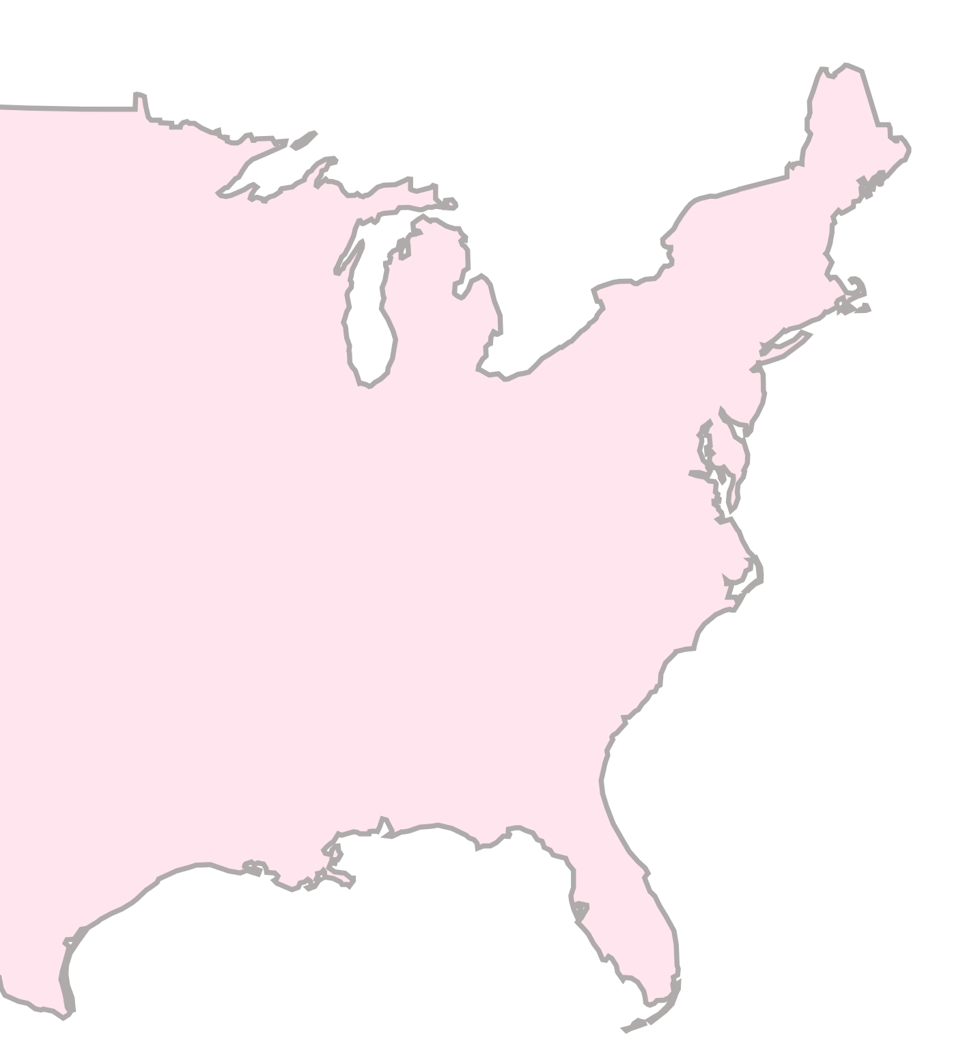







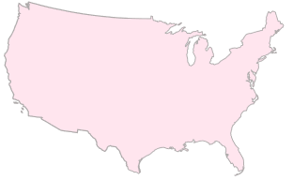



Generate a reanalysis dataset indicating the probabilities of having a flash flood event at each domain’s grid-box
From ERA5-ecPoint
- Return period class for extreme rainfall (99th percentile)
- Ratio between extreme-mean rainfall
Train an artificial neural network (ANN) using flash flood reports from Storm Event Database (SED)
Train period: 2005 to 2020
Predictors
From ERA5
- Percentage of soil saturation
- Leaf Area Index
- Standard deviation of the orography
Sensitivity Analysis n.1
Assess how the ANN’s accuracy is sensitive to having sparse and scarce flood reports in the training phase.
This was simulated by randomly reducing the flood reports by 10%, 20%, ….., and 90% on each day of the training dataset.
Test reanalysis quality against SED flash flood reports
Verification period: 2021
Test reanalysis impact on flash-flood-focused verification of rainfall forecasts
Verification period: 2022
Explain ANN outcomes using Shapley approach
Sensitivity analysis n.1
Assess ANN’s accuracy varies with sparse flash flood reports.

