Slide 1
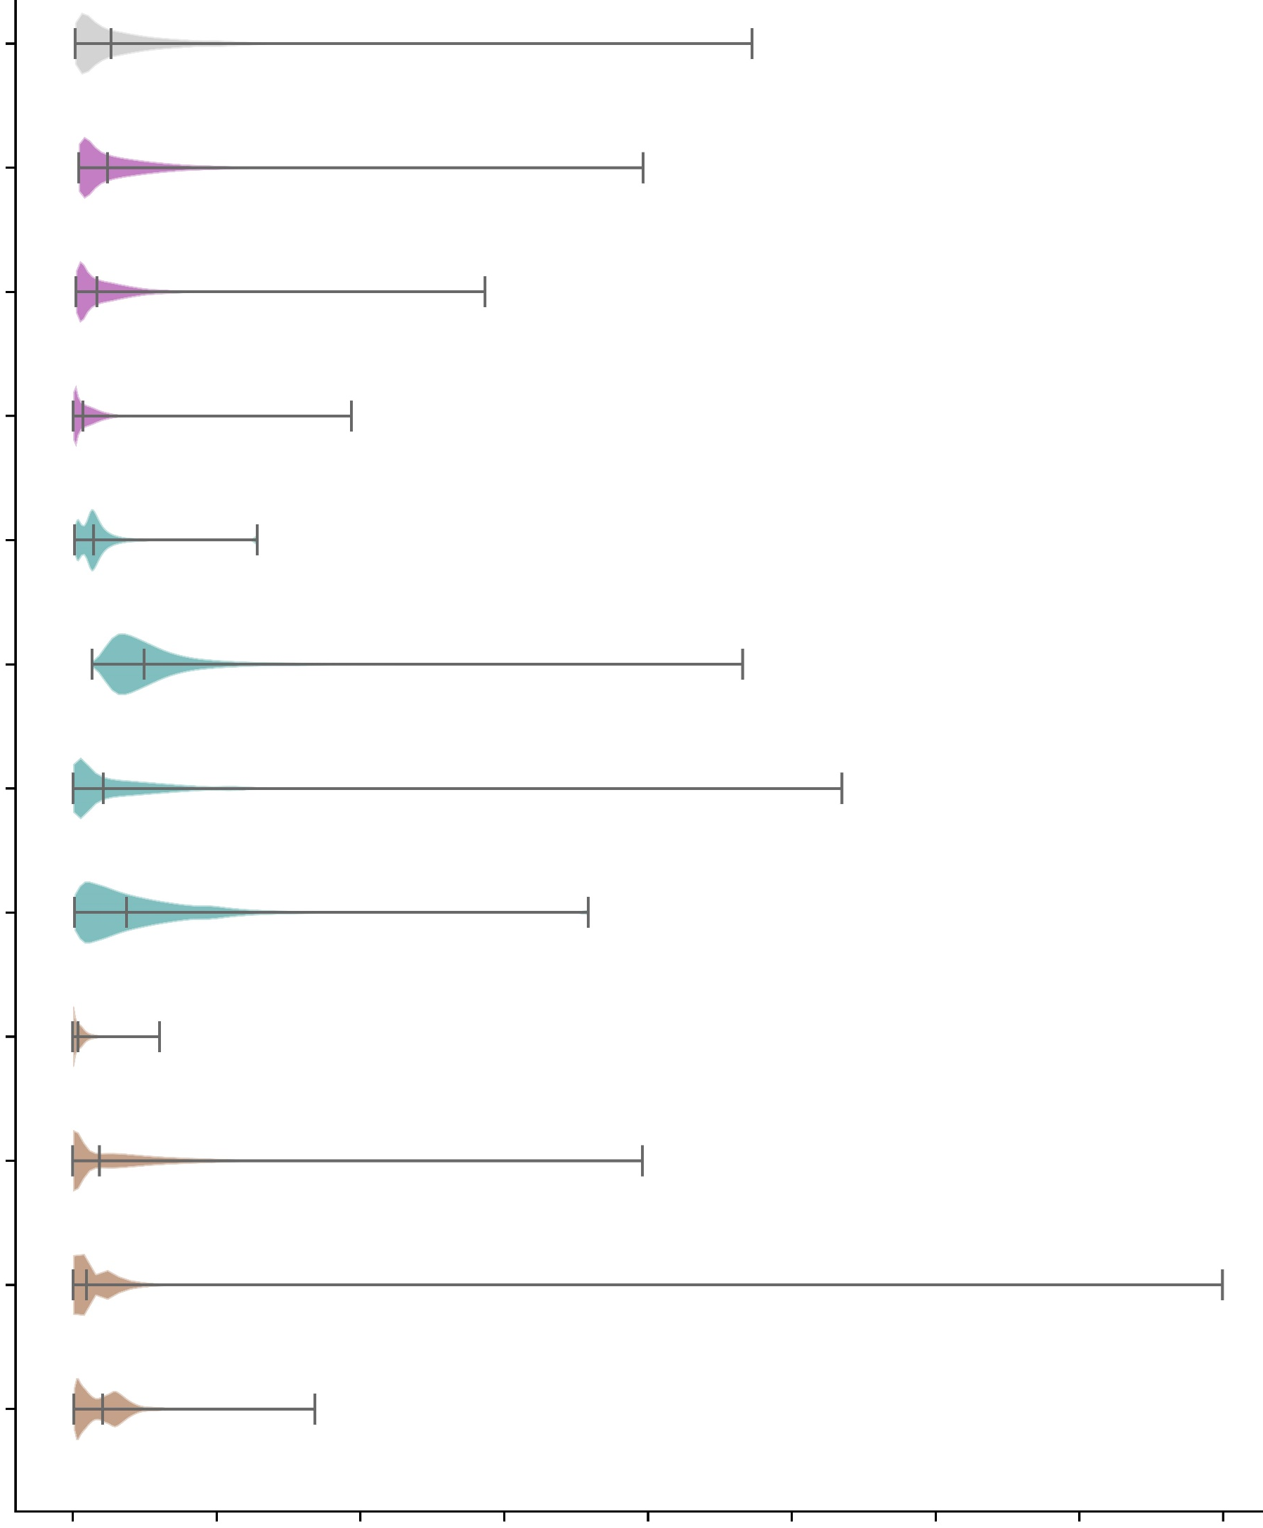
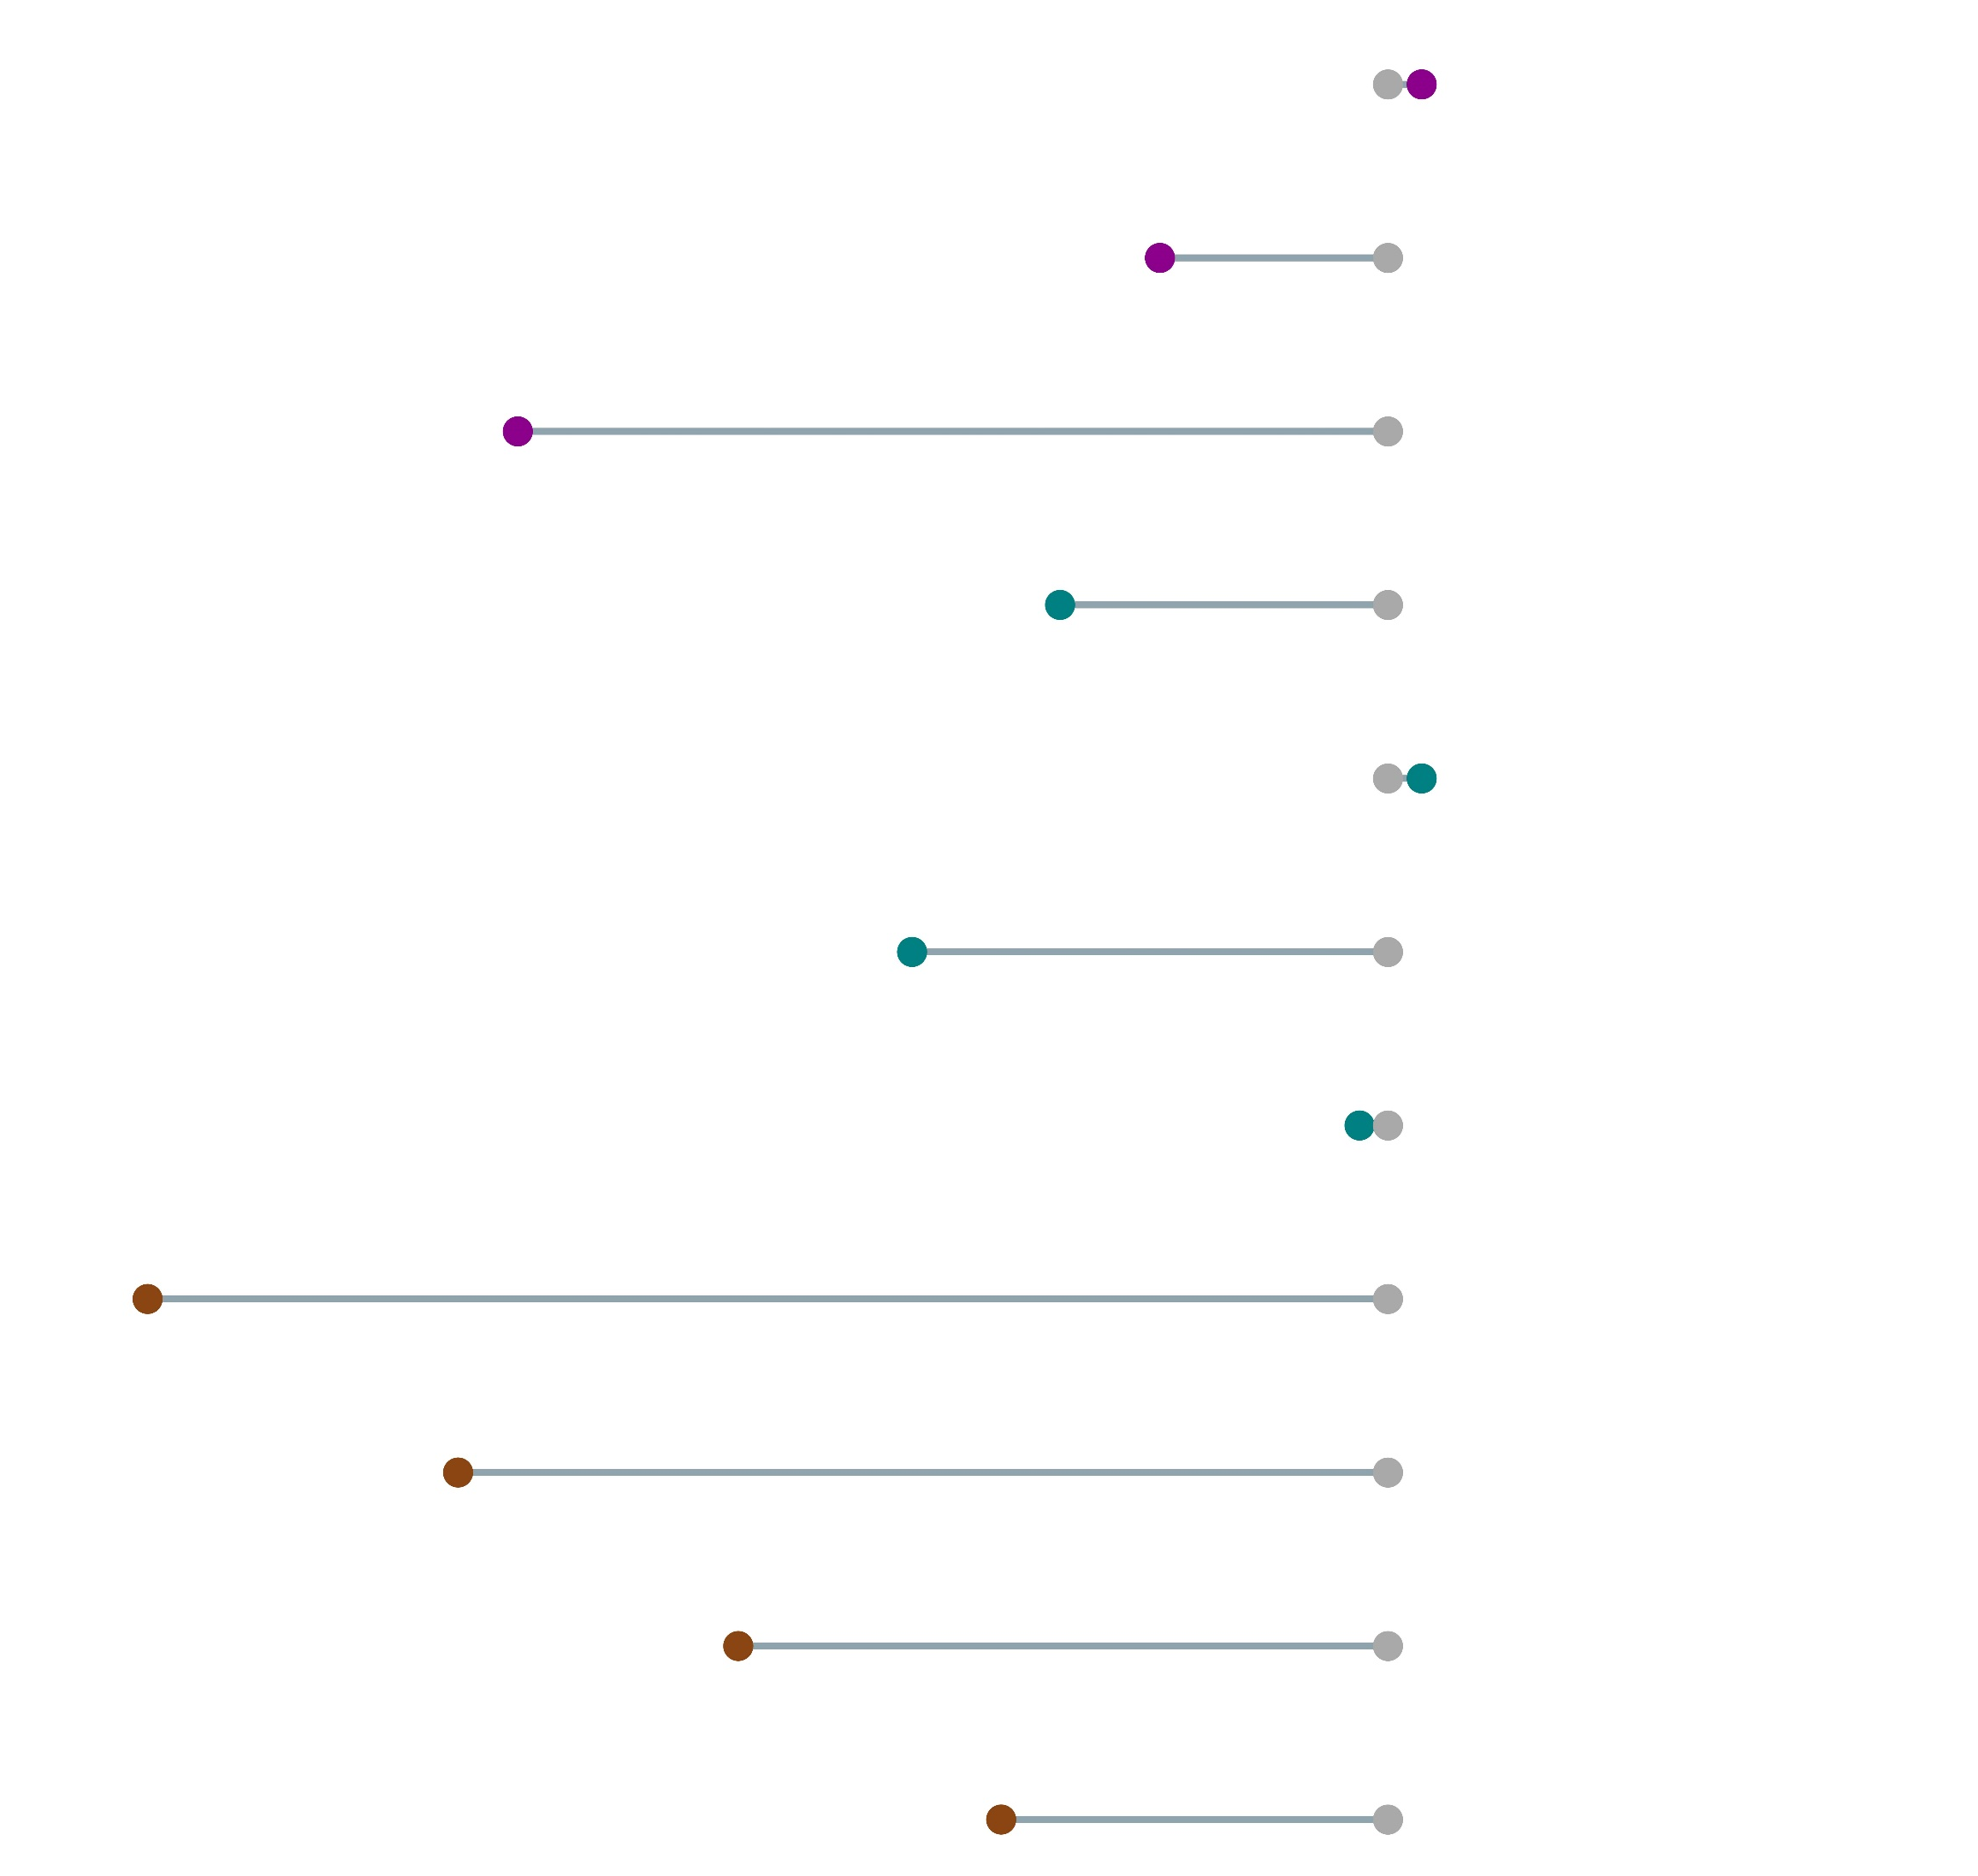
Distribution of probabilities of having a flash flood event in a grid-box
Number of grid-boxes exceeding the climatological average probability (0.08%) of having a flash flood event in a grid-box
AllFF
RedRnd_10
(+1.42 %)
251486
RedRnd_50
(-9.56 %)
224252
(-36.50 %)
RedRnd_90
157447
NoEastGP
(-13.75 %)
213860
(+ 1.42 %)
NoWestGP
251486
NoSouthGP
(-19.96 %)
198465
NoNorthGP
(-1.18 %)
245018
(-52.04 %)
NoEastFF
118936
(-39.00 %)
NoWestFF
151235
(-27.25 %)
NoSouthFF
180380
(-16.22 %)
NoNorthFF
207735
0
2
4
6
8
10
12
14
16
247953 (AllFF)
Probabilities [%]
Number of grid-boxes [-]

