Slide 1
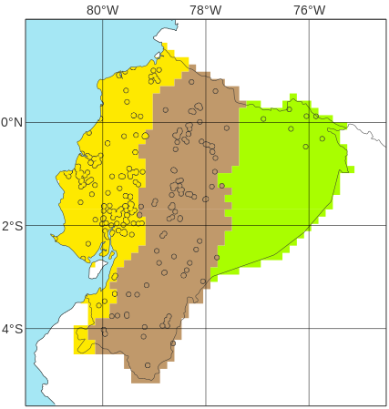





Point flood reports for
“La Costa”
“La Sierra”
“El Oriente”
2019
2020
EFFCI >= 1
a
d
EFFCI >= 6
b
e
EFFCI >= 10
c
f

