Slide 1
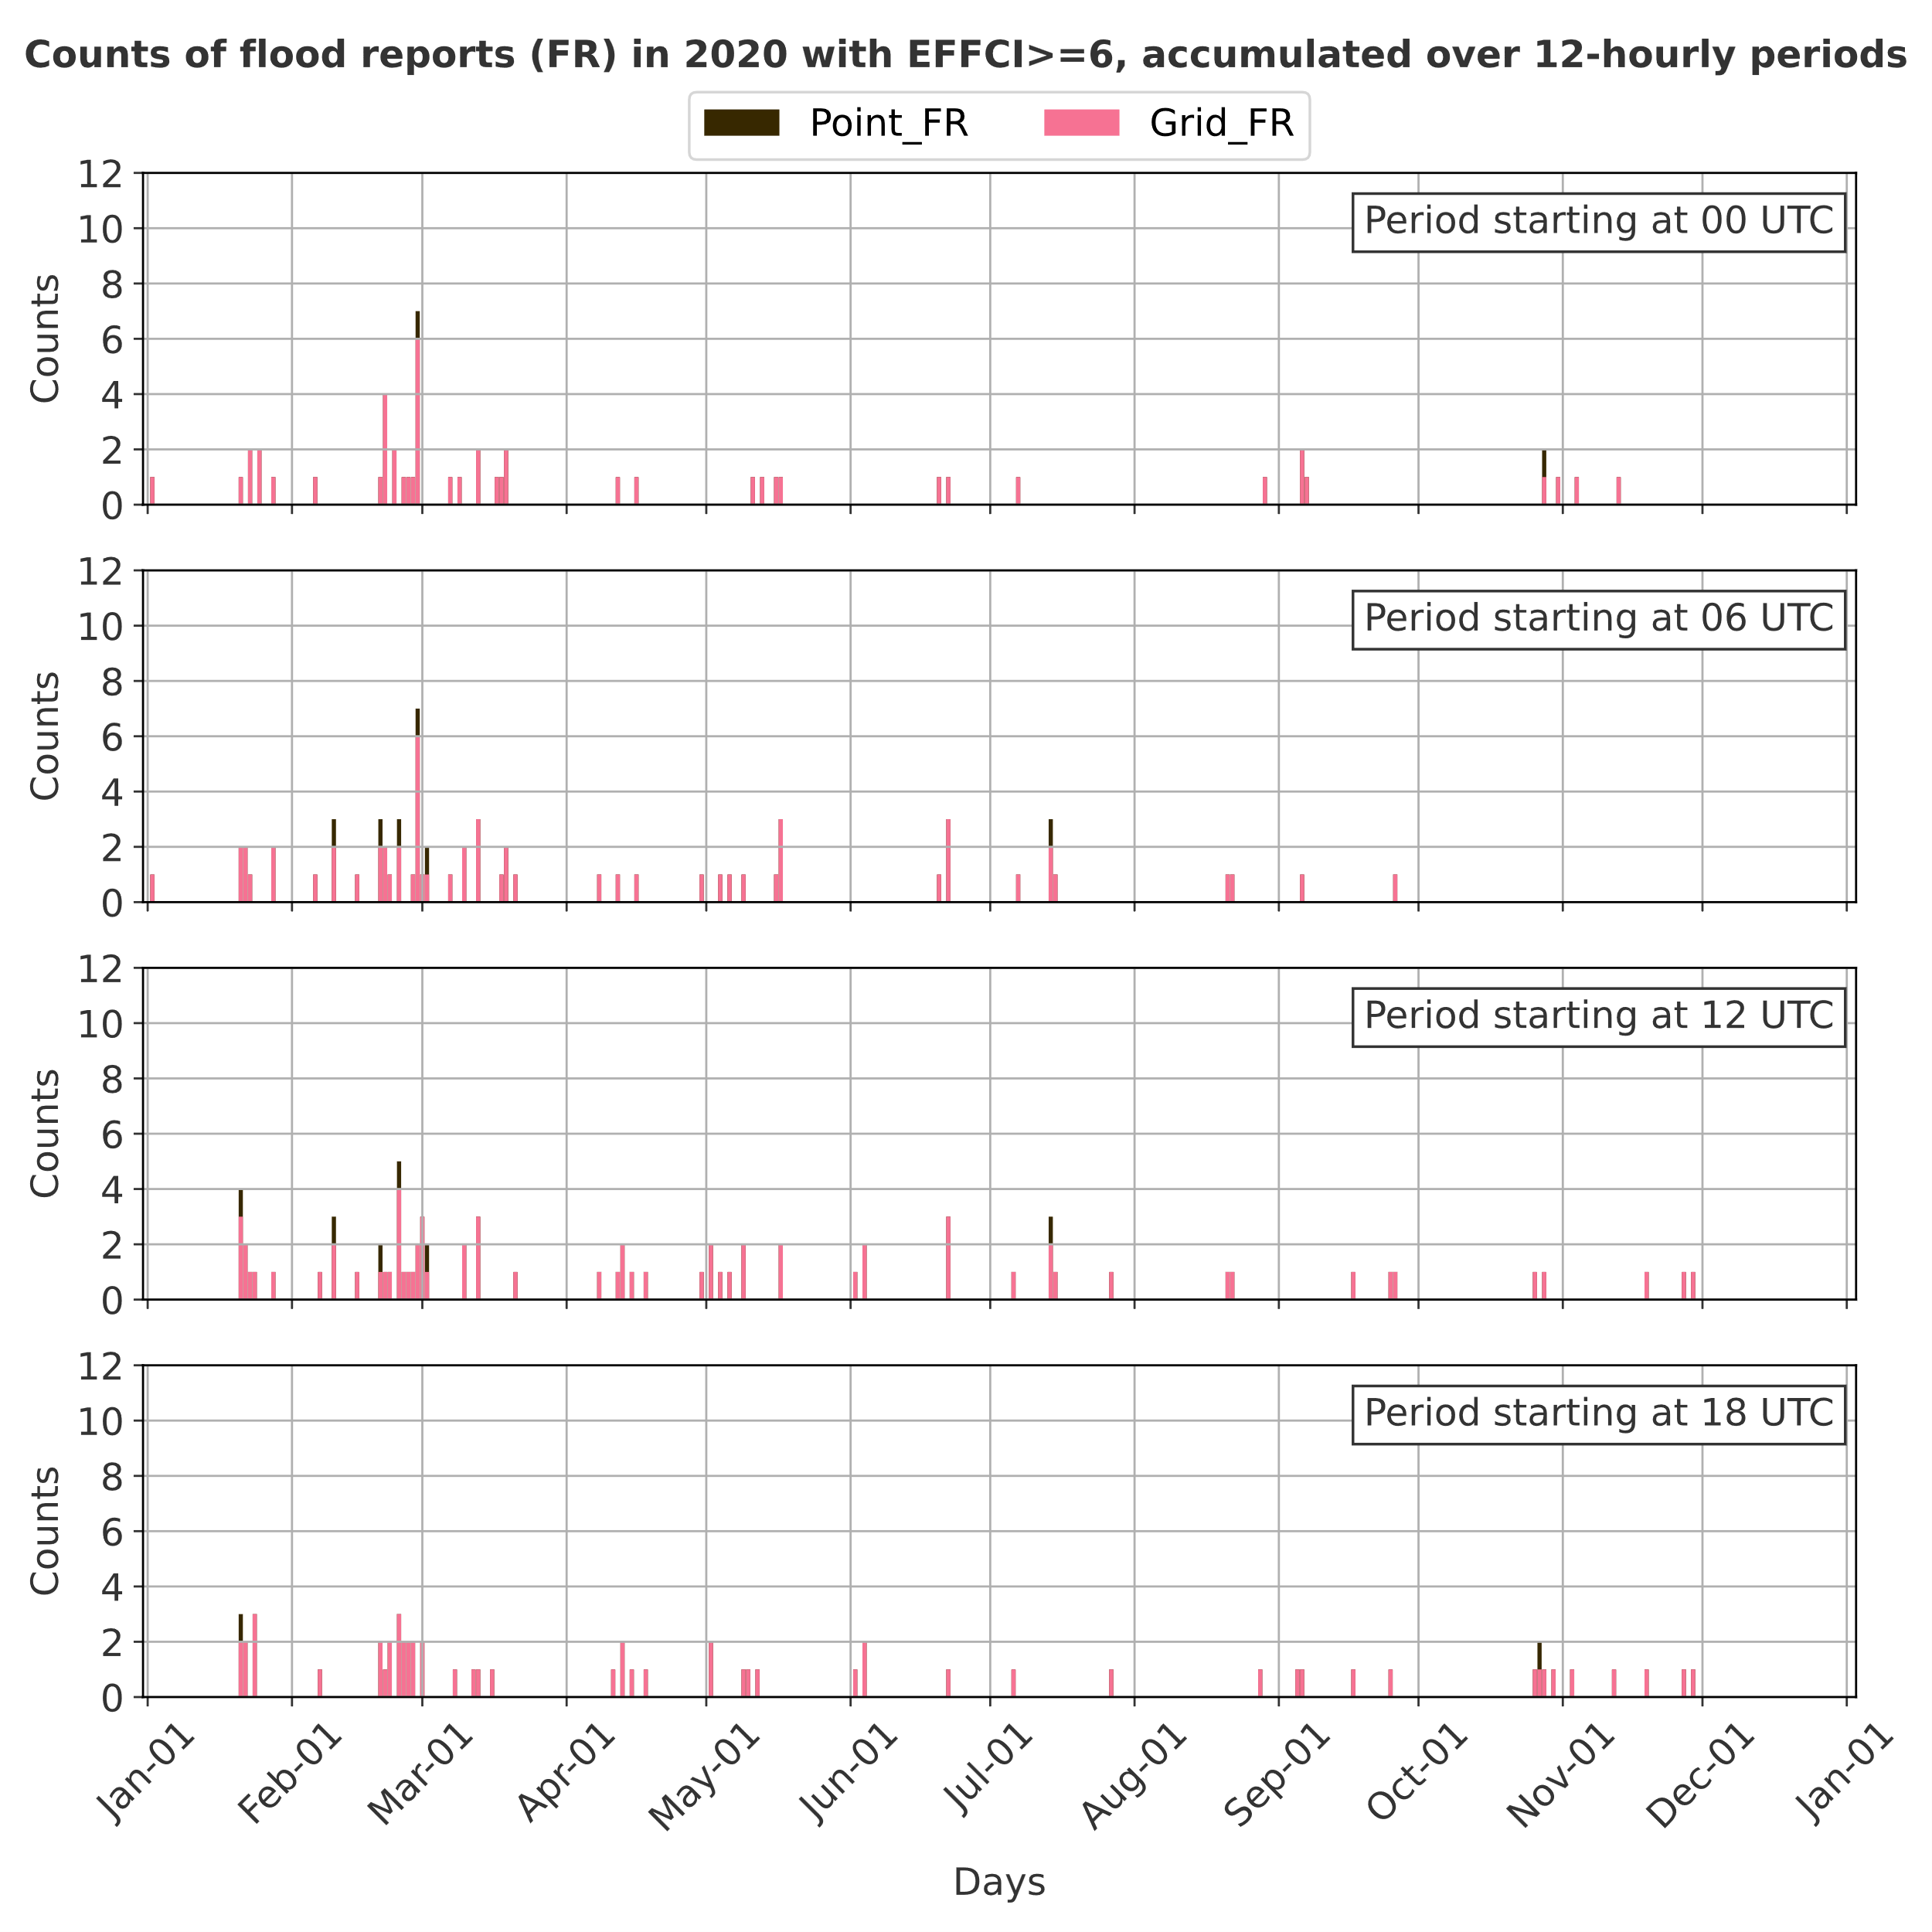
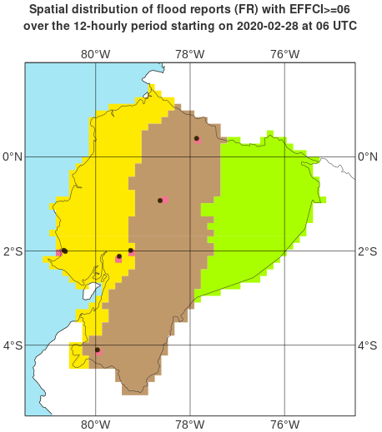
a
b
Periods ending at 12 UTC
Spatial distribution of Point_FR and Grid_FR in the 12-hourly period ending on 2020-02-28 at 18 UTC
Point_FR
Grid_FR
Periods ending at 18 UTC
Periods ending at 00 UTC
“La Costa”
“La Sierra”
Periods ending at 06 UTC
“El Oriente”

