Slide 1
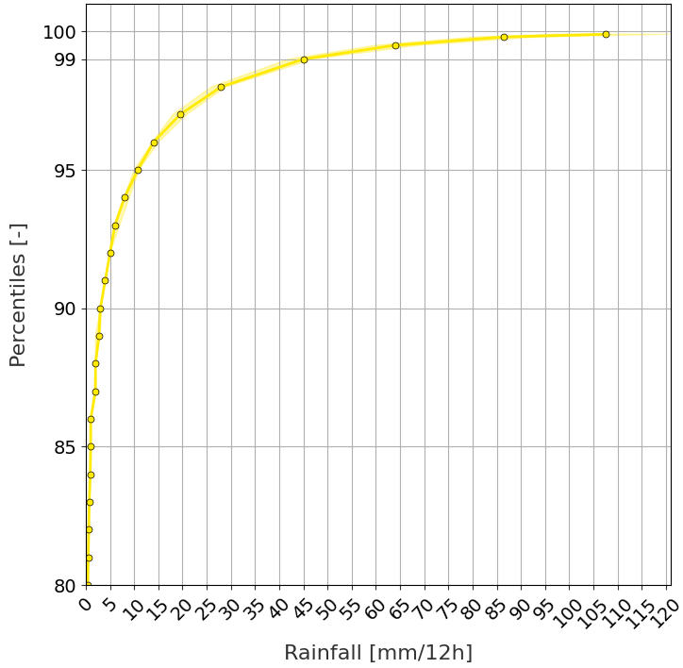
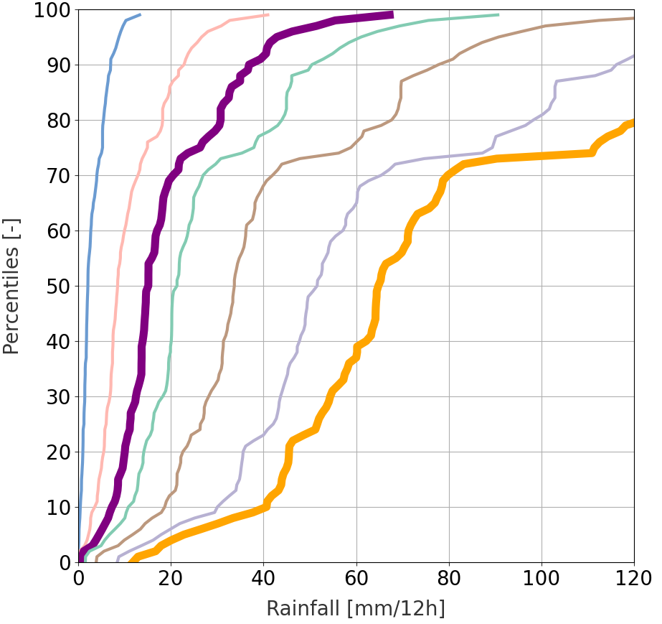
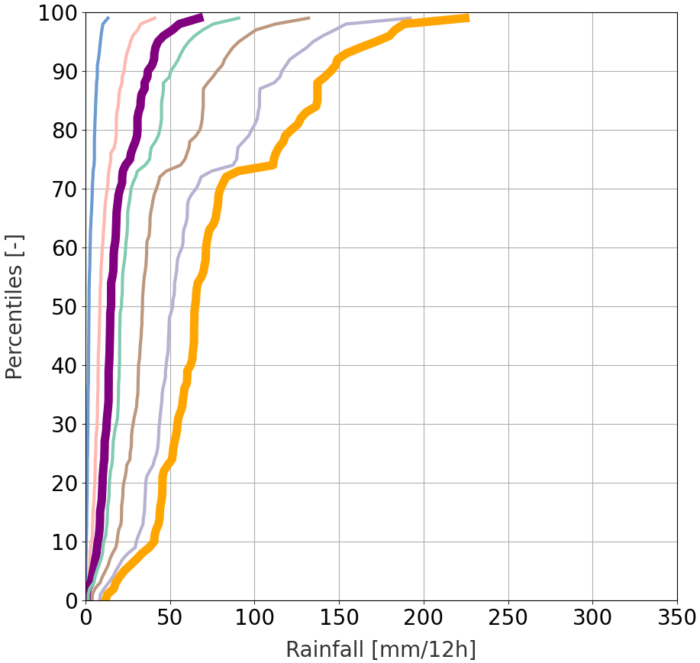
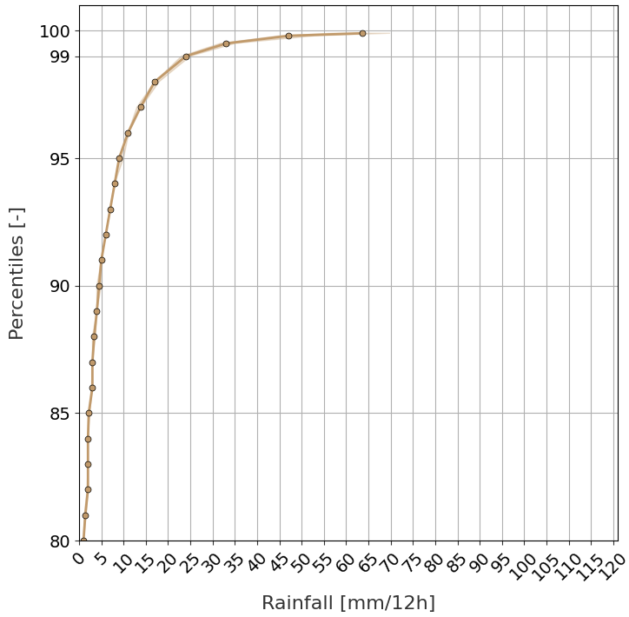
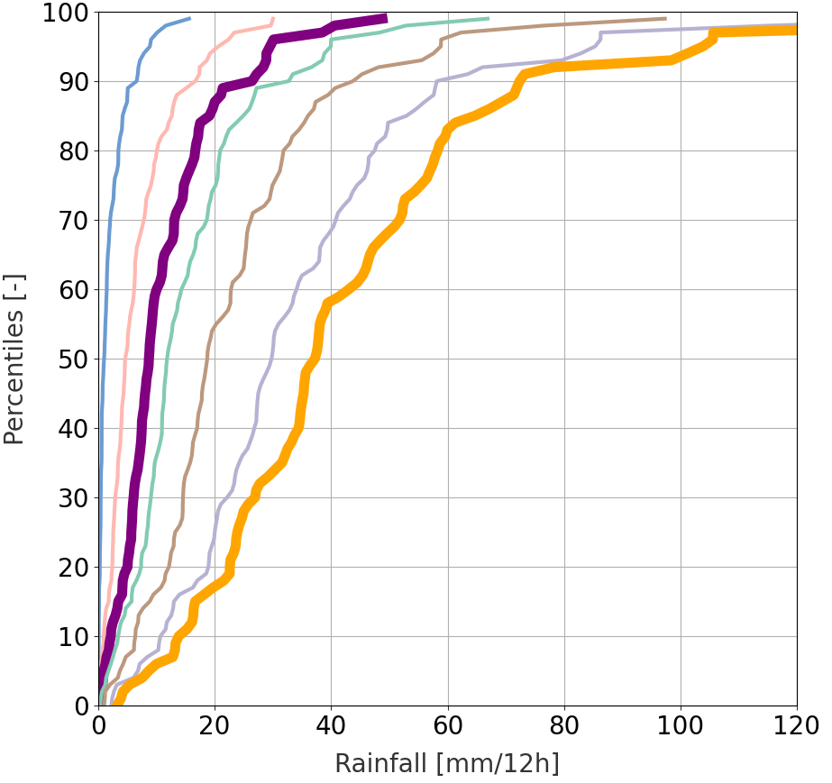
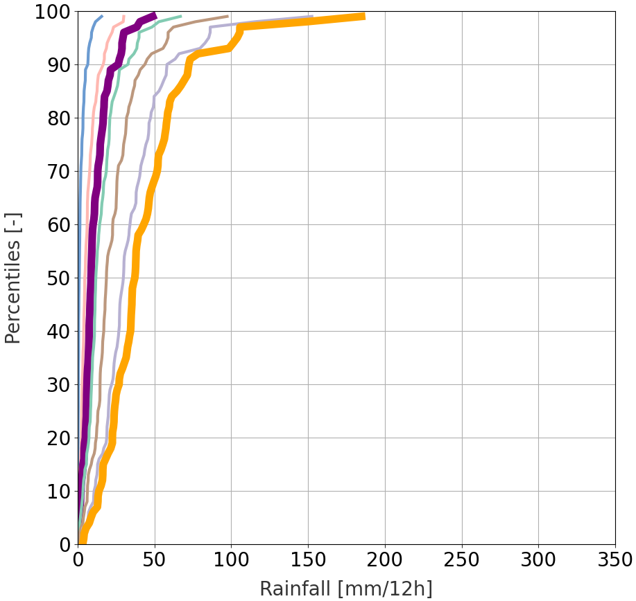
Rainfall climatology from SYNOP
from 2010-01-01 to 2019-12-31
Verifying Rainfall Thresholds (VRT)
95% CI
Net distributions of tp(x^{th} perc) values from short-range ecPoint rainfall forecasts
Climatology
La Costa
50th perc
75th perc
85th perc
VRT_{MS}
La Sierra
90th perc
95th perc
98th perc
VRT_{S}
Moderately severe rainfall events (tp_{MS})
99th perc
Severe rainfall events (tp_{S})
a
b
Top ¾ most extreme flood events
La Costa
tp_{MS}
tp_{S}
c
d
Top ¾ most extreme flood events
La Sierra
tp_{MS}
tp_{S}

