Slide 1
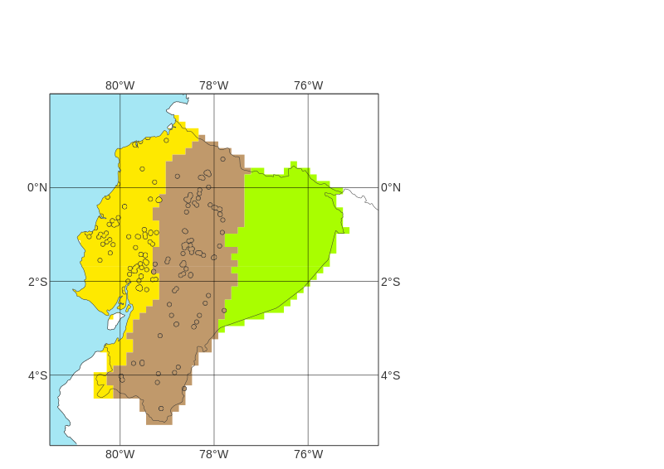
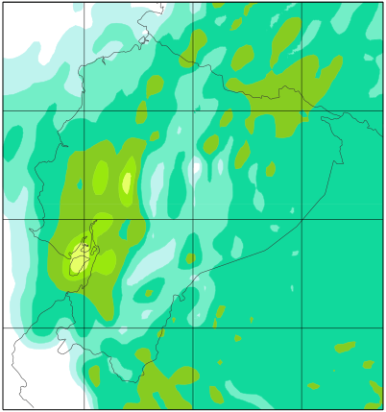
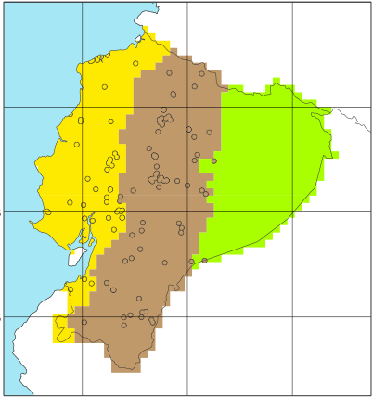
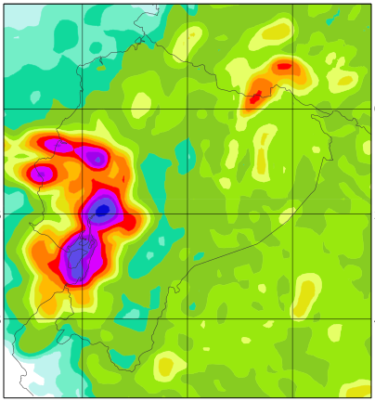
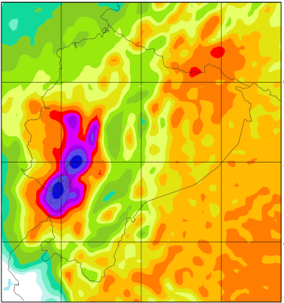
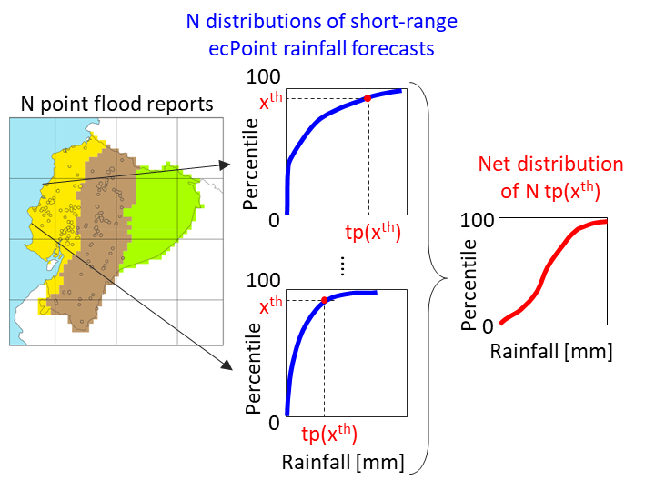
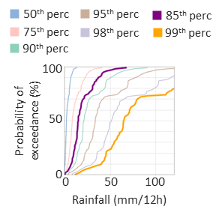
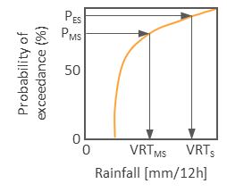
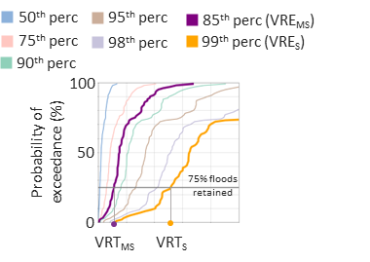
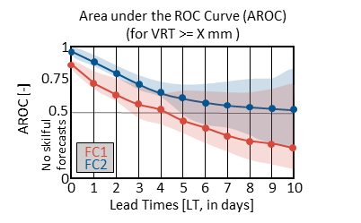
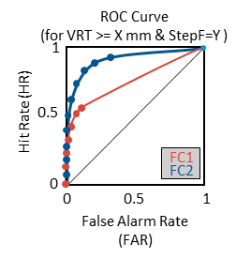
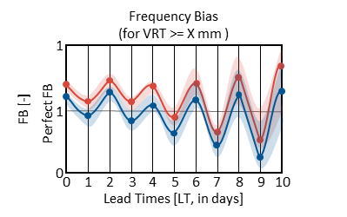
Definition of Verifying Rainfall Thresholds (VRTs)
START: analyse performance of rainfall forecasts (FC) in identifying areas at risk of flash floods.
Objective verification analysis
STOP
NO
Have point flash flood reports (FFR) for year X?
NO
YES
Are VRTs known?
Read VREs
YES
STOP
Read point FFRs for year X
NO
Have FFR for year Y?
Figure 3b
Figure 2a & 2b
Figure 2c & 2d
Read OBS
YES
Are high-density point-rainfall observations (OBS) associated with FFRs available?
YES
FC1
FC2
Create distribution of OBS associated with FFRs, and select percentiles P_{MS} and P_{S} defining VRTs for moderately-severe (VRT_{MS}) and severe (VRT_{S}) flash floods.
NO
Read flash flood reports
Read FC1 and FC2.
Read short-range ecPoint FC
Figure 2c & 2d
Figure 3e
Define the net distribution of rainfall totals associated with FFRs from short-range ecPoint forecasts.
Create observational fields, for different VREs and accumulation periods, up to medium-range leads.
Create forecasts fields, for different VREs and accumulation periods, up to medium-range leads.
Calculation of forecast discrimination ability
Compute ROC curves for different VRTs and accumulation periods, and Areas under the ROC curve (AROC) for different VRTs.
Calculation of forecast reliability
Compute Frequency Bias for different VRTs.
Section 4.1 & Figure 6
Section 4.2.1
Section 4.2.2
Tp obs available for long period (e.g., 10 years)?
YES
Create distribution of tp obs and use it to define the values of moderately severe and severe rainfall totals.
Section 5.1
& Figure 8
Section 4.1 & Figure 7
Section 5.2.1 & Figure 9
Section 5.2.2 & Figure 11
Section 5.2.1 & Figure 10
END

Slide 2
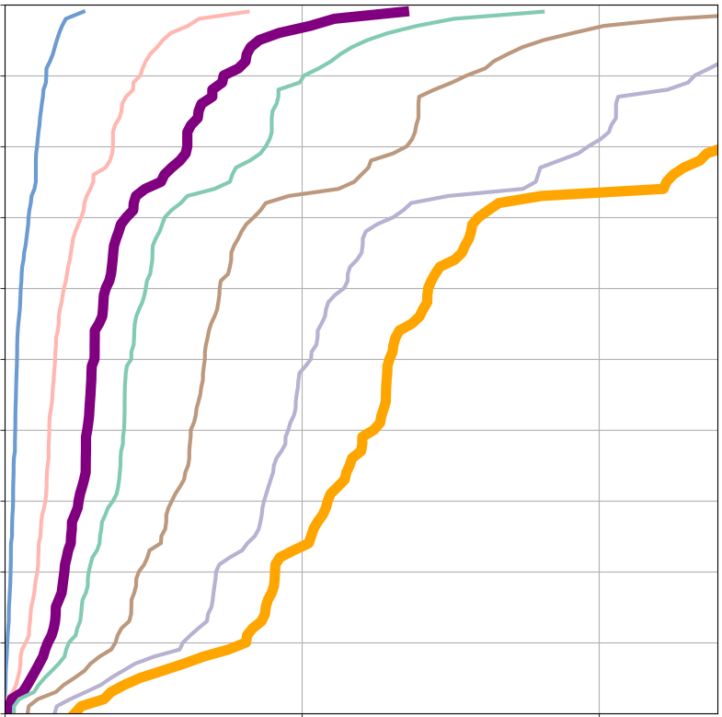
50th perc
95th perc
85th perc
75th perc
99th perc
90th perc
98th perc
100
100
Probability of exceedance (%)
P_{ES}
Probability of exceedance (%)
P_{MS}
50
50
0
Rainfall (mm/12h)
0
0
50
100
0
VRT_{MS}
VRT_{S}
Rainfall [mm/12h]
ROC Curve
(for VRT >= X mm & StepF=Y )
Area under the ROC Curve (AROC)
(for VRT >= X mm )
Frequency Bias
(for VRT >= X mm )
Hit Rate (HR)
1
1
FB [-]
1
AROC [-]
0.75
0.5
1
0.5
Perfect FB
FC1
No skilful forecasts
FC2
FC1
0
0
FC2
0
1
2
3
4
5
6
7
8
9
10
0
0.5
1
0
0
1
2
3
4
5
6
7
8
9
10
Lead Times [LT, in days]
False Alarm Rate (FAR)
Lead Times [LT, in days]

Slide 3
N distributions of short-range ecPoint rainfall forecasts
100
N point flood reports
x^{th}
Percentile
Net distribution of N tp(x^{th})
0
tp(x^{th})
100
100
....
Percentile
x^{th}
0
Percentile
Rainfall [mm]
0
tp(x^{th})
Rainfall [mm]

