Slide 1
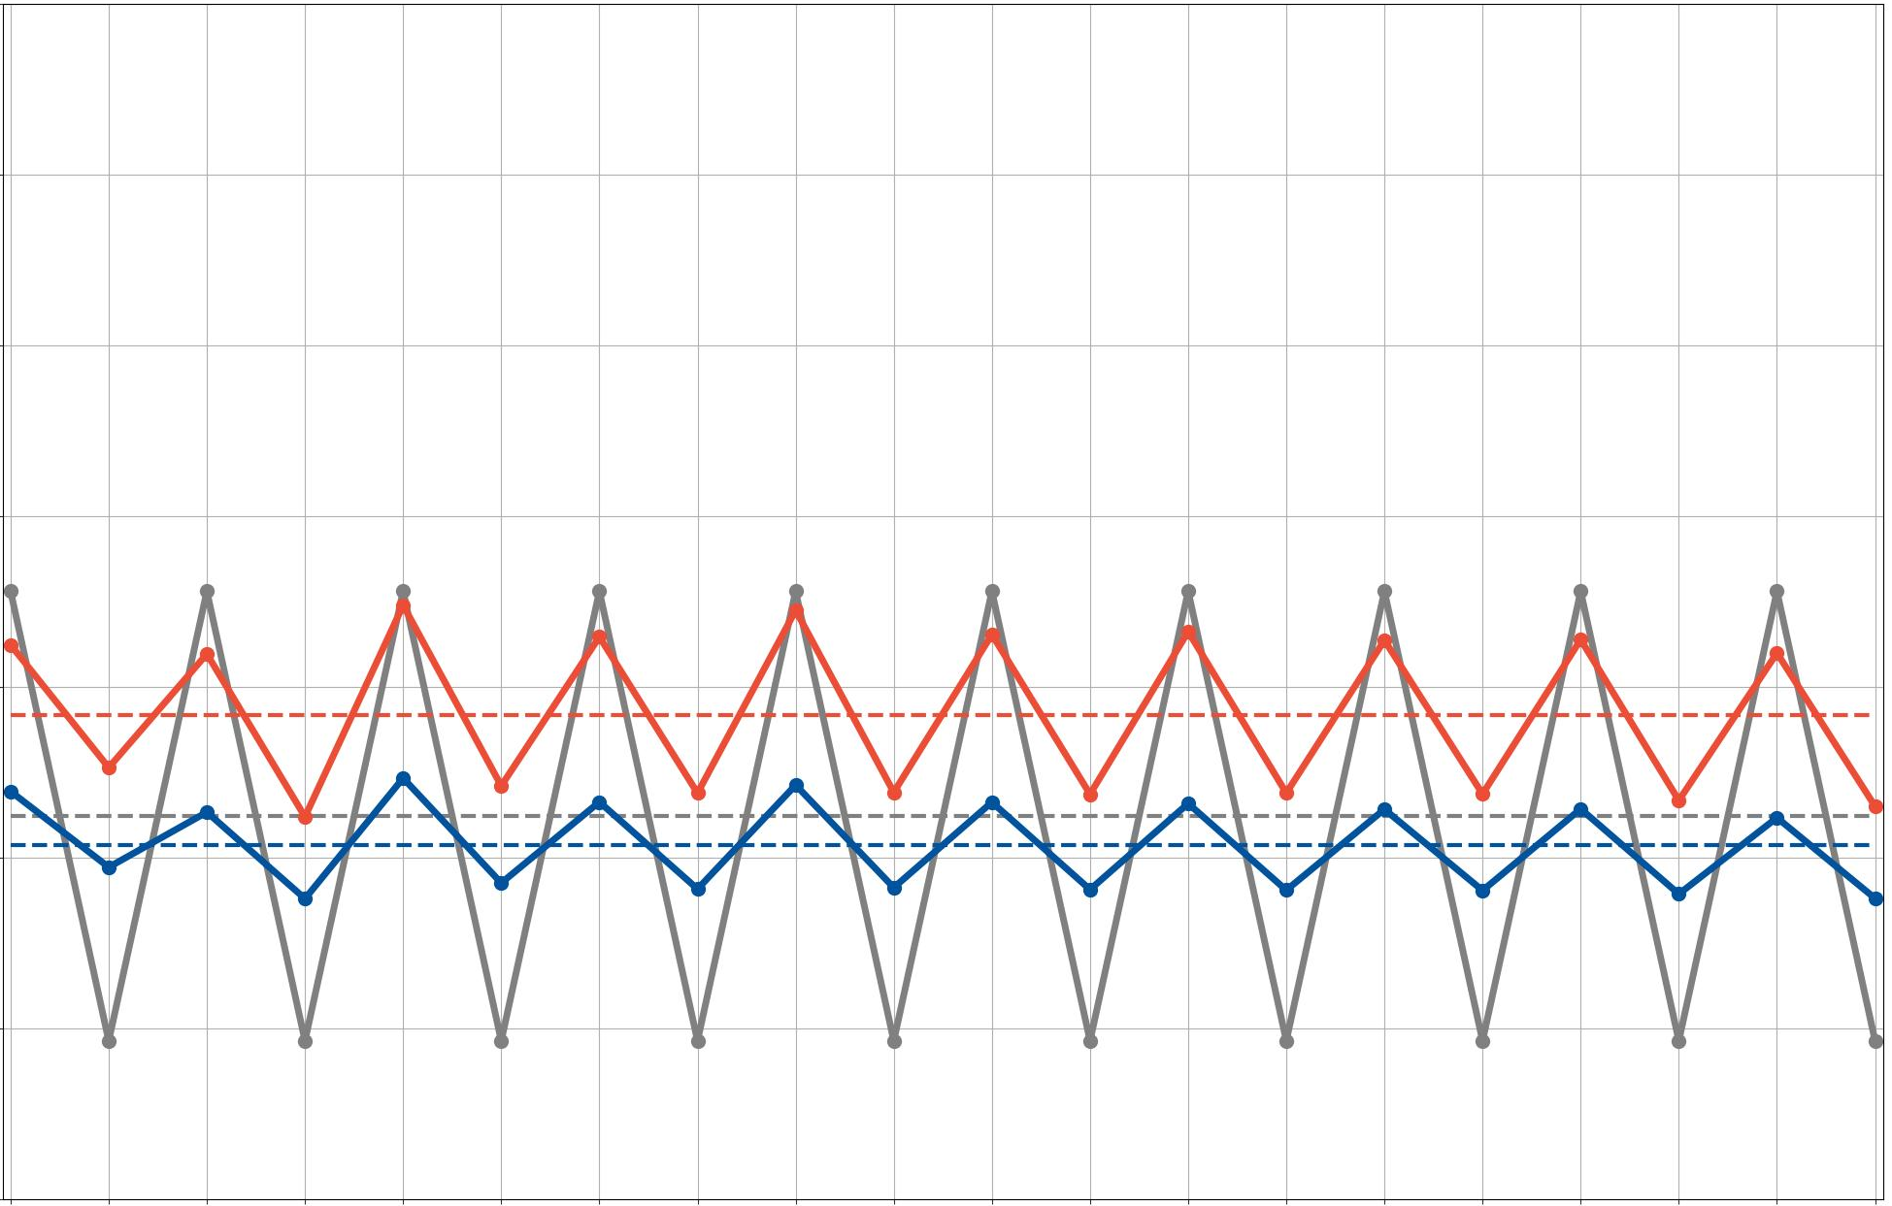
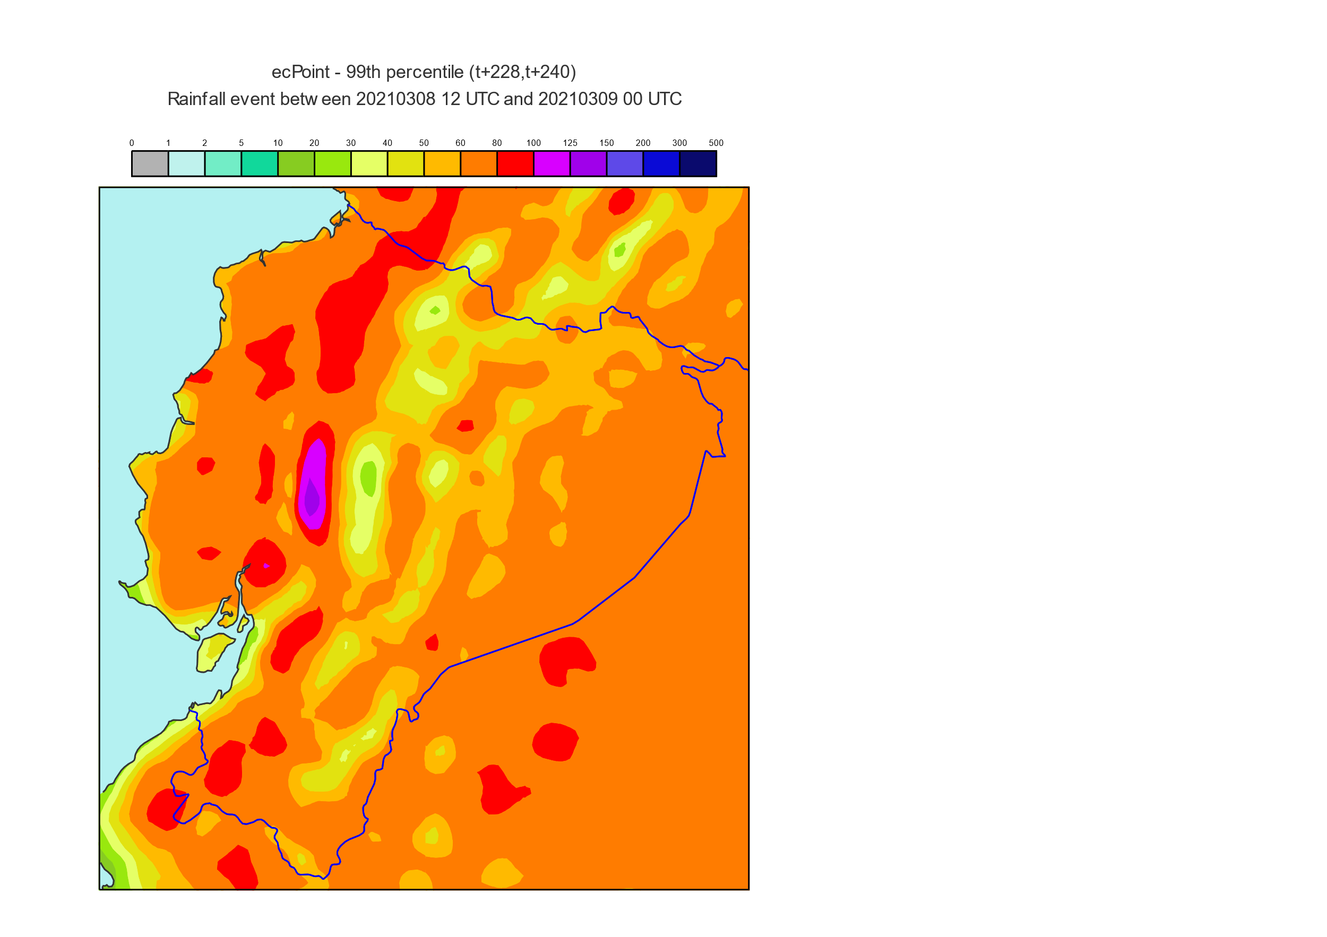
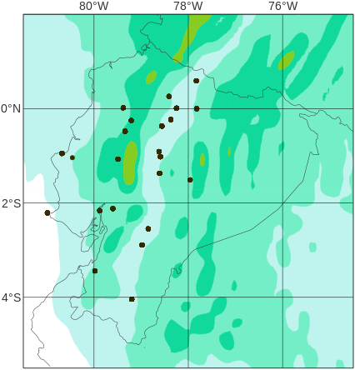
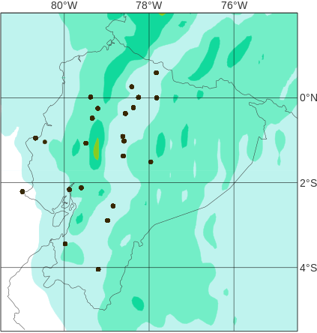
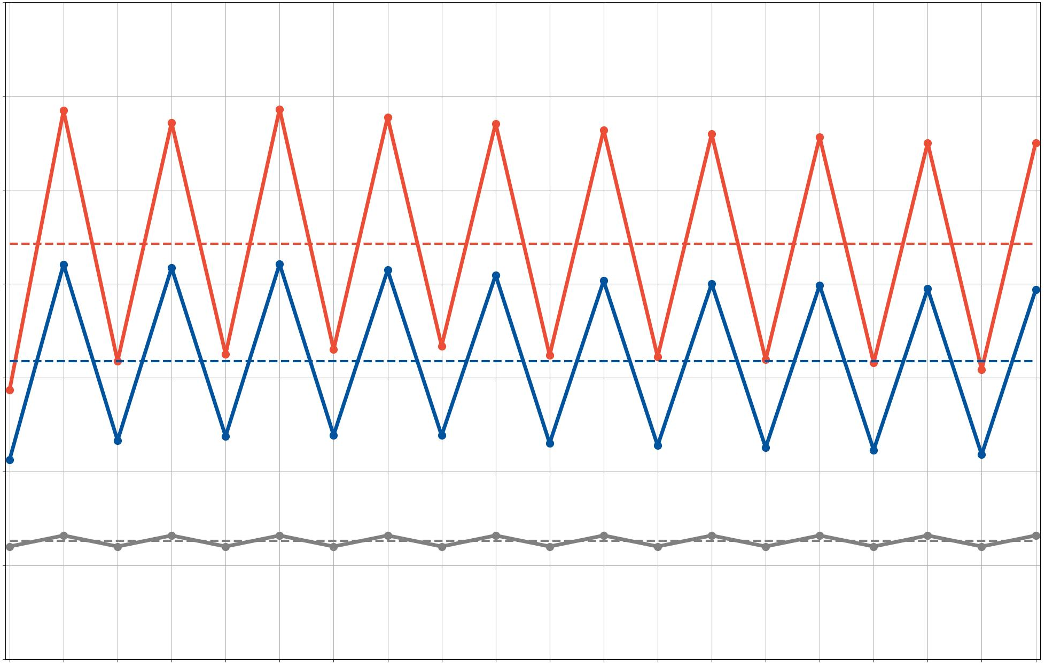
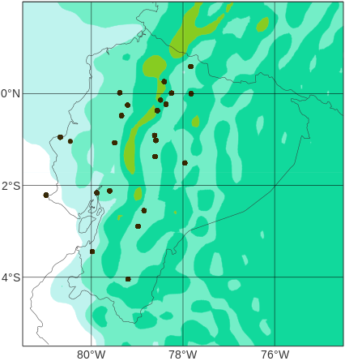
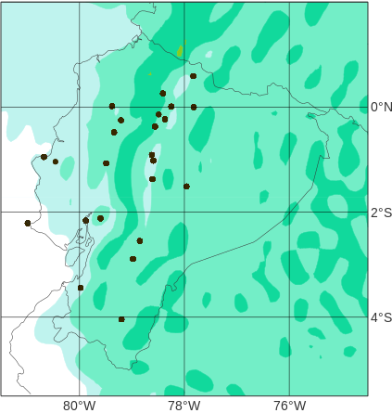
2020’s 12-hourly rainfall average
Diurnal
cycle
Trend
12-hourly accumulation periods
ENS
0000 – 1200 UTC (1800 – 0600 LT), Nighttime
ecPoint
1200 – 0000 UTC (0600 – 1800 LT), Daytime
OBS
Location of rain gauges in “La Costa” and “La Sierra”
7
La Costa
a
Spatial distribution of rainfall average [mm/12h]
6
0
1
2
5
10
20
30
40
50
60
80
100
125
150
200
300
500
5
4
c
ENS
ecPoint
Rainfall average [mm/12h]
3
d
2
e
f
1
0
T+60, Nighttime
7
La Sierra
d
b
6
c
e
5
f
4
Rainfall average [mm/12h]
3
c
2
e
T+72, Daytime
1
0
d
f
12
24
36
48
60
72
84
96
108
120
132
144
156
168
180
192
204
216
228
240
Lead time steps for the 00 UTC run and at the end of the
12-hourly accumulation periods [in hours]
D1
D2
D3
D4
D5
D6
D7
D8
D9
D10
Lead times (in days)

