Slide 1
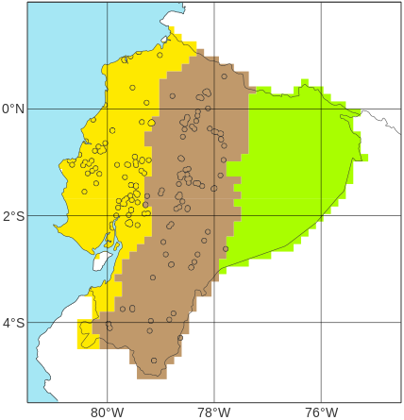
Schematic representation of the definition of verifying rainfall thresholds (VRTs) using short-range ecPoint rainfall forecasts
Location of N point flood reports in “La Costa”, with EFFCI>=6, in 2019 (from Figure 3b)
100
b
x^{th}
a
Percentile
c
Net distribution of the N tp(x^{th}) values
0
tp(x^{th})
100
100
x^{th}
75% of point flood reports retained
Distribution of short-range ecPoint rainfall forecasts (i.e., realizations) for each of the N point flood reports.
Percentile
Percentile
0
tp(x^{th})
25th
100
....
x^{th}
0
tp(25th) = VRT
Rainfall [mm]
Percentile
0
tp(x^{th})
Rainfall [mm]

