Slide 1
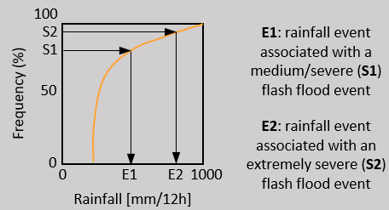
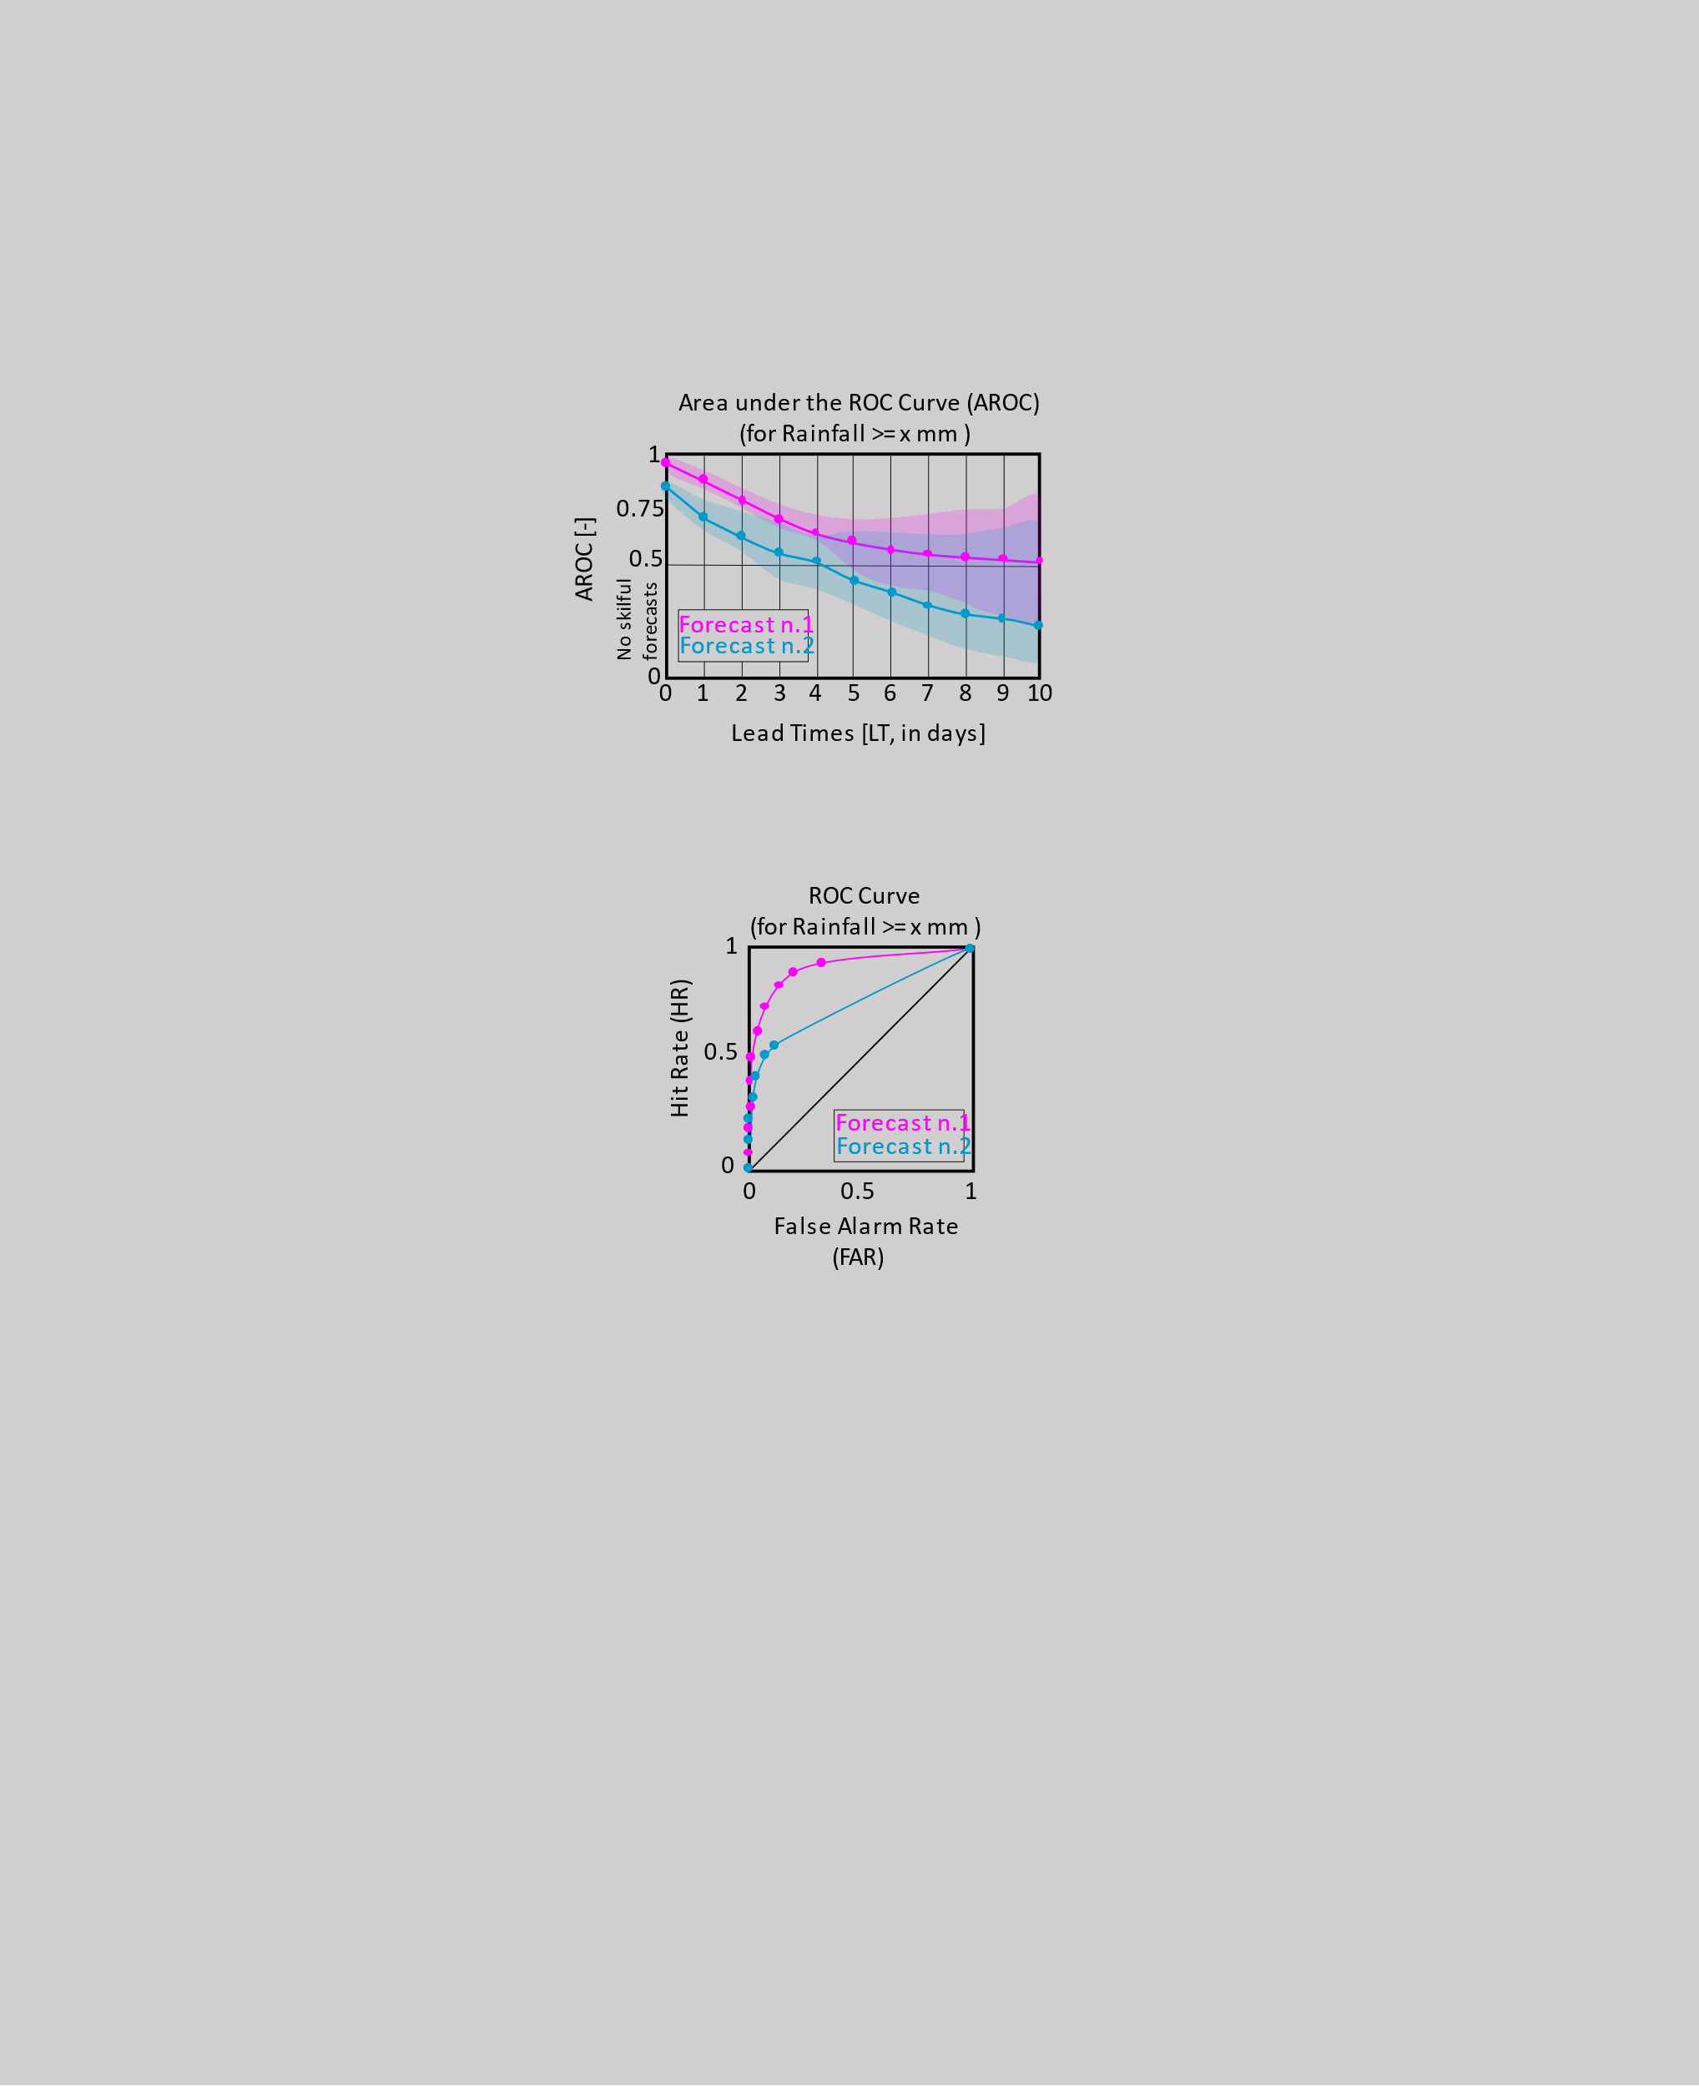
START
OBJECTIVE VERIFIOCATION TO ASSESS FORECASTS’ PERFORMANCE IN IDENTIFYING AREAS AT FLASH FLOOD RISK
YES
Are the magnitudes of rainfall events associated with “medium/severe” and “extremely severe” flash floods known?
NO
YES
NO
STOP
NO
Presence of flash flood reports?
Read the magnitude of rainfall events associated with “medium/severe” and “extremely severe” flash floods
Read rainfall observations
YES
Presence of rainfall obs to associate with flash flood reports?
Compare the skill of rainfall forecasts associated with different severities of flash floods
(RQ2, Section 4.2)
Compare the lead time of skilful rainfall forecasts associated with different severities of flash floods
(RQ3, Section 4.2)
YES
Plot the distribution of rainfall events associated with the flash floods reports.
NO
DEFINITIONING THE DISTRIBUTION OF RAINFALL TOTALS ASSOCIATED WITH FLASH FLOODS
Read the 99 members of the short-range ecPoint rainfall forecasts for the nearest gridbox to each flash flood.
Presence of flash flood reports?
NO
STOP
Extract the rainfall value for a medium/severity and extremely severe flash flood event, and compute the distribution of such values.
Read flash flood reports
Read rainfall forecasts
Create observational fields, for each forecast accumulation period, up to medium-range lead times.
Create forecasts fields, for each forecast accumulation period, up to medium-range lead times.
Extract the rainfall value correspondent to the 25th percentile (i.e., 75% of the flood reports are retained).
Compute contingency tables, for each forecast accumulation period, up to medium-range lead times, for rainfall events associated with different severities of flash floods.
NO
Compute ROC curves for each forecast accumulation period, up to medium-range lead times, for rainfall events associated with different severities of flash floods.
(RQ2 and RQ3,
Section 5.2)
Compute Areas under the ROC curve (AROC), for each forecast accumulation period, up to medium-range lead times, for rainfall events associated with different severities of flash floods.
(RQ2 and RQ3,
Section 5.2)

Slide 2
100
S2
E1: rainfall event associated with a medium/severe (S1) flash flood event
Frequency (%)
S1
50
E2: rainfall event associated with an extremely severe (S2) flash flood event
0
0
E1
E2
1000
Rainfall [mm/12h]
Area under the ROC Curve (AROC)
(for Rainfall >= x mm )
AROC [-]
1
0.75
0.5
No skilful forecasts
Forecast n.1
Forecast n.2
0
0
1
2
3
4
5
6
7
8
9
10
Lead Times [LT, in days]
ROC Curve
(for Rainfall >= x mm )
Hit Rate (HR)
1
0.5
Forecast n.1
0
Forecast n.2
0
0.5
1
False Alarm Rate (FAR)

