Slide 1
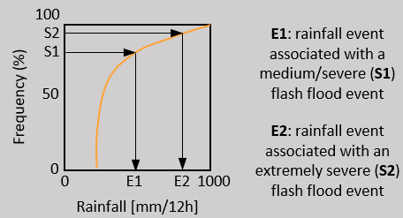
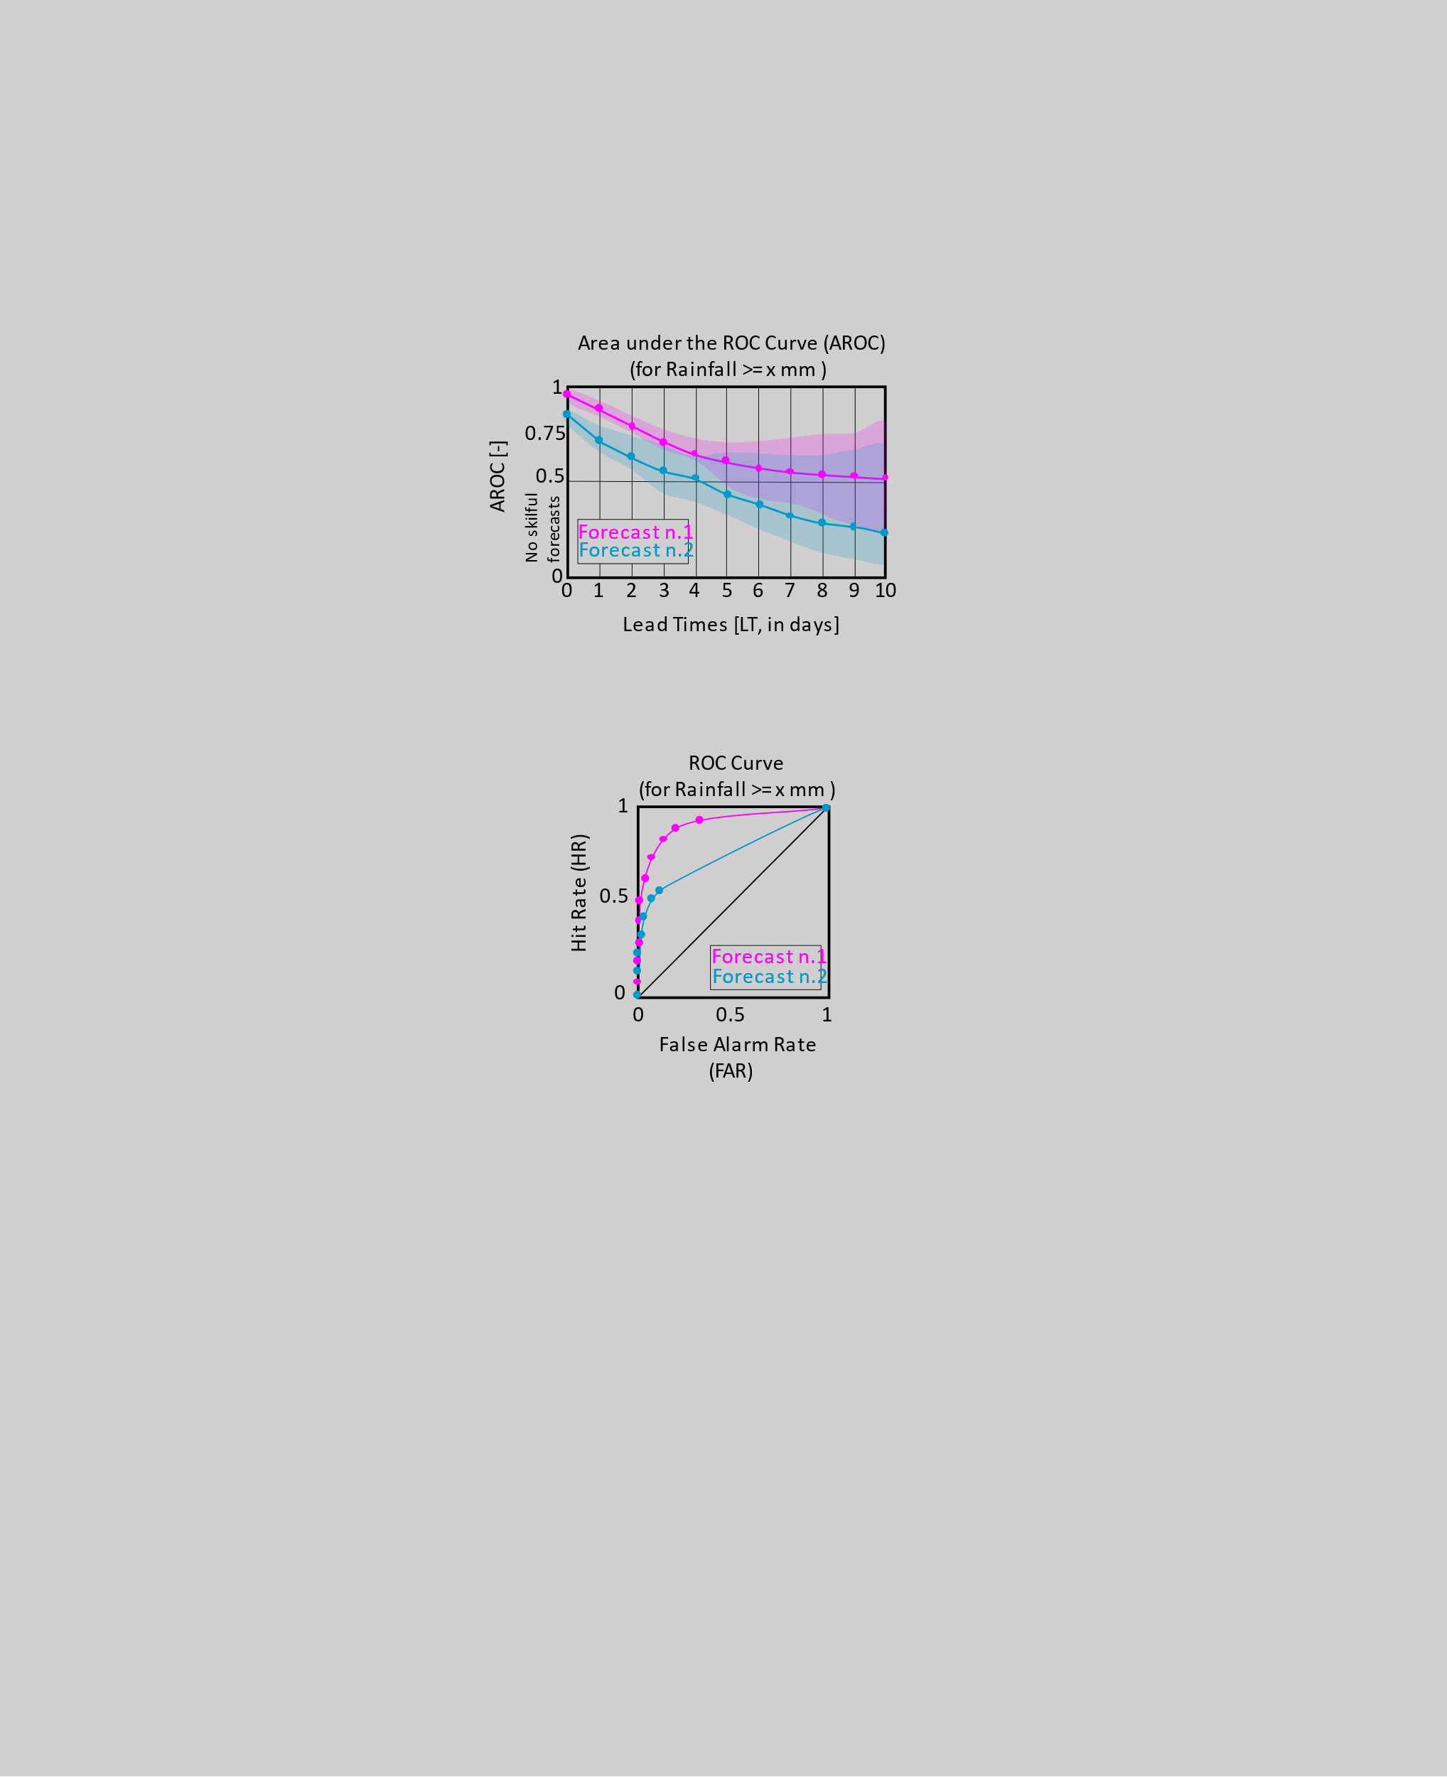
START
Are the magnitudes of rainfall events associated with “medium/severe” and “extremely severe” flash floods known?
NO
YES
DEFINITIONING THE DISTRIBUTION OF RAINFALL TOTALS ASSOCIATED WITH FLASH FLOODS
STOP
NO
Presence of flash flood reports?
Read the magnitude of rainfall events associated with “medium/severe” and “extremely severe” flash floods
OBJECTIVE VERIFIOCATION TO ASSESS FORECASTS’ PERFORMANCE IN IDENTIFYING AREAS AT FLASH FLOOD RISK
Read the point flash flood reports
Compare the skill of rainfall forecasts associated with different severities of flash floods
(RQ2, Section 4.2)
Compare the lead time of skilful rainfall forecasts associated with different severities of flash floods
(RQ3, Section 4.2)
Extract lat/lon and date/time from point flash flood reports.
Read rainfall observations
Presence of rainfall obs to associate with the flash flood reports?
Presence of flash flood reports?
NO
STOP
YES
Convert the lat/lon and date/time in the flash flood reports and rainfall obs to make them comparable.
Are lat/lon and date/time comparable between flash flood reports and rainfall obs?
NO
NO
Define the list of 4 short-range accumulation periods to consider for the ecPoint-Rainfall forecasts to use as rainfall obs proxies.
(RQ1, Section 4.1)
Read flash flood reports
Read rainfall forecasts
Create observational fields, for each forecast accumulation period, up to medium-range lead times.
Create forecasts fields, for each forecast accumulation period, up to medium-range lead times.
Extract the rainfall values associated with each flash flood report.
Read the short-range ecPoint-Rainfall forecasts.
Plot the distribution of rainfall values as percentiles.
Extract the 99 rainfall values for each accumulation period in the nearest grd box to the flash flood report lat/lon coordinates.
Compute contingency tables, for each forecast accumulation period, up to medium-range lead times, for rainfall events associated with different severities of flash floods.
Extract the 99 rainfall values for each accumulation period in the nearest grd box to the flash flood report lat/lon coordinates.
Compute ROC curves for each forecast accumulation period, up to medium-range lead times, for rainfall events associated with different severities of flash floods.
From the distribution of 4x99 forecast instances, extract the percentile(s) representing different magnitude(s) of rainfall events potentially leading to differently severe flash floods (i.e., medium/severity, 85° percentile, and extremely severe, 99° percentile).
(RQ2 and RQ3,
Section 5.2)
Plot the distribution of rainfall values as percentiles for each magnitude(s) of rainfall events potentially leading to flash floods.
Compute Areas under the ROC curve (AROC), for each forecast accumulation period, up to medium-range lead times, for rainfall events associated with different severities of flash floods.
(RQ1,
Section 5.1)
Extract the rainfall value correspondent to the 25th percentile (i.e., 75% of the flood reports are retained) to define the verifying rainfall event (VRE), and round it to the nearest integer.
(RQ2 and RQ3,
Section 5.2)

Slide 2
100
S2
E1: rainfall event associated with a medium/severe (S1) flash flood event
Frequency (%)
S1
50
E2: rainfall event associated with an extremely severe (S2) flash flood event
0
0
E1
E2
1000
Rainfall [mm/12h]
Area under the ROC Curve (AROC)
(for Rainfall >= x mm )
AROC [-]
1
0.75
0.5
No skilful forecasts
Forecast n.1
Forecast n.2
0
0
1
2
3
4
5
6
7
8
9
10
Lead Times [LT, in days]
ROC Curve
(for Rainfall >= x mm )
Hit Rate (HR)
1
0.5
Forecast n.1
0
Forecast n.2
0
0.5
1
False Alarm Rate (FAR)

