Slide 1
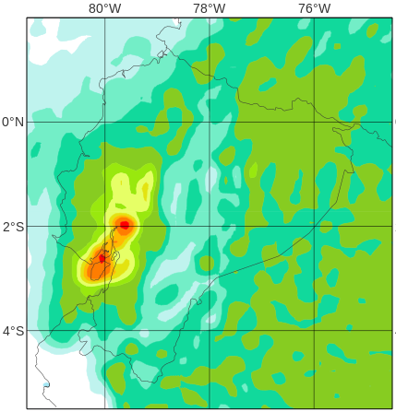
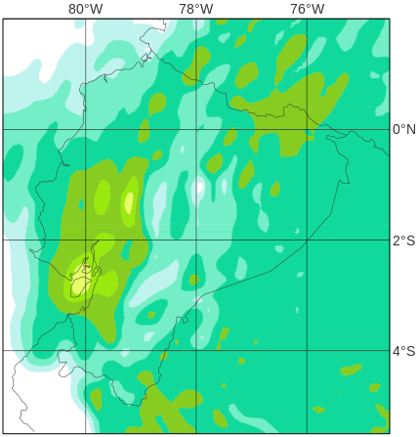
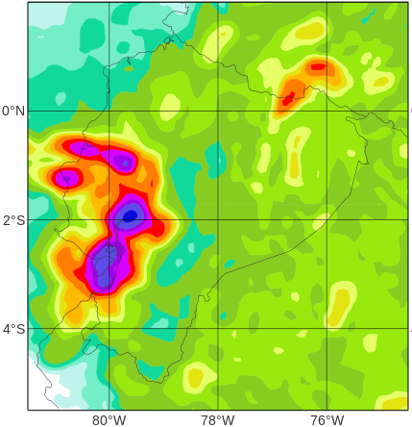
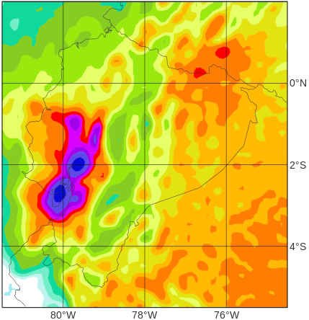
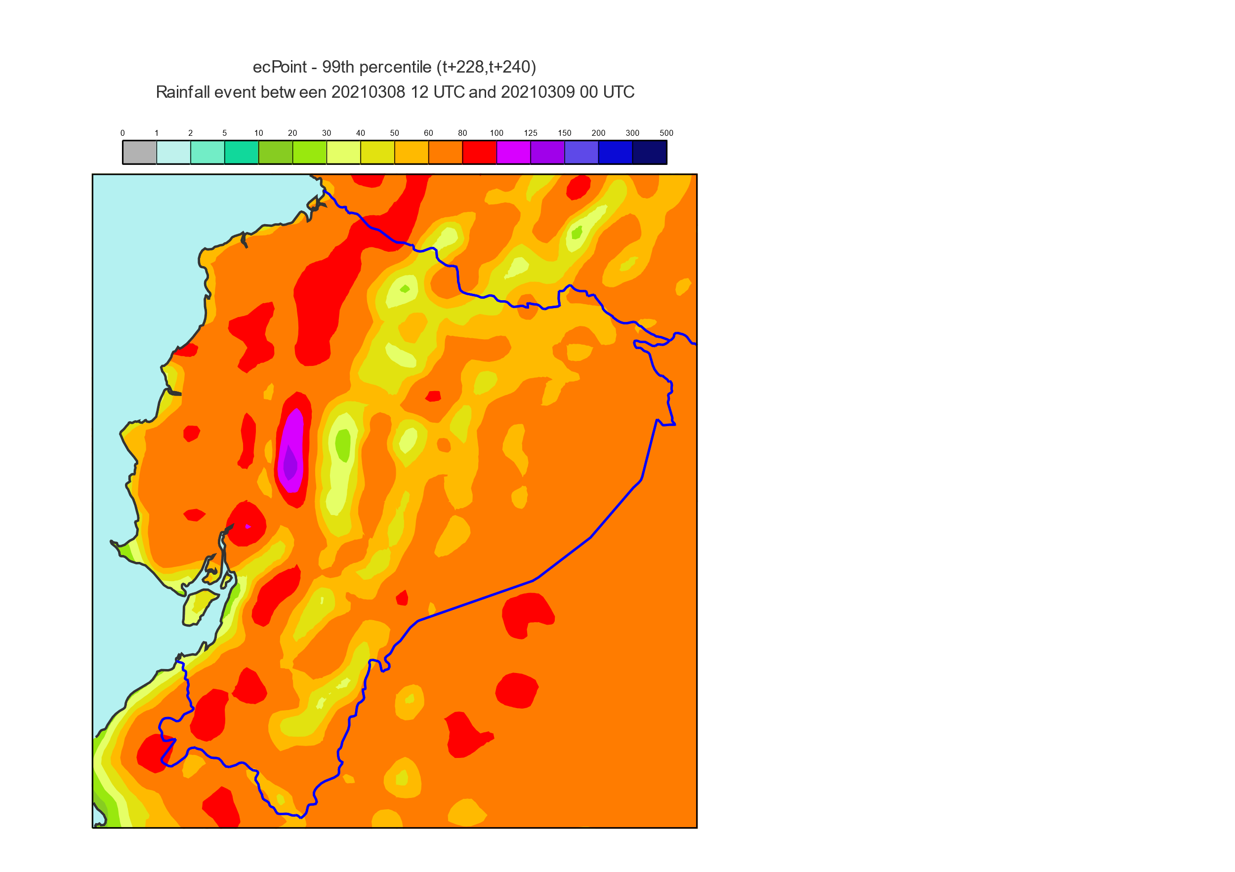
Percentiles for 12-hourly rainfall forecasts
RUN: 26th February 2020, 00 UTC (t+60, t+72)
VT: 28th February, from 06 to 18 UTC
ENS
ecPoint
0
a
c
1
2
5
85th percentile
10
20
30
40
50
mm/12h
b
d
60
80
100
99th percentile
125
150
200
300
500

