Slide 1
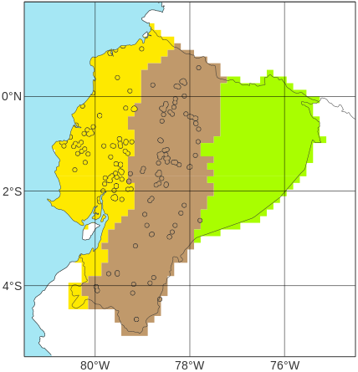
Schematic representation of how short-range ecPoint rainfall forecasts are used to determine verifying rainfall thresholds (VRT)
Location of the considered N point flood reports
(example taken for the 2019’s N=93 flood reports with EFFCI>=6 in “La Costa”)
100
b
x^{th}
a
Percentile
c
0
tp(x^{th})
Net distribution of the N flash-flood-triggering tp(x^{th}) events
100
x^{th}
100
Distribution of short-range ecPoint rainfall forecasts for each of the N point flood reports
Percentile
0
tp(x^{th})
Percentile
100
....
x^{th}
0
Rainfall [mm]
Percentile
0
tp(x^{th})
Rainfall [mm]
tp(x^{th}): flash-flood-triggering rainfall events
d
Rainfall climatology from SYNOP observations
e
Net distribution for x₁th percentile
Net distribution for x₂th percentile
Net distribution for x₃th percentile
Moderately severe rainfall events (TP_{MS})
Top ¼ most extreme flood events
100
Severe rainfall events (TP_{S})
100
P₃
P₂
Top ½ most extreme flood events
P₁
75
VRT_{MS}: candidate for moderately severe VRT
Top ¾ most extreme flood events
50
Percentile
Percentile
VRT_{S}: candidate for severe VRT
tp_{MS}
tp_{S}
25
50
0
tp₁
tp₂
tp₃
VRT_{MS}
VRT_{S}
Rainfall [mm]
Rainfall [mm]

