Slide 1
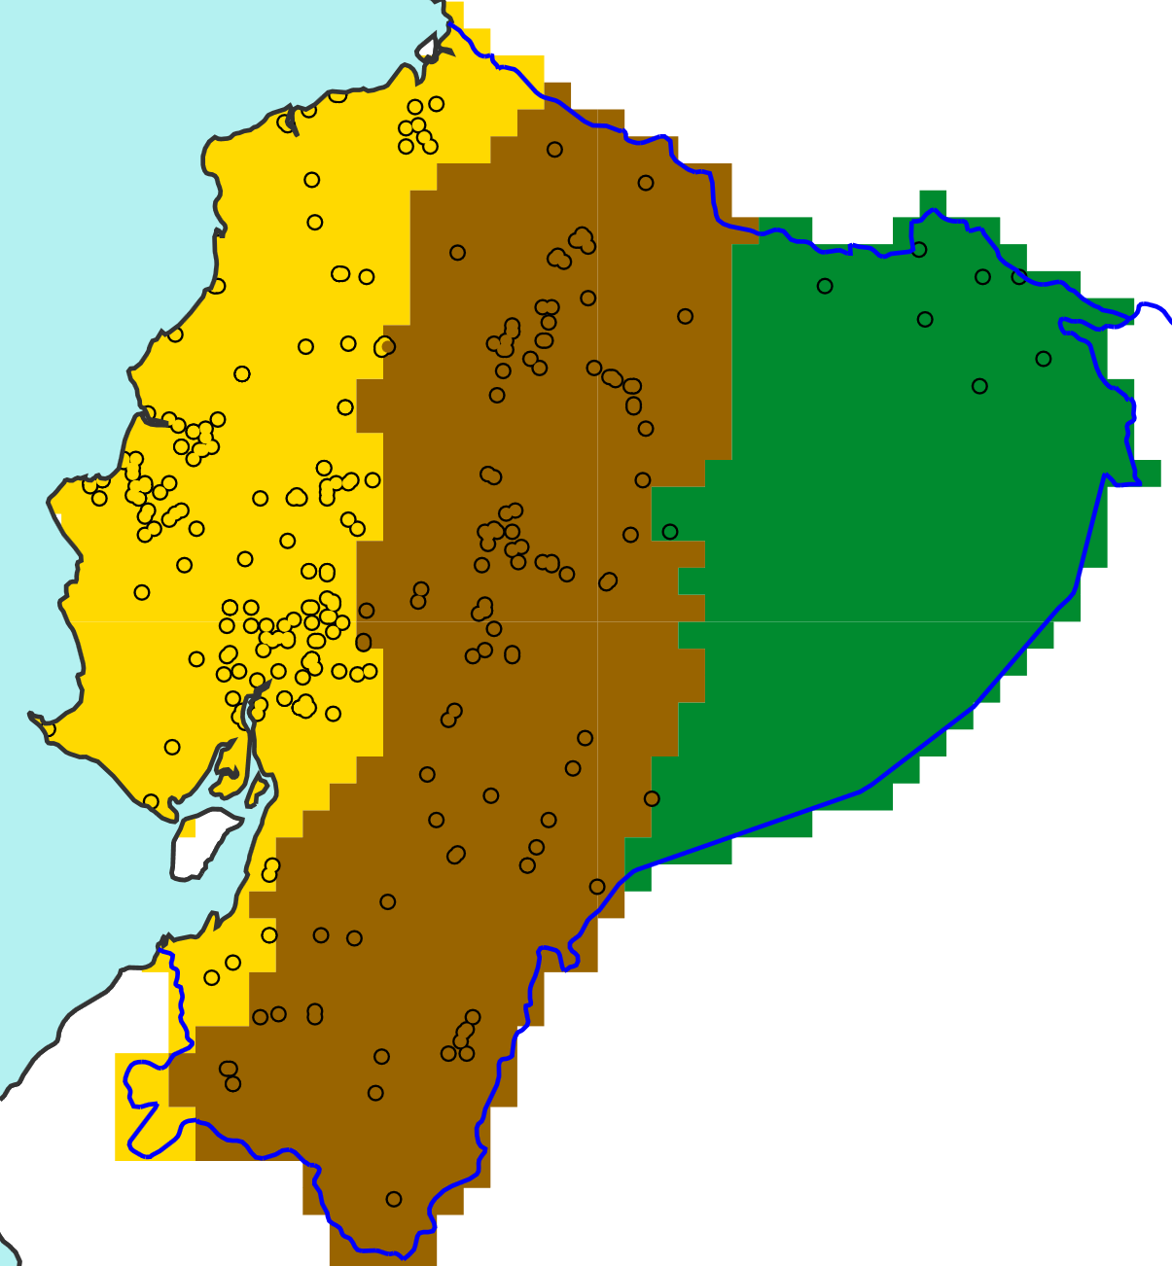

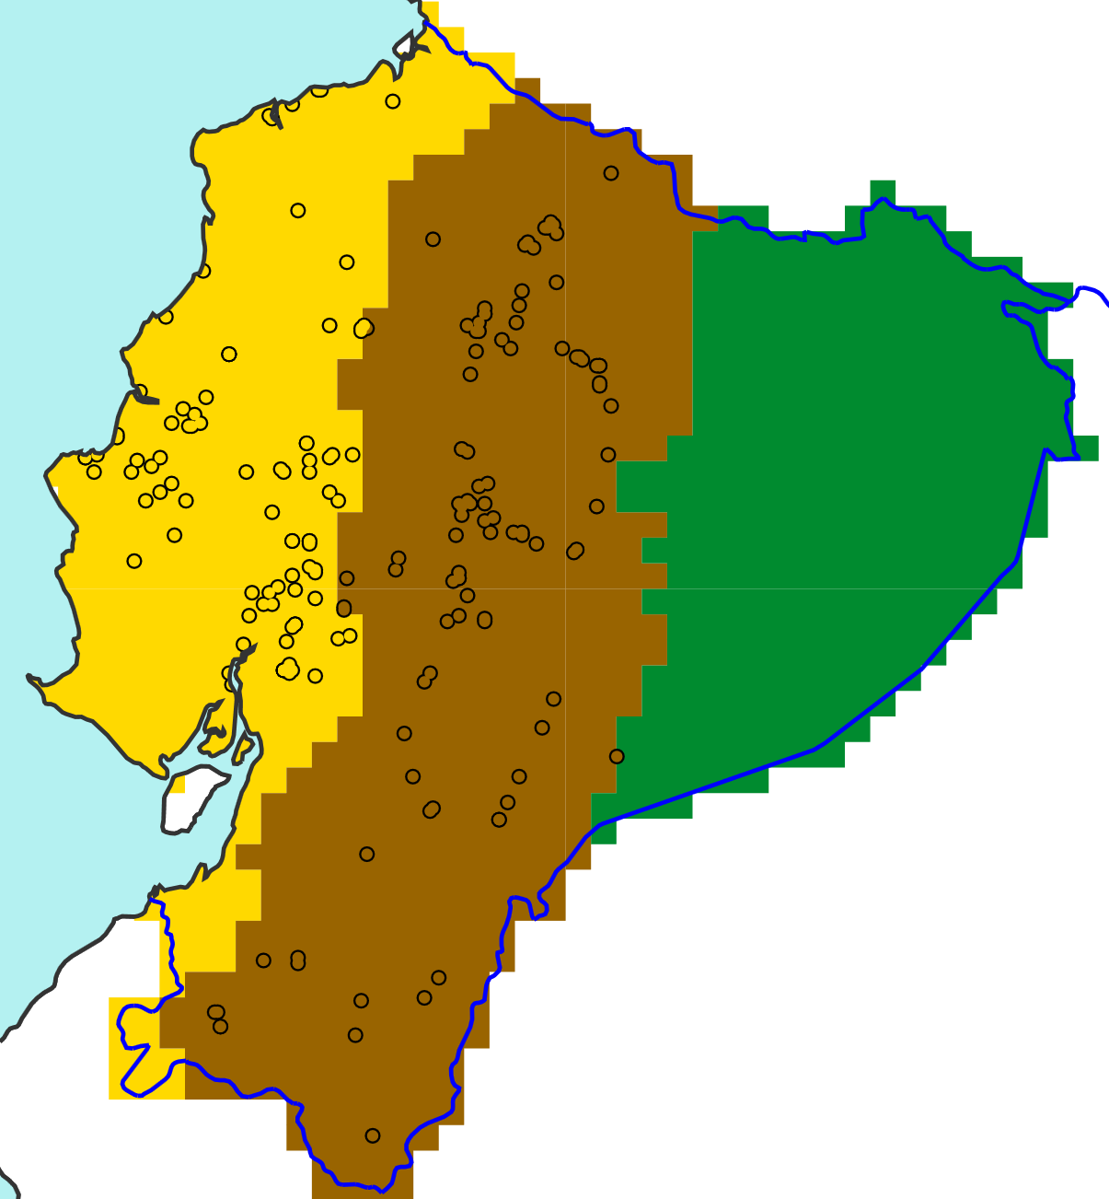
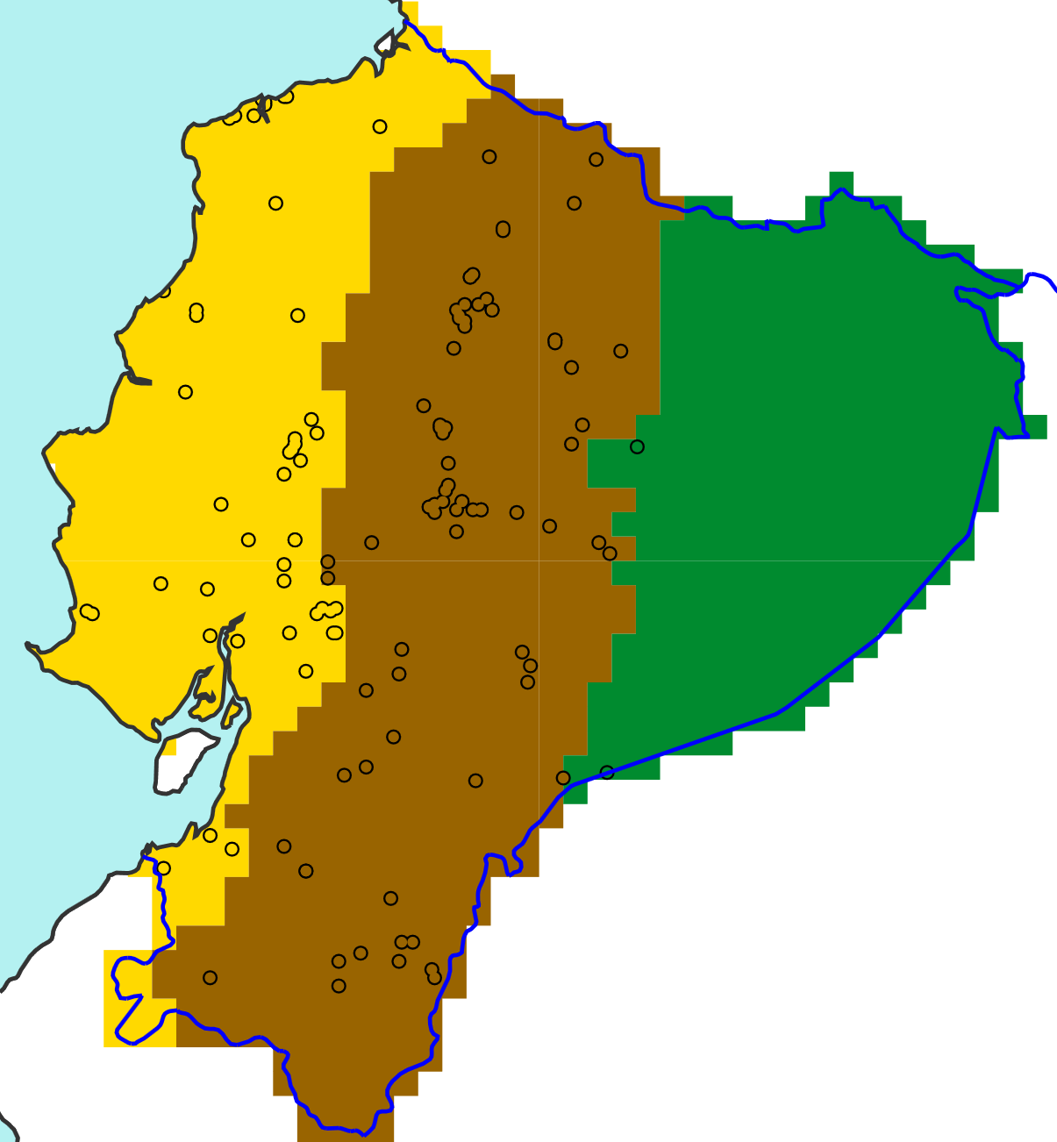
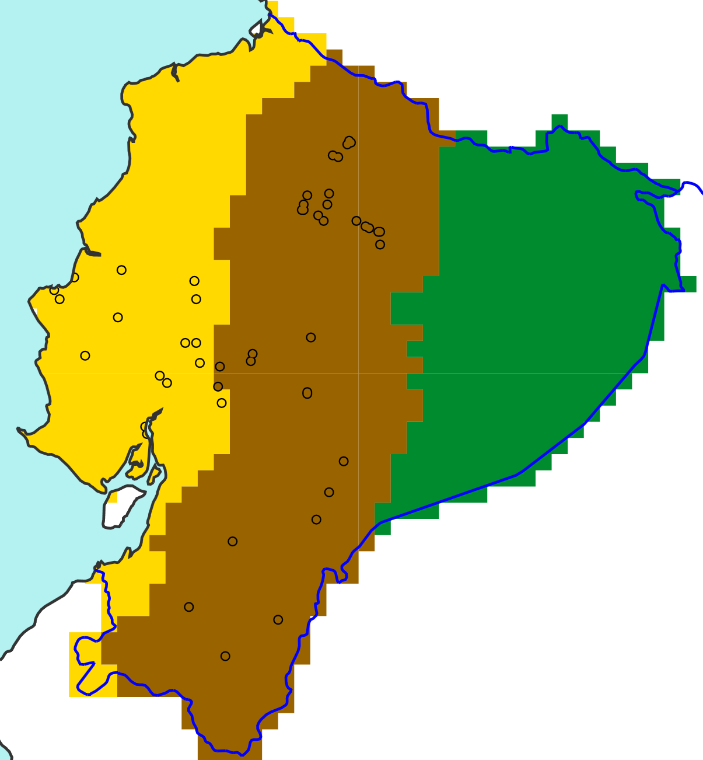

2019
2020
a
d
EFFCI >= 1
Point flood reports for:
“La Costa”
“La Sierra”
“El Oriente”
b
e
EFFCI >= 6
c
f
EFFCI >= 10

