Slide 1
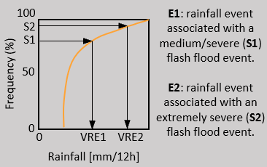
START
NO
Are VREs known?
YES
STOP
NO
Have flash flood reports for year X?
Read VREs
YES
Read flash flood reports
Compare performance in identifying areas at risk of flash floods for rainfall forecasts FC1 and FC2
Read rainfall observations
Have rainfall obs associated with the flash flood reports?
YES
Create distribution of rainfall totals associated with all flash flood reports.
NO
Have flash flood reports for year Y?
NO
STOP
Define VREs using short-range ecPoint-Rainfall forecasts.
Define VREs for flash floods with different levels of severity defined by percentiles of rainfall distribution.
Read flash flood reports
Read FC1 and FC2.
Create observational fields, for different VREs and accumulation period, and up to considered lead time.
Create forecasts fields, for different VREs and accumulation period, and up to considered lead time.
Method explained in Section 4.2 and Figure 5.
Results presented in Section 5.1 and Figure 6.
Compute correspondent contingency tables.
Compute ROC curves for different VREs and accumulation periods.
Compute Areas under the ROC curve (AROC) for different VREs.

Slide 2
100
E1: rainfall event associated with a medium/severe (S1) flash flood event.
E2: rainfall event associated with an extremely severe (S2) flash flood event.
S2
Frequency (%)
S1
50
0
0
VRE1
VRE2
Rainfall [mm/12h]
Area under the ROC Curve (AROC)
(for Rainfall >= x mm )
AROC [-]
1
0.75
0.5
No skilful forecasts
Forecast n.1
Forecast n.2
0
0
1
2
3
4
5
6
7
8
9
10
Lead Times [LT, in days]
ROC Curve
(for Rainfall >= x mm )
Hit Rate (HR)
1
0.5
Forecast n.1
0
Forecast n.2
0
0.5
1
False Alarm Rate (FAR)

