Slide 1
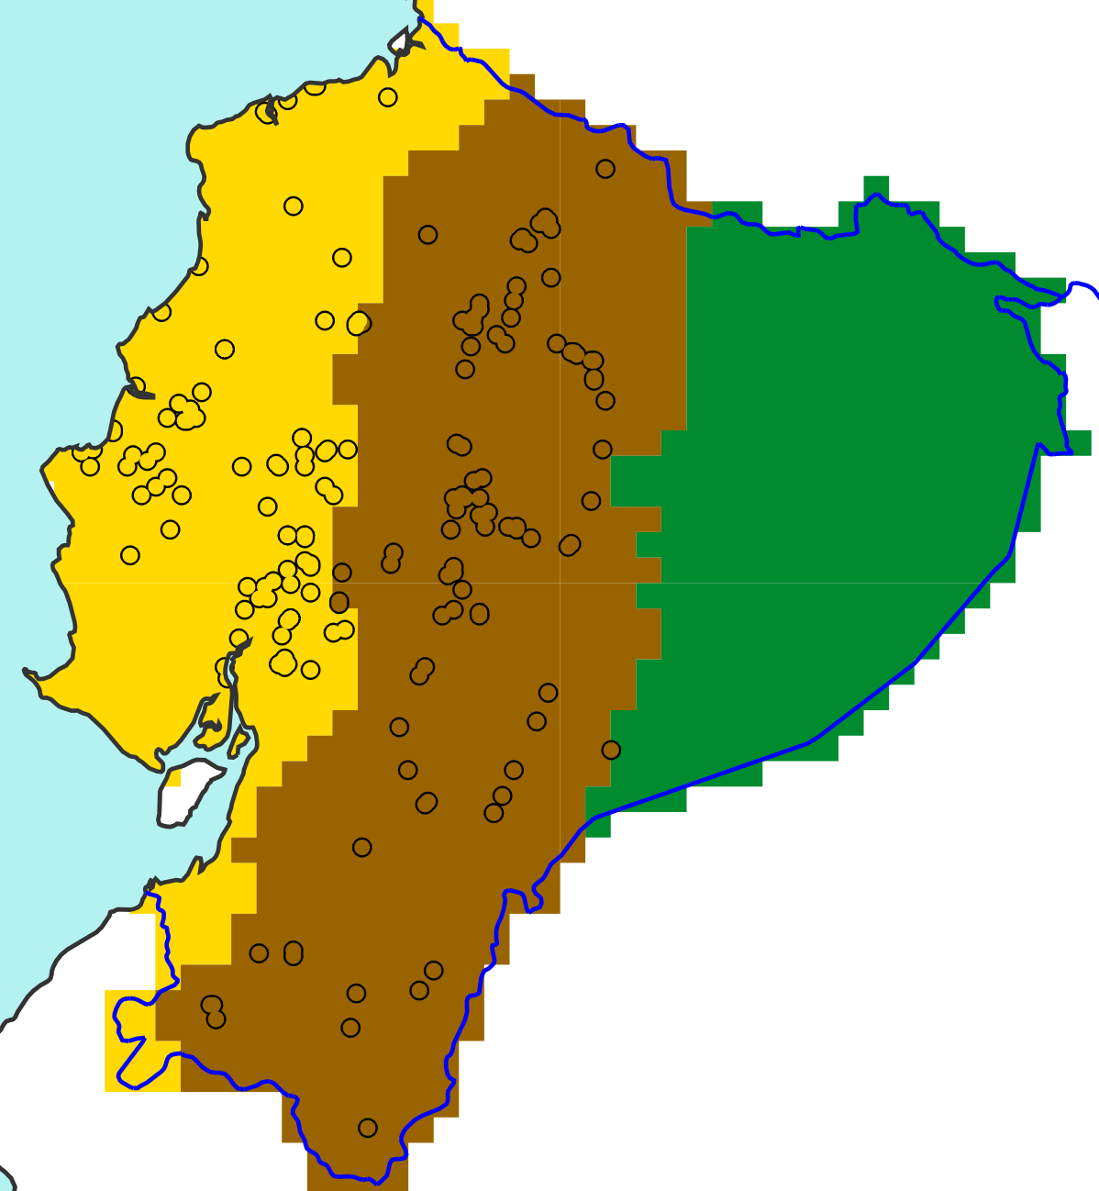
100
b
x^{th}
a
c
Percentile
Net distribution of the N tp(x^{th}) values
0
100
100
tp(x^{th})
75% of point flood reports retained
x^{th}
Percentile
Percentile
Short-range ecPoint-Rainfall realizations, one distribution
for each of the N point flood reports
0
tp(x^{th})
25th
....
100
0
tp(25th) = VRE
x^{th}
Point flood reports for:
Rainfall [mm]
“La Costa”
Percentile
“La Sierra”
“El Oriente”
0
tp(x^{th})
N point flood reports in “La Costa”
Rainfall [mm]

