Slide 1
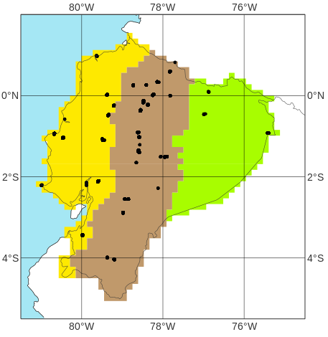
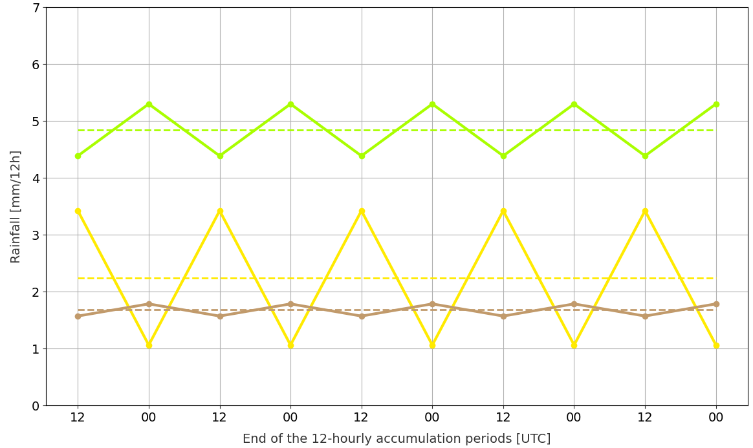
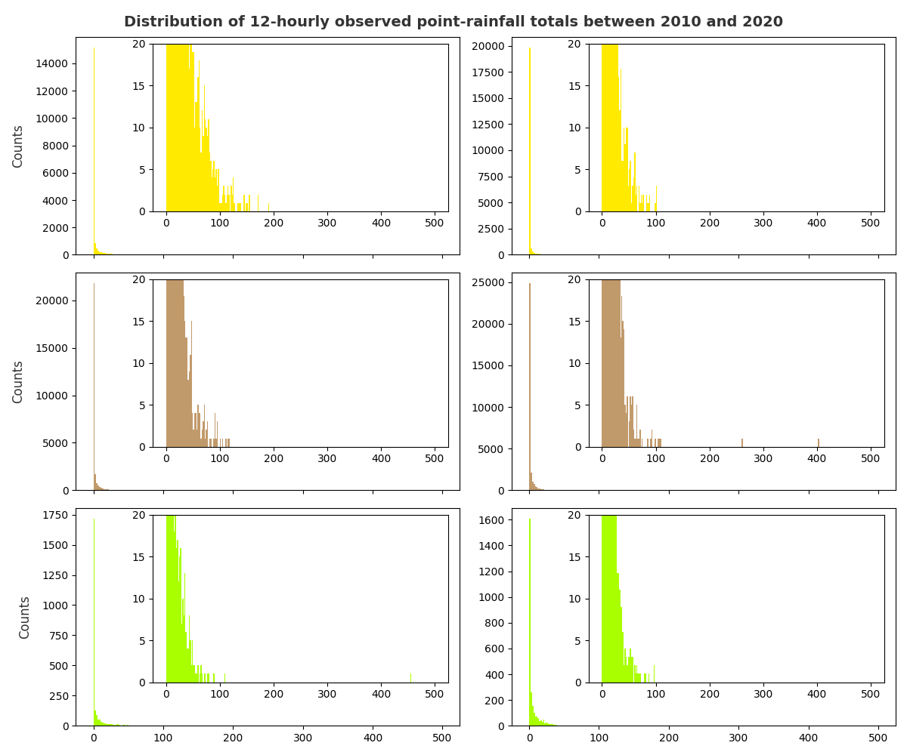
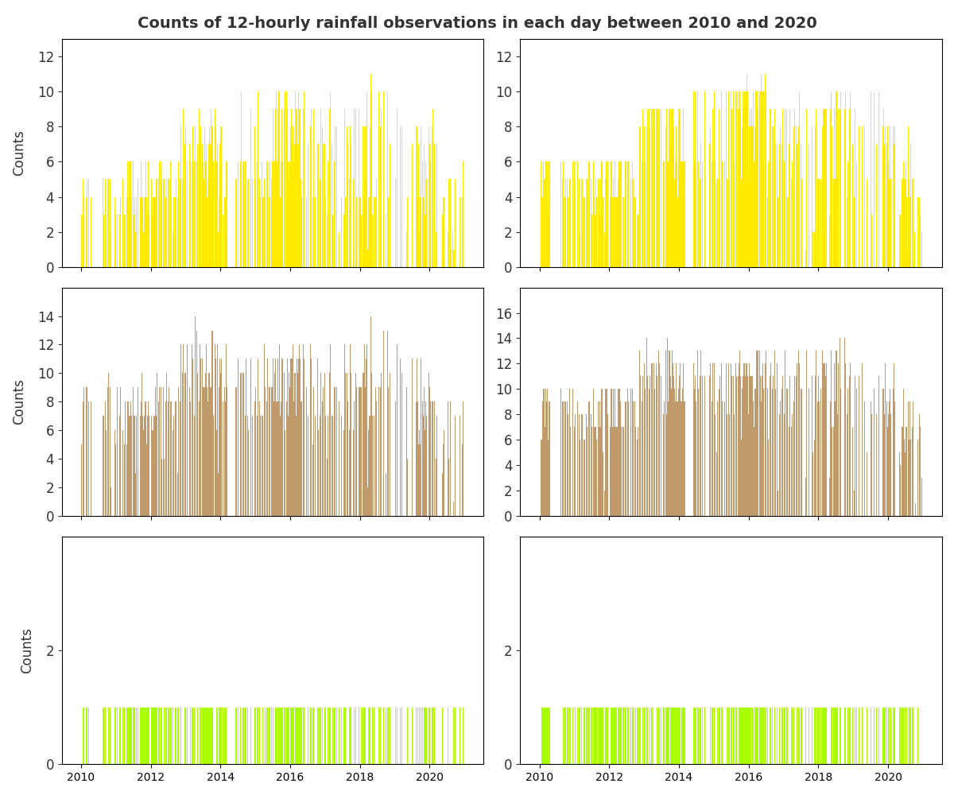
Description of SYNOP observations of 12-hourly rainfall between 2010-01-01 and 2020-12-31
Location of all observations
a
Rainfall diurnal cycle averaged over the period
c
“La Costa”
“La Sierra”
“El Oriente”
Distribution of rainfall totals
d
Counts of observations each day
b
Accumulation periods
ending at 12 UTC
Accumulation periods
ending at 00 UTC
Accumulation periods
ending at 12 UTC
Accumulation periods
ending at 00 UTC
Rainfall [mm /12h]
Rainfall [mm /12h]

