Slide 1
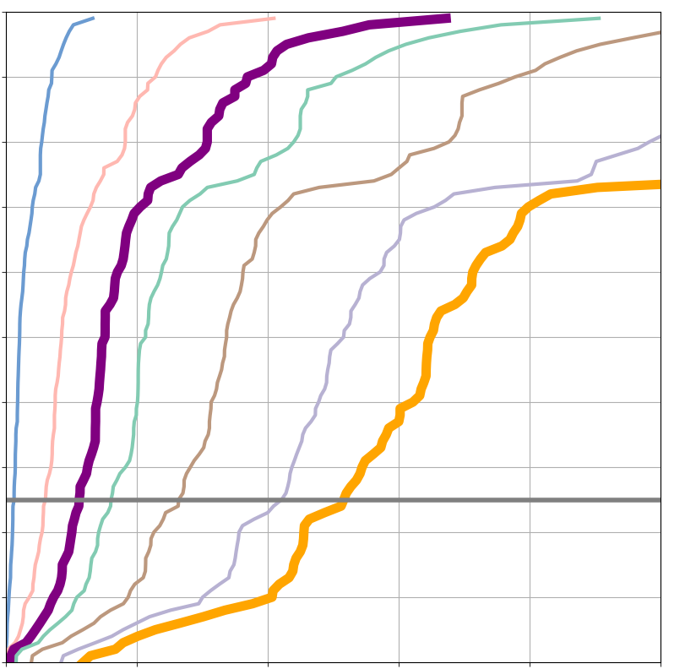
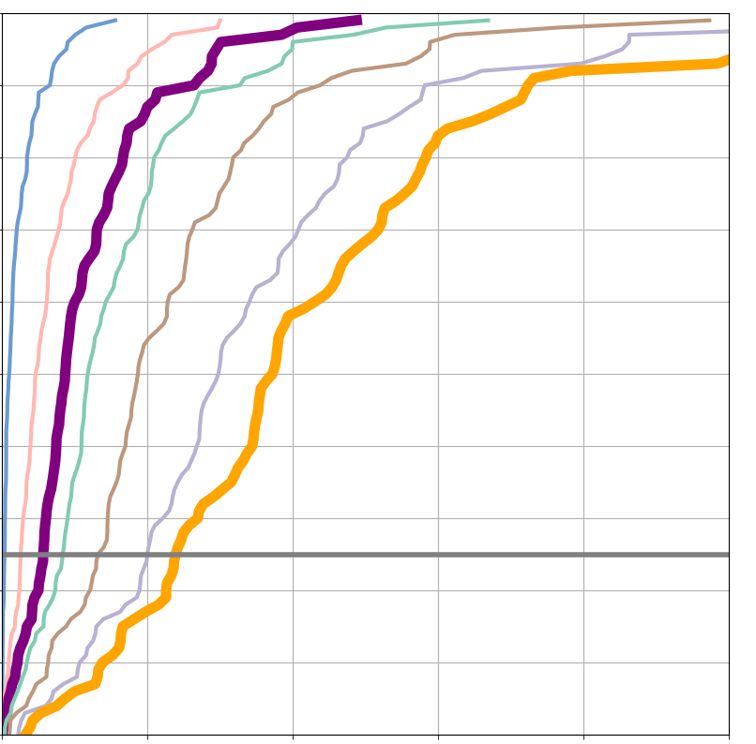
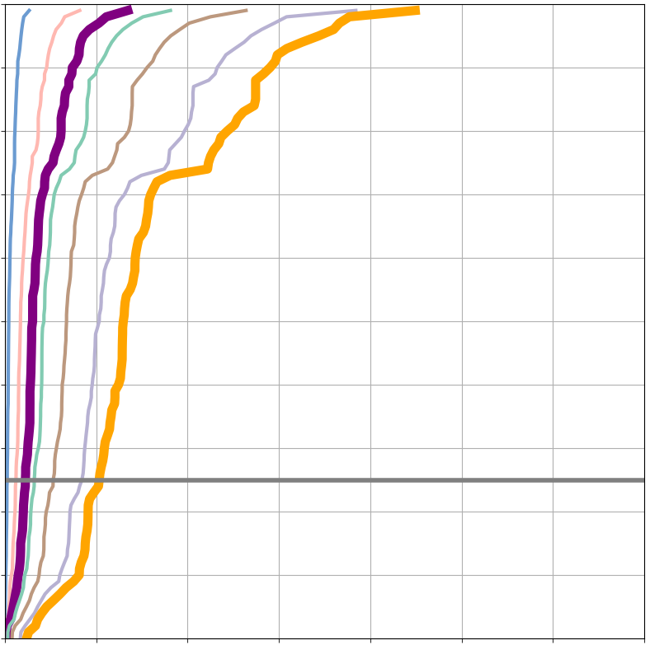
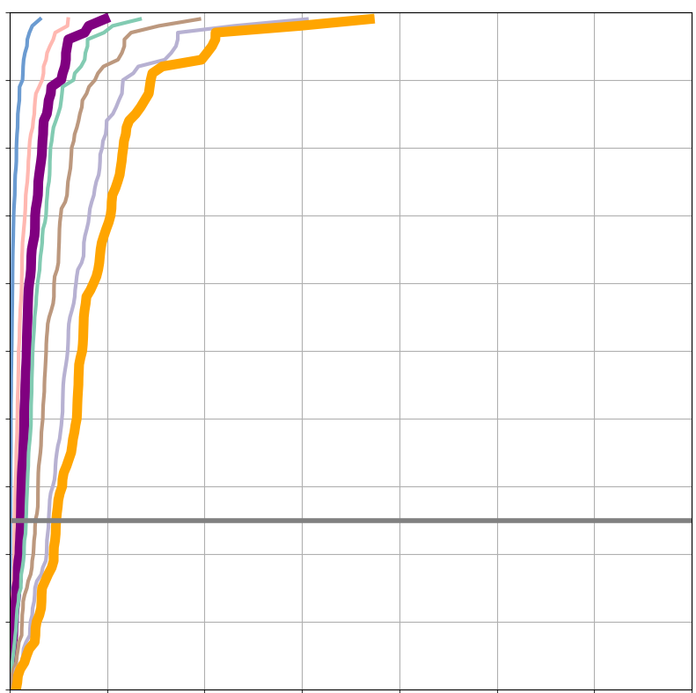
VRTs from short-range ecPoint rainfall forecasts
50th perc
75th perc
85th perc
90th perc
95th perc
98th perc
99th perc
VRT_{MS}
VRT_{S}
EFFCI >= 6
La Costa
La Sierra
a
100
b
100
90
90
100
80
100
80
80
70
70
80
60
60
60
Percentiles [%]
60
50
50
Percentiles [%]
40
40
40
40
20
30
75% FRs retained
20
30
75% FRs retained
0
20
20
0
0
50
150
250
350
10
0
50
150
250
350
10
0
0
0
20
40
60
80
100
0
20
40
60
80
100
Rainfall [mm/12h]
Rainfall [mm/12h]

