Slide 1
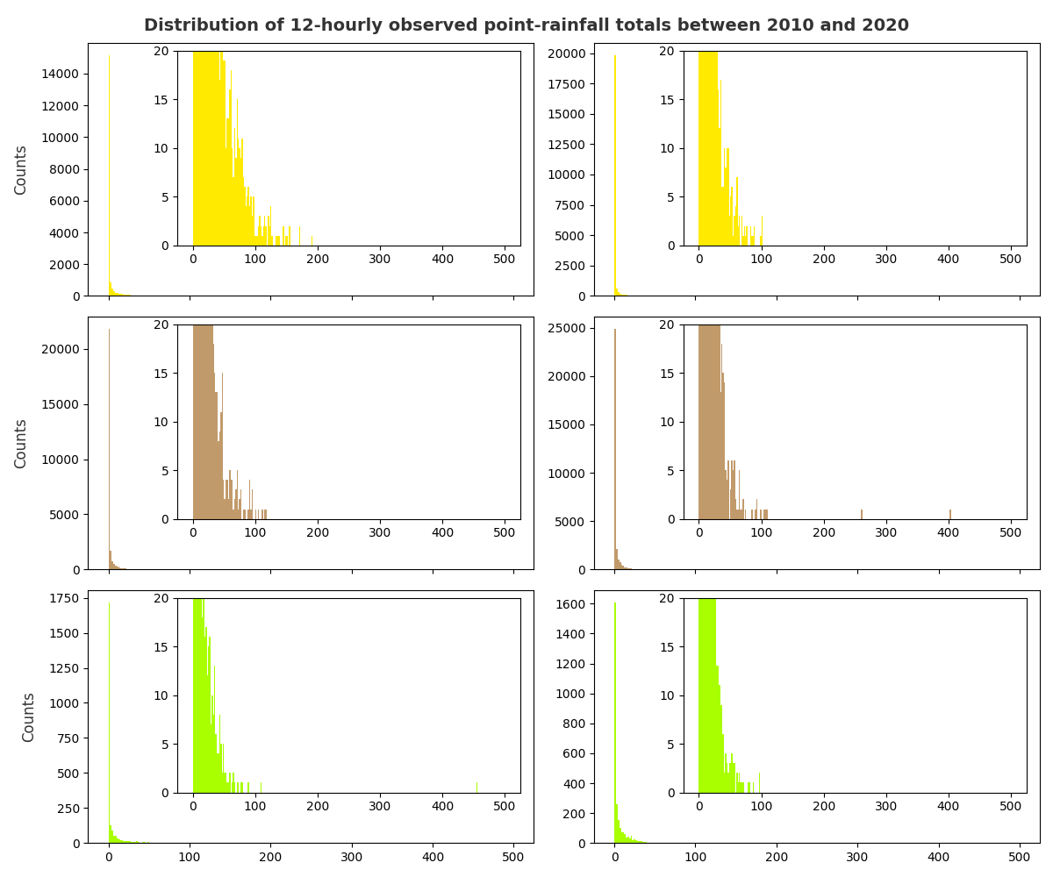
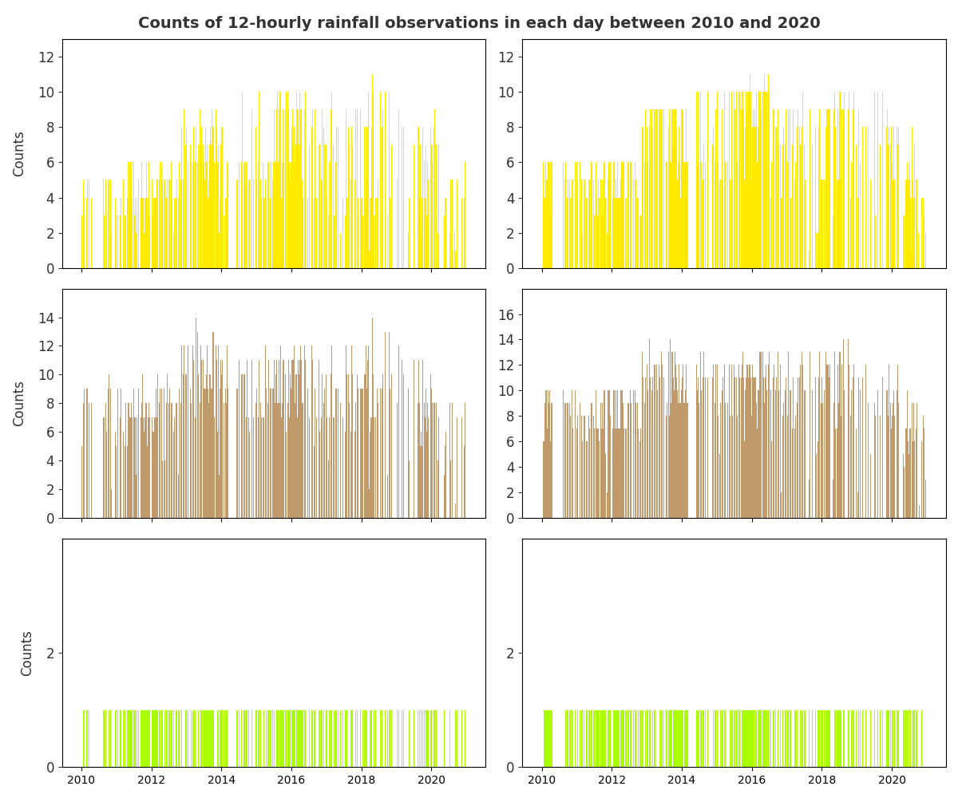
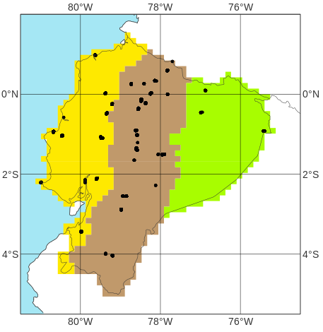
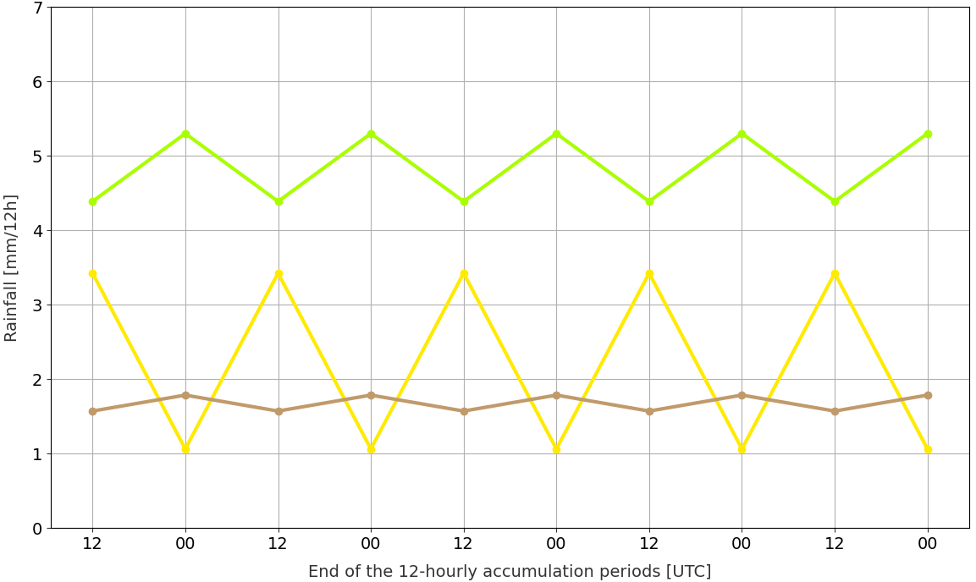
Description of SYNOP observations of 12-hourly rainfall between 2010-01-01 and 2020-12-31
Distribution of rainfall totals
Counts of observations each day
b
a
Accumulation periods
ending at 12 UTC
Accumulation periods
ending at 00 UTC
Accumulation periods
ending at 12 UTC
Accumulation periods
ending at 00 UTC
Rainfall [mm /12h]
Rainfall [mm /12h]
Location of observations
c
Rainfall diurnal cycle averaged over the period
d
“La Costa”
“La Sierra”
“El Oriente”

