Slide 1
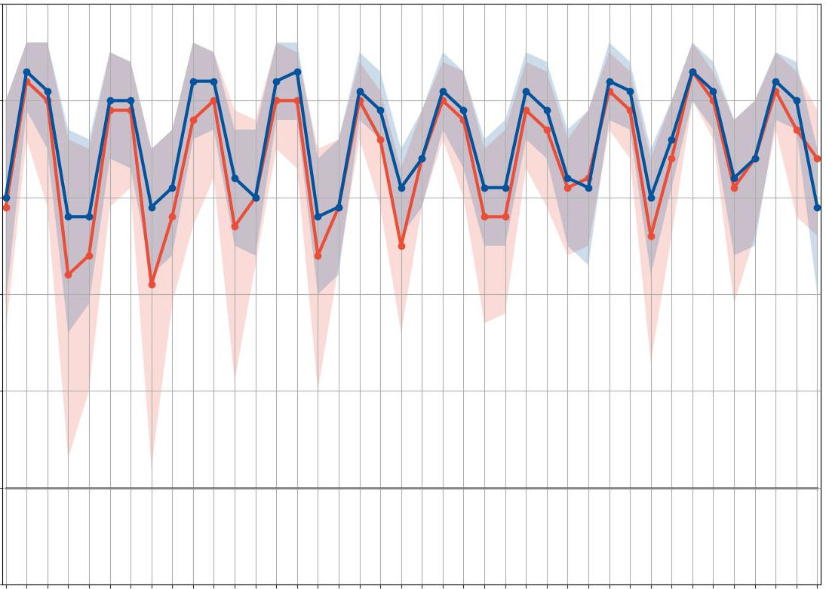
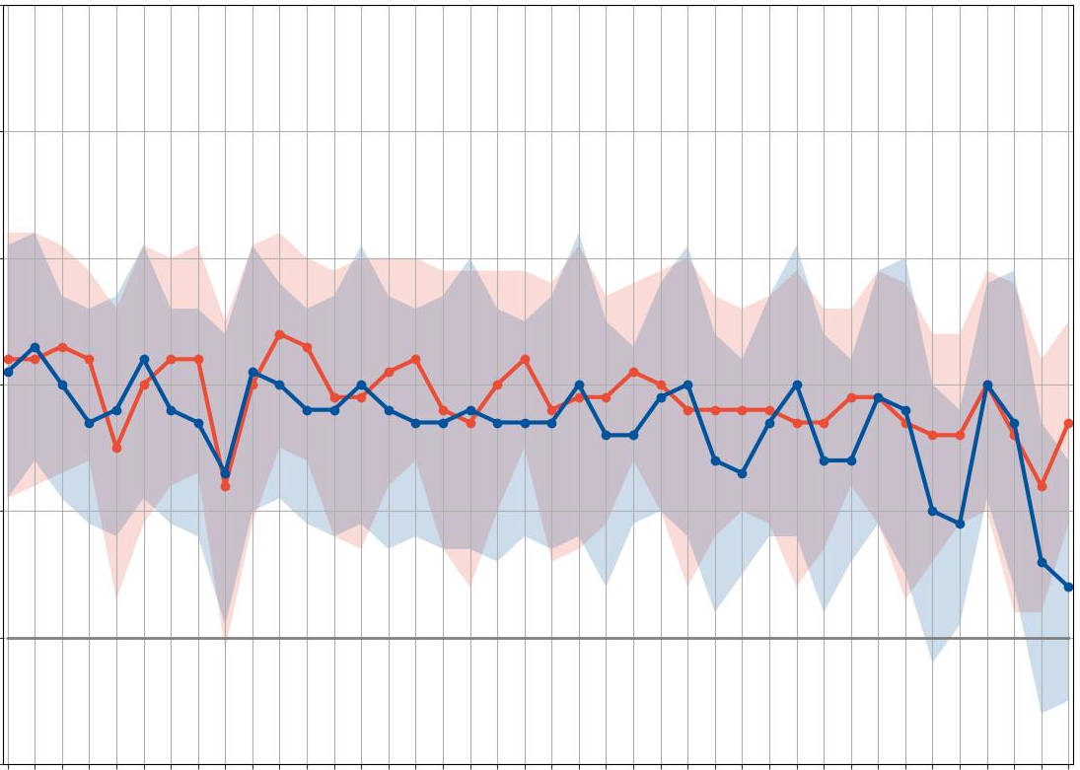
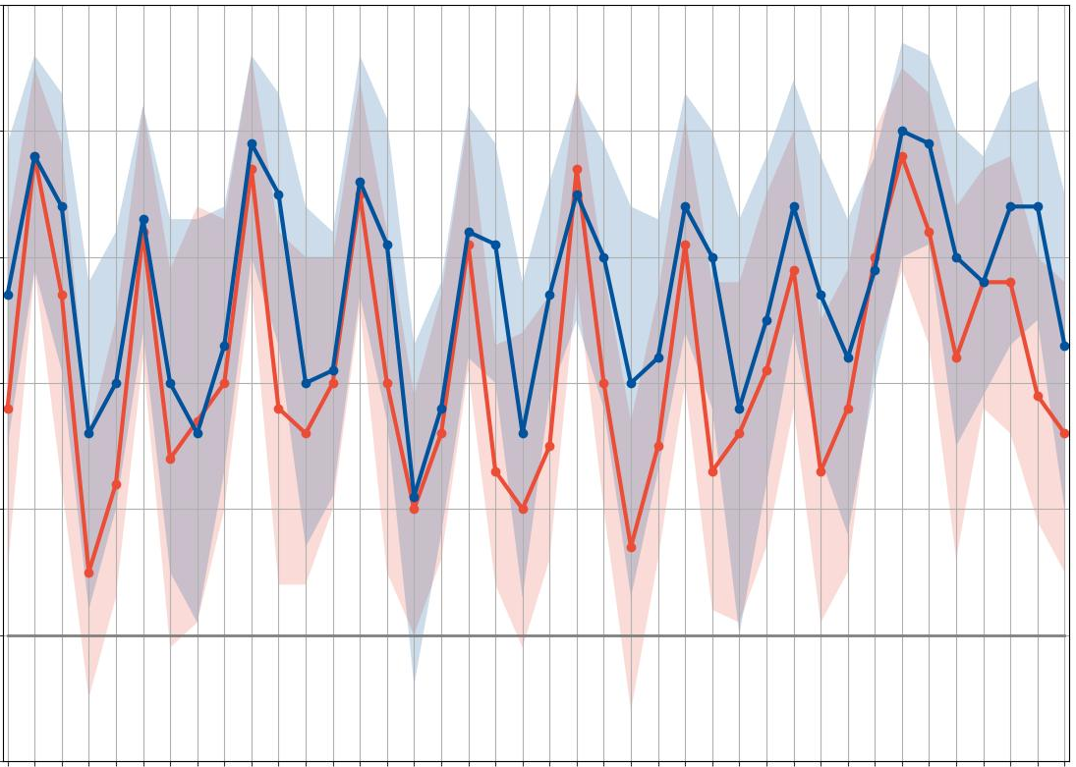
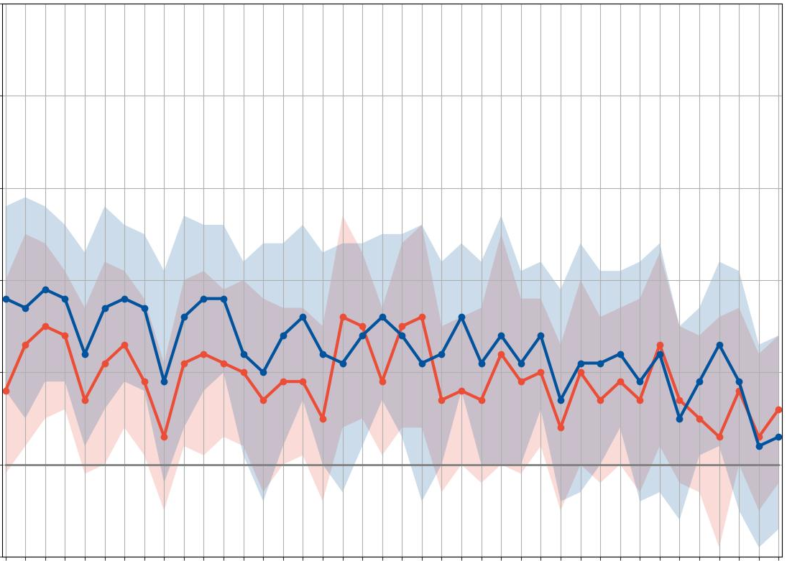
Area Under the ROC curve (AROC)
AROC
95% CI
12-hourly accumulation periods
ENS
Nighttime
Daytime
ecPoint
0000 – 1200 UTC (1800 – 0600 LT)
1200 – 0000 UTC (0600 – 1800 LT)
0600 – 1800 UTC (0000 – 1200 LT)
1800 – 0600 UTC (1200 – 0000 LT)
1
La Costa
La Sierra
c
VRT_{MS} = 6 mm/12h
.9
.8
Better score
.7
AROC [-]
tp >= VRT_{MS}
.6
.5
No skill
a
VRT_{MS} = 10 mm/12h)
.4
12
24
36
48
60
72
84
96
108
120
132
144
156
168
180
192
204
216
228
240
12
24
36
48
60
72
84
96
108
120
132
144
156
168
180
192
204
216
228
240
1
18
30
42
54
66
78
90
102
114
126
138
150
162
174
186
198
210
222
234
246
18
30
42
54
66
78
90
102
114
126
138
150
162
174
186
198
210
222
234
246
d
VRT_{S} = 26 mm/12h
.9
.8
Better score
.7
tp >= VRT_{S}
AROC [-]
.6
.5
No skill
b
VRT_{S} = 50 mm/12h
.4
12
24
36
48
60
72
84
96
108
120
132
144
156
168
180
192
204
216
228
240
12
24
36
48
60
72
84
96
108
120
132
144
156
168
180
192
204
216
228
240
18
30
42
54
66
78
90
102
114
126
138
150
162
174
186
198
210
222
234
246
18
30
42
54
66
78
90
102
114
126
138
150
162
174
186
198
210
222
234
246
Lead time steps for the 00 UTC run and at the end of the
12-hourly accumulation periods [in hours]
Lead time steps for the 00 UTC run and at the end of the
12-hourly accumulation periods [in hours]
D1
D2
D3
D4
D5
D6
D7
D8
D9
D10
D1
D2
D3
D4
D5
D6
D7
D8
D9
D10
Lead times (in days)
Lead times (in days)

