Slide 1
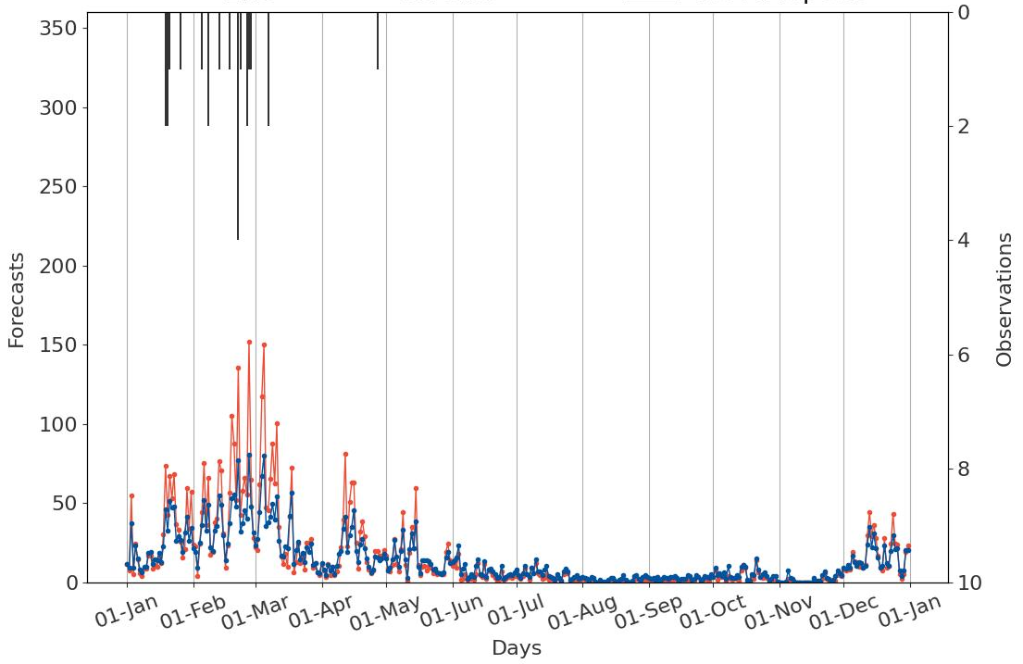
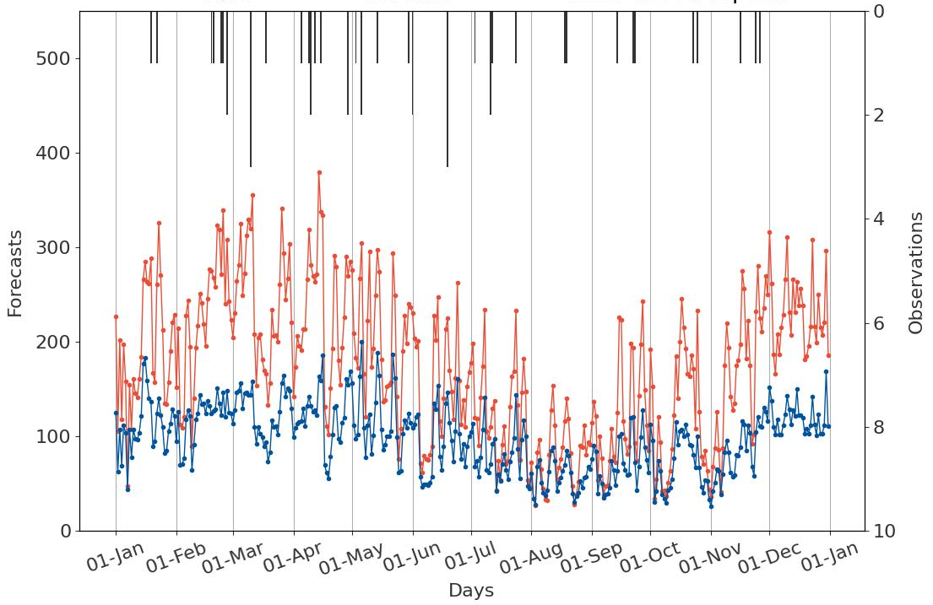
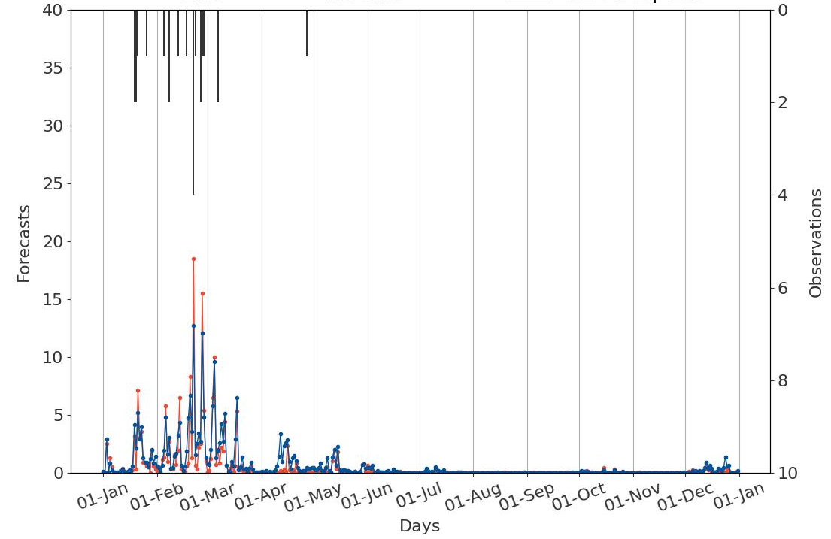
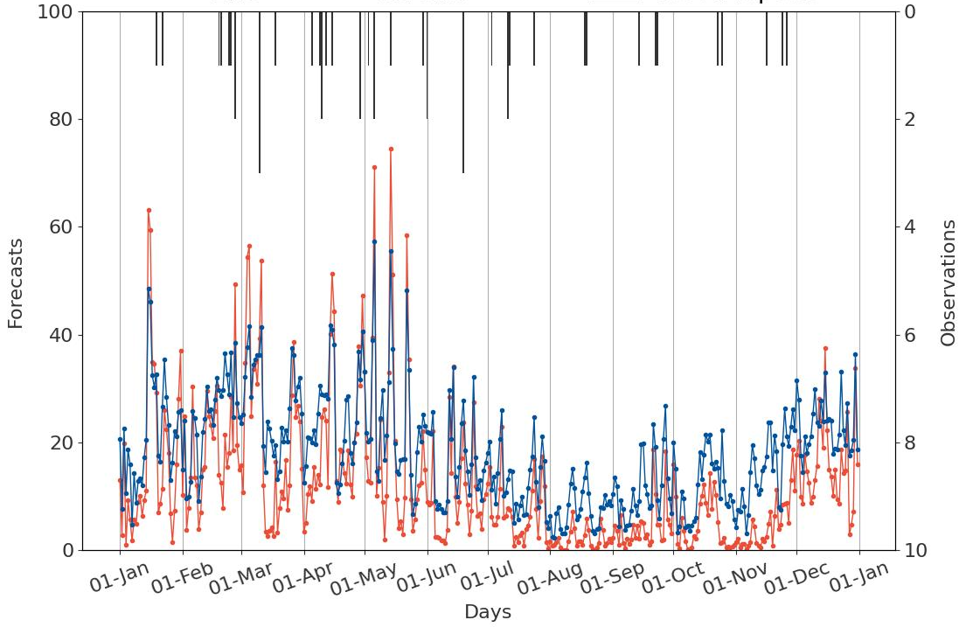
Counts of yes-events in forecasts and observations
ENS
ecPoint
Flood reports
La Costa
La Sierra
a
c
tp >= VRT_{MS}
b
d
tp >= VRT_{S}

