Slide 1
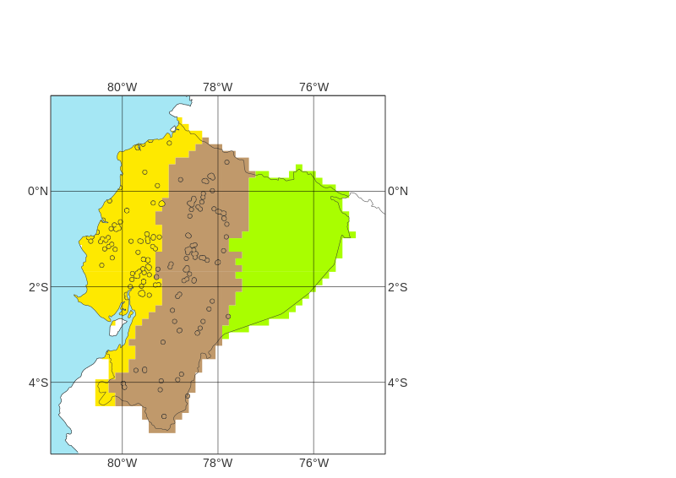
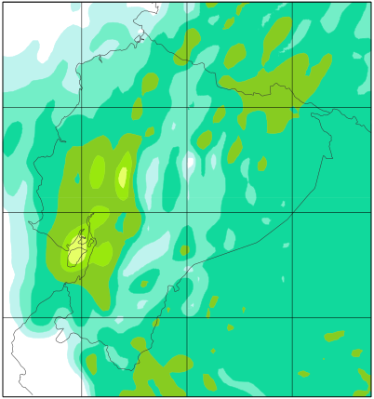
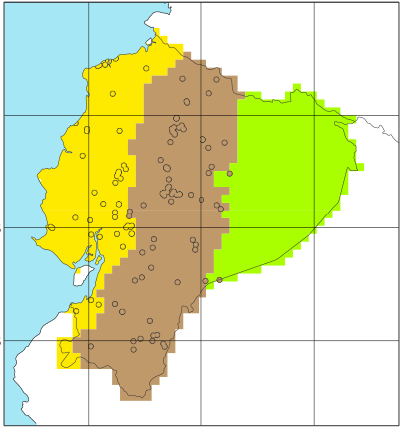
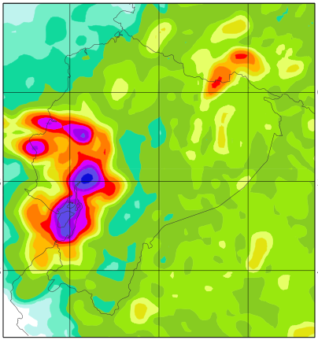
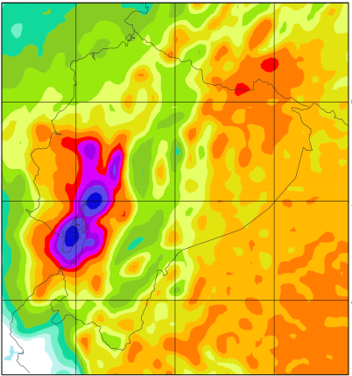
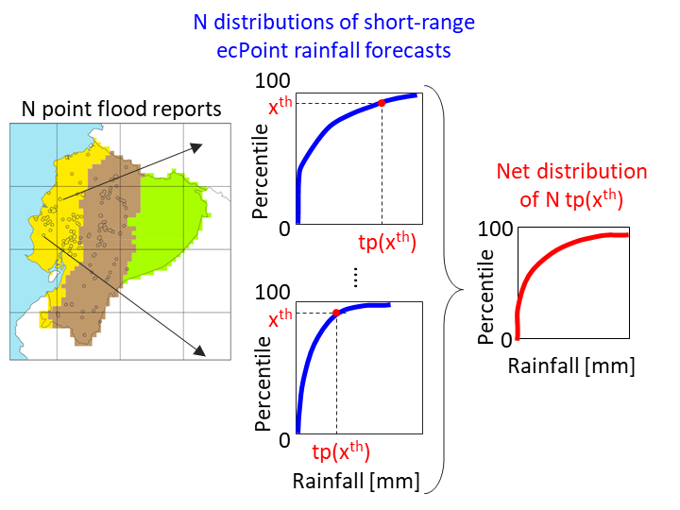
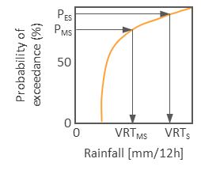
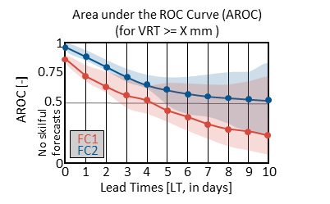
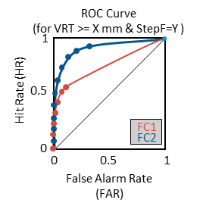
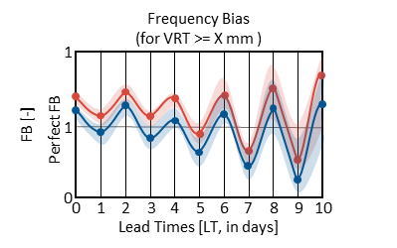

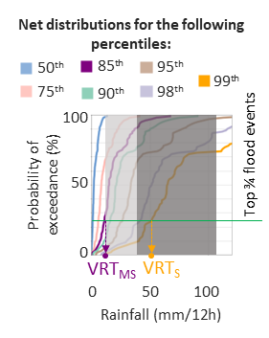
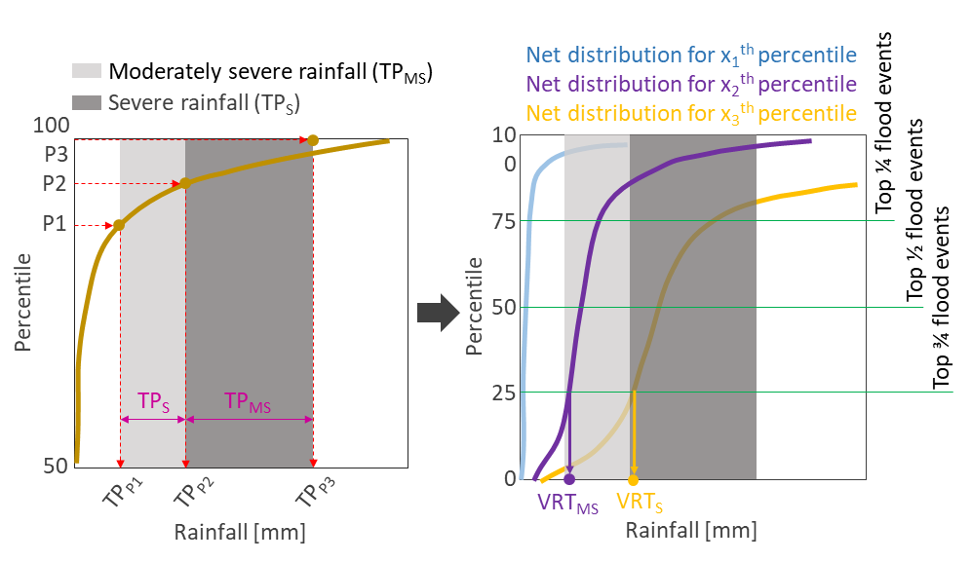
Definition of Verifying Rainfall Thresholds (VRTs)
START: analyse performance of rainfall forecasts (FC) in identifying areas at risk of flash floods.
Objective verification analysis
STOP
NO
Have point flash flood reports (FFR) for year X?
NO
YES
Are VRTs known?
Read VREs
YES
Have point FFRs for year Y?
NO
STOP
Read point FFRs
Figure 2b
YES
Read OBS
Are high-density point-rainfall observations (OBS) associated with FFRs available?
Read point FFRs
Read FC1 and FC2
YES
Create distribution of OBS associated with FFRs and select percentiles P_{MS} and P_{S} defining VRTs for moderately severe (VRT_{MS}) and severe (VRT_{S}) flash floods.
NO
Figure 2e
FC1
Figure 5a & 5b
FC2
Figure 5c & 5d
Read short-range ecPoint FC
Figure 5c & 5d
Create observational fields, for different VREs and accumulation periods, up to medium-range leads.
Create forecasts fields, for different VREs and accumulation periods, up to medium-range leads.
Define the net distribution of rainfall totals associated with FFRs from short-range ecPoint forecasts.
Calculation of forecast discrimination ability
Compute ROC curves for different VRTs and accumulation periods, and Areas under the ROC curve (AROC) for different VRTs.
Calculation of forecast reliability
Compute Frequency Bias for different VRTs.
Section 4.2.1
Section 4.2.2
Section 4.1 & Figure 8a-c
Are OBS available to create an observational rainfall climatology (Clim_{OBS})?
NO
Identify range of values for moderately severe (TP_{MS}) and severe (TP_{S}) rainfall events from online search.
YES
Select the most appropriate VRT_{MS} and VRT_{S} maximizing the number of flood reports considered in the analysis.
Section 5.2.1 & Figure 10
Section 5.2.1 & Figure 11
Section 5.2.2 & Figure 12
Read OBS
Figure 2b
Create Clim_{OBS} to define range of values for moderately severe (TP_{MS}) and severe (TP_{S}) rainfall events. It will help to define the VRT_{MS} and VRT_{S.}
END
Section 4.1 & Figure 8d-e
Section 5.1 & Figure 9

Slide 2
100
Probability of exceedance (%)
P_{ES}
P_{MS}
50
0
0
VRT_{MS}
VRT_{S}
Rainfall [mm/12h]
ROC Curve
(for VRT >= X mm & StepF=Y )
Area under the ROC Curve (AROC)
(for VRT >= X mm )
Frequency Bias
(for VRT >= X mm )
Hit Rate (HR)
1
1
FB [-]
1
AROC [-]
0.75
0.5
1
0.5
Perfect FB
FC1
No skilful forecasts
FC2
FC1
0
0
FC2
0
1
2
3
4
5
6
7
8
9
10
0
0.5
1
0
0
1
2
3
4
5
6
7
8
9
10
Lead Times [LT, in days]
False Alarm Rate (FAR)
Lead Times [LT, in days]

Slide 3
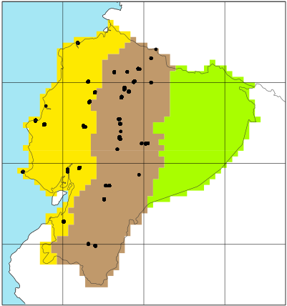
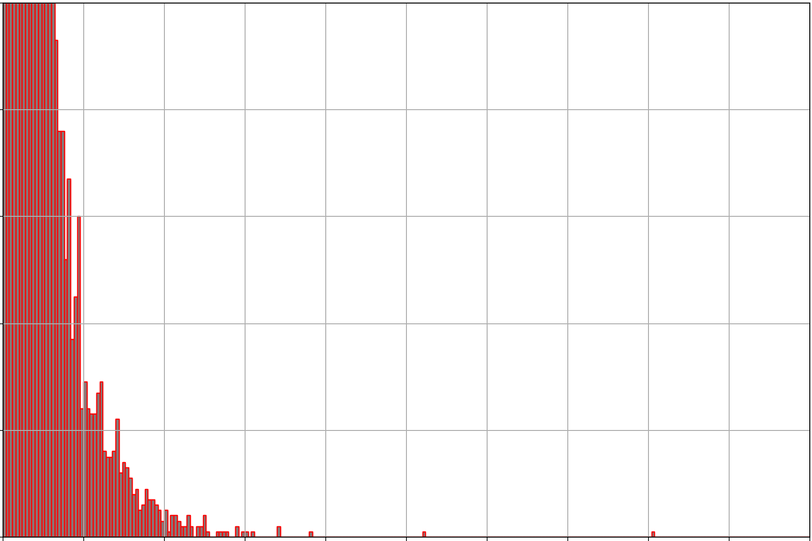
N distributions of short-range ecPoint rainfall forecasts
100
N point flood reports
x^{th}
Percentile
Net distribution of N tp(x^{th})
0
tp(x^{th})
100
100
....
Percentile
x^{th}
0
Percentile
Rainfall [mm]
0
tp(x^{th})
Rainfall [mm]
OBS location
OBS distribution
Frequency [-]
100
80
60
40
20
0
200
400
0
Rainfall [mm/12h]

Slide 4
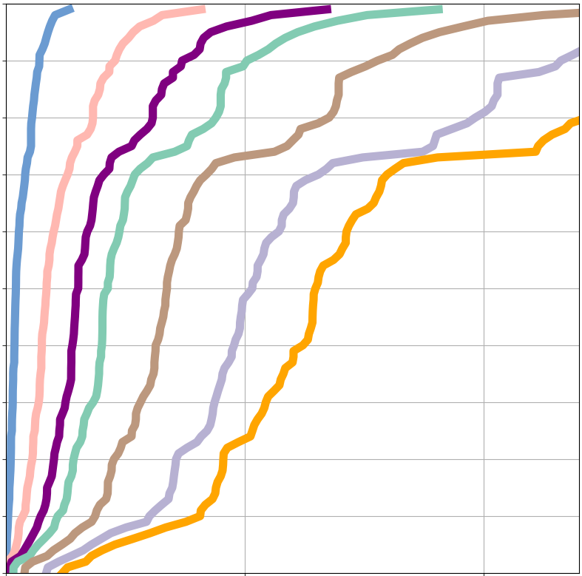
Net distributions for the following percentiles:
50th
85th
95th
99th
75th
90th
98th
100
Probability of exceedance (%)
Top ¾ flood events
50
0
Rainfall (mm/12h)
VRT_{MS}
VRT_{S}
0
50
100
Moderately severe rainfall (TP_{MS})
Net distribution for x₁th percentile
Net distribution for x₂th percentile
Net distribution for x₃th percentile
Severe rainfall (TP_{S})
Top ¼ flood events
100
100
P3
P2
Top ½ flood events
P1
75
Percentile
50
Top ¾ flood events
Percentile
TP_{S}
TP_{MS}
25
50
0
TP_{P1}
TP_{P2}
TP_{P3}
VRT_{MS}
VRT_{S}
Rainfall [mm]
Rainfall [mm]

