Slide 1
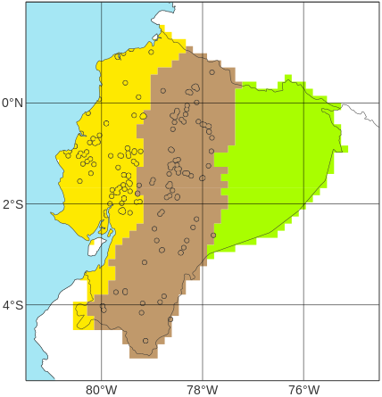
Schematic representation of the definition of verifying rainfall thresholds (VRTs) using short-range ecPoint rainfall forecasts
Location of N point flood reports in “La Costa”, with EFFCI>=6, in 2019 (from Figure 3b)
b
100
x^{th}
a
Percentile
c
0
Net distribution of the N tp(x^{th}) values
100
tp(x^{th})
100
x^{th}
Distribution of short-range ecPoint rainfall forecasts (i.e., realizations) for each of the N point flood reports.
Percentile
Percentile
0
tp(x^{th})
100
....
x^{th}
0
Rainfall [mm]
Percentile
0
tp(x^{th})
Rainfall [mm]
d
Moderately severe rainfall (TP_{MS})
e
Net distribution for x₁th percentile
Net distribution for x₂th percentile
Net distribution for x₃th percentile
Severe rainfall (TP_{S})
100
100
P3
Top ¼ flood events
P2
P1
75
Top ½ flood events
Percentile
50
Percentile
Top ¾ flood events
TP_{S}
TP_{MS}
25
50
0
TP_{P1}
TP_{P2}
TP_{P3}
VRT_{MS}
VRT_{S}
Rainfall [mm]
Rainfall [mm]

