Slide 1
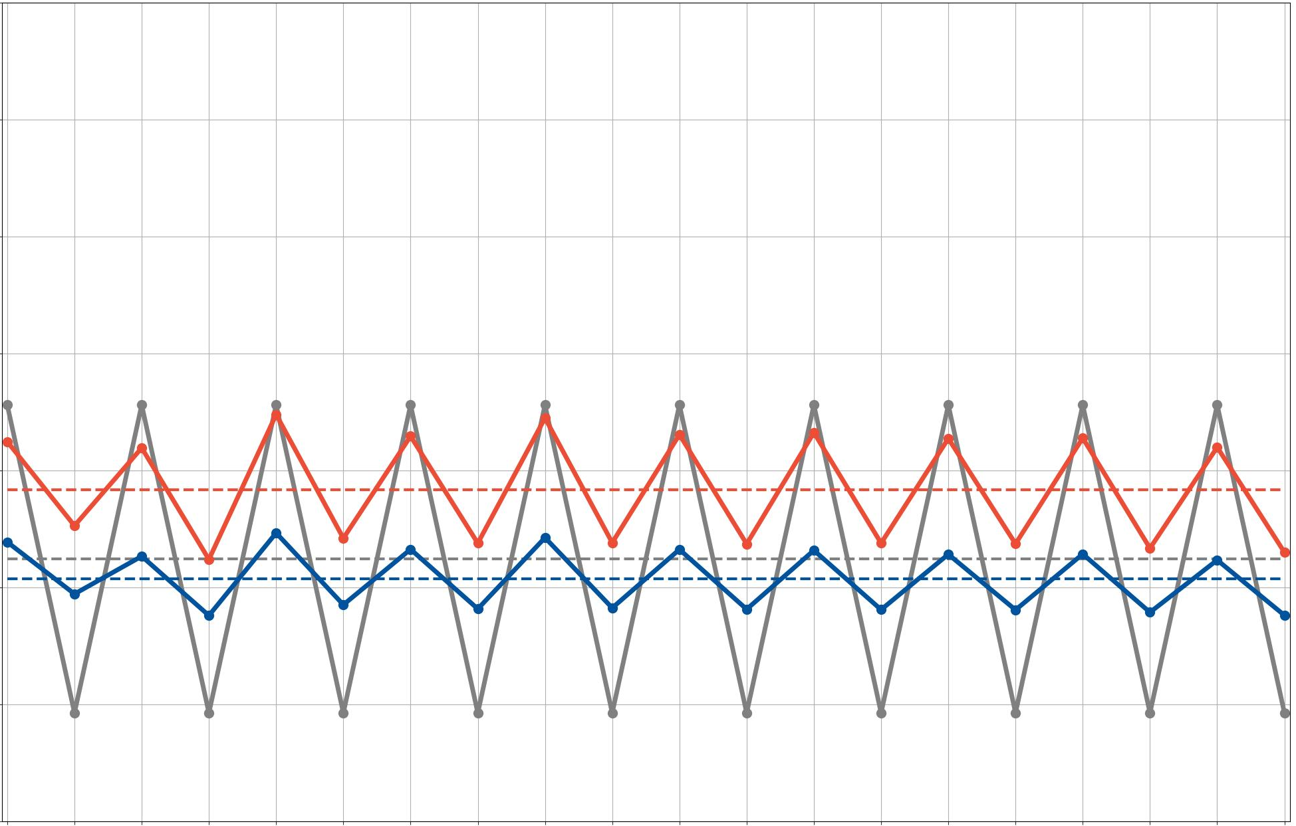
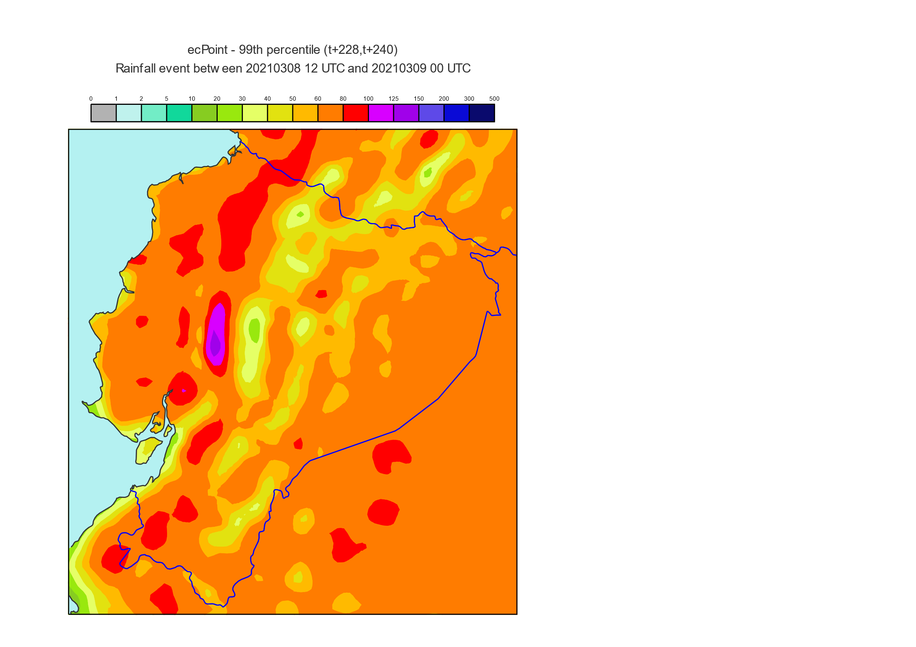
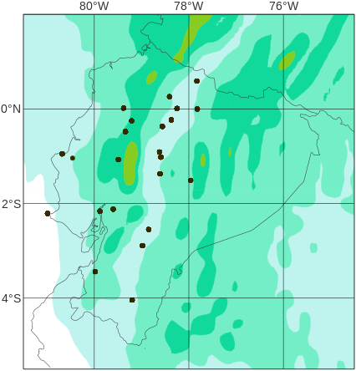
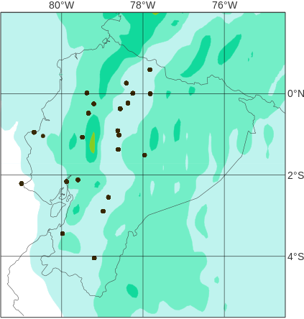
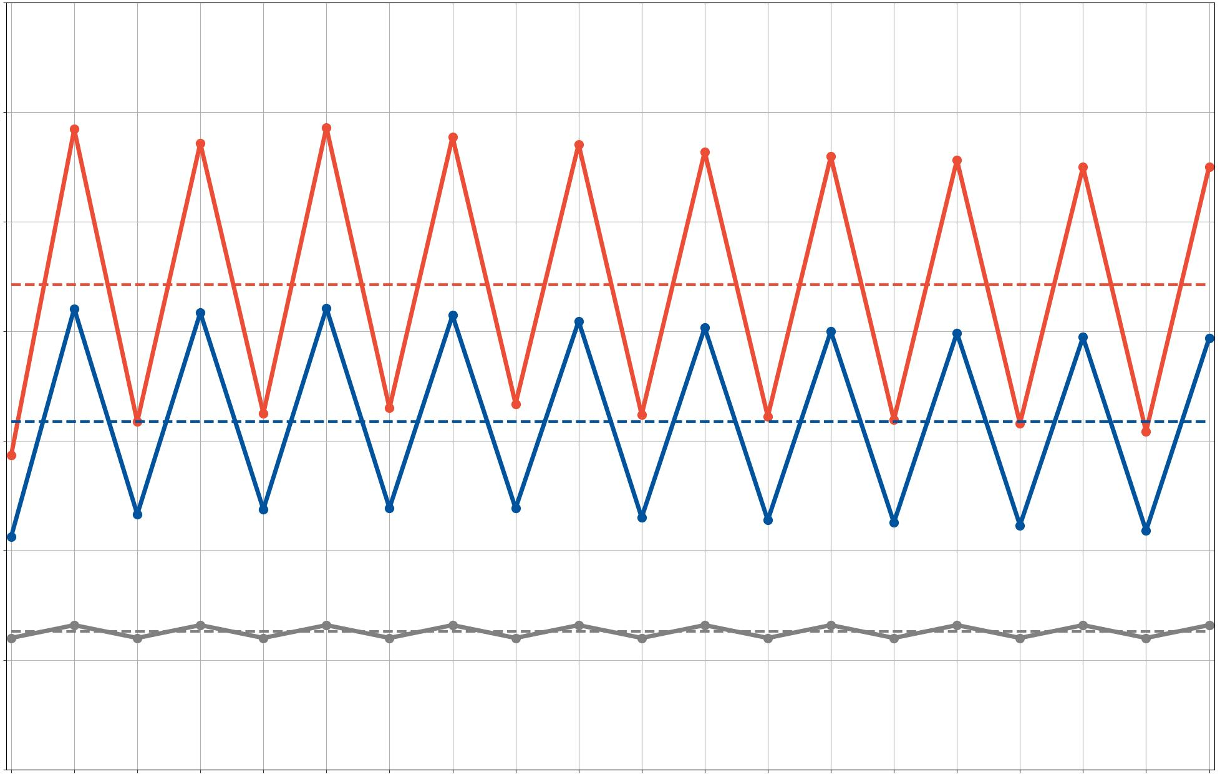
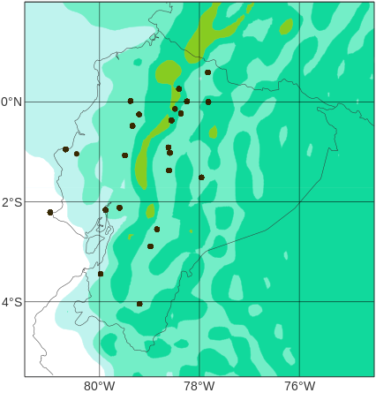
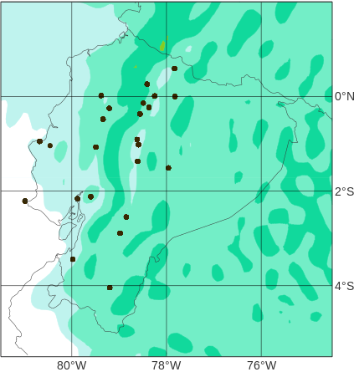
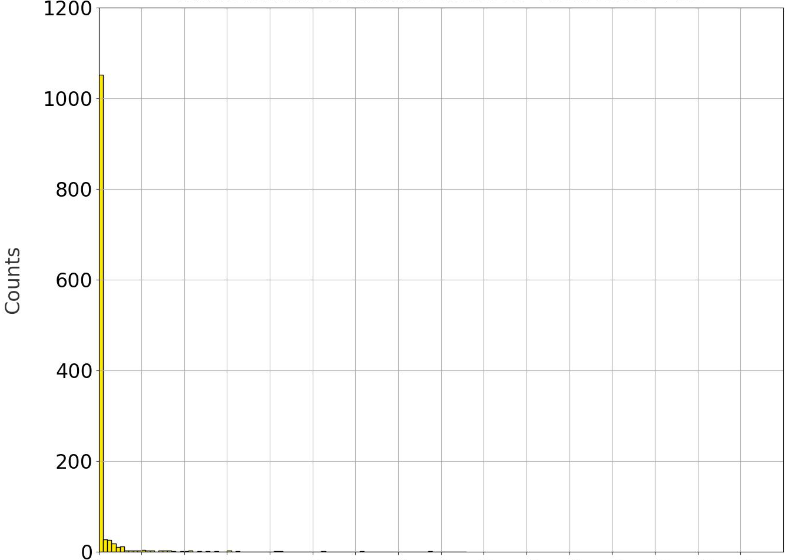
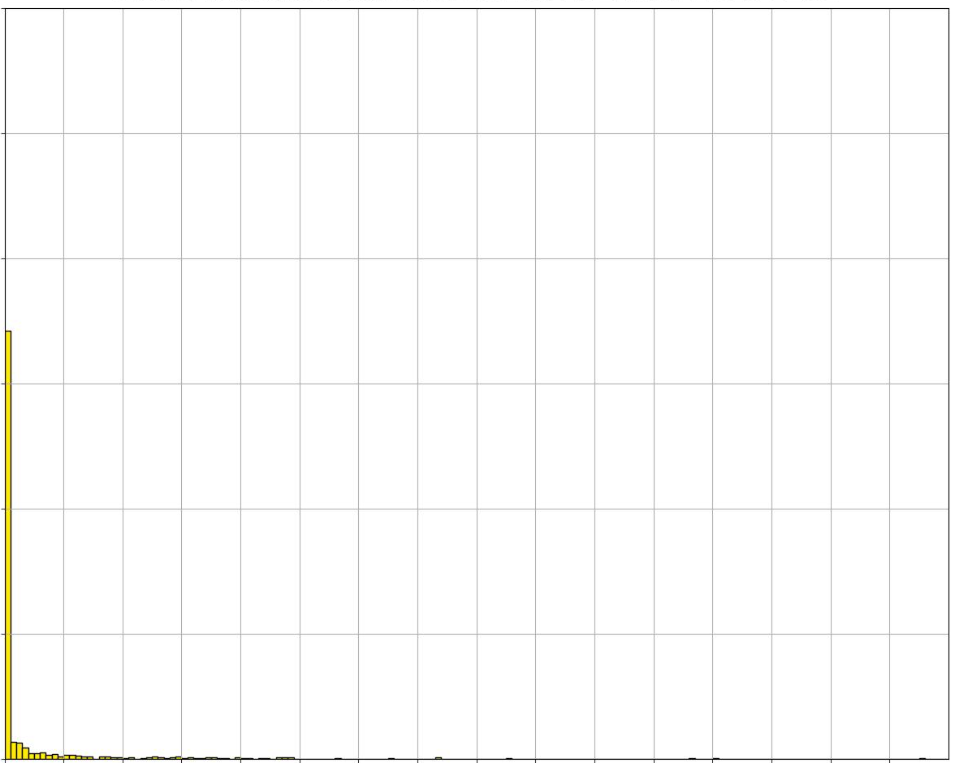
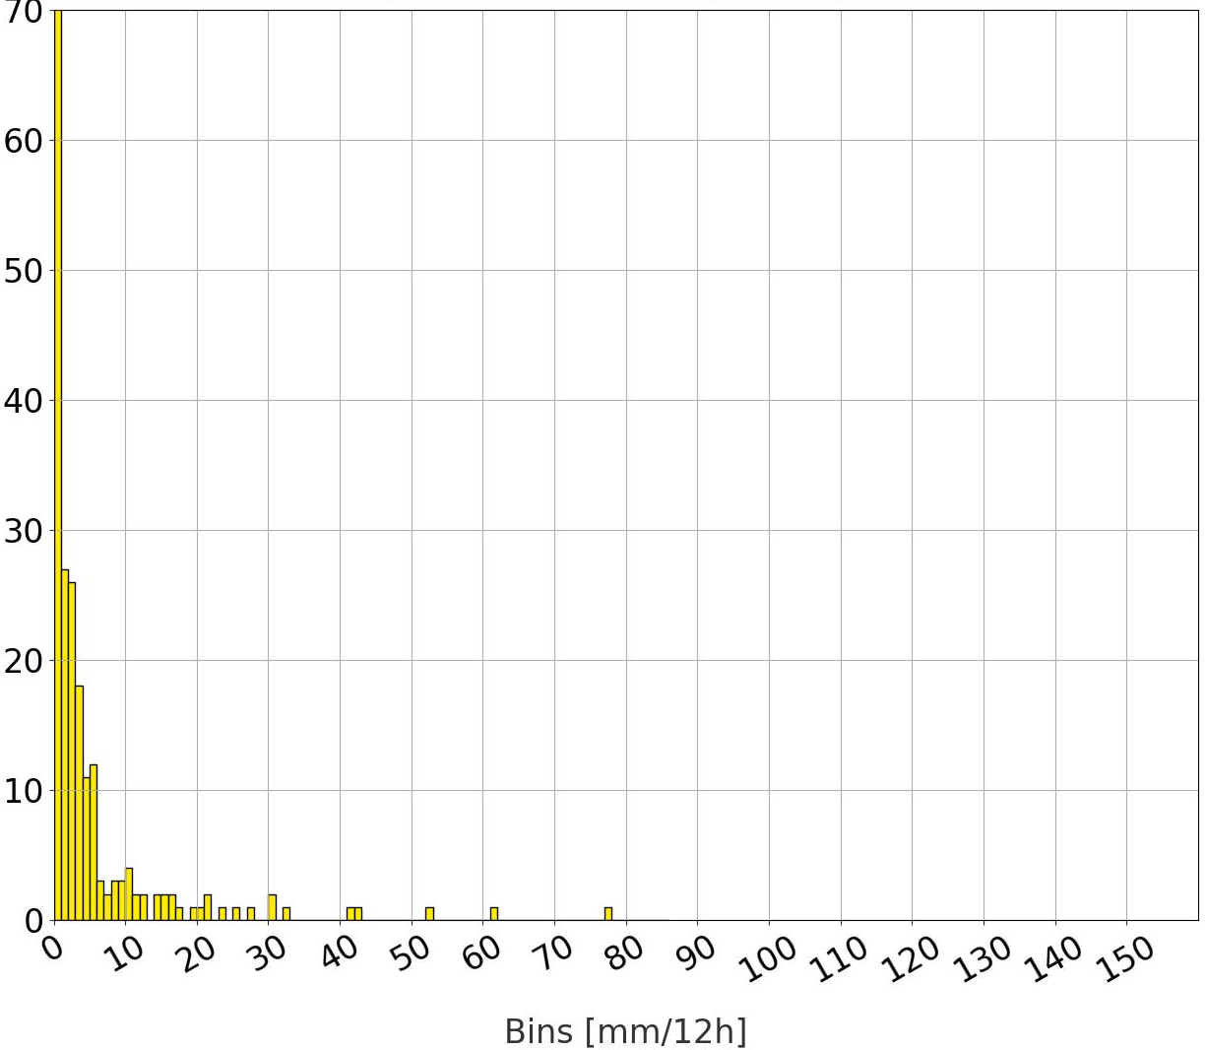
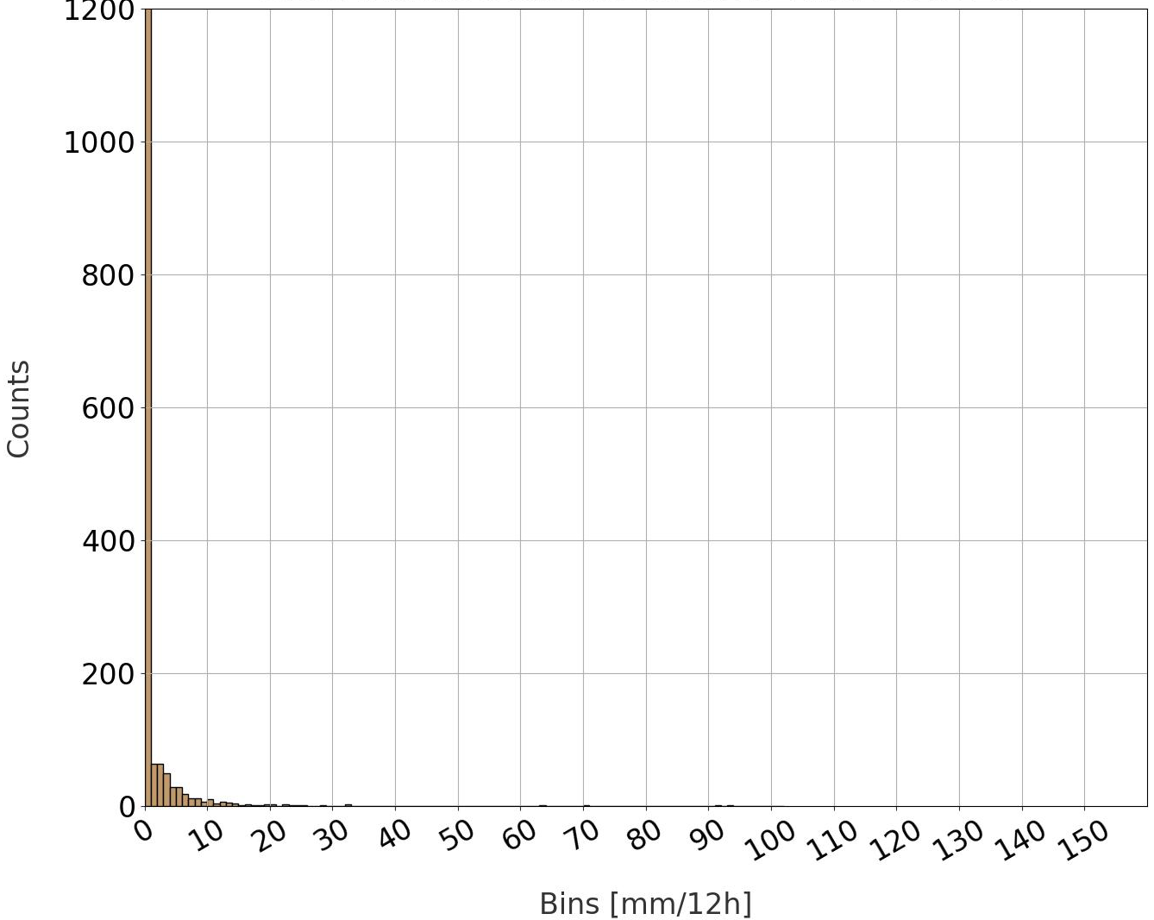
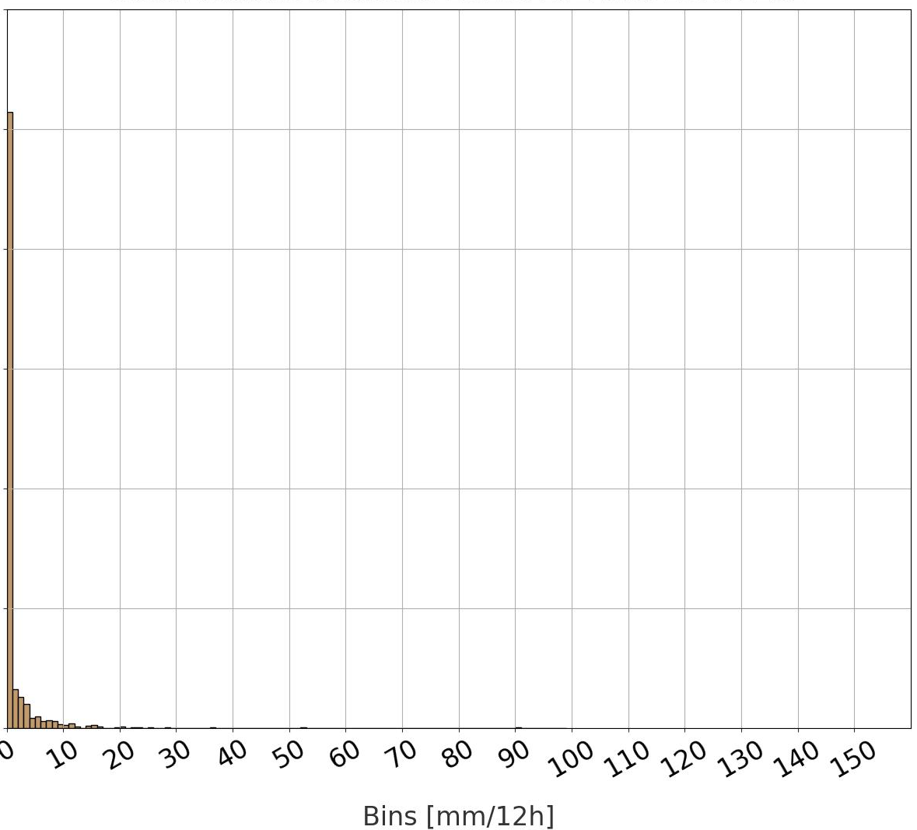
Average rainfall for 2020
Diurnal
cycle
Average
12-hourly accumulation periods
Location of rain gauges in “La Costa” and “La Sierra”
ENS
0000 – 1200 UTC (1800 – 0600 LT), Nighttime
Spatial distribution of average rainfall [mm/12h]
ecPoint
1200 – 0000 UTC (0600 – 1800 LT), Daytime
0
1
2
5
10
20
30
40
50
60
80
100
125
150
200
300
OBS
500
7
La Costa
ENS
ecPoint
6
5
4
a
Average rainfall [mm/12h]
3
c
b
T+60, Nighttime
2
d
1
a
c
0
7
La Sierra
6
b
5
d
T+72, Daytime
4
Average rainfall [mm/12h]
3
a
b
d
2
c
1
0
12
24
36
48
60
72
84
96
108
120
132
144
156
168
180
192
204
216
228
240
Lead time steps for the 00 UTC run and at the end of the
12-hourly accumulation periods [in hours]
D1
D2
D3
D4
D5
D6
D7
D8
D9
D10
Lead times (in days)

