Slide 1
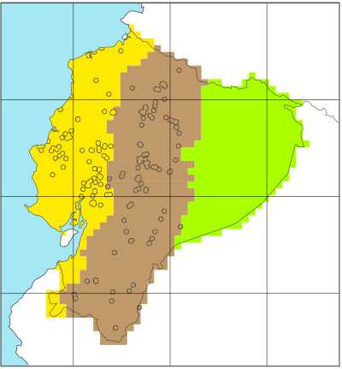
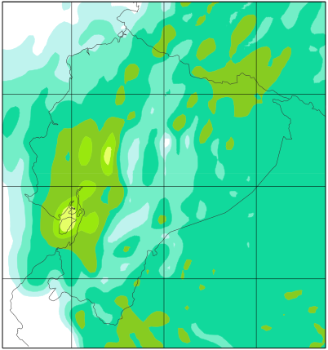
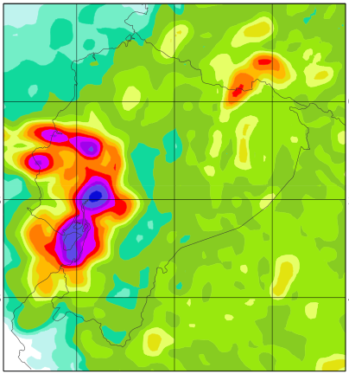
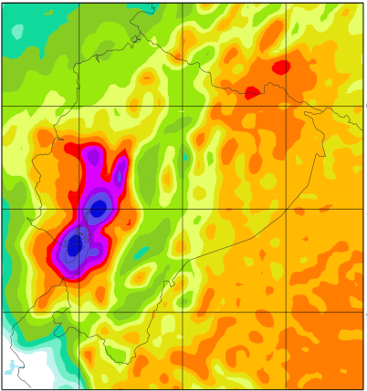
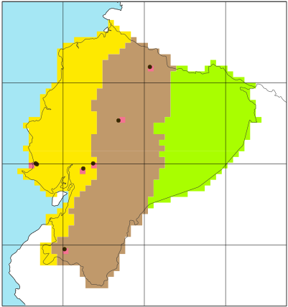
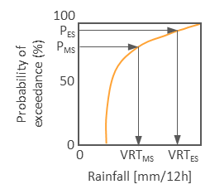
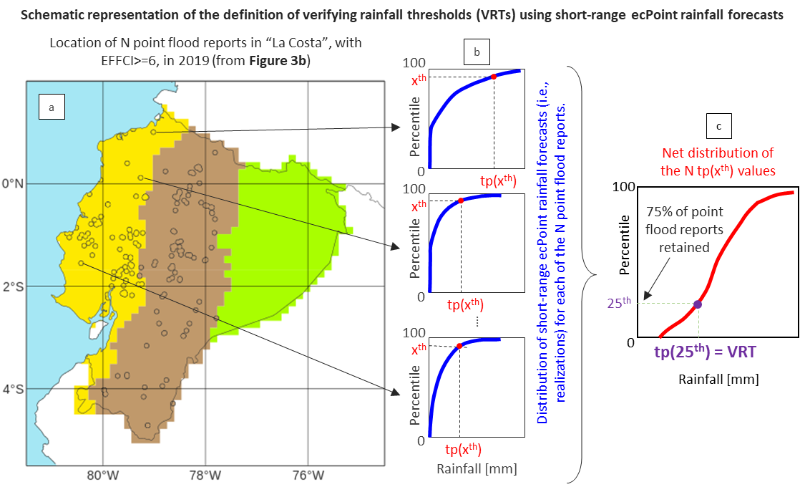
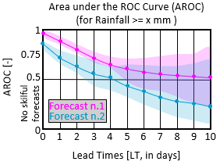
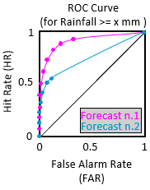
Definition of Verifying Rainfall Thresholds (VRTs)
START: analyse performance of rainfall forecasts (FC) in identifying areas at risk of flash floods.
Objective verification analysis
STOP
NO
Have point flash flood reports (FFR) for year X?
NO
Are VRTs known?
YES
Read VREs
STOP
YES
NO
Have FFR for year Y?
Read point FFRs for year X
Figure 2
Figure 3b
Have point-rainfall observations (tp obs) associated with FFRs?
YES
Read tp obs
Read flash flood reports
Read FC1 and FC2.
YES
Create distribution of tp obs associated with FFR and select percentiles P_{MS} and P_{S} defining VRTs associated with moderately-severe (VRT_{MS}) and severe (VRT_{S}) flash floods.
NO
Create observational fields, for different VREs and accumulation periods, up to medium-range leads.
Create forecasts fields, for different VREs and accumulation periods, up to medium-range leads.
Read short-range ecPoint rainfall forecasts
Figure 2c & d
Figure 4
Define VRTs using short-range ecPoint-Rainfall forecasts.
Estimation of calibration:
compute Frequency Bias for different VREs and accumulation periods.
Estimation of discrimination ability:
compute ROC curves for different VREs and accumulation periods, and Areas under the ROC curve (AROC) for different VREs.
Section 4.2.1
Section 4.2.2
Section 4.1 & Figure 6
Section 5.2.1 & Figure 7
Section 5.2.1 & Figure 7
Section 5.2.1 & Figure 7
Section 5.1 & Figure 7
END

Slide 2
100
Probability of exceedance (%)
P_{ES}
P_{MS}
50
0
0
VRT_{MS}
VRT_{ES}
Rainfall [mm/12h]
ROC Curve
(for Rainfall >= x mm )
Hit Rate (HR)
1
Area under the ROC Curve (AROC)
(for Rainfall >= x mm )
AROC [-]
1
0.5
0.75
Forecast n.1
0.5
Forecast n.2
No skilful forecasts
0
Forecast n.1
0
0.5
1
Forecast n.2
False Alarm Rate (FAR)
0
0
1
2
3
4
5
6
7
8
9
10
Lead Times [LT, in days]

